Slide 1
Viewing sensor values
BY SANJAY AND ARVIND SESHAN

Slide 2
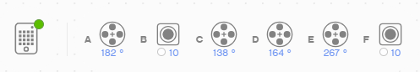
Lesson Objectives
Learn how to view sensor values on SPIKE Prime and Robot Inventor

Slide 3
Why do you need sensor data?
Sensor data can be….
Used to help program more easily (no more guess and check!!)
Used to help program more accurately
Used to debug code as well as build issues
SPIKE Prime and Robot Inventor have no screen, but you can still view sensor data using the Hub Dashboard

Slide 4
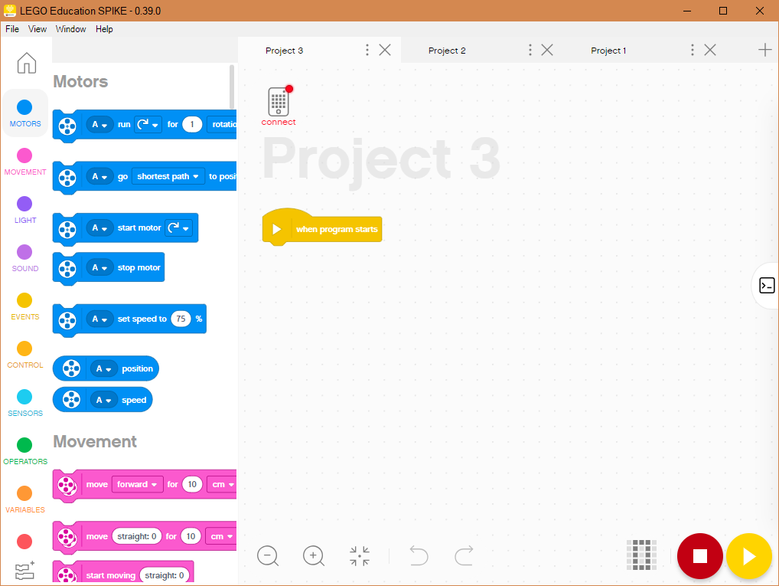
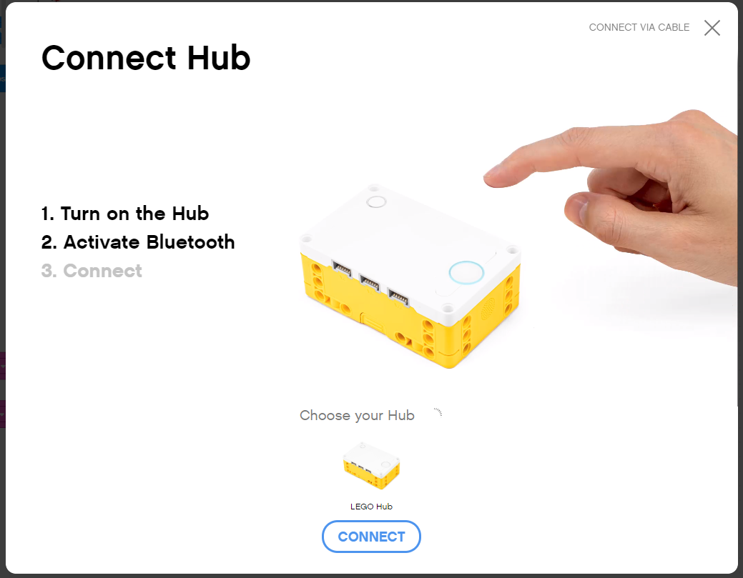
You must be Connected to hub
To view any sensor data, you must first be connected to the Hub (SPIKE Prime or Robot Inventor)
Click on the small Hub icon in a Project in SPIKE Prime or Robot Inventor

Slide 5
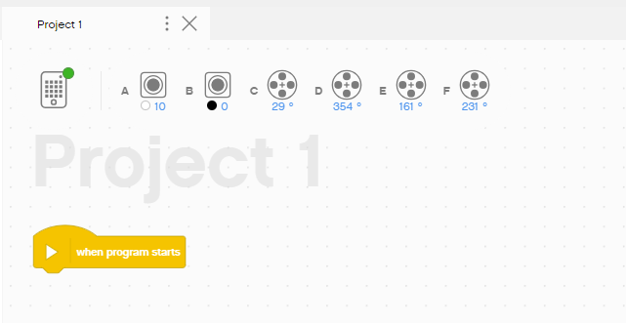
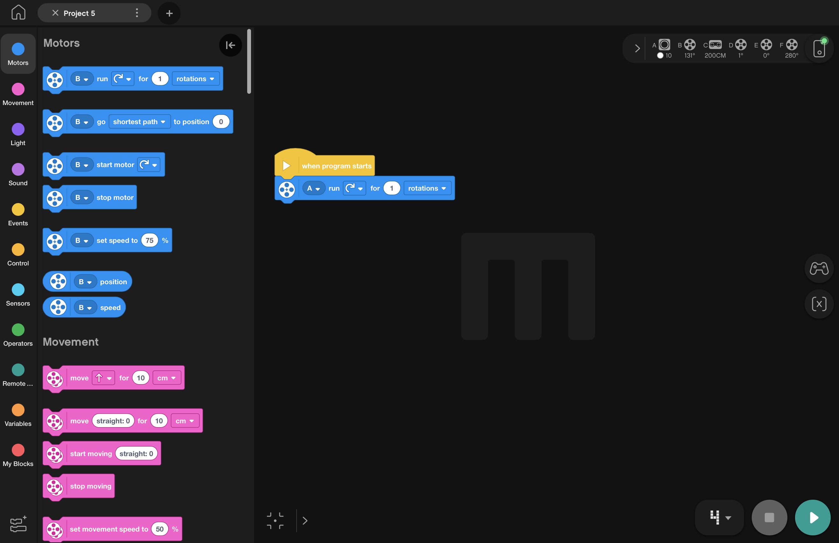
Sensor values on Project page
Once connected to the Hub, Sensor and Motor Values are visible on the top of each Project page in both SPIKE Prime and Robot Inventor
SPIKE Prime
Robot Inventor

Slide 6
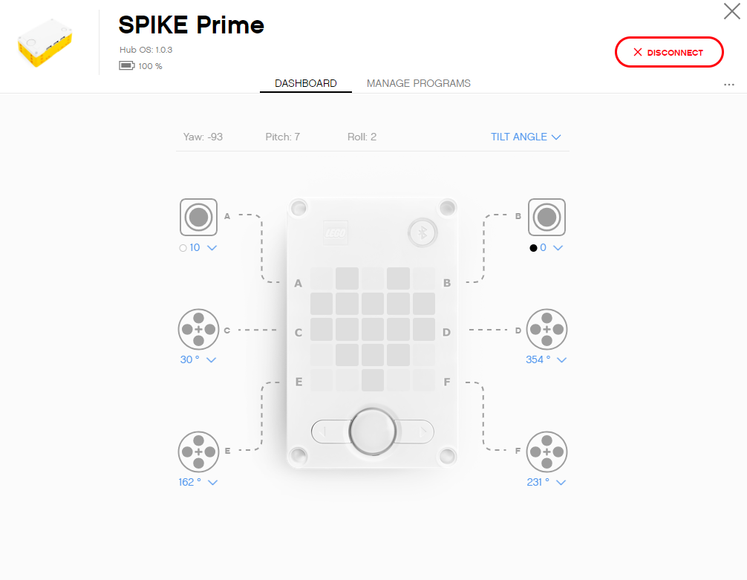
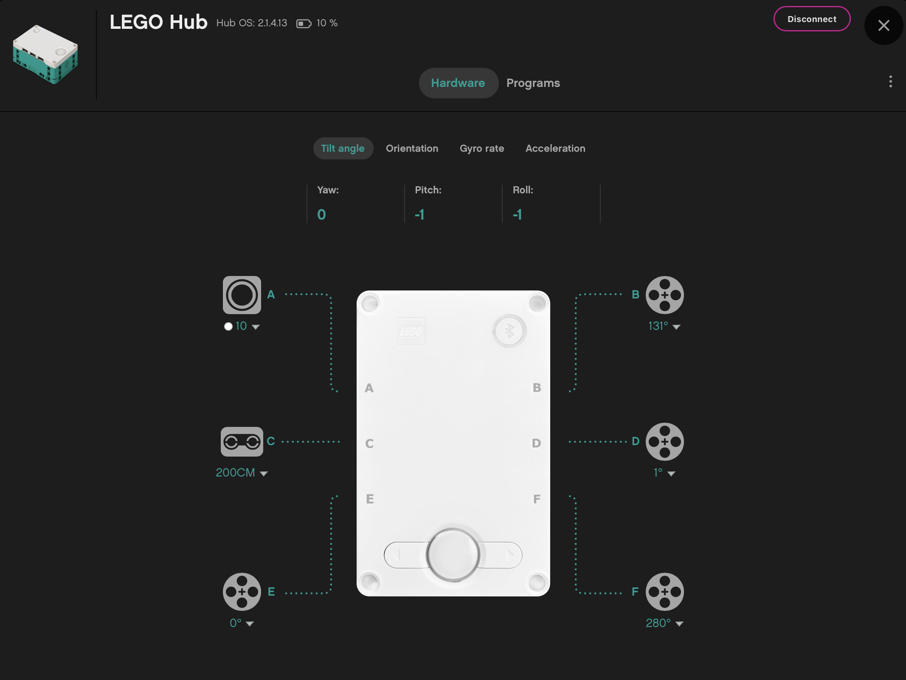
Sensor values on DASHBOARD
Clicking on the Hub Icon in either SPIKE Prime or Robot Inventor takes you to the Hub Dashboard where you can see more sensor data
SPIKE Prime
Robot Inventor

Slide 7
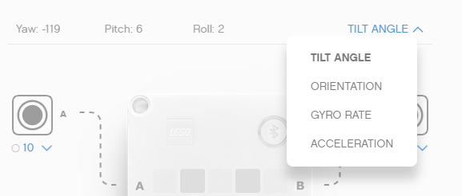
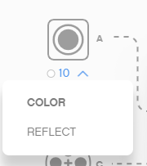
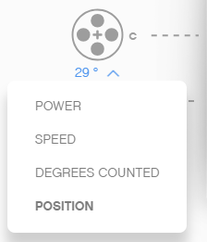
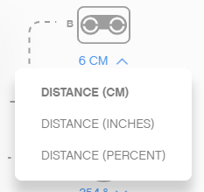
More sensor data on the dashboard
From the Hub Dashboard, you can also see a lot of additional information about each sensor/motor
Select the mode using the down arrow
You can also see values for the built-in gyro sensor
Note: Robot Inventor does not come with a Force Sensor
Gyro Sensor
Color Sensor
Force Sensor
Distance Sensor

Slide 8
Sensor data is powerful
Sensor data can help you program better and also help you debug your code
As you go through the rest of our lessons, you will use this feature often.
As you complete each challenge, think about how knowing sensor data might help you.
The next page has many several examples to think about.

Slide 9
When can sensor data can help?
Reduce Guess-and-Check: I want my robot to turn a particular amount, but I am not sure how much to turn without guessing.
Debug Code: The robot does not follow the green line like I programmed it to do. Why not? What color does the robot think that green line is?
Check Builds: I built my robot with the Force sensor a little bit inside the robot. I am not sure that the Force sensor is getting pressed enough. How can I make sure the sensor is getting pressed?
Test Sensors: I told my robot to stop when the Distance sensor is 20cm away. But it seems to stop earlier. Is the sensor working correctly? How can I see what the Distance sensor sees?

Slide 10
CREDITS
This lesson was created by Sanjay Seshan and Arvind Seshan for Prime Lessons
More lessons are available at www.primelessons.org
This work is licensed under a Creative Commons Attribution-NonCommercial-ShareAlike 4.0 International License.

