Slide 1
BUILD A ROBOT
BY SANJAY AND ARVIND SESHAN

Slide 2
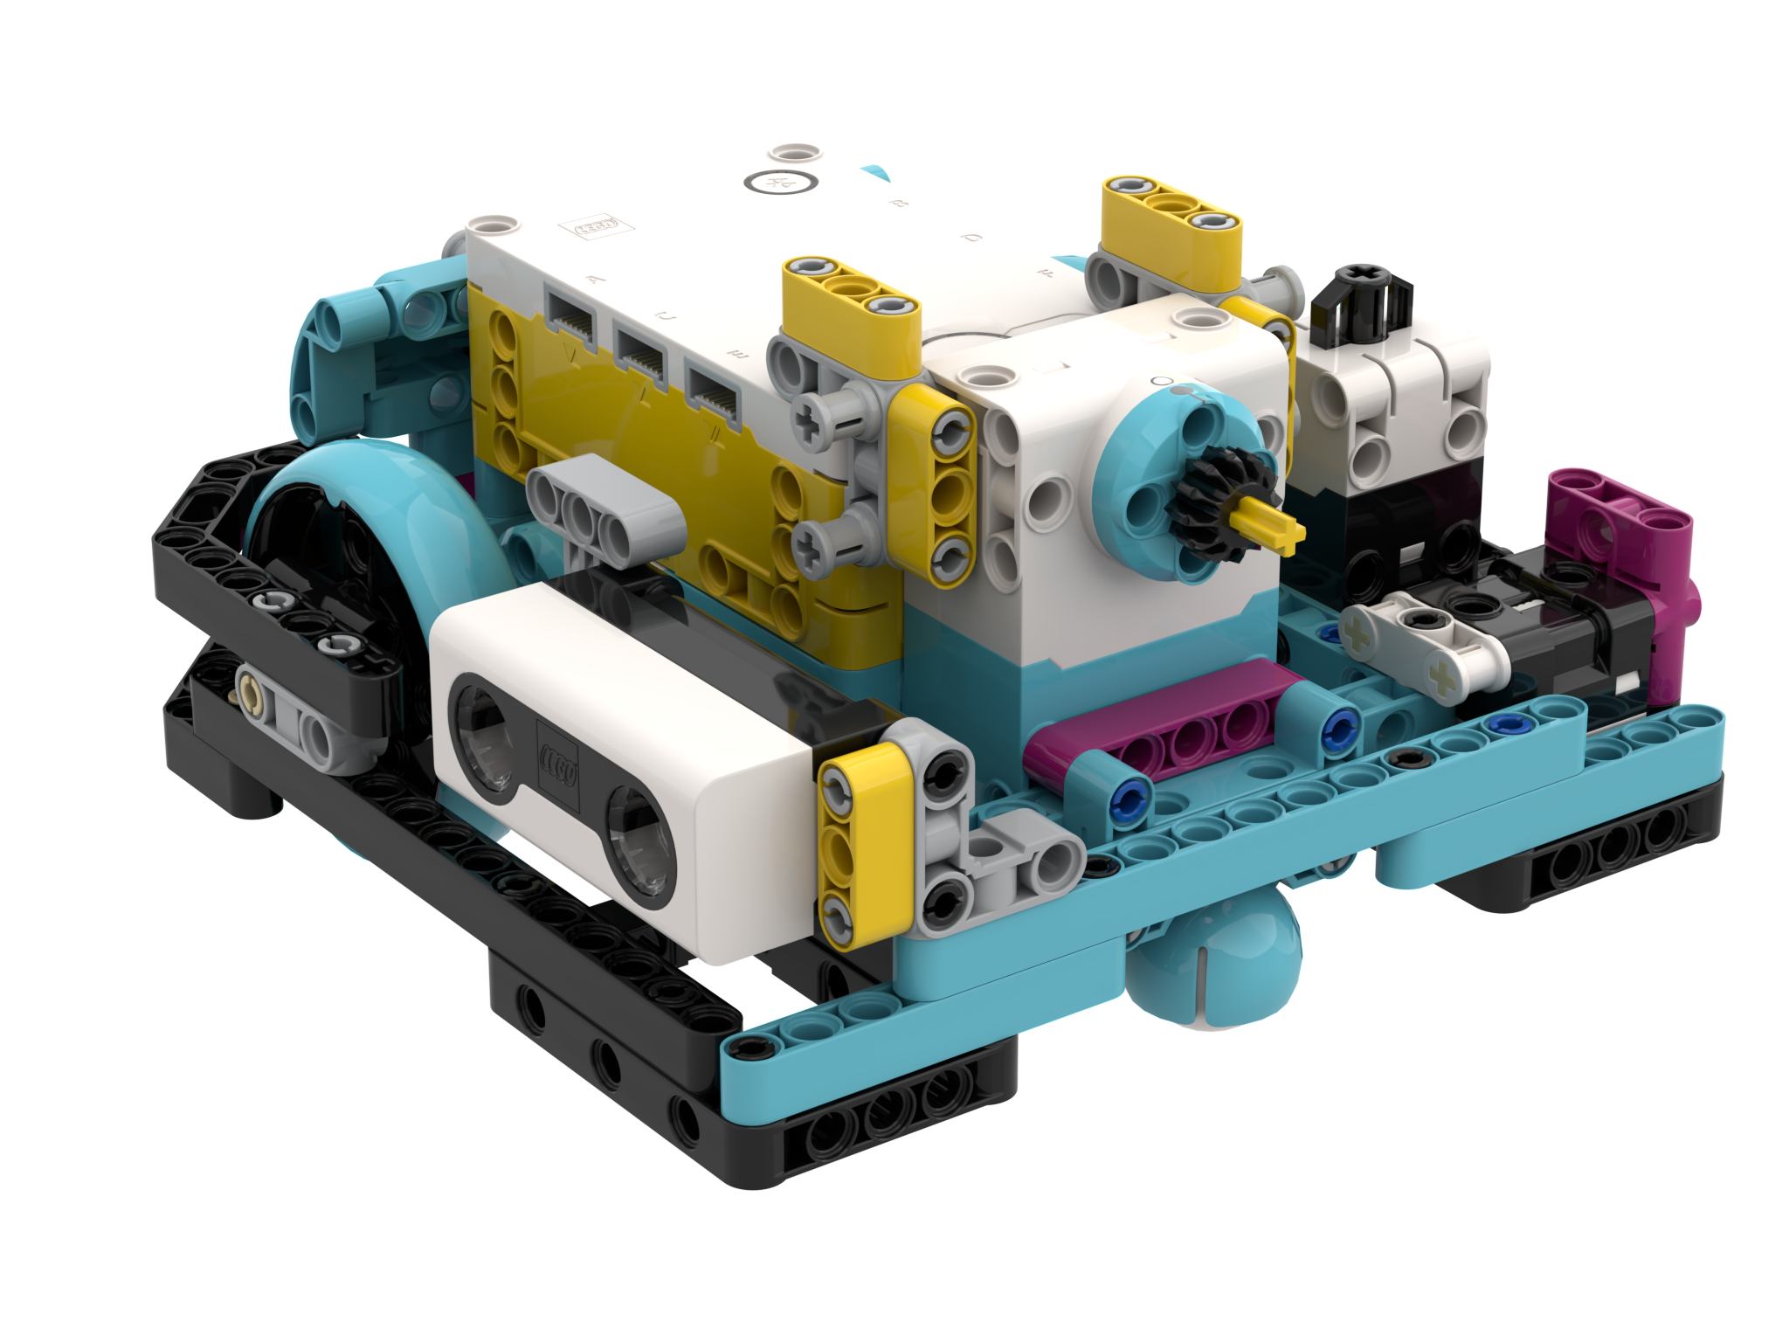
SPIKE PRIME ROBOT
For our lessons, a basic robot build with two driving motors would be ideal. You can attach sensors and additional motors as you need
We provide build instructions for a several training robots on our website
As we grow our content, we will add new training models (Models for Robot Inventor will be added)
No matter what robot you use, make sure you pay attention to what port motors and sensors are connected to in any challenge solutions provide
Droid Bot IV

Slide 3
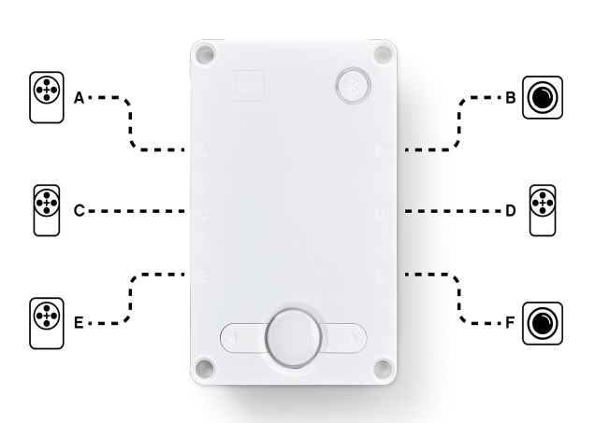
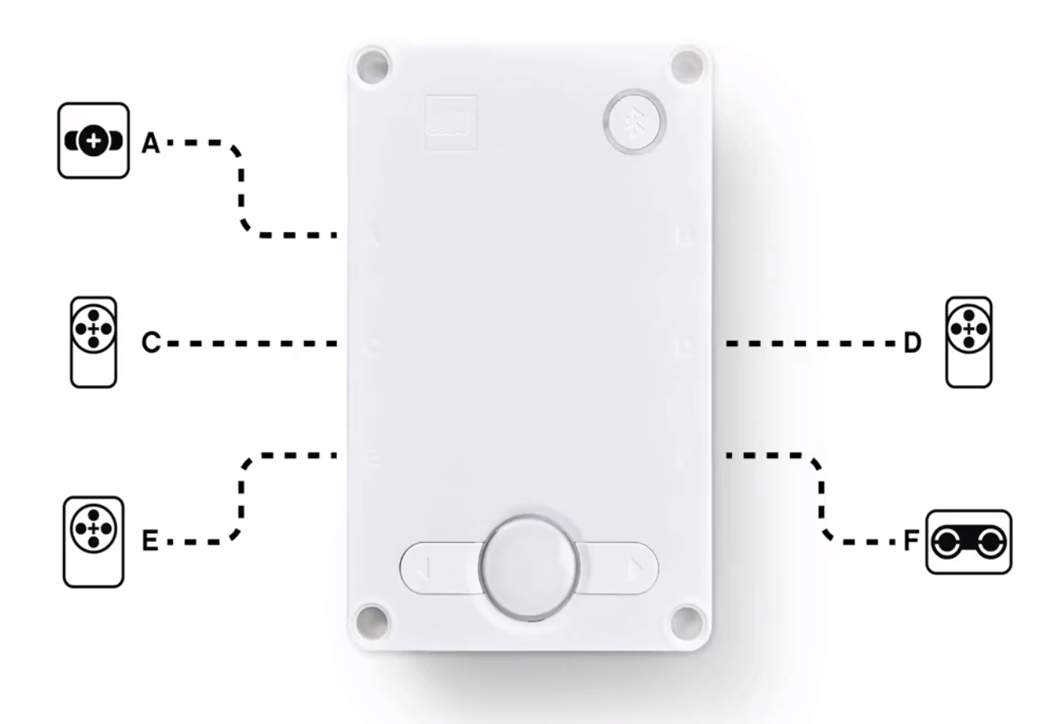
SAMPLE ROBOT: Droid Bot IV
Droid Bot IV is our custom training robot
It only uses parts available in the SPIKE Prime Set (45678). No Expansion Set needed.
All sensors are pre-mounted for use in our lessons
The wheel size is 56mm and the motors and sensors are configured as below.
Build instructions have been provided for building this robot
Droid Bot IV Configuration

Slide 4
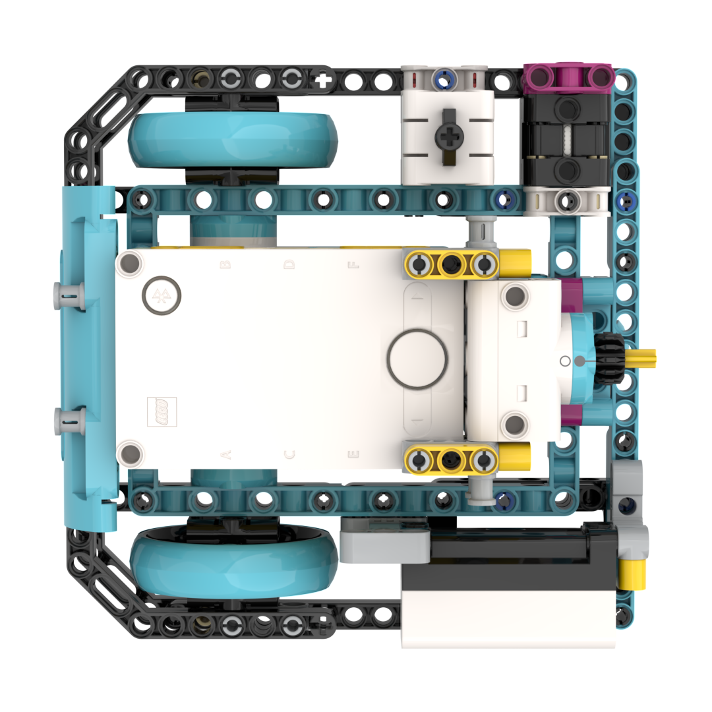
Droid Bot IV Wiring guide
A: Medium Motor
F: Force Sensor
B: Color Sensor
D: Large Motor
E: Medium Motor
C: Distance Sensor

Slide 5
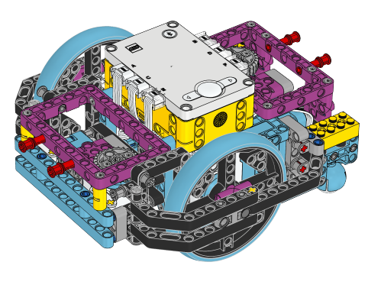
Advanced Driving base (ADB)
You can also use the Advanced Driving Base (ADB).
It will require the SPIKE Prime Set (45678) as well as the SPIKE Prime Expansion Set (45680).
Instructions to build this model are available inside the SPIKE Prime and software online: https://education.lego.com/en-us/lessons/prime-competition-ready/assembling-an-advanced-driving-base
Please note how the basic ports are configured on the diagram on the right. Since all the sensors cannot start off connected to the Hub, you will have to disconnect ports so you can add the Distance and Force Sensors used in our lessons
The color sensors on ADB are also not optimally positioned for using in Color Mode. (see next slide)
ADB Default settings

Slide 6
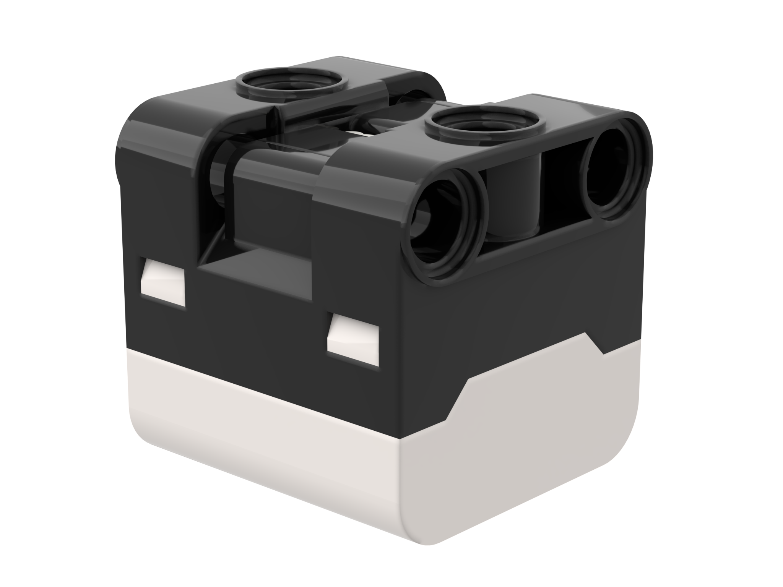
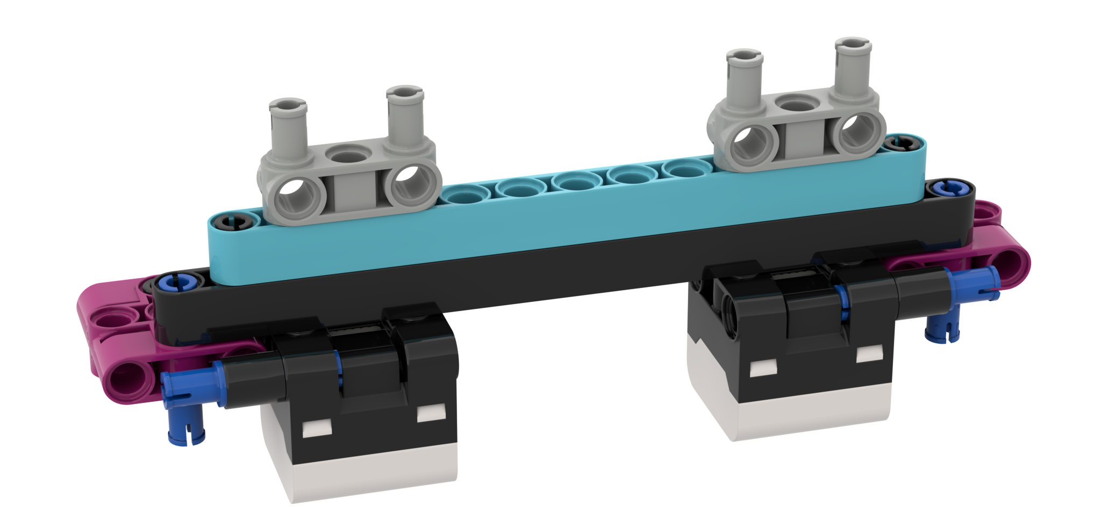
NOTE: Color Sensor Position
To use the color sensor in Color Mode to find a line or line follow with the Advanced Driving Base (ADB), you will have to make a modification to the design
The standard location for the color sensor is too low according to the SPIKE Prime Specifications. Black does not read correctly in Color Mode using electrical tape lines or a FIRST LEGO League challenge mat.
The color sensor on ADB is mounted at about 8mm off the ground, but the optimal distance for mounting the sensor according to the specs is 16mm.
The solution is to raise the color sensor. Instructions are provided on this website
16mm
2M (2 LEGO Modules)

Slide 7
CREDITS
This lesson was created by Sanjay Seshan and Arvind Seshan for Prime Lessons
More lessons are available at www.primelessons.org
This work is licensed under a Creative Commons Attribution-NonCommercial-ShareAlike 4.0 International License.

