Slide 1
installing software & Firmware on SPIKE Prime and ROBOT INVENTOR
BY SANJAY AND ARVIND SESHAN

Slide 2
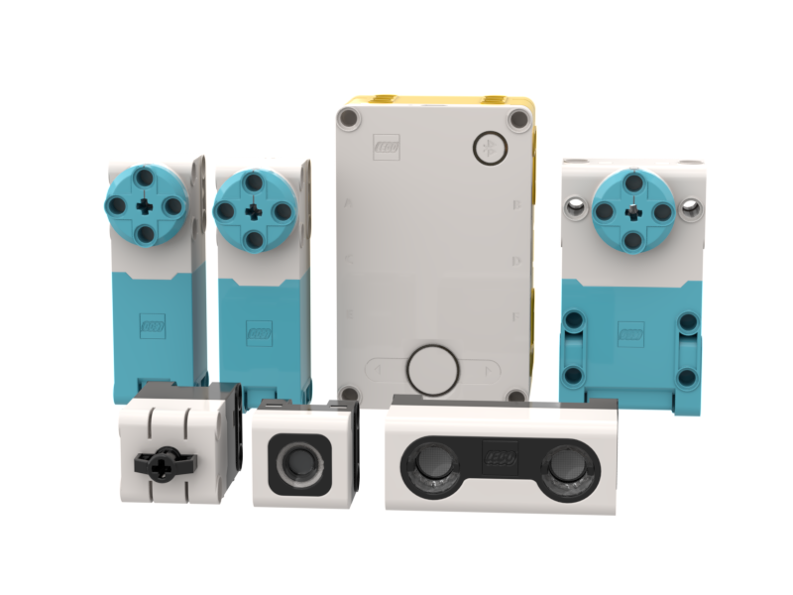
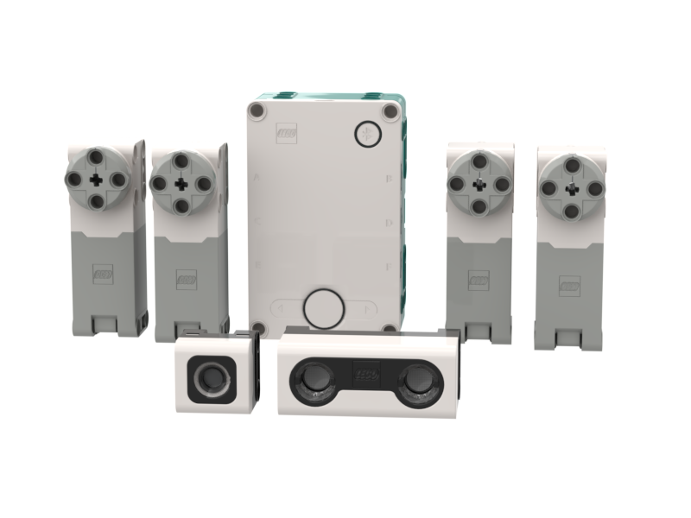
Lesson Objectives
Learn how to update SPIKE Prime and Robot Inventor

Slide 3
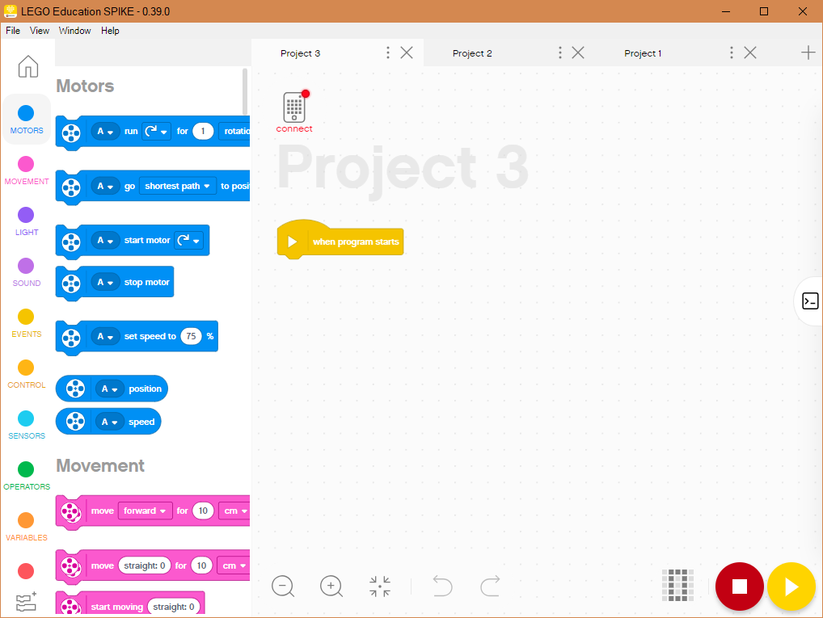
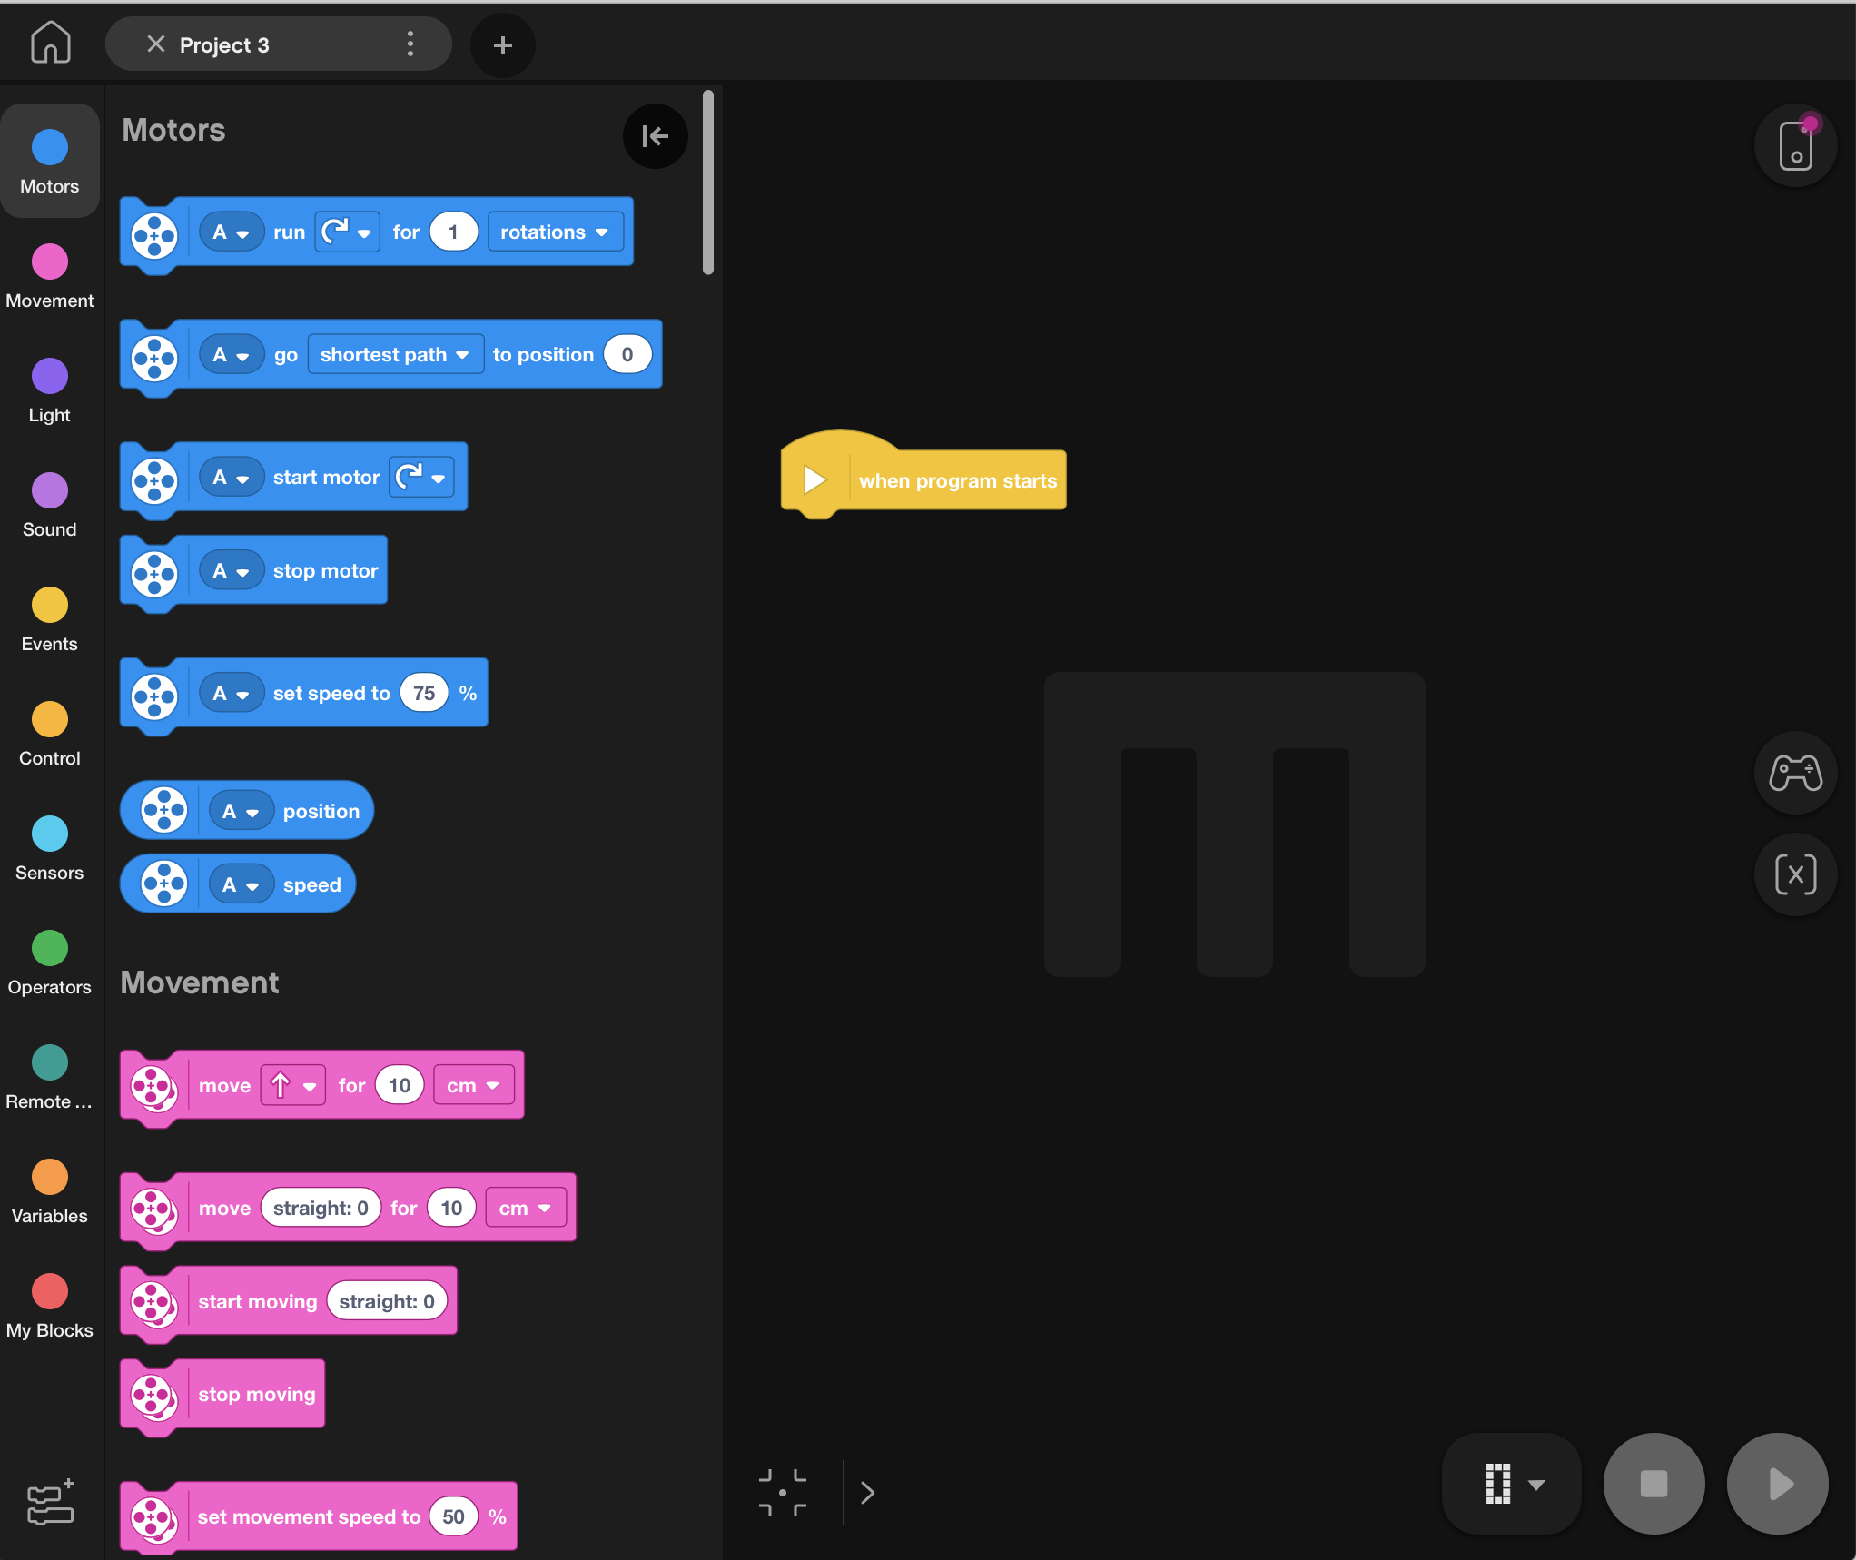
FIRST USE
Connect your SPIKE Prime or Robot Inventor to your computer using the USB Cable for OS Updates
The software will auto-connect to the brick if you are using USB
Note: If you are using the iOS, Android, or Chromebook version of the software, you may need to connect to your Hub using a computer the very first time to update the firmware on the Hub. Subsequent updates may be possible via Bluetooth. [This process may get updated.]

Slide 4
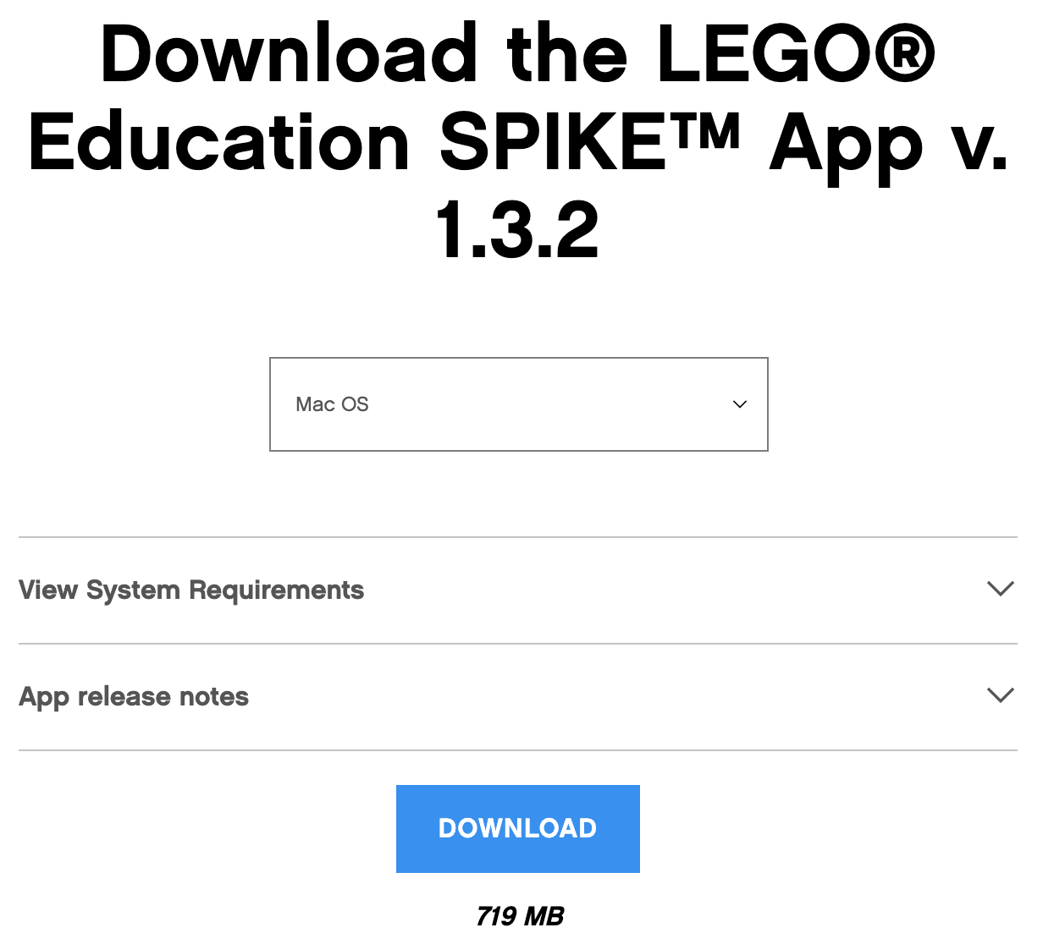
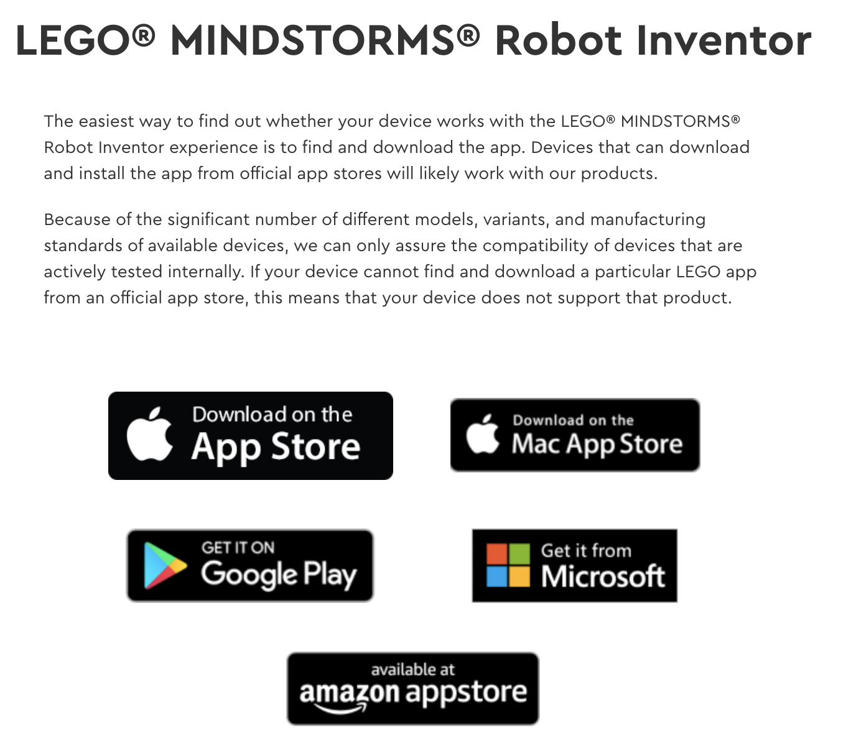
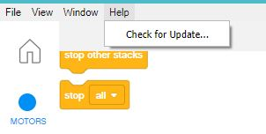
Install latest Software
SPIKE Prime: https://education.lego.com/en-us/downloads/spike-prime/software
Robot Inventor: https://www.lego.com/en-us/service/device-guide/mindstorms-robot-inventor/
You can check for SPIKE Prime Software Updates from inside the App
Click on the Help Menu inside a Project and Check for Update
There is no equivalent choice in Robot Inventor (you will be prompted for any updates or you can visit the app store)

Slide 5
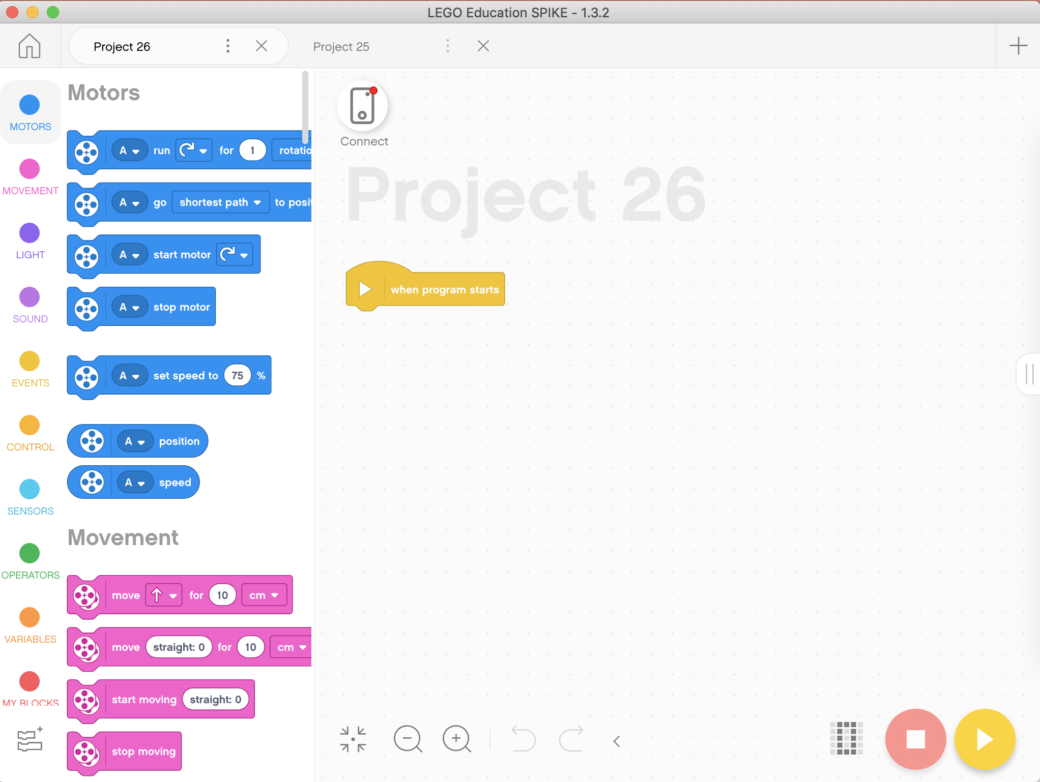
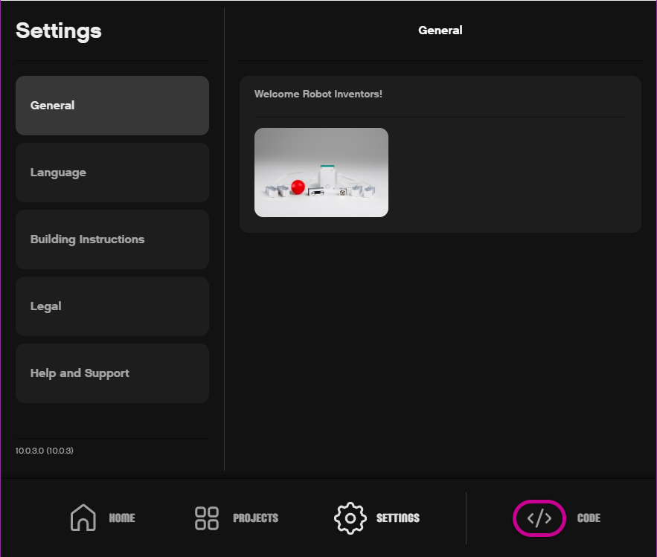
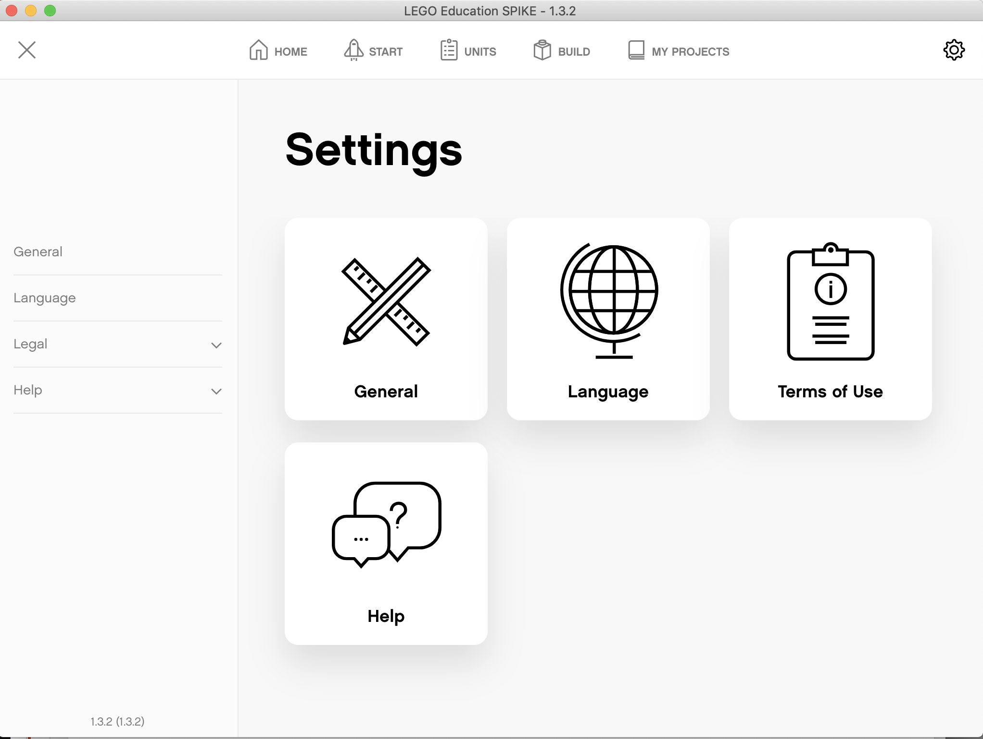
CHECKING WHAT SOFTWARE VERSION YOU ARE RUNNING
In SPIKE Prime, the version is at the top of all screens. You can also click on the gear icon on the top right of the home screen to access the Settings page.
In Robot Inventor, click on Settings at the bottom of the home screen
SPIKE Prime
Robot Inventor

Slide 6
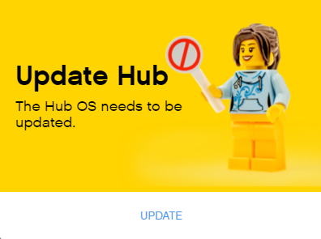
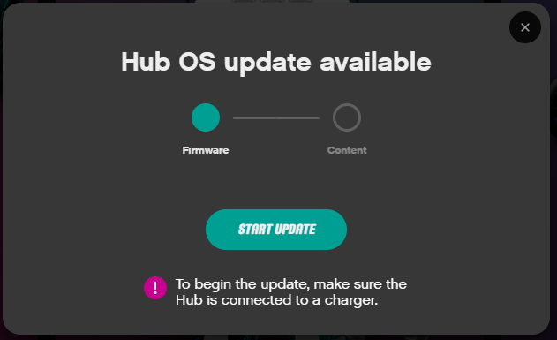
Updating the hub operating system
If there is an Update for SPIKE Prime or Robot Inventor available, you will get a popup telling you to do so
SPIKE Prime
Robot Inventor

Slide 7
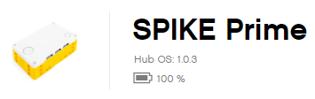
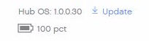
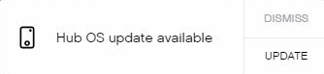
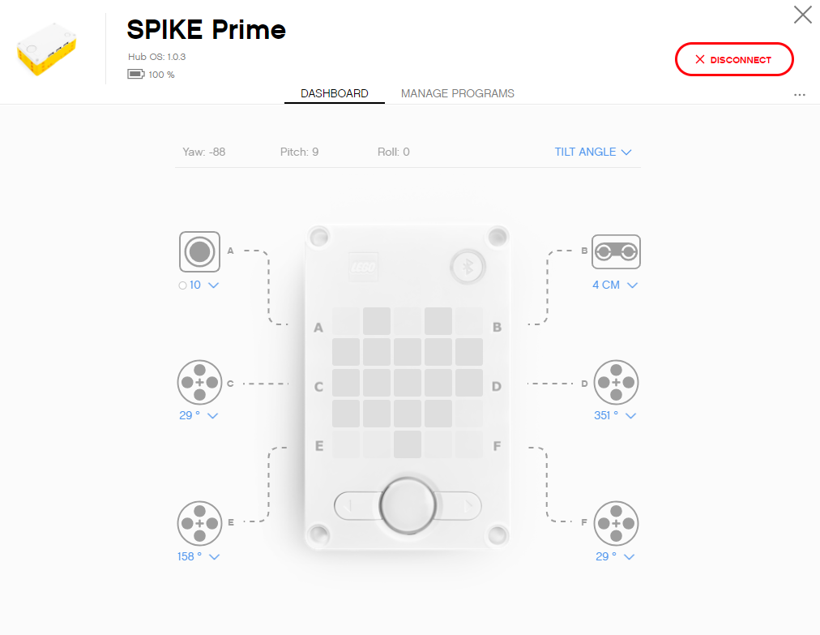
INSTALL LATEST HUB OS
When a new Hub OS is available a button labeled Update will appear next to the current Hub OS in the Hub Dashboard
You may also see a pop-up show up on the right side of the screen indicating a Hub OS update is available
Never disconnect the Hub while the update is in progress

Slide 8
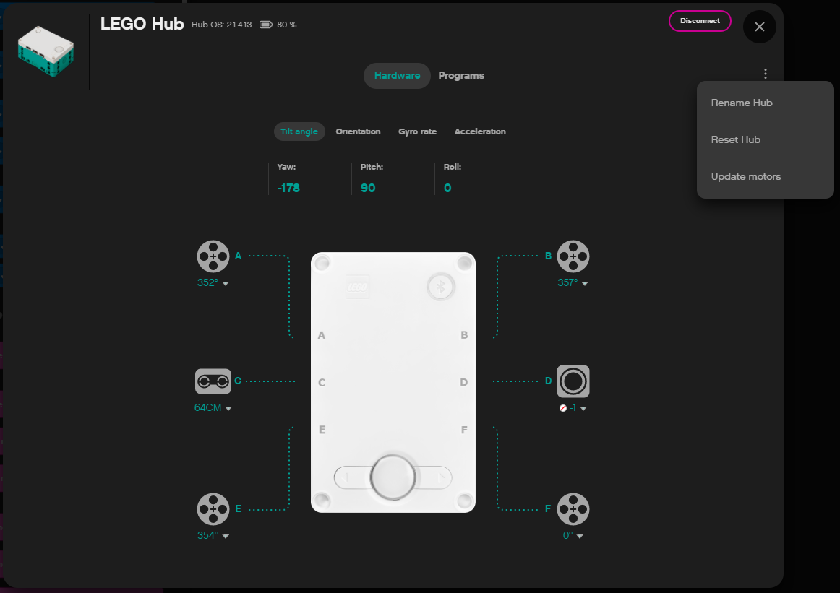
CHECKING WHAT HUB OS VERSION YOU ARE RUNNING
To check what version of firmware you are running, you can click on the small Hub icon in either SPIKE Prime or Robot Inventor from inside a Project file
This will take you to the Dashboard where you can see the firmware version on the top left.
SPIKE Prime
Robot Inventor

Slide 9
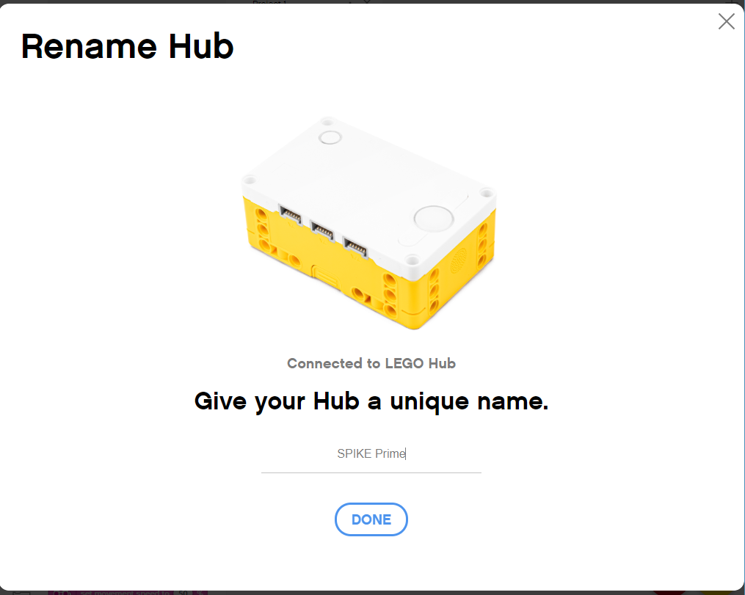
Renaming ThE HUb
The first time you update your Hub OS, you will be prompted to rename your Hub
After that you can rename your Hub by clicking on small the Hub icon in a Project and entering the Hub Dashboard
In the SPIKE Prime or Robot Inventor Dashboard, click on the three dots on the top right and rename your Hub
SPIKE Prime
Robot Inventor

Slide 10
CREDITS
This lesson was created by Sanjay Seshan and Arvind Seshan for Prime Lessons
More lessons are available at www.primelessons.org
This work is licensed under a Creative Commons Attribution-NonCommercial-ShareAlike 4.0 International License.

