Slide 1
USING Light blocks
BY SANJAY AND ARVIND SESHAN

Slide 2
Lesson Objectives
Learn how program the LED lights on the Hub
Learn how to turn on the lights of the Distance Sensor
Learn how to display sensor values to the LED Matrix

Slide 3
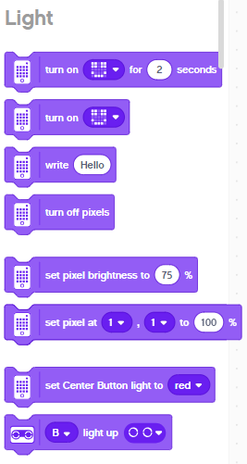
Light blocks
Light blocks can be found in purple Block Palette
You can use these blocks for many fun applications including turning on the lights of the ultrasonic sensor, creating patterns using the 5X5 LED Matrix and even display scrolling text
Customize the lights on the light matrix to any design
Display scrolling text
Dim or brighten the lights
Change the color of the center button
Light up the ultrasonic

Slide 4
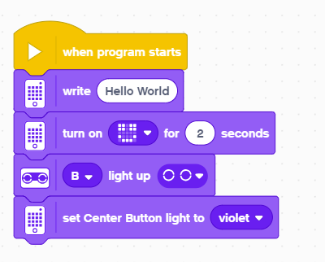
Challenge: light up the world
Write “Hello World” using the light matrix
Then display a Smiley Face for 4 seconds
Light up all the lights around the Distance Sensor
Change the Center Button Light to a color of your choice
Hello World will scroll through the Light Matrix
Display a smiley face
Light up the Distance Sensor’s “eye”
Make the center button violet

Slide 5
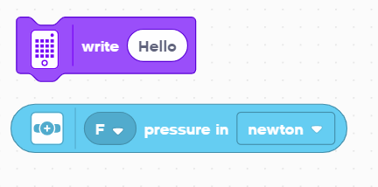
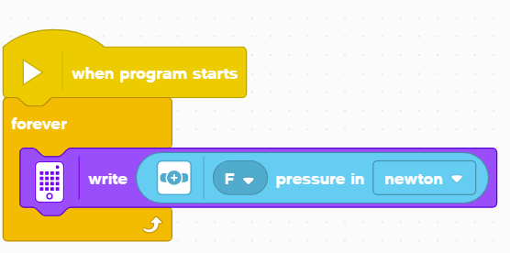
Challenge: Displaying Sensor Values
How hard am I pushing the Force Sensor?
Create a program in a loop that lets you view the force applied to the Force Sensor on the LED Matrix
Display the results in Newtons (0-10)
This program displays the value of the Force Sensor to the LED Matrix
The value of the Force sensor is written to the screen

Slide 6
CREDITS
This lesson was created by Sanjay Seshan and Arvind Seshan for SPIKE Prime Lessons
More lessons are available at www.primelessons.org
This work is licensed under a Creative Commons Attribution-NonCommercial-ShareAlike 4.0 International License.

