Slide 1
Managing Projects
BY SANJAY AND ARVIND SESHAN

Slide 2
Lesson Objectives
Learn how to create and name projects
Learn how to duplicate and delete projects
Learn how to copy code across projects
Learn how to order your projects on your Hub
Learn how to share project files

Slide 3
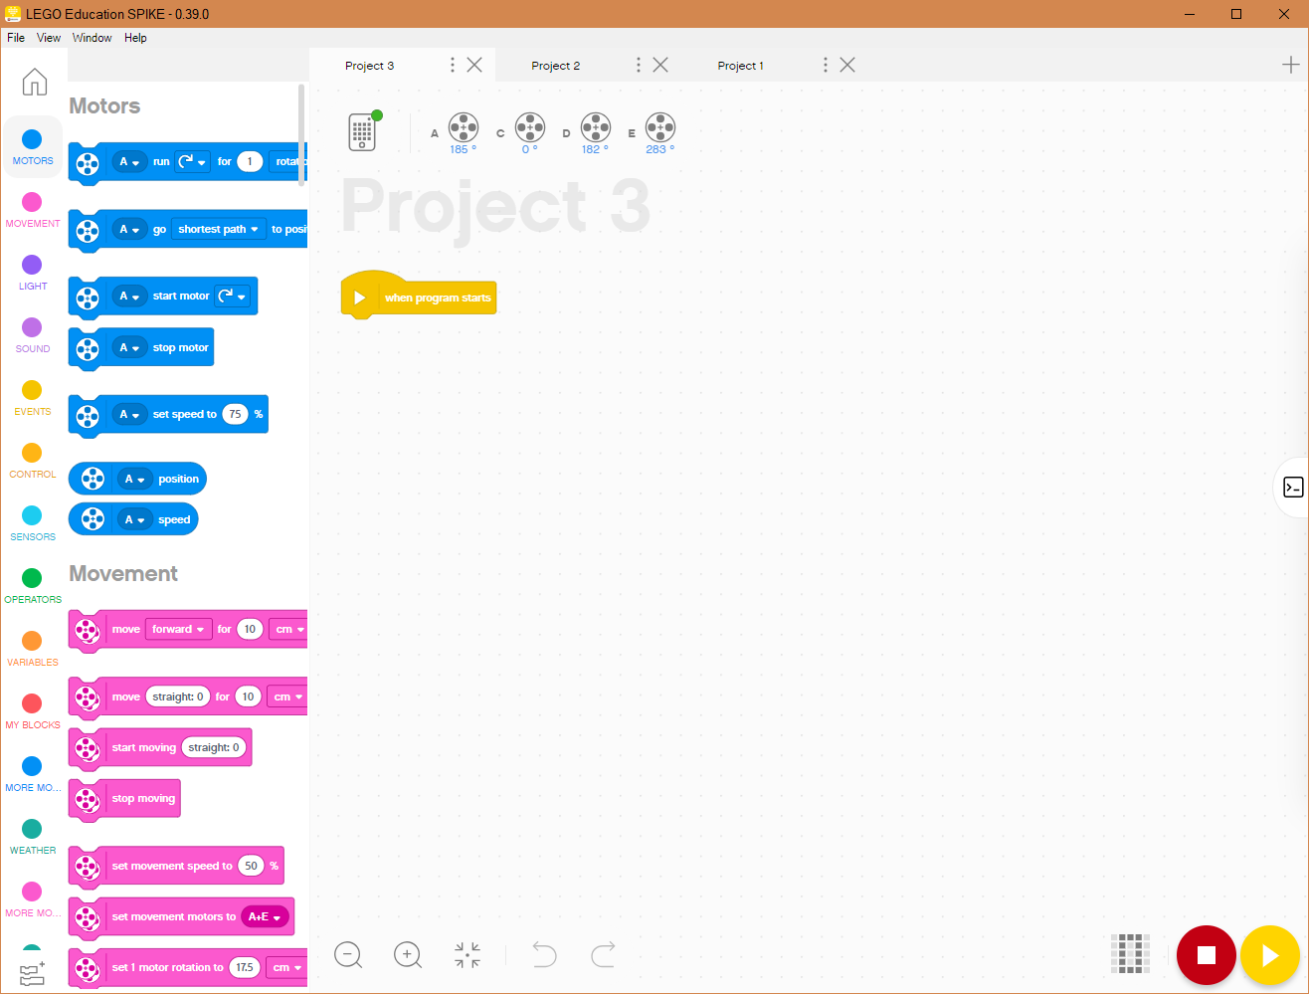
Create PROJECTS
New Project
To create a new project, click on the + sign on the top right.

Slide 4
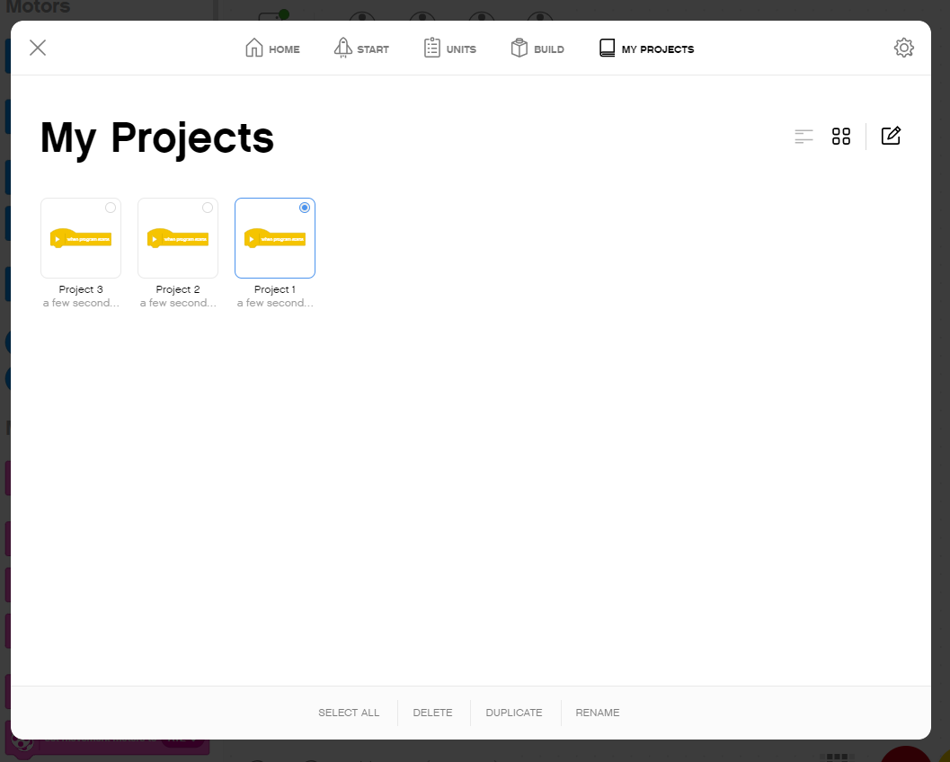
Delete, duplicate, rename PROJECTS
My Projects shows a list of the projects you have made.
To edit an existing project click on the edit icon [1] and then select the project you want to modify. Select the desired action (delete/duplicate/rename) [2].
[1]
[2]

Slide 5
Another way to Rename projects
The … next to the Project name lets to rename projects and also move them to a different location

Slide 6
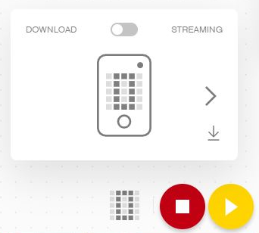
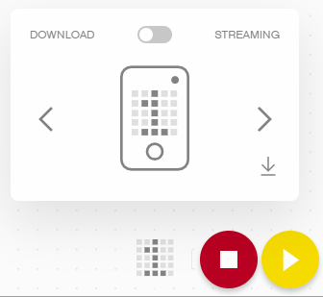
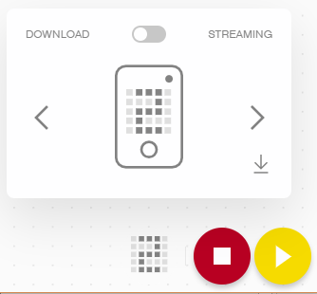
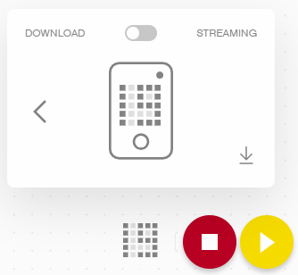
Ordering projects
Download/Run
The Download/Run Icon lets you pick the mode to download
This is also where you can select what “slot” on the Hub you want your project to be saved in
Use the arrow to change the number from 0 to any number between 0-19
The Hub can store up to 20 programs
…

Slide 7
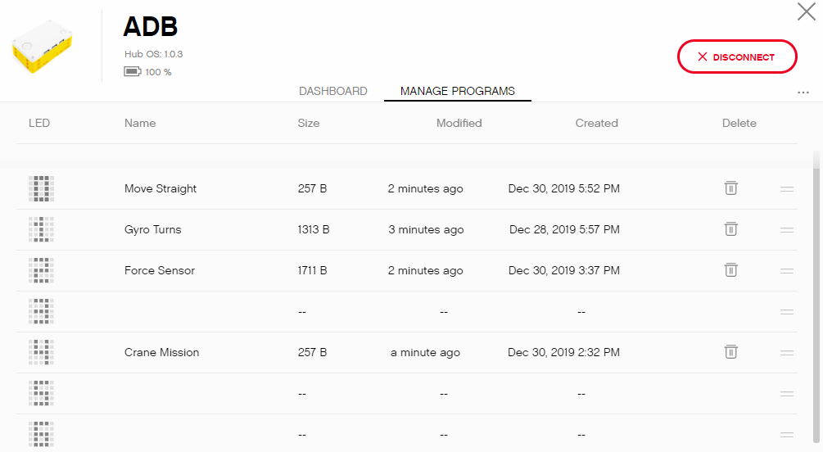
CHANGING THE ORDER OF PROJECTS
The Hub Dashboard lets to view all the projects currently on the Hub and reorder them
Press the Trashcan icon to delete projects from the Hub
Press and hold the equal sign icon (=) to drag a project into a new position

Slide 8

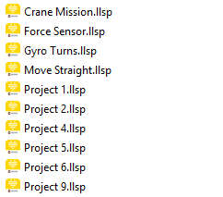
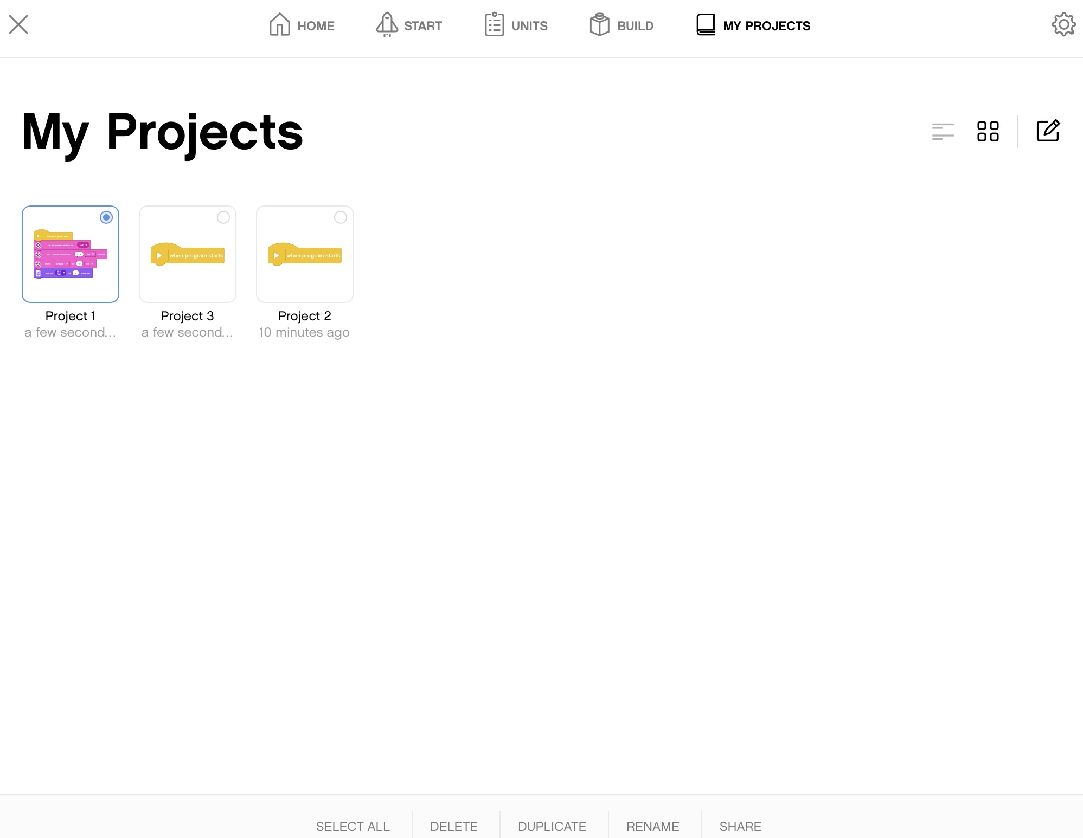
Sharing projects
SPIKE Prime files have a .llsp extension.
You can find all the files saved in your My Documents folder inside a folder called LEGO Education SPIKE Prime
You can email or share these files with anyone
Projects do auto-save, however, it is good practice to backup your program files
In the iOS App version, go to My Projects.
Click on the Edit Icon [1]
Pick the Project you want to share [2]
Select Share from the bottom menu [3]
[1]
[2]
[3]

Slide 9
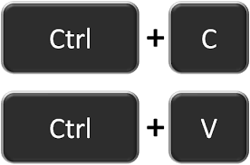
Copying code between projects
Click on the program stack you wish to copy to another project
Hit CTRL-C to Copy the stack (⌘ Command-C on Mac OS X)
Go to the other project file and hit CTRL-V (PASTE) (⌘ Command-V on Mac OS X)

Slide 10
CREDITS
This lesson was created by Sanjay Seshan and Arvind Seshan for SPIKE Prime Lessons
More lessons are available at www.primelessons.org
This work is licensed under a Creative Commons Attribution-NonCommercial-ShareAlike 4.0 International License.

