Slide 1
CREATING A SPIKE PRIME ROBOT CAD
BY SANJAY AND ARVIND SESHAN

Slide 2
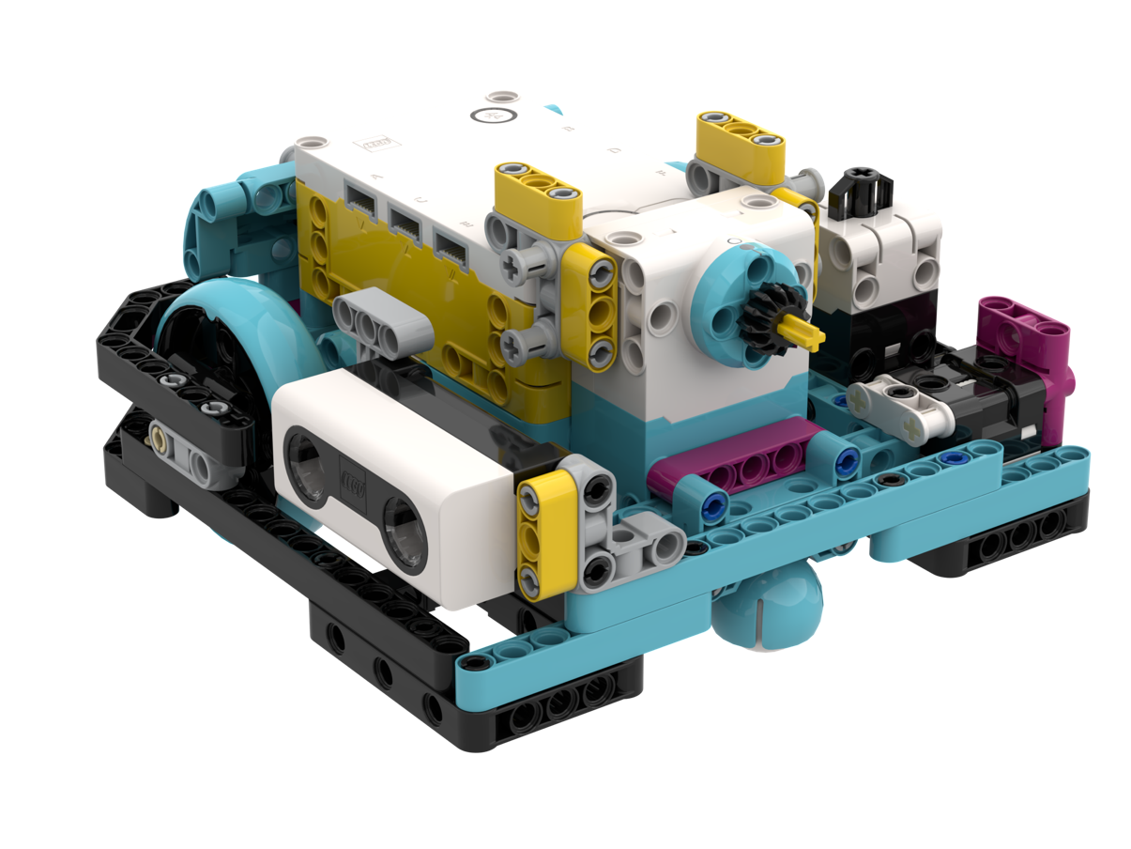
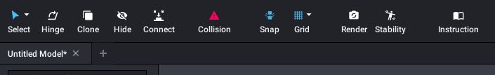
Robot Design
Being able to design your robot ahead of time or being able to document your design can be useful
You can now design a SPIKE Prime robot using Bricklink’s Studio 2.0
Studio 2.0 lets you create high quality renders of your robot
You can also use the same software to generate build instructions
Droid Bot IV made in Studio 2.0

Slide 3
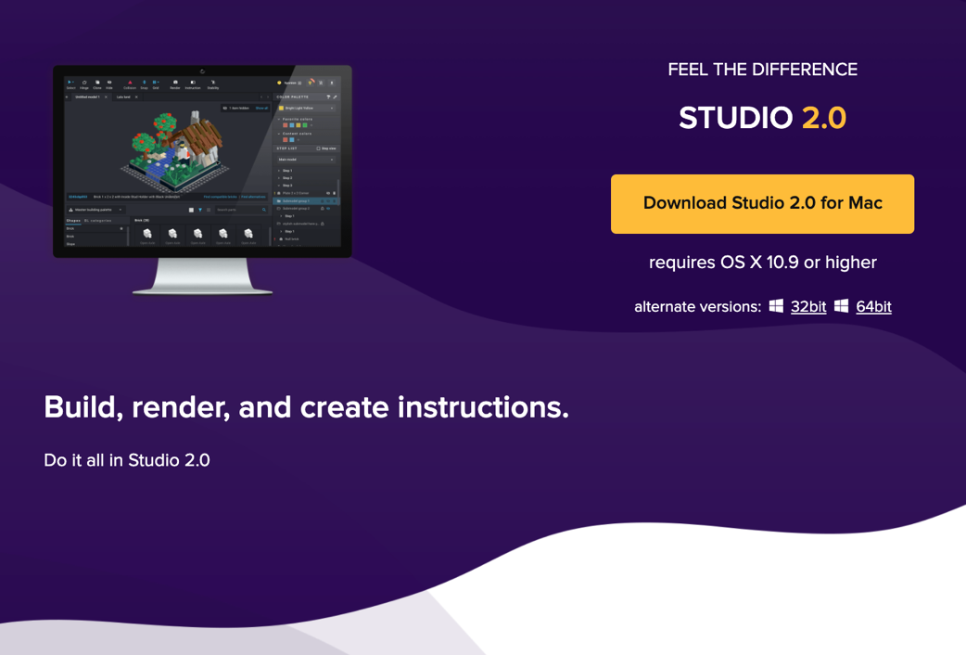
Step1: DOWNLOAD AND INSTALL SOFTWARE
https://www.bricklink.com/v3/studio/download.page

Slide 4
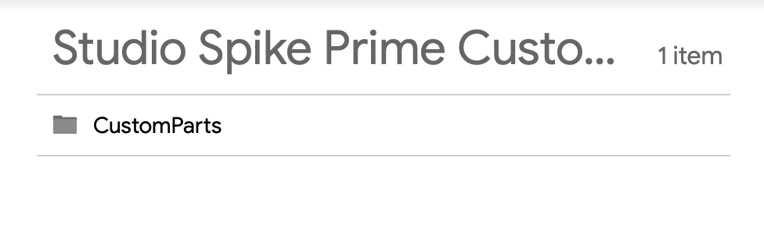
STEP 2: Install A CUSTOM PARTS PACK
Go to the following drive and download the entire CustomParts folder (this was created by Philo Hurbain)
It contains all the SPIKE Prime electronics and the new LEGO elements in the set
https://drive.google.com/open?id=17YU4BkiRdbmpHFgSegkDYvc21wq5MSJi
Unzip the contents and place in C:\Users\{your username}\AppData\Local\Stud.io
Spike Prime parts will then be available in the Custom Parts palette of Studio.
For Mac installs, refer to this page:
https://www.reddit.com/r/lego/comments/fmqp7z/instructions_for_importing_custom_parts_in_studio/

Slide 5
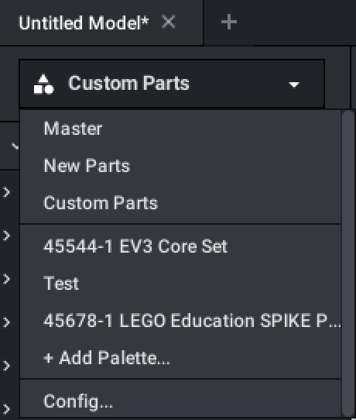
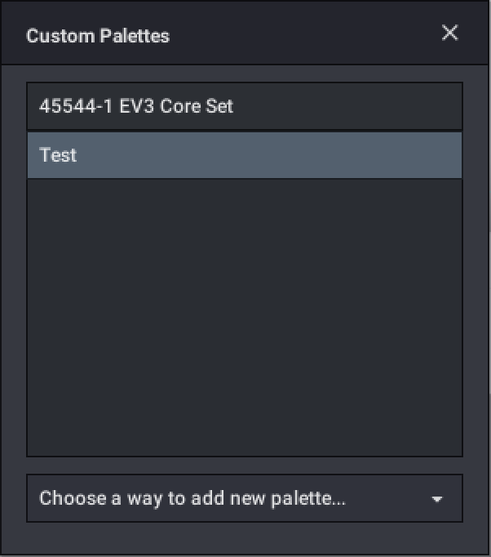
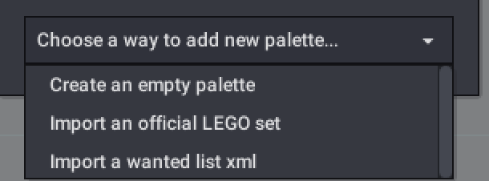
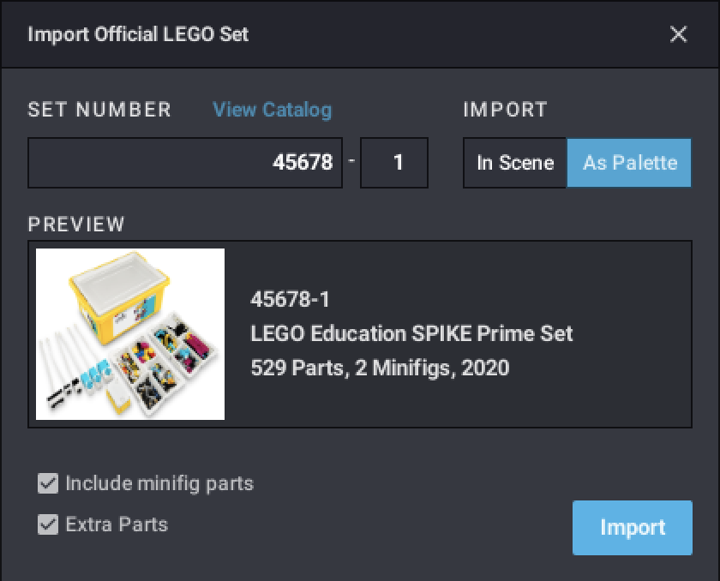
STEP 2: ALTERNATIVE METHOD (*Has some bugs)
1. Select Config from the pull-down menu
2. From the Custom Palettes menu, select choose a 3. way to add new palette
4. Select import an official LEGO set
5. Type in the set number (45678 and 45680)
6. Import the elements
* Note: As of July 7, 2020 this method fails to import the SPIKE Prime electronics. Hopefully, Studio will fix this.

Slide 6
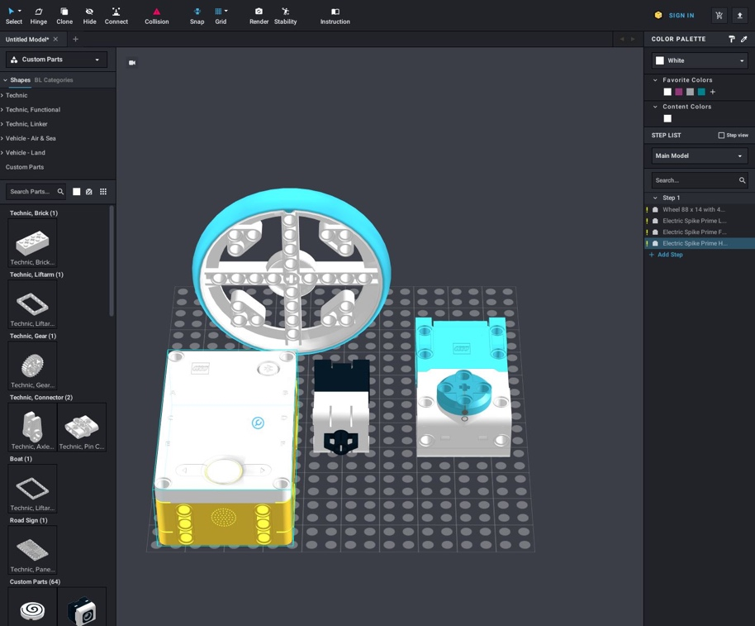
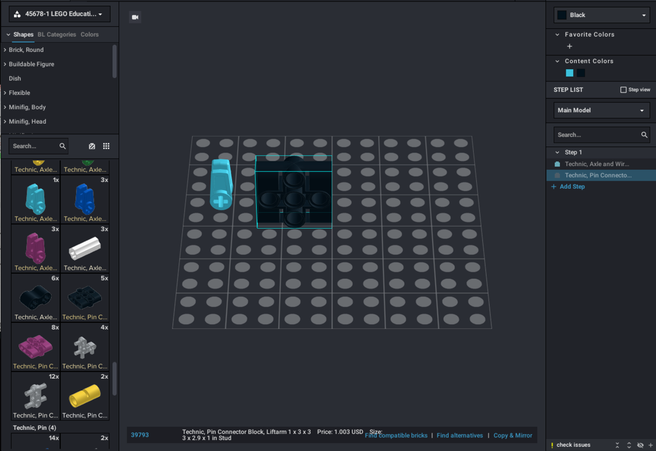
STEP 3: USING THE NEW ELEMENTS
Select parts from CUSTOM or using the SET NUMBER/NAME that you imported.
The parts in that collection will appear below
Select Custom
Select Set Number
You can now drag SPIKE Prime components into the canvas and build with them just like any other part.

Slide 7
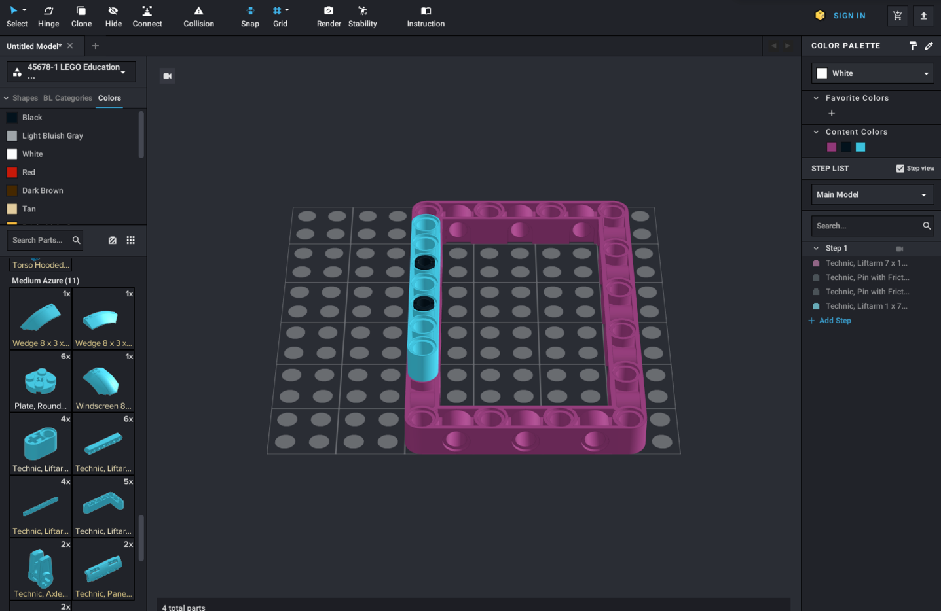
TIPS FOR USING STUDIO 2.0
Enable Snap – more like LDD and easier for beginners
Import frequently used sets (e.g. EV3 45444 and SPIKE Prime 45678) so you will have the basic parts without having to look up names and numbers
Change colors using the color palette
Add steps as you go. If you add parts in the order than makes sense, it is easier to spilt into steps to create build instructions

Slide 8

BASIC BUILDING TIPS
Drag components from left column and on to the canvas.
To rotate an item, click on an element (it will be highlighted), and then use the arrow keys to change its orientation
If you need to change the angle of an element, use the Hinge tool
When you want to connect two pieces together, if you have Snap tool enabled, the pieces will mesh correctly if you bring them close together

Slide 9
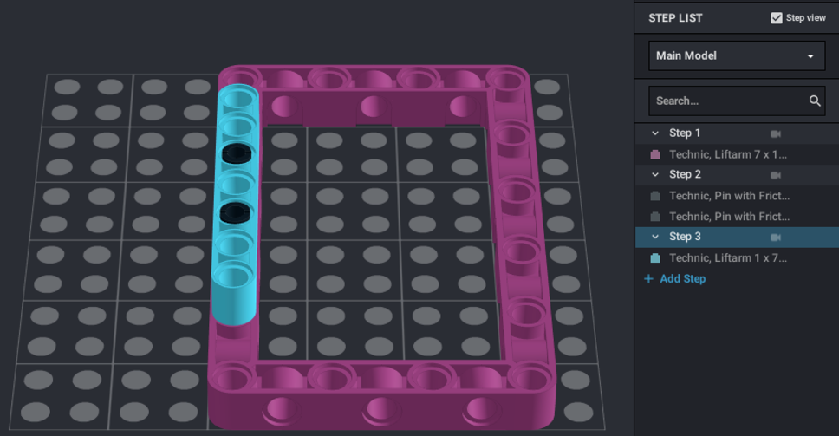
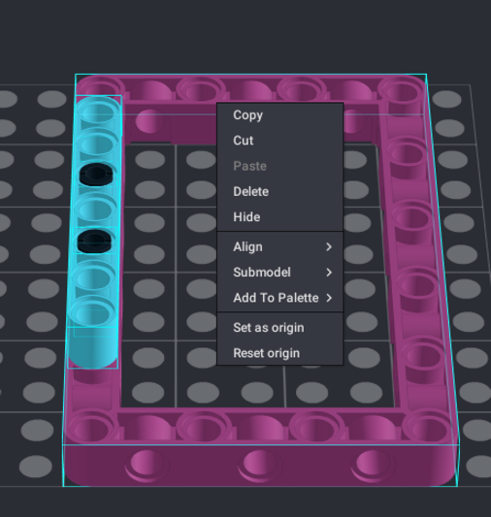
CREATING BASIC BUILD INSTRUCTIONS
As you add elements, they get added to Step 1 on the right column
Add new Steps and move elements as you need with your mouse
If you select Step View, each time you click on a Step number, you will see just the new elements from that step
Once you have all the elements placed into Steps, you can click on Instructions from the top bar to format the actual steps and generate a PDF
If you want to make smaller submodels inside the larger model, highlight all the parts you want in the submodel and right click to pick “submodel” You can now make steps for just this submodel.

Slide 10
CREDITS
This lesson was created by Sanjay Seshan and Arvind Seshan for SPIKE Prime Lessons
More lessons are available at www.primelessons.org
This work is licensed under a Creative Commons Attribution-NonCommercial-ShareAlike 4.0 International License.

