Slide 1
How to use these Lessons
By sanjay and Arvind Seshan

Slide 2
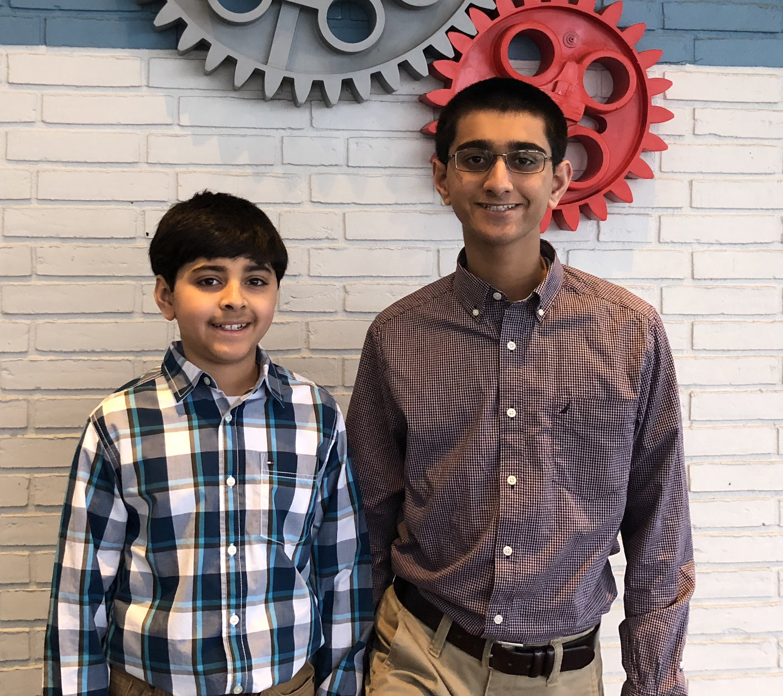
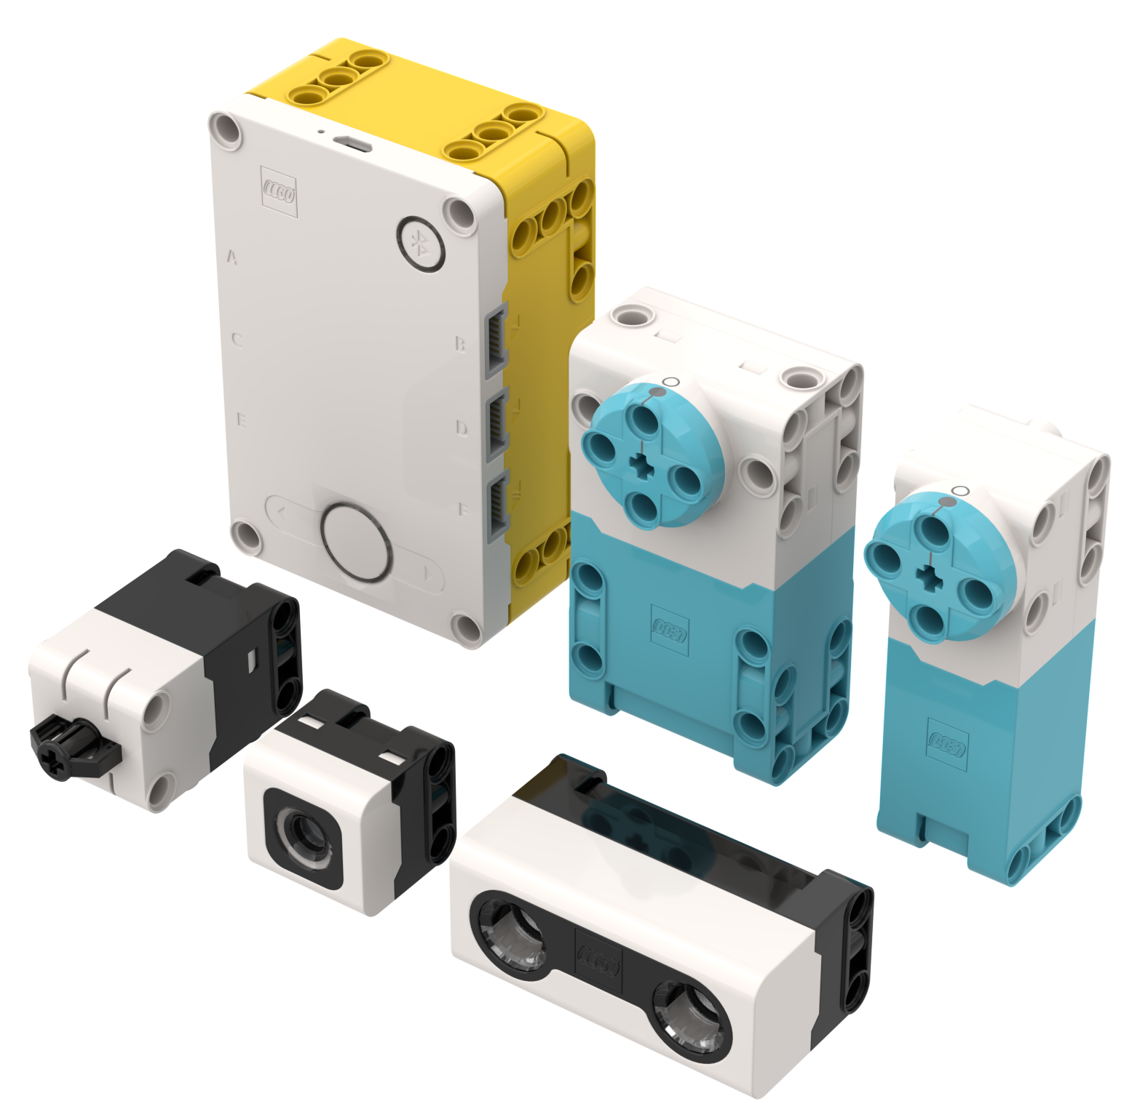
WHO ARE the authors?
We are high school students from Pittsburgh, PA, USA
We have won First Place Programming and First Place Champion’s at World Festival. Our robots have consistently scored top 6 in the world every year.
We also authored all the lessons on EV3Lessons.com which are used by more than 550,000 users worldwide. FLLTutorials.com has an additional 100,000 users.
We were also selected to be the “First 5” – Two of the first five community members selected by LEGO to give feedback on SPIKE Prime as it was being developed
In short, we have a strong background in teaching, writing lessons, and competing in LEGO robotics.
Arvind and Sanjay Seshan in Billund, Denmark in 2017

Slide 3
Mission and focus
There are programming lessons available inside the SPIKE Prime software. Those lessons are short, project-based lessons. There is a competition unit included.
Our SPIKE Prime lessons offer a different perspective. We focus on one build – a basic training robot with two drive wheels, and concentrate on developing programming skills
The skills we teach can be applied to any project or competition
We believe strongly in the need for discovery. At no time will we provide direct solutions to a competition. It is expected that you learn the concept and apply it situations you need in competition
We believe strongly that sensor usage is a valuable tool to increase robot reliability, and so you will find majority of our lessons talk about sensors in some way
Our lessons are designed to be completed in order so that you will have the correct prerequisites for each lesson. They are organized into handy units that build upon each other.

Slide 4
Lesson format
Our lesson content and format are based on seven years of writing and teaching programming lessons.
We try to keep our lessons short (10-12 slides) on purpose.
Our lessons are not YouTube videos on purpose. However, we will provide a supplemental video to demonstrate robot movement when needed.
Every lesson includes the following components:
Objectives, Main Blocks, Challenge, Solution
Lessons are grouped together into units

Slide 5
SPIKE PRIME lessons
UNIT 1 – Getting Started
How to use these Lessons
Building a Robot
Easier Building with SPIKE Prime
Installing Software and Firmware
UNIT 2 – Navigating the Software
Introduction to Hub and Software
Managing Projects
Viewing Sensor Values
UNIT 3 – Moving and Turning
Configuring Robot Movement
Moving Straight
Turning with Gyro
More Accurate Turns
UNIT 4 – Good Programming Practices
Pseudocode
Commenting Code
UNIT 5 – Using Sensors
Introduction to Force Sensor
Introduction to Color Sensor
Introduction to Distance Sensor
UNIT 6: Better Programming Techniques
Using Repeat Blocks
Using Sound Blocks
Using Light Blocks
Using If-Then Blocks
UNIT 7: Putting it all Together
Moving an Object with Stall Detection
Basic Line Follower
Challenges

Slide 6
SPIKE PRIME lessons
UNIT 8 – Advanced Programming Techniques
Introduction to Events
Event Synchronization
Variables
My Blocks
UNIT 9 – Advanced Sensor Use
Squaring on a Line
Proportional Line Follower
Gyro Move Straight
PID Line Follower
UNIT 10 – Techniques for FIRST LEGO League
Acceleration
Debugging Techniques
Reliability Techniques
UNIT 11 – MicroPython
Introduction to MicroPython
More lessons planned and coming soon

Slide 7
CREDITS
This lesson was created by Sanjay Seshan and Arvind Seshan for SPIKE Prime Lessons
More lessons are available at www.primelessons.org
This work is licensed under a Creative Commons Attribution-NonCommercial-ShareAlike 4.0 International License.

