Slide 1
SPIKE PRIME & FIRST LEGO LEAGUE
Sanjay Seshan and Arvind Seshan
Primelessons.org, EV3Lessons.com, FLLTutorials.com

Slide 2
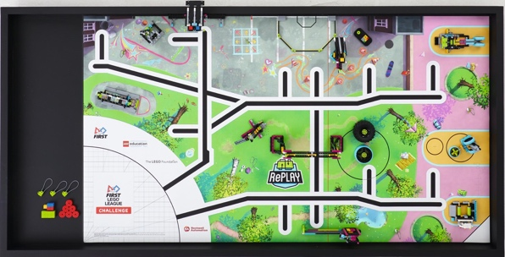
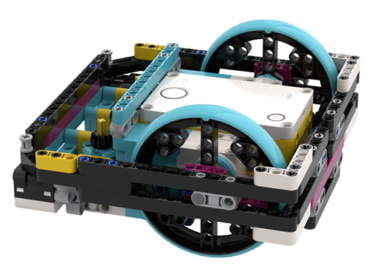
Objectives
Compare EV3 and SPIKE Prime
Focus on the needs of FIRST LEGO League teams
Note: We do not represent FIRST or LEGO Education. All opinions are our own.

Slide 3
Comparison
SPIKE Prime vs. EV3 Overview

Slide 4


Hub/Ports
5 second boot time (convenient for teams if the hub/brick were to crash before or during a run)
6 universal ports (can be used for sensors or motors) with a built-in gyro
30 second boot time, even longer for MicroPython
4 sensor + 4 motor specialized ports
Conclusion: You do not lose much in terms of ports by switching to the SPIKE Prime

Slide 5
Sensors used in FIRST LEGO League
Color Sensor (improved with more colors and better recognition)
Distance Sensor (can be taken apart for custom components – for hobbyists, not FLL)
Force Sensor (reads pressures from 0-10N)
Built-in 6-axis gyro and accelerometer (no drift and minimal lag)
Color Sensor
Ultrasonic Sensor
Touch Sensor (binary – pressed or released)
Gyro Sensor (drift and lag issues)
Conclusion: SPIKE Prime has the same sensors and they are overall better than the EV3’s

Slide 6
Programming Languages Available
Primary: Word Blocks: Scratch-based programming
Secondary: [Micro-]Python (text-based): built into same App, has basic tutorials and examples available. Has some extra commands and functionality (similar to EV3)
Can only use Scratch or MicroPython
Block based: EV3-G/EV3 Lab (LabView-like) or Scratch-based EV3 Classroom (Mac only right now)
Text based (official): MicroPython. Requires microSD Card, Visual Studio Code IDE (requires additional work/not built-in)
Can use non-LEGO supported languages (e.g. Java, C++, etc.), but usually require an SD card
The text based languages generally provide more functionality
Conclusion: SPIKE Prime’s software is easier to switch between block-based and Python,
but has fewer languages available

Slide 7
Features and Tradeoffs
More detailed look at SPIKE Prime

Slide 8

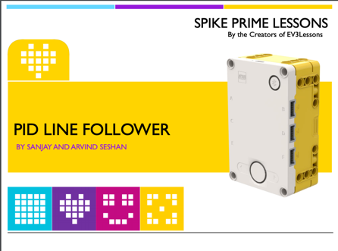
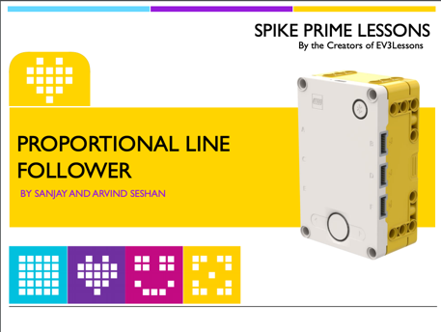
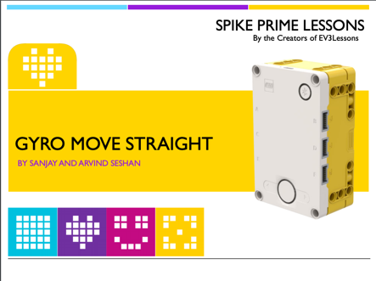

Advanced Programming
EV3 programming techniques can also be done in SPIKE Prime
You can use Proportional control, gyro move straight, PID line follower, squaring on a line, etc. in both Scratch and MicroPython
Videos https://www.facebook.com/PrimeLessons/
Lessons: http://www.primelessons.org/

Slide 9
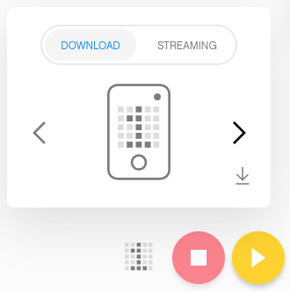
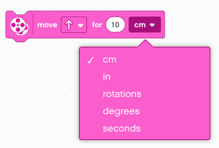
Improvements with SPIKE Prime (Software)
Finding and Ordering Programs: Built in menu with slots for projects (can organize list by run number unlike with the EV3)
Monitoring Variables Easily: Variables monitor allows users to easily view data to debug code – you can easily debug without an LCD screen – write debug data to a variable and it will show up on the PC screen when connected
Different Platforms – Same Blocks: Same software across all platforms (for EV3, Chromebooks, Android, and iPads had a limited version of the software) – allows for mixed-platform programming amongst team members
Move_CM: Movement blocks can take centimeters/inches as an input in addition to degrees, rotations, and seconds – easier to program robot to navigate the field (for EV3, you would have to make a My Block)
Stall Detection: Built in stall detection on motors

Slide 10
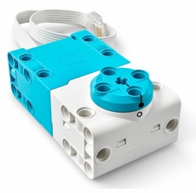
Improvements with SPIKE Prime (Hardware)
Size: Smaller form factor for electronic components
Shape: Electrical components have a more rectangular shape and more connection points (overall easier to build with)
Wires: Wires are easier to manage with thinner wires and wire clips
Motors: Built-in absolute positioning on motors
Charging: USB charging for battery – same as download port
Color Sensor: Improved color sensor – more colors and works at a greater distance from the mat

Slide 11

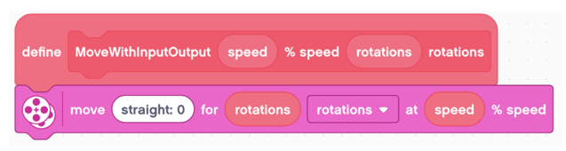
Tradeoffs: My Blocks
My Blocks are only available for use in the project that they are created in.
However, they can be copied and pasted from one project to another
No outputs from My Blocks
There is a work around that uses variables
In MicroPython, functions can be imported and have outputs
These are all problems specific to Scratch (also problems with EV3 Classroom)

Slide 12
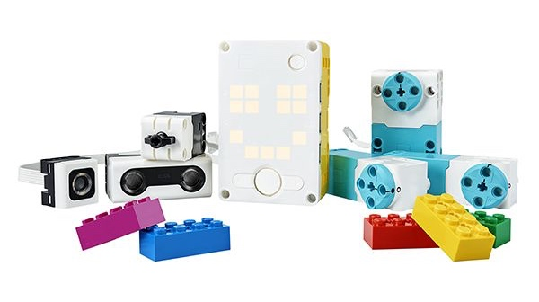
Tradeoffs: Calibration, Files, Wires
Distance Sensor: Does not work at angles when close to a surface
Color Sensor Calibration: None
You can work around this with code
The sensor seems to work well without a calibration
Files: No file reading/writing
This can be done in MicroPython
Battery: Battery must be connected to the hub to charge – you cannot have extra batteries on the side charging (i.e. you must own another hub to charge extras)
Wire length: Fixed
However, for FIRST LEGO League, the wire length is sufficient
If the length is too long, you can use the wire clips to easily keep wires out of the way
Notes:
Display?
Buttons
Menu

Slide 13
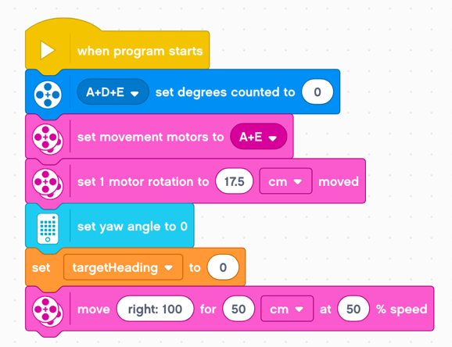
Tradeoffs: Steering Blocks
Steering input is not linear
The difference between 100 steering and 99 steering is significant
Workaround: Use Tank Blocks

Slide 14
Tradeoffs: File Size
At some project size (we have seen this in programs as small as 100 blocks), the program starts to fail
The motors and sensors disconnect when the program starts and then reconnect. Code run while sensors/motors are disconnected fail to run correctly.
For even larger programs, the code may not download at all
Workaround: Teams will need to wait at the beginning of their code for sensors and motors to reconnect

Slide 15
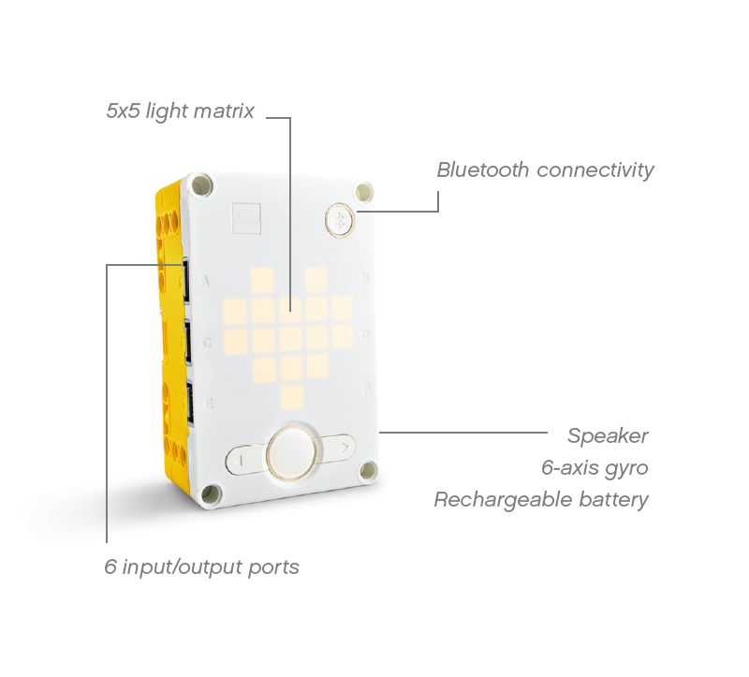
Tradeoffs: Gyro
There is no Gyro Drift or Lag, but there are other tradeoffs
Gyro Rate: Cannot access the gyro rate or accelerometer in Scratch, but this can done in MicroPython
Gyro Inaccuracies: E.g. turning the hub 360 degrees produces a gyro reading that is not 360.
This is typically hub specific. E.g. Hub 1 will consistently be 7 degrees off and Hub 2 will consistently be 4 degrees off.
The error is impacted by the complexity of other running code. E.g. updating the light matrix at the same time will increase the error by about 25 degrees per 360 degree turn.
Workaround: For (1), you may need to scale gyro readings after measuring the error for your hub. For (2), you will need to make sure gyro readings are done less frequently and/or have little code running at the same time.
Notes:
Display?
Buttons
Menu

Slide 16
Common Misconceptions
What people think about SPIKE Prime

Slide 17
Age Level
SPIKE Prime is only for a beginners and primary school students
Even though the default software is Scratch and the colors target younger ages, the capabilities of SPIKE Prime match those of the EV3
There is also MicroPython for older students
SPIKE Prime has lowered the entry point, but the ceiling is as high as EV3

Slide 18
SPIKE Prime Motors
SPIKE Prime motors are less powerful and worse for FIRST LEGO League
It is true that the motors are less powerful
However, there really is no need for more power than what the SPIKE Prime motors have. If more torque is needed, increasing the gear ratio should be sufficient.

Slide 19
Accuracy and Reliability
SPIKE Prime is less accurate and less reliable than EV3.
SPIKE Prime has built in stall detection, an improved color sensor
The SPIKE Prime Gyro is less accurate, but it does not have drift and lag
Regarding accuracy, the SPIKE Prime motors are comparable with the EV3 motors
All reliability techniques that can be done in EV3 can also be done in SPIKE Prime.

Slide 20
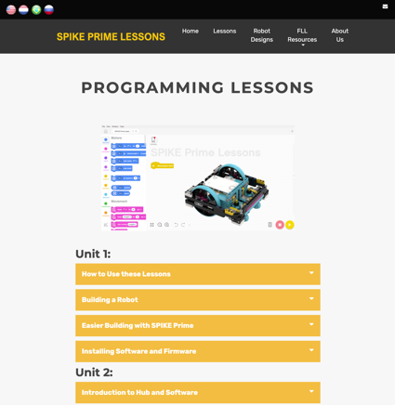
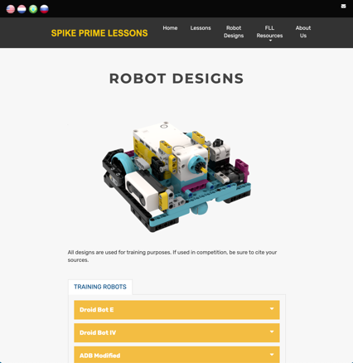
Resources
There are few resources for SPIKE Prime, but many available for EV3
PrimeLessons.org will have a complete set of lessons from beginner to advanced
We will support all teams
There is an online community to ask for help (LEGO SPIKE Community and FLL Challenge Share & Learn on Facebook)
New resources are coming out every week.
Built-in resources in the software for Scratch and MicroPython

Slide 21
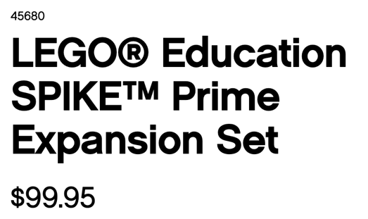

Cost
SPIKE Prime is expensive or same price as EV3
SPIKE Prime is actually cheaper than the EV3
The expansion pack gives you motors and sensors (much better value compared to EV3 expansion)

Slide 22

Bugs
SPIKE Prime will have bugs
SPIKE Prime is new.
There are updates coming all the time to fix bugs. Install the updates.
EV3 also had bugs. LEGO has historically addressed these quickly in updates but some bugs were only uncovered/addressed after several years.
The community usually develops workarounds

Slide 23
Overall Conclusions
If you have EV3s or just bought them, no problem
EV3 is a great product
FIRST always allows multiple platforms
Competitions are not geared to a platform (no extra points for one platform over another)
If you have the budget/just starting out (regardless of age of the students), want a new challenge, you can give SPIKE Prime a try
There are limitations in SPIKE Prime. It is not the same as EV3
But DO NOT underestimate the capabilities of SPIKE Prime

Slide 24
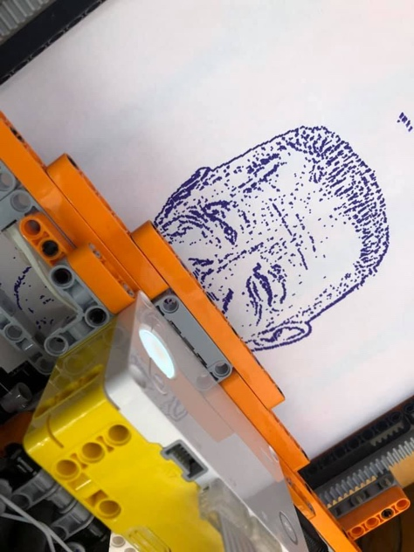
Thank You!
Photo Printer made with SPIKE Prime in Python
Do you have any questions?
www.primelessons.org
www.flltutorials.com
www.ev3lessons.com
https://www.facebook.com/groups/FLLShareandLearn/

