Slide 1
Dictionaries and sets
By Sanjay and Arvind Seshan

Slide 2
Lesson Objectives
Learn to create and use dictionaries and sets

Slide 3
Sets
Similar to lists
Stores a set of items
All items are unique and unordered
You can only place one of any item in a set
There is no order to a set (even if you entered in the items in a certain order)
Sets are items in {a, b,...} brackets
You can add to a set using the add method
>> s1 = set() # do not use {} to initialize empty set
>> s1.add(5) # add to a set
>> s1.add(2)
>> print(s1)
{2, 5}
>> s2 = {1, 2, 4, 4, "hello"} # define set
>> print(s2) # note only one 4 is below
{1, 2, 4, 'hello'}

Slide 4
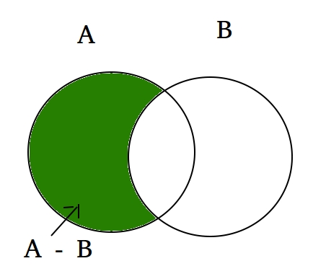
More on sets
You can find the difference, intersection, union, etc. between sets
If you try to add a list to a set, or any other mutable type, the program will crash
In general, it is much faster to do lookups on set than on a list due to something called hashing
>> print(s2.difference(s1))
{'hello'}
>> print(s2.intersection(s1))
{1, 2, 4}
>> s2.add([4,1])
TypeError: unhashable type: 'list'

Slide 5
Set Methods
Method | Description
add() | Adds an element to the set
clear() | Removes all the elements from the set
copy() | Returns a copy of the set
difference() | Returns a set containing the difference between two or more sets
difference_update() | Removes the items in this set that are also included in another, specified set
discard() | Remove the specified item
intersection() | Returns a set, that is the intersection of two other sets
intersection_update() | Removes the items in this set that are not present in other, specified set(s)
Highlighted ones are most important

Slide 6
Set Methods Cont.
isdisjoint() | Returns whether two sets have a intersection or not
issubset() | Returns whether another set contains this set or not
issuperset() | Returns whether this set contains another set or not
pop() | Removes an element from the set
remove() | Removes the specified element
symmetric_difference() | Returns a set with the symmetric differences of two sets
symmetric_difference_update() | inserts the symmetric differences from this set and another
union() | Return a set containing the union of sets
update() | Update the set with the union of this set and others

Slide 7
Copying Sets
Just like 1d lists, use the copy method
s1 = {1, 2, 3}
s2 = s1.copy()
Sets are also mutable, like lists, so you need to be careful when doing something like s1=s2

Slide 8
Dictionaries
Think like an English dictionary
Matches something to a definition
Defined using {} braces and : colons
Format for each element is item:definition → typically called key:value
d = {"hello":"a greeting", "red":"a color"}
The keys/items (e.g. “hello”) must be unique, but many keys can have the same definition
Keys can be any immutable data type (e.g. int, str)
Values/definitions can be anything, (e.g. int, list, None)
Use d2 = d.copy() to copy a dictionary (dicts are mutable)

Slide 9
Dictionary Methods
The highlighted ones are the most important
Method | Description
clear() | Removes all the elements from the dictionary
copy() | Returns a copy of the dictionary
fromkeys() | Returns a dictionary with the specified keys and value
get() | Returns the value of the specified key
items() | Returns a list containing a tuple for each key value pair
keys() | Returns a list containing the dictionary's keys
pop() | Removes the element with the specified key
popitem() | Removes the last inserted key-value pair
setdefault() | Returns the value of the specified key. If the key does not exist: insert the key, with the specified value
update() | Updates the dictionary with the specified key-value pairs
values() | Returns a list of all the values in the dictionary

Slide 10
Getting a Value
Sets:
Dicts:
Addressed similar to a list → use [] brackets next to dict variable containing a key to get the “value”
s = {1, 2, 3}
3 in s # True
"hi" in s # False
d = {"a":1,"b":2}
d["a"] == 1 # True
d["b"] == 2 # True

Slide 11
Challenge
Translate a handful of Spanish words to English and print the result
Hola → hello
Rojo → red
Naranja → orange
Verde → green

Slide 12
Challenge Solution
d = {"hola":"hello", "rojo":"red", "naranja":"orange", "verde":"green"}
data = "hola"
print(d[data]) # hello
data = "naranja"
print(d[data]) # orange

Slide 13
Review
List → stores values [1, 2, 2, 3, “hello”] (mutable)
Tuple → stores values (1, 2, 2, 3, “hello”) (immutable)
Set → stores unique values {1, 2, 3, “hello”} (mutable, but elements must be immutable)
Dictionary → stores values that can be indexed with a key {1:“a”, 2:“b”} (mutable, but keys must be immutable)

Slide 14
CREDITS
This lesson was created by Sanjay and Arvind Seshan for Prime Lessons
More lessons are available at www.primelessons.org
This work is licensed under a Creative Commons Attribution-NonCommercial-ShareAlike 4.0 International License.

