Slide 1
Debugging Techniques
BY SANJAY AND ARVIND SESHAN

Slide 2
Lesson Objectives
Learn the importance of debugging
Learn some techniques for debugging your code

Slide 3
Why Debug?
Debugging is a useful strategy to figure out where in your program something is going wrong or what went wrong
Once your code starts to become long or complicated (e.g. using sensors), it can become hard to figure out where in the program you are
The following slides show you some ways of knowing where you are in your program or knowing what values your sensors see
You will see that these techniques can be VERY USEFUL to any programmer.
Locate Error
Think of Solution
Fix Error
Re-Test Program
HURRAY!

Slide 4
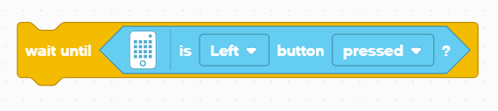
Wait For Button Press
Place a Wait Until Button Press block in your program
Place these wait for button presses every block or two close to where the robot is not working correctly
This can help you pinpoint which block is causing the robot to fail
The robot will stop and “wait for you to press the button”

Slide 5
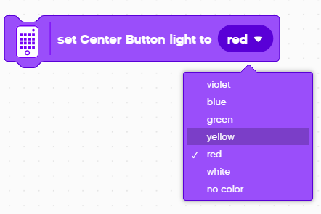
Visual Alerts: CENTER Button LIGHT
Place these blocks at critical steps in your program
You will then be able to visualize what block is playing and figure out where the error might be

Slide 6
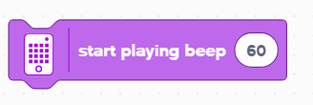
Sound Alerts: sound block
You can insert different sounds at intervals (about every 5 blocks or so, and then run the program again while listening for beeps.
These sounds can help you narrow down where in the program something is going wrong.

Slide 7
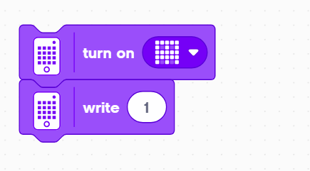
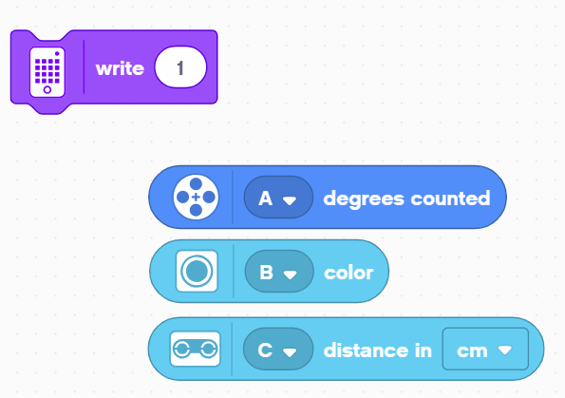
Print to Screen: LIGHT Block
Use a Light Block, to display information on the LED Light Matrix
You can display a custom shape or write something to the screen
Replacing the “1” can also be helpful for displaying data
Motor Degrees block lets you see how many degrees the motor has moved
A Color Sensor block lets you see what color the sensor is reading
A Distance Sensor block lets you see how far away the object it.

Slide 8

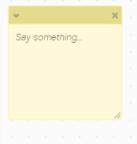
Video and COMMENTS
Recording your robot and replaying can be very helpful in debugging. Some cellphones have a slow motion mode that can help you diagnose problems.
Comments are also a useful way to debug. Use them to remember older values you may have entered in the block.

Slide 9
CREDITS
This lesson was created by Sanjay Seshan and Arvind Seshan for SPIKE Prime Lessons
More lessons are available at www.primelessons.org
This work is licensed under a Creative Commons Attribution-NonCommercial-ShareAlike 4.0 International License.

