Slide 1
Squaring on Lines
BY SANJAY AND ARVIND SESHAN

Slide 2
Lesson Objectives
Learn how to get your robot to square up (straighten out) when it comes to a line
Learn how squaring (also known as aligning on a line) can help the robot navigate
Learn how to improve initial code for aligning by repeating a technique
Practice creating a useful My Block

Slide 3
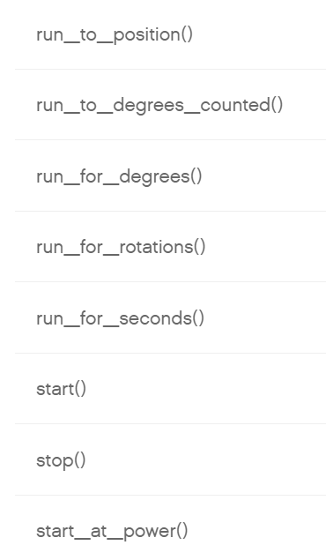
Review
Move Steering lets you control both motors at the same time
What if you want to move or stop one motor at a time?
Use the Single Motor Commands
motor = Motor('A')

Slide 4
WHY Align/Square on a line?
Aligning on a line helps the robot navigate
Robots get angled as they travel farther or turn (the error accumulates)
Aligning on a line can straighten out a robot.
Aligning can tell a robot where it is when it has to travel far
Example Goal: Your robot must deliver an object only inside a small END area. The distance between start and end is 8 feet (~2.5m)
Do you think your robot can travel 8 feet and continue to be straight?
End
8ft
Start

Slide 5
Three Easy Steps to Align
Challenge: Make the robot straighten out (align/square up)
STEP 1: Start both motors and a loop
STEP 2: Stop one motor when the sensor on the corresponding side sees the line
STEP 3: Stop moving the second motor when the sensor on that side sees the line
STEP 4: Exit the loop
Hints: Use Single Motors and a loop

Slide 6
NOTES on the solution
Our solution uses 2 Color Sensors (connected in ports E and F).
Our solution assumes that the color sensor on port E is next to the wheel on motor port A and color sensor on port F is next to the wheel on motor port B.
You should adjust the ports as needed
Your color sensors should NOT be placed right next to each other

Slide 7
Basic Solution: Move Until Line
from spike import PrimeHub, LightMatrix, Button, StatusLight, ForceSensor, MotionSensor, Speaker, ColorSensor, App, DistanceSensor, Motor, MotorPair
from spike.control import wait_for_seconds, wait_until, Timer
from math import *
hub = PrimeHub()
colorF = ColorSensor('F')
colorB = ColorSensor('B')
motorA = Motor('A')
motorE = Motor('E')
motorA.start(speed=-30)
motorE.start(speed=30)
foundA = False
foundE = False
while (not foundA or not foundE):
if (colorF.get_color()=="black"):
motorE.stop()
foundE = True
if (colorB.get_color()=="black"):
motorA.stop()
foundA = True
Starts motors
Wait for color sensors to detect black and stop motors

Slide 8
Improving your code
What do you notice about the solution we just presented?
The robot is not always perfectly straight (aligned) at the end of it.
Both color sensors are on the line, but the robot stops at an angle if you started at a sharp angle
Challenge Continued: Think about how you can improve this code so that the robot ends straighter
Solution: repeat the align except look for white this time

Slide 9
CREDITS
This lesson was created by Sanjay Seshan and Arvind Seshan for Prime Lessons
More lessons are available at www.primelessons.org
This work is licensed under a Creative Commons Attribution-NonCommercial-ShareAlike 4.0 International License.

