Slide 1
Repeat blocks
BY SANJAY AND ARVIND SESHAN

Slide 2
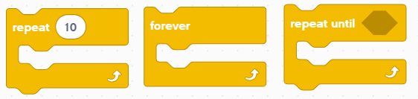
Lesson Objectives
Learn how to repeat an action using the Repeat Block

Slide 3
Repeating code
Let us say that you want the robot to repeat an action over and over again.
Would you copy the blocks over and over?
What if you wanted to repeat the action forever?
You can use the Repeat Blocks to repeat an action for a number of times or until some exit condition is met
Repeat Blocks make repeating a task multiple times easy
The added benefit is that a loop can end whenever you want (a specific number of times, run forever, a specific condition, etc.)
Loop blocks can be found in the Control Block Palette

Slide 4
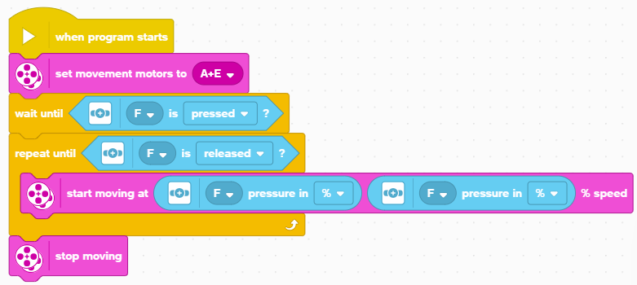
Using A Repeat Until Block
In this example, the robot adjusts the speed of the motors based on the Force sensor until the Force sensor is released. This type of loop is different than a wait until block since you can perform different actions while you are waiting
Configure your motors
Wait until the sensor is first pressed
Loop until the sensor is released
Adjust the speed of the motor based on the current force reading each time through the loop.

Slide 5
Challenge: Around the box
Go around the box
To do this, you will have to move forward 20 cm and turn right
Repeat this action 4 times till you are all the way around the box
You will have to remember the lesson on Moving Forward and Turning to complete this challenge
You repeat those two actions in a Repeat block
20cm

Slide 6
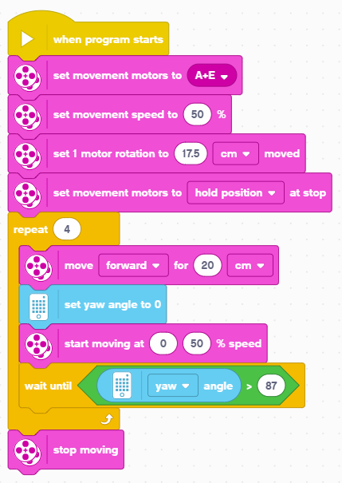
Challenge Solution
In previous lessons, you learnt how to configure your robot. The first set of blocks sets the movement motors, % Speed, Move CM and sets the motors to hold. (see Configuring Your Robot Lesson). This program has been configured for Droid Bot IV
Code to move the robot 20cm forward (see Moving Lesson) and Turning 90 degrees (see Turning with Gyro Lesson)

Slide 7
CREDITS
This lesson was created by Sanjay Seshan and Arvind Seshan for SPIKE Prime Lessons
More lessons are available at www.primelessons.org
This work is licensed under a Creative Commons Attribution-NonCommercial-ShareAlike 4.0 International License.

