Slide 1
USING Sound & Music BLOCKS
BY SANJAY AND ARVIND SESHAN

Slide 2
Lesson Objectives
Learn how to use sound blocks
Learn how to create and modify sounds
Learn how to add the Music Blocks to the Palette
Compose some music

Slide 3
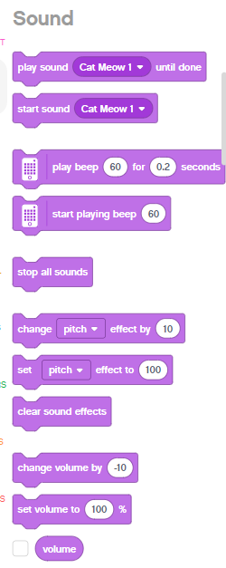
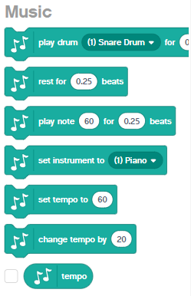
Sound blocks
Sound blocks can be found in two of the Block Palettes
The Music Blocks must be added to your Block Palette using Extensions
You can play tones, change instruments and even create custom sounds
Sound blocks can be added to your projects for fun, but also for debugging purposes – e.g. they can be used to indicate when a piece of code has completed
Note: Only the play “beep” sound blocks actually play on the Hub. The other sounds play on your device (laptop/tablet, etc.)

Slide 4
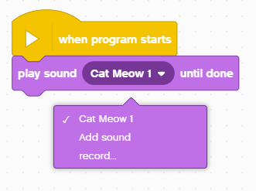
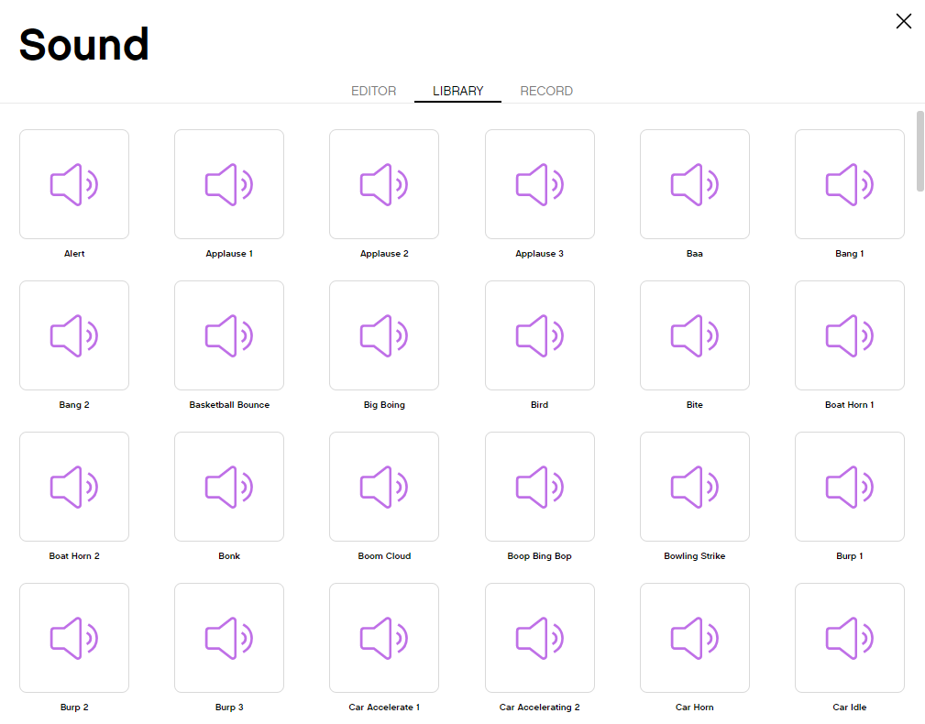
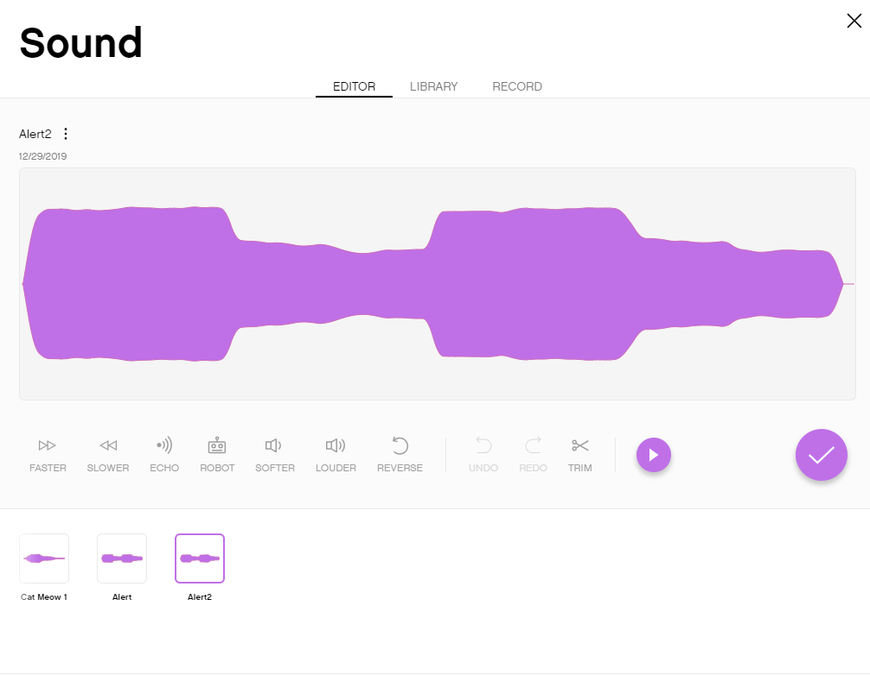
ADDING more Sounds
You Add more sounds using the dropdown menu
There are many sounds in the Sound Library
Once you select the sound, you can also modify them

Slide 5
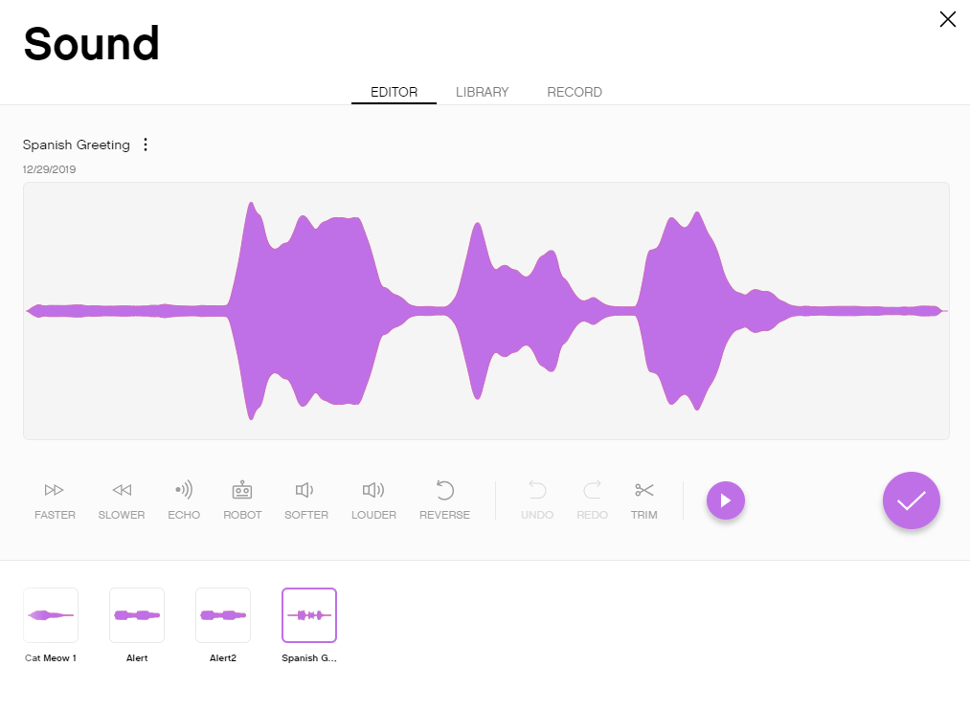
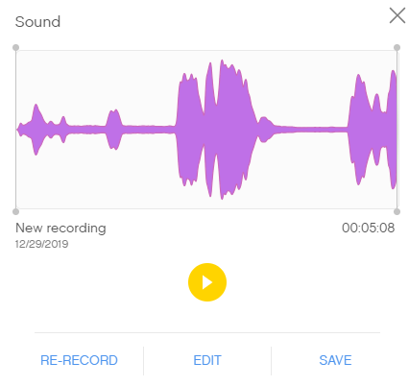
recording custom sounds
You can record custom sounds in two ways: either from the “record” or “add menu”

Slide 6

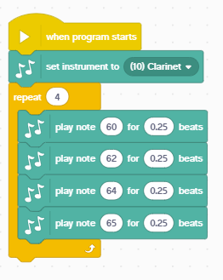
Challenge and sample solution
Play an instrument
Add the Music Extension Blocks by clicking on the Extensions Icon at the bottom of the Block Palette
Pick your favorite instrument
Compose a short piece of music and play it 4 times
The instrument is set to Clarinet
Music is played 4 times using the Repeat Block
Four notes are played

Slide 7
CREDITS
This lesson was created by Sanjay Seshan and Arvind Seshan for SPIKE Prime Lessons
More lessons are available at www.primelessons.org
This work is licensed under a Creative Commons Attribution-NonCommercial-ShareAlike 4.0 International License.

