Slide 1
Introduction to Color sensor
By Sanjay and Arvind Seshan

Slide 2
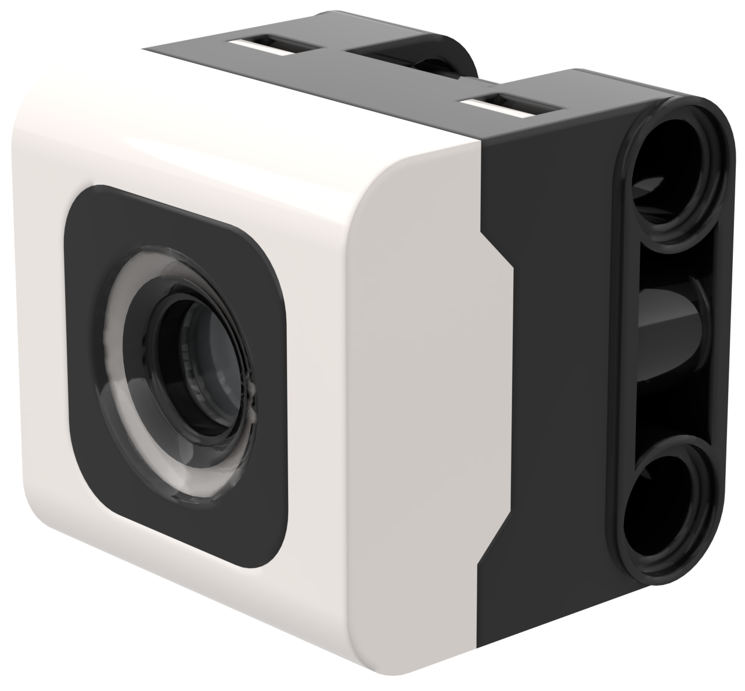
Lesson Objectives
Learn how to use the Color Sensor
Learn how to use the Wait Until Block
Note: Although images in this lessons may show a SPIKE Prime, the code blocks are the same for Robot Inventor

Slide 3
What is a Color sensor?
The sensor API can report either the color or reflectivity measured
Unlike the EV3, reflectivity is measured while shining a white light, not a red light.
The sensor can report 8 colors (shown on right) and no color (None)
Optimal reading distance according to the specs: 16 mm (depending on object size, color, and surface)
'black'
'violet'
'blue'
'cyan'
'green'
'yellow'
'red'
'white'
None

Slide 4
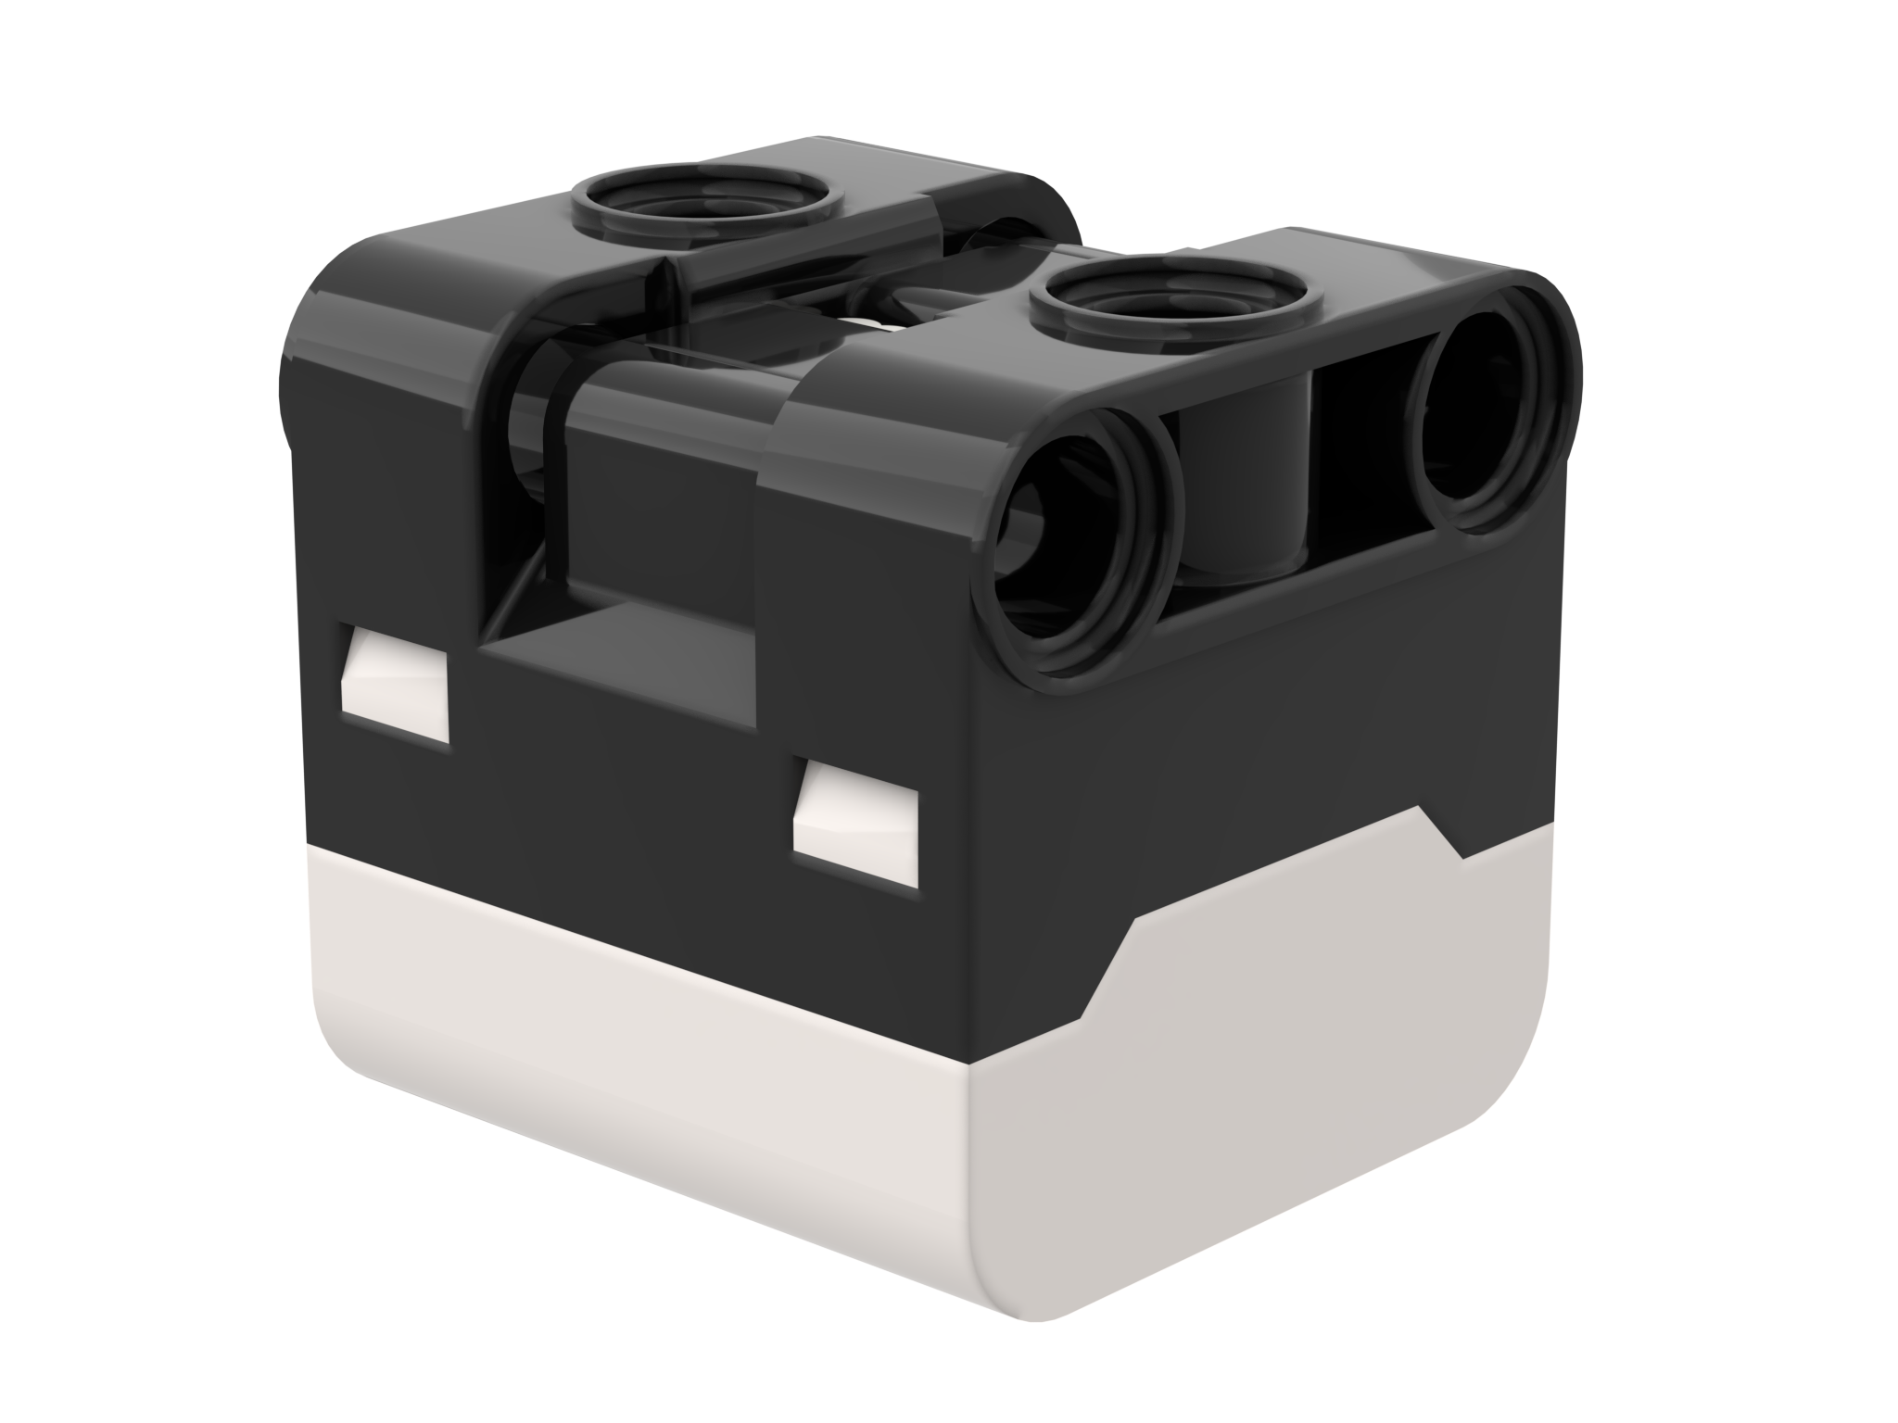
NOTE: ADB and sensing color
The color sensor on ADB is mounted at about 8mm off the ground, but the optimal distance for mounting the sensor according to the specs is 16mm.
When using this robot design, Black does not read correctly in Color Mode using electrical tape lines or a FIRST LEGO League challenge mat.
See the next slide for modifications. The build instructions are also provided as a separate file on our site.
16mm
2M (2 LEGO Modules)

Slide 5
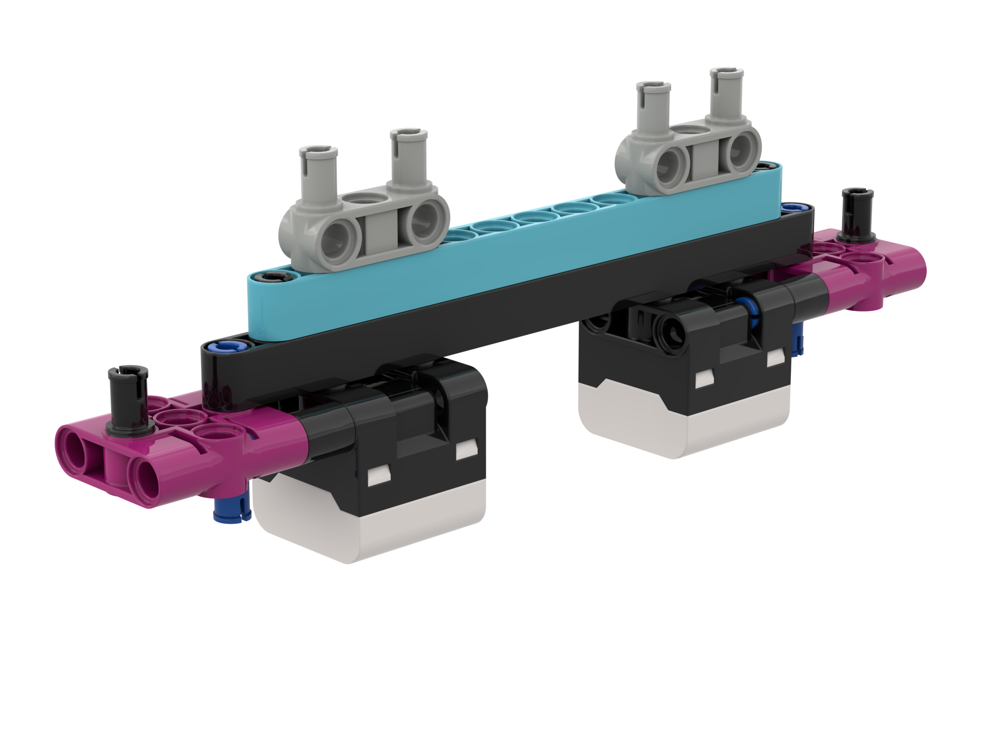
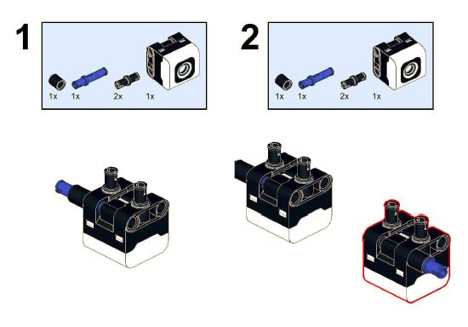
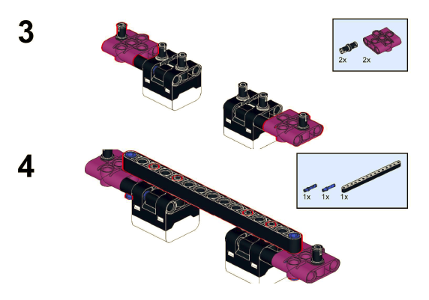
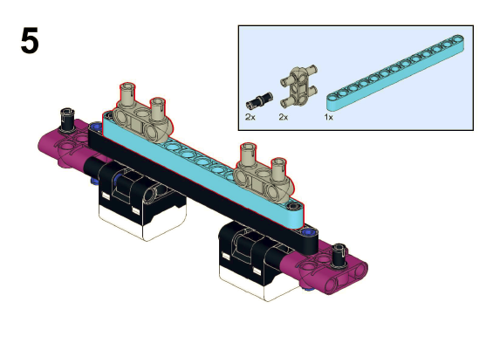
Modifications to ADB
Build instructions for modifying the front bumper of ADB so that the color sensors are raised one LEGO module up are included on this website

Slide 6
How do you program with a color Sensor?
Before using the sensor, it must be initialized as an object
color = ColorSensor('B')
The two modes you can program the color sensor in: Color Mode and Reflected light mode
We will use color mode in this lesson
The ColorSensor class provides a method to wait until the color is detected:
color.wait_until_color(color)
Name for the sensor
Port

Slide 7
Color sensor methods
get_color()
Reads current color
get_ambient_light()
Reads ambient light intensity
get_blue()
Reads just the blue component of the RGB color
get_green()
Reads just the green component of the RGB color
get_red()
Reads just the red component of the RGB color
get_reflected_light()
Reads reflected light intensity
get_rgb_intensity()
Reads overall RGB intensity
light_up(light_1=100, light_2=100, light_3=100)
Adjusts color sensor light brightness
light_up_all(brightness=100)
wait_for_new_color()
wait_until_color(color)

Slide 8
Challenge 1
Program your robot to move straight until the color sensor sees black
You will need to use the Wait Until color or while loops
color.wait_until_color('black’)
Or
while (color. get_color() != "black"): pass
Basic steps:
Set the movement motors for your robot (A and E for Droid Bot IV and ADB robot)
Set the stop action to brake
Set the % speed for your robot
Initialize the color sensor
Start moving straight
Use the wait_until_color() method to detect when the color sensor sees black
Stop moving

Slide 9
Challenge 1: Solution
In previous lessons, you learnt how to configure your robot. (See Configuring Your Robot Lesson)
motor_pair = MotorPair('A', 'E')
motor_pair.set_stop_action('brake')
motor_pair.set_default_speed(30)
color = ColorSensor('B')
motor_pair.start()
color.wait_until_color('black')
motor_pair.stop()
Configure robot
Start moving
Wait until the color sensor sees black
Stop moving

Slide 10
CREDITS
This lesson was created by Sanjay and Arvind Seshan for Prime Lessons
More lessons are available at www.primelessons.org
This work is licensed under a Creative Commons Attribution-NonCommercial-ShareAlike 4.0 International License.

