Slide 1
Configuring robot Movement
By Sanjay and Arvind Seshan

Slide 2
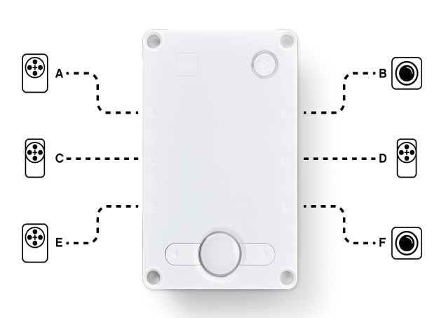
Lesson objectives
Learn to configure robot movement on a SPIKE Prime robot
Learn how to add you first lines to the programming canvas
Note: Although images in this lessons may show a SPIKE Prime, the code blocks are the same for Robot Inventor

Slide 3
Why configure your code?
Every robot is different
Before you can program to move or turn, you need to first set how you have configured your robot:
What ports are the drive motors connected to?
What type of wheels are you using?
What fast do you want to move?
Do you want to stop immediately at the end of a move?
This information needs to be in every program you write

Slide 4
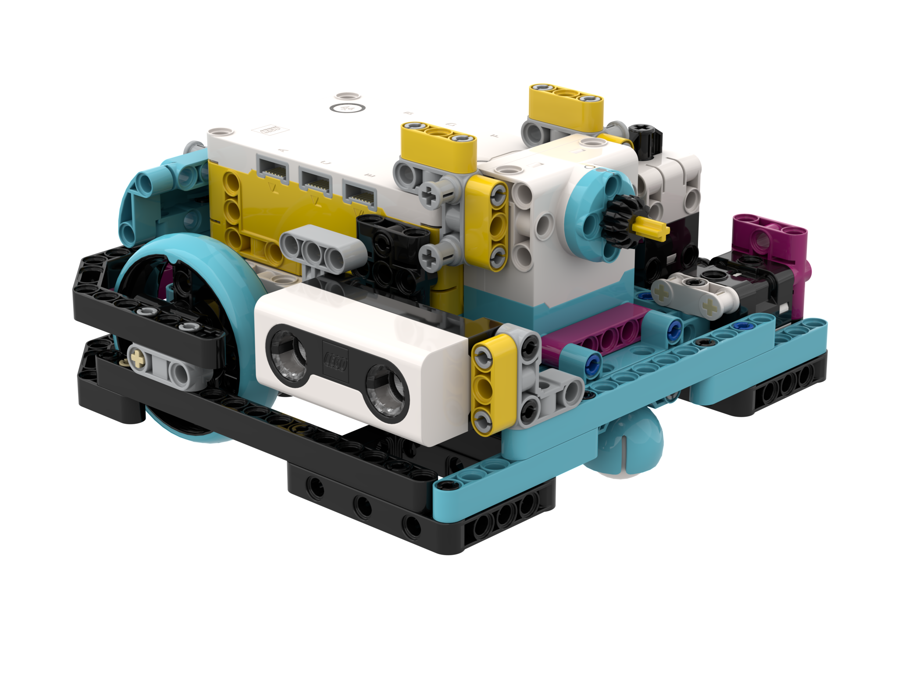
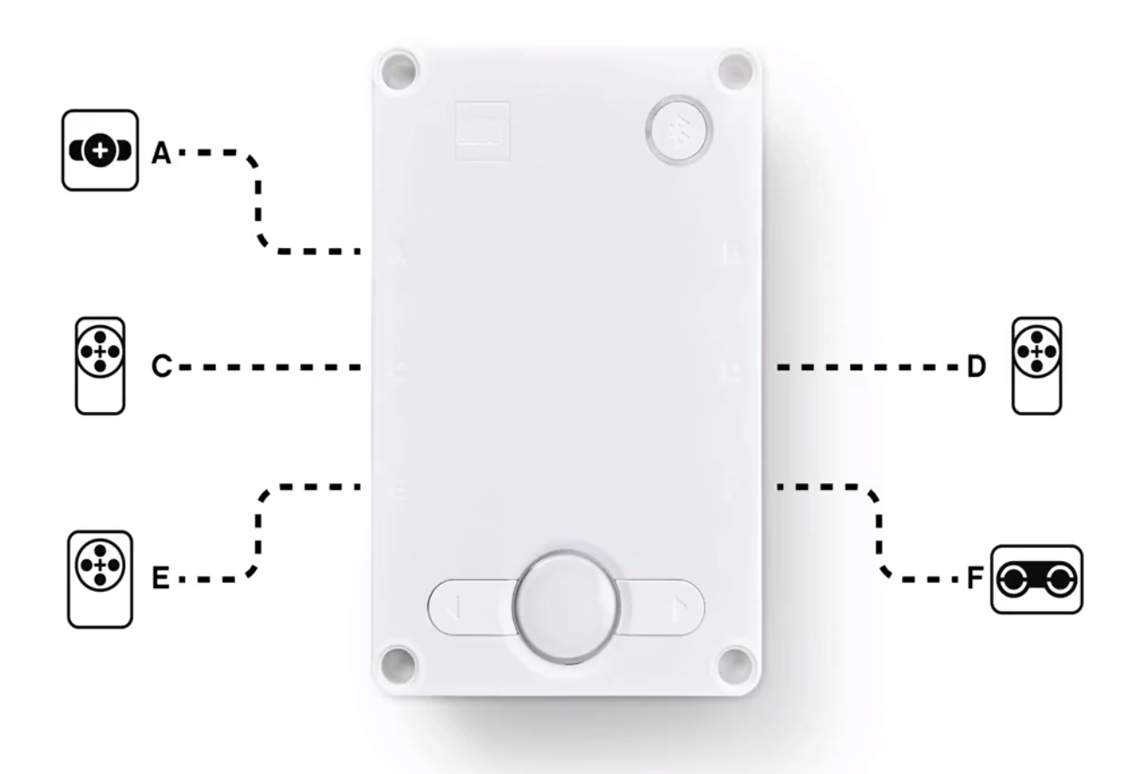
What is connected to each port?
Droid Bot IV
ADB
Droid Bot IV Configuration
ADB Default settings
Drive Motor
Drive Motor
Drive Motor
Drive Motor

Slide 5
Configuring Movement Blocks
Before using movement methods, you must configure the robot first. The below constructor (a special function that returns an object of the requested type) creates a MotorPair that can be used to move the robot.
MotorPair(left_motor_port, right_motor_port) Determines which motors are connected to the left & right wheels (change the settings for your robot). Whenever functions have 2 inputs for wheels – the first one is for the left wheel and second is for right.
The MotorPair type has 3 methods that further configure movement:
set_motor_rotation(amount, unit='cm’) Sets the ratio of one motor rotation to the distance travelled.
set_default_speed(speed) Sets the “default” speed for move methods you may use later in the program.
set_stop_action(action) Determines what the robot does at the end of a move method (brake, hold position, or float).
These methods definitions can be found in the Motor Pairs tab in the Knowledge Base.
Left
A
Right
E

Slide 6
Motor Pair Initialization
To use MotorPair, both motors in the pair must be initialized.
motor_pair = MotorPair('A', 'E')
Name for the MotorPair
Port of the left motor
Port of the right motor

Slide 7
Wheel Size and Movement configuration
The move method for MotorPair moves the robot a specified distance (by default in CM)
motor_pair.move(amount, unit='cm', steering=0, speed=None)
However, prior to using this method, you have to tell the program the number of cm per rotation travelled using the set_motor_rotation method.
motor_pair.set_motor_rotation(amount, unit='cm’)
amount: distance travelled in one rotation
Default: 17.6cm (small wheel)
unit: either ‘cm’ or ‘in’
You will need to calculate the amount value as it depends on what wheel you use. The next two slides explain different ways to calculate this value.
Note that you can use inches instead of centimeters if you prefer

Slide 8
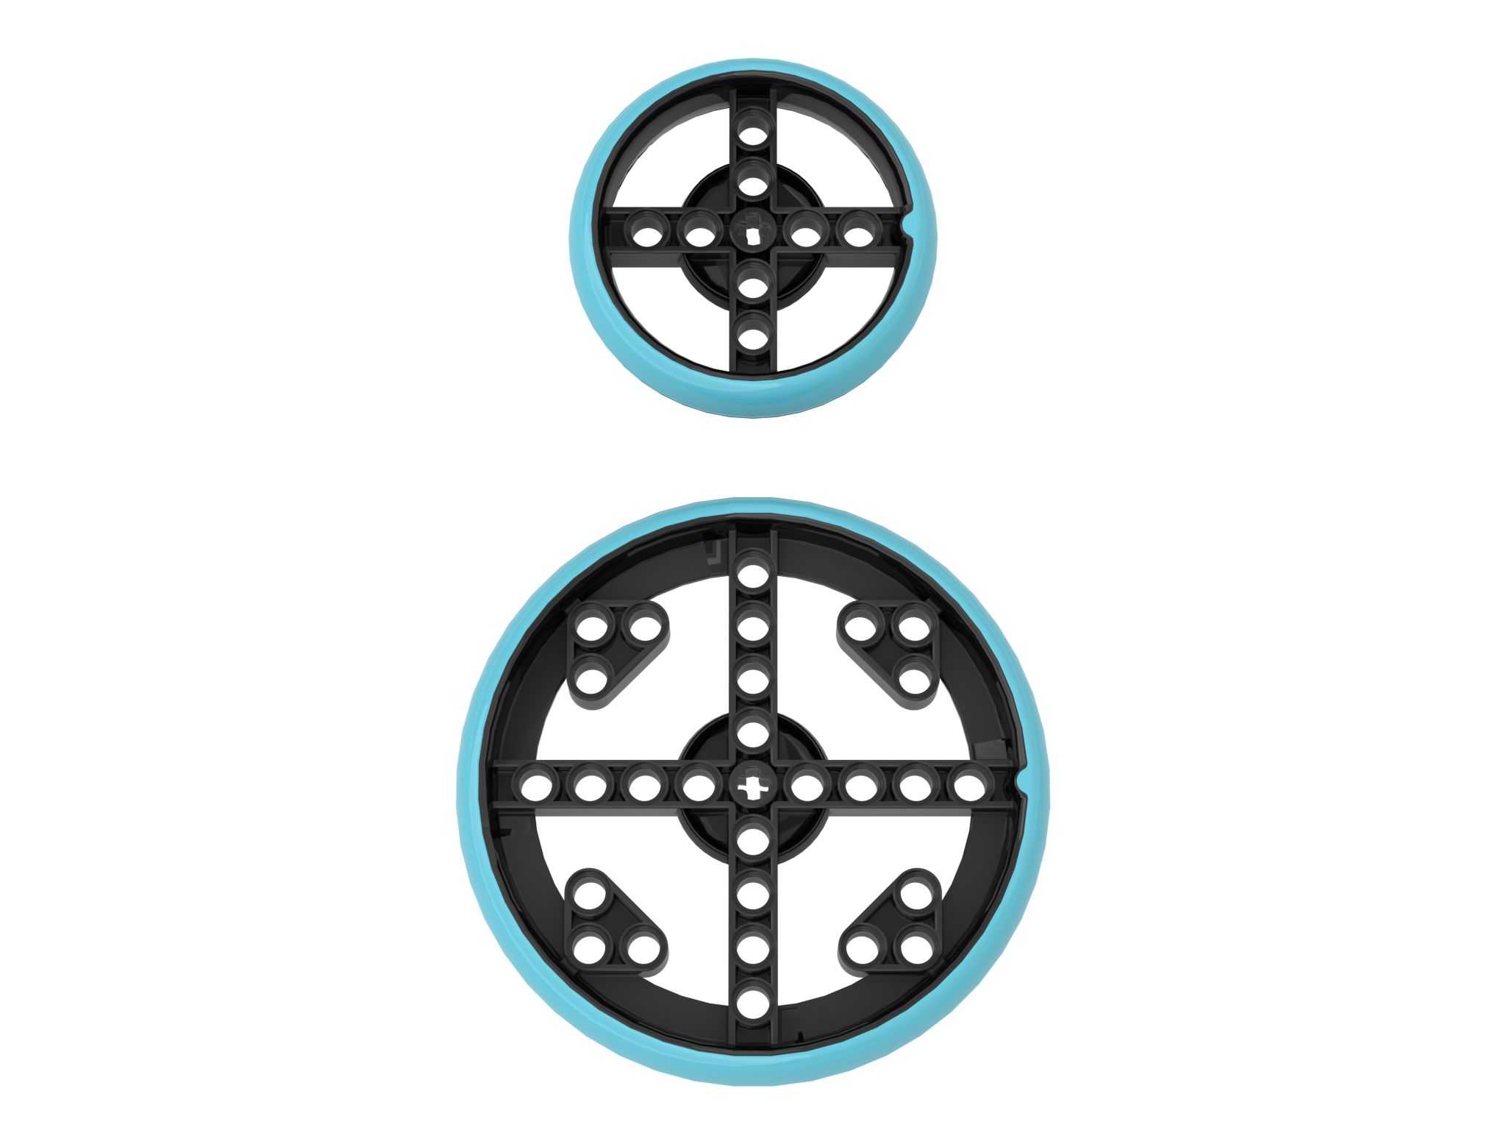
How Many CM Does The Robot Move in 1 Rotation? (Method 1)
Look up the wheel size in mm printed on your tire and divide by 10 to convert to cm (because 1cm=10mm)
Multiply the answer in step 1 by π (3.14) to compute circumference
Use the value to set the motor rotation block
Example calculation using the standard small SPIKE Prime wheels (used in Droid Bot IV):
Small SPIKE Prime Wheels = 5.6cm in diameter
5.6cm × π = 17.6cm per rotation
Example calculation using the standard large SPIKE Prime set wheels (used in ADB):
Large SPIKE Prime Wheels = 8.8 cm in diameter
8.8 cm × π = 27.6 cm per rotation
Helpful chart with common LEGO wheels and their diameters.
http://wheels.sariel.pl/
motor_pair.set_motor_rotation(17.6, 'cm')
motor_pair.set_motor_rotation(27.6, 'cm')

Slide 9
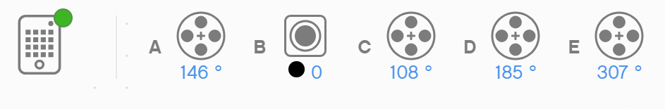
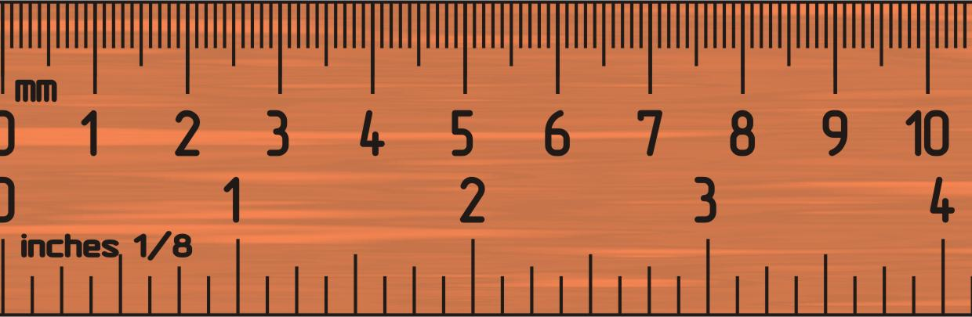
How Many CM Does The Robot Move in 1 Rotation? (Method 2)
Use the Dashboard to view sensor data to find the Motor Degrees value
Put your ruler next to your wheel/robot at 0 centimeters (whatever part of the robot you use to align with 0, you should use to use to measure distance in step 2)
Roll your robot forward until the motor encoder reading (in the SPIKE software) reaches 1 rotation, or 360 degrees. Once you learn to program movement, you can program the robot to move 1 rotation forward.
Read the number of CM the robot moved along the ruler
Use the values to configure your robot’s movement
A
E

Slide 10
Stop Modes: brake vs. Hold vs. Coast
'brake'– after move, bring motors to a hard stop
'hold'– after move, bring motor to a hard stop and use motor power to counter any further movement until the motor is used again. You will not be able to move the motor by hand.
'coast' – after move, allow motors to move due to momentum
In general, we will use 'hold' or 'brake' in most of our programs.
set_stop_action(action)
1 motor_pair.set_stop_action('brake')
2 motor_pair.set_stop_action('hold')
3 motor_pair.set_stop_action('coast')

Slide 11
Setting Default Speed
If no specific speed value is given as an input to the move method, the method will use the default speed
For example, the code below will move at 30 speed because no other speed is specified in the method call and 30 speed was set as the default speed.
motor_pair = MotorPair('A', 'E')
motor_pair.set_stop_action('hold')
motor_pair.set_motor_rotation(17.5, 'cm')
motor_pair.set_default_speed(30)
motor_pair.move(15, 'cm', steering=0)

Slide 12
Putting it together
For Droid Bot IV, smaller wheels are used. One rotation only moves 17.5cm. The default speed is, therefore, also set higher.
For ADB, the larger wheels are used. One rotation moves 27.6cm. The default speed is lower for additional control.
Droid Bot IV
motor_pair = MotorPair('A', 'E')
motor_pair.set_stop_action('hold')
motor_pair.set_motor_rotation(17.5, 'cm')
motor_pair.set_default_speed(50)
ADB
motor_pair = MotorPair('A', 'E')
motor_pair.set_stop_action('hold')
motor_pair.set_motor_rotation(27.6, 'cm')
motor_pair.set_default_speed(25)

Slide 13
CREDITS
This lesson was created by Sanjay and Arvind Seshan for Prime Lessons
More lessons are available at www.primelessons.org
This work is licensed under a Creative Commons Attribution-NonCommercial-ShareAlike 4.0 International License.

