Slide 1
Introduction to Force sensor
By Sanjay and Arvind Seshan

Slide 2
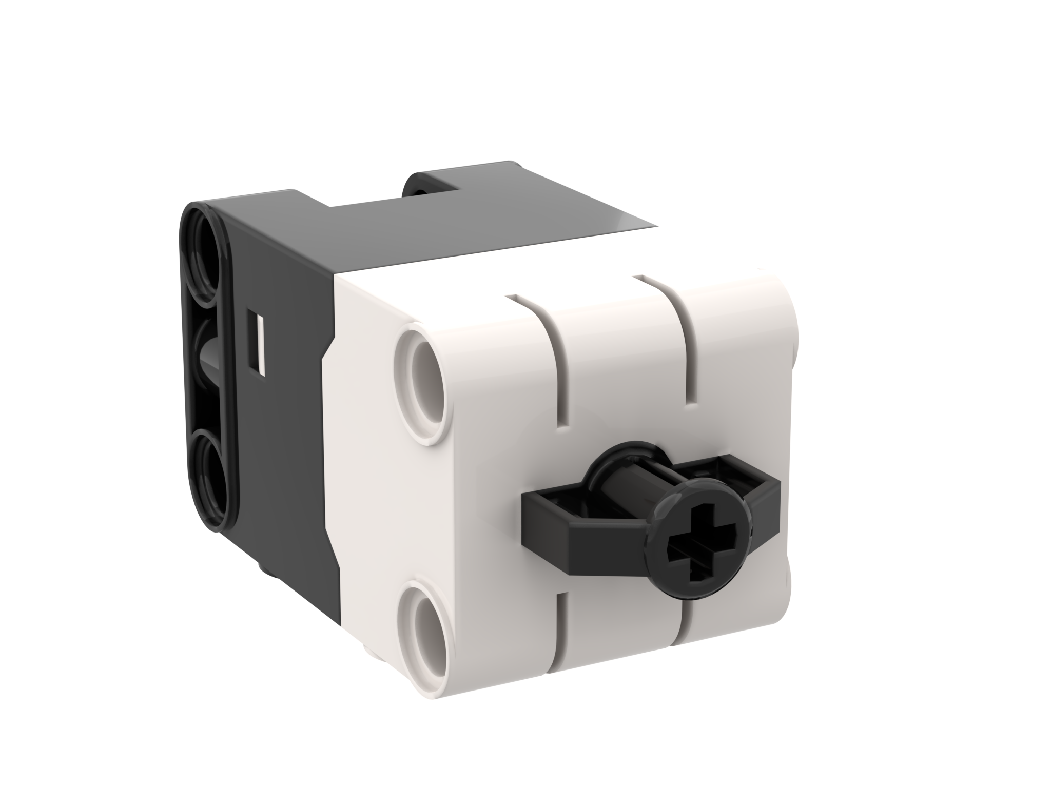
Lesson Objectives
Learn how to use the Force Sensor
Learn how to use the Wait Functions
Note: Force Sensor does not come with Robot Inventor. However, the python environment for Robot Inventor does support the sensor.

Slide 3
What is a force sensor?
The Force Sensor does two main types of sensing:
Touch sensing
Force sensing
You can measure the Force in percent or Newtons
The following methods are available
.is_pressed()
.get_force_newton()
.get_force_percentage()
.wait_until_pressed()
.wait_until_released()

Slide 4
How do you program with a force Sensor
Just like with motors, the force sensor must be initialized before use
force = ForceSensor('F')
There are two modes of the force sensor
The two modes are
Pressed – even a gentle tap is detected
Released – hold the sensor in and release it any amount
Name for the sensor
Port
Waiting until pressed/released:
force.wait_until_pressed()
force.wait_until_released()
or using while loops...
while (not force.is_pressed()): pass
while (force.is_pressed()): pass

Slide 5
Challenge 1: Move until Pressed
Program your robot to move straight until you press the sensor with your hand
You will use the wait_until_pressed() method for this challenge
force.wait_until_pressed()
Basic steps:
Set the movement motors for your robot (A and E for Droid Bot IV and ADB robot)
Set the stop action to brake
Set the % speed for your robot
Initialize the force sensor
Start moving straight
Use the wait_until_pressed() function to detect when the Force Sensor is pressed
Stop moving

Slide 6
Challenge 1: Solution
In previous lessons, you learnt how to configure your robot. The first 3 lines set the movement motors, the stop action, and the default speed. (See Configuring Your Robot Lesson)
motor_pair = MotorPair('A', 'E')
motor_pair.set_stop_action('brake’)
motor_pair.set_default_speed(30)
force = ForceSensor('F')
motor_pair.start()
force.wait_until_pressed()
motor_pair.stop()
Configure robot
Start moving
Wait until the Force Sensor is pressed
Stop moving

Slide 7
CREDITS
This lesson was created by Sanjay and Arvind Seshan for Prime Lessons
More lessons are available at www.primelessons.org
This work is licensed under a Creative Commons Attribution-NonCommercial-ShareAlike 4.0 International License.

