Slide 1
Turning With the Gyro
By Sanjay and Arvind Seshan

Slide 2
Lesson Objectives
Learn how to turn using the built-in gyro sensor
Learn how to use the wait_until() function with sensors
Note: Although images in this lessons may show a SPIKE Prime, the code blocks are the same for Robot Inventor

Slide 3
methods YOU NEED in this lesson
Motion Sensor methods – Used to read and reset the values of the gyro sensor
hub.motion_sensor.get_yaw_angle()
hub.motion_sensor.reset_yaw_angle()
Operator Functions – Tests a relation between two values and outputs a Boolean (true/false) result
greater_than_or_equal_to(a, b)

Slide 4
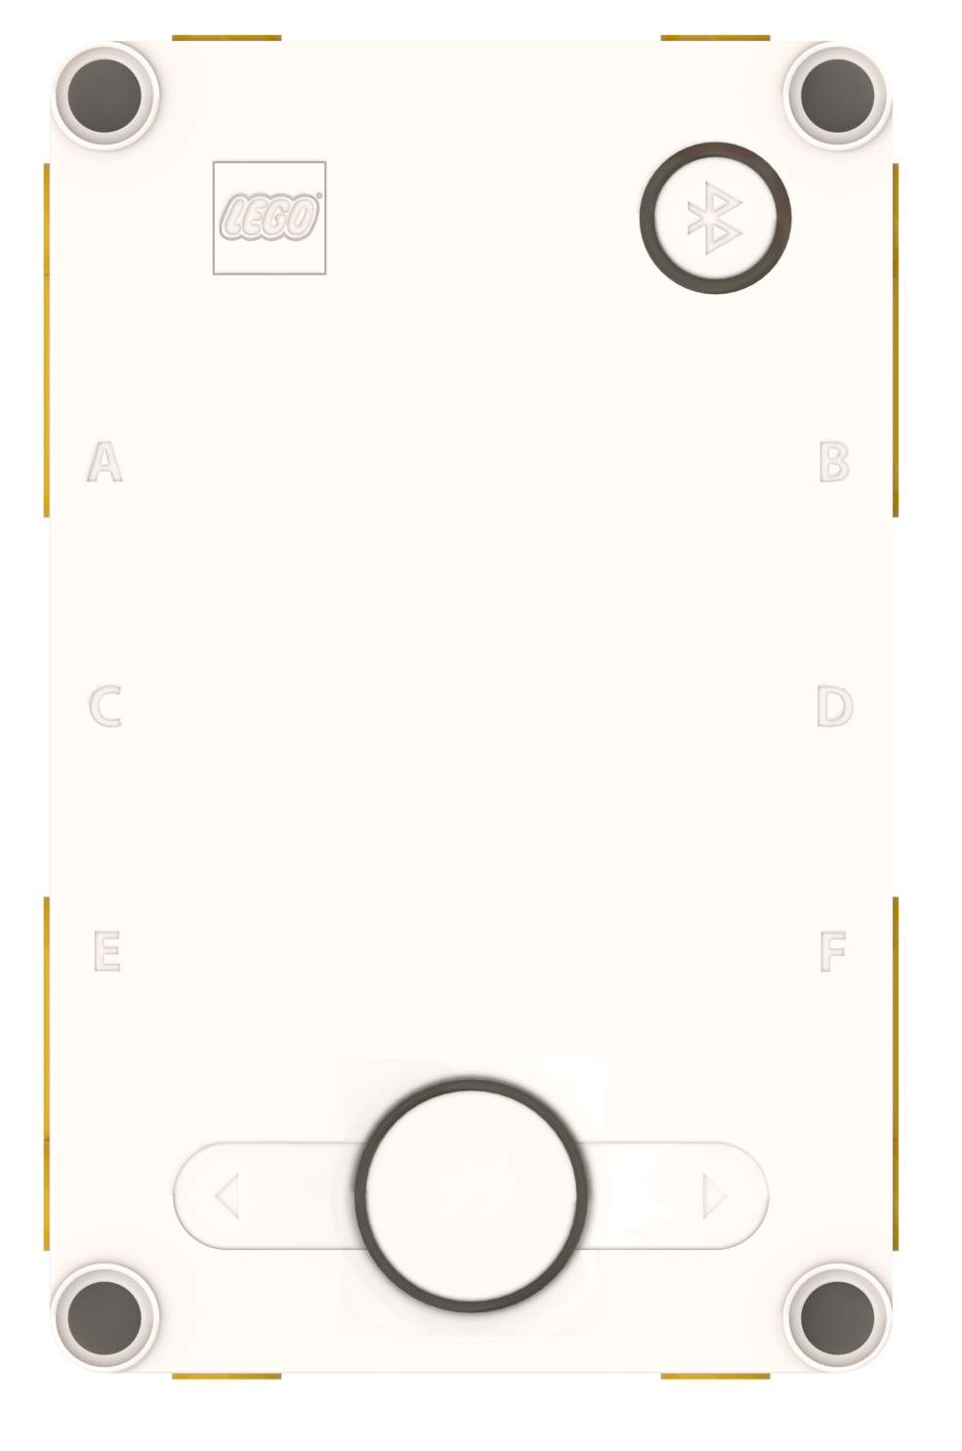
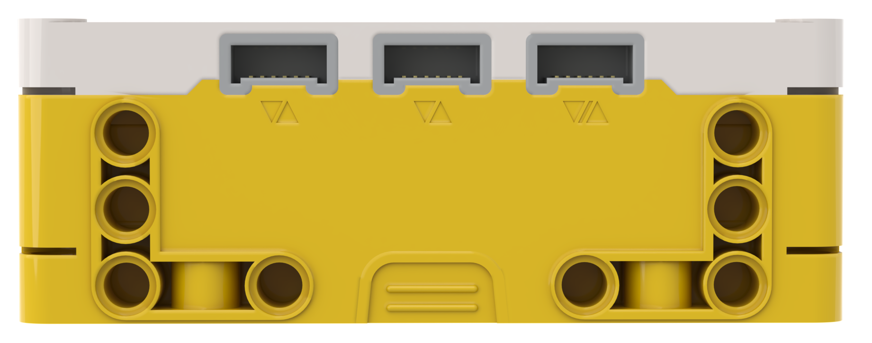
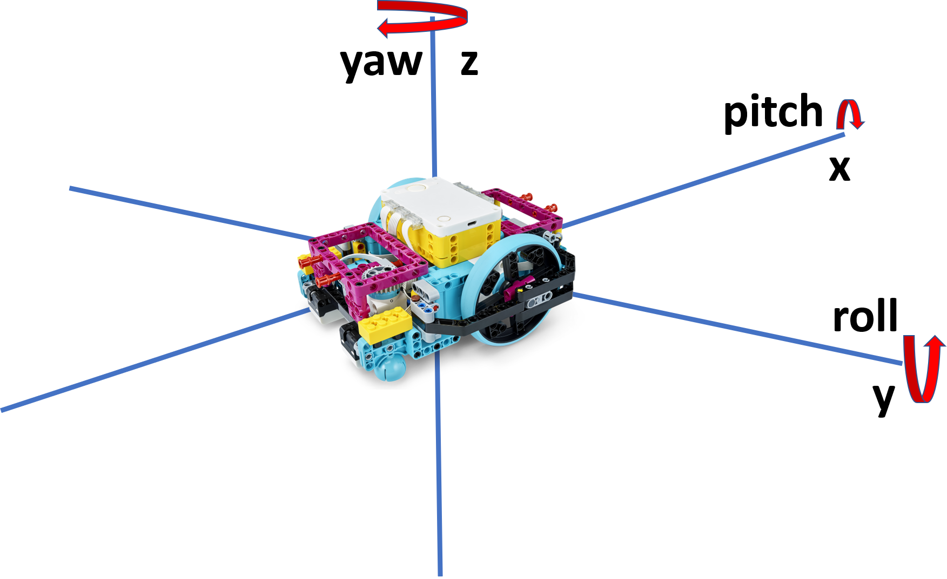
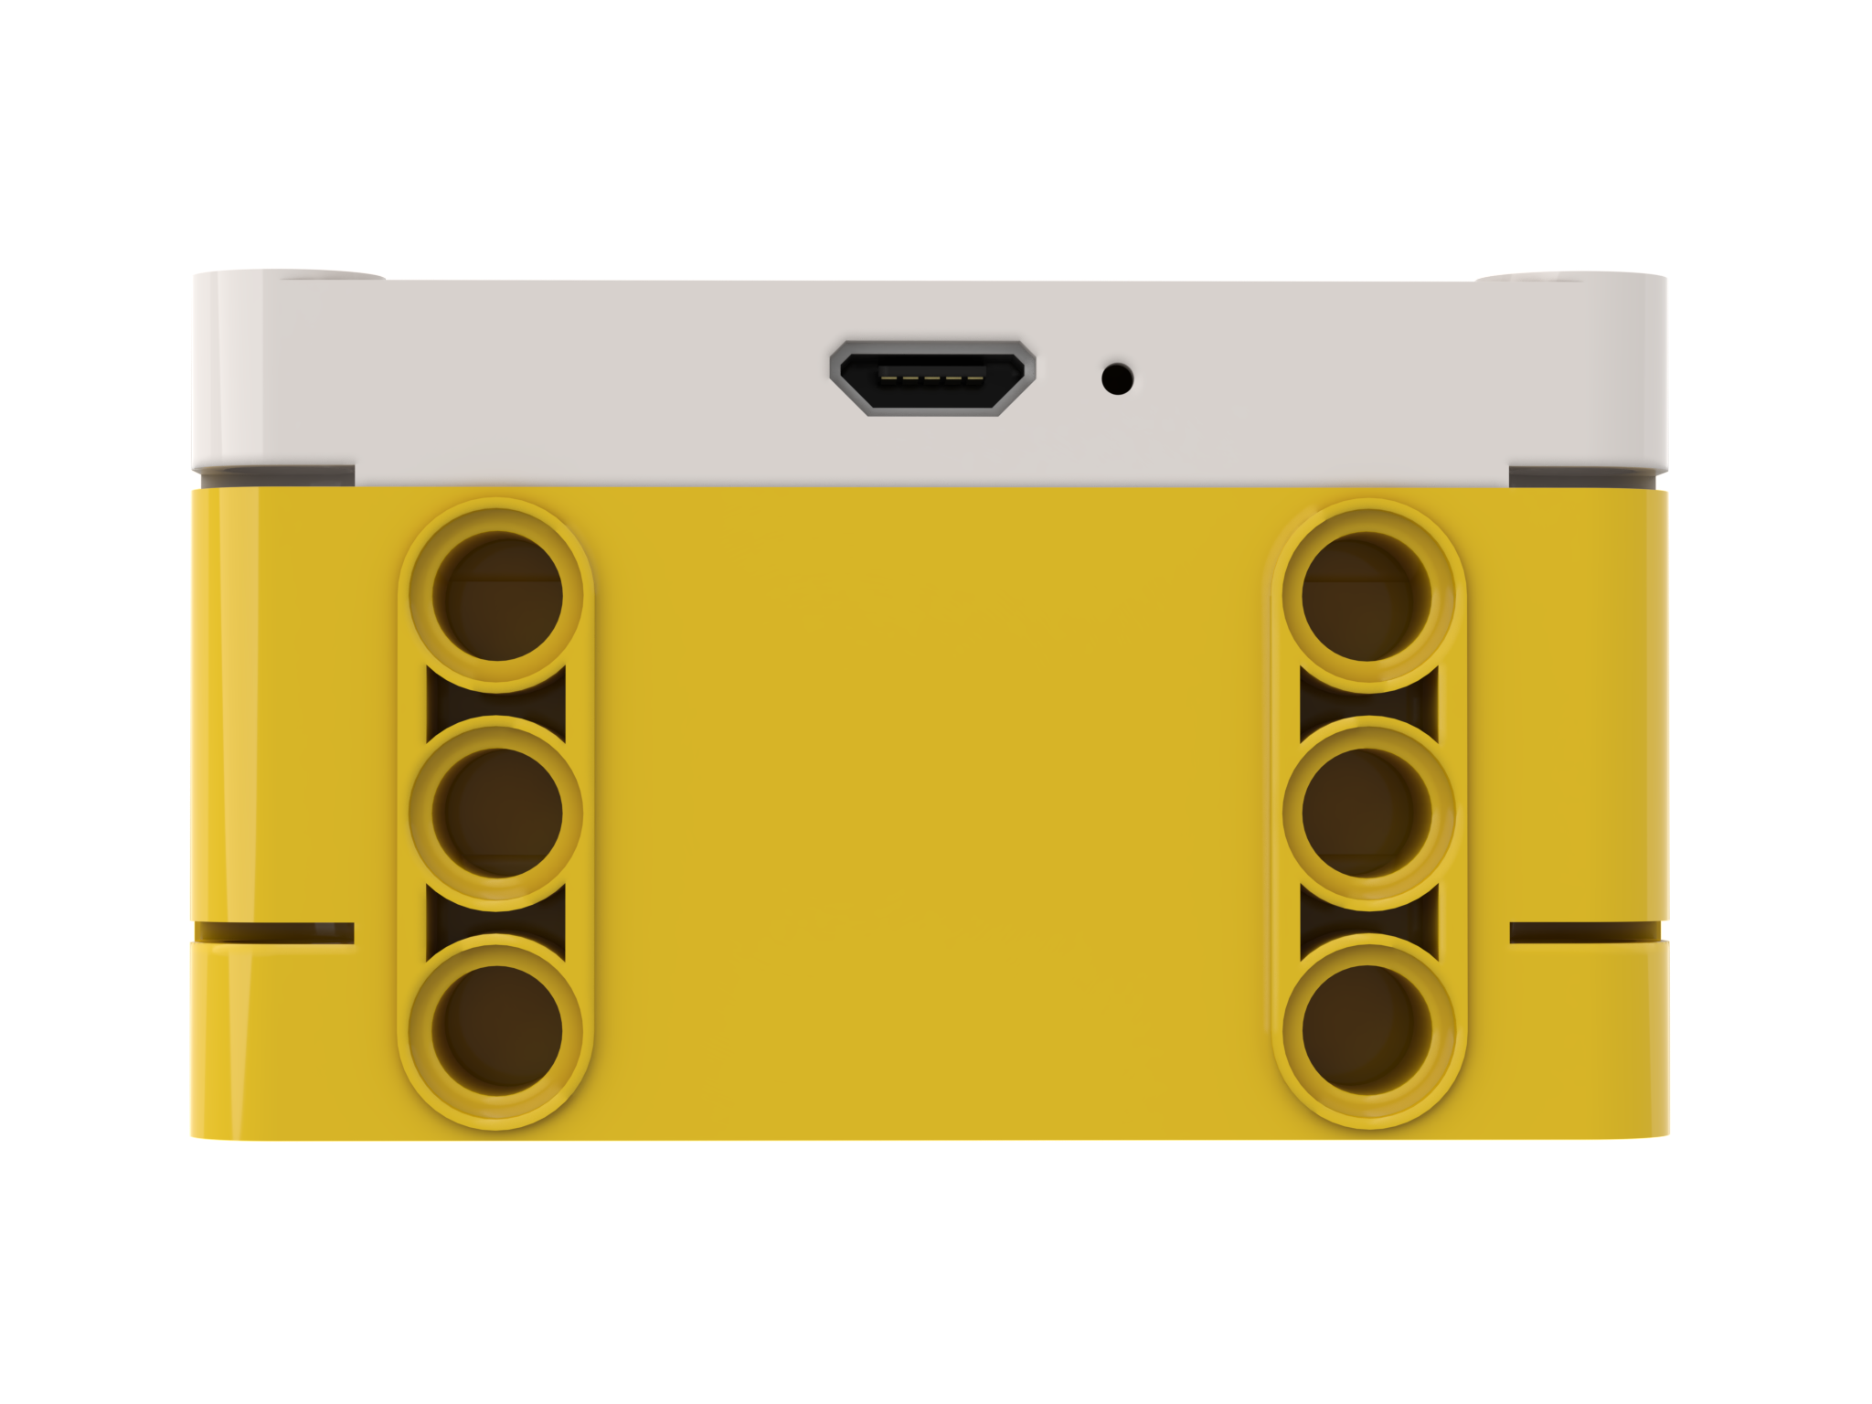
Robot Orientation: YAW, PITCH and ROLL
Yaw is turning the Hub to right or left
Pitch is turning the Hub up and down
Just like x, y and z coordinates are used to describe a robot’s position,
yaw, pitch and roll are terms used to describe a robot’s orientation.
Yaw is rotation around the z-axis. Pitch is rotation around y-axis.
Roll is rotation around the x-axis.
The built-in Gyro Sensor can measure the robot’s orientation
Roll is turning the Hub to side-to-side

Slide 5
Using the gyro sensor to turn
The gyro sensor can be programmed to measure the hub’s yaw, pitch and roll
These values can be used to sense if the robot has turned around x, y, or z axes
In this lesson, we will focus on yaw which can be used to determine if a robot has turned left or right
For pitch and roll, the robot uses gravity to determine what is a zero reading. Flat on the ground is 0 pitch and 0 roll.
For yaw, the robot doesn’t have a compass to tell it what is north or south. Therefore, you need to tell the robot what it should consider zero. This is done with the reset_yaw_angle() method.
Note that clockwise is positive in yaw measurement
hub.motion_sensor.get_yaw_angle()
hub.motion_sensor.reset_yaw_angle()

Slide 6
Waiting for the gyro to reach an angle
There are two options to measure if the robot has reached the desired angle
Option I: LEGO-specific API
Use the operator functions. Then, use the Wait Functions – Makes the program pause execution for some time.
from spike.operator import greater_than_or_equal_to, equal_to, [etc.]
from spike.control import wait_until
wait_until(get_value_function, operator_function=<function equal_to>, target_value=True)
This option is easier to use
Option II: General Python API
Use while loops
start moving....
while (hub.motion_sensor.get_yaw_angle() < ANGLE):
<code>
stop moving....
Easier for running code while waiting. You could also use a user defined operator_function in wait_until() – but a while loop makes the code clearer.
If you do not want to run code, you can place pass in place of <code> to skip the iteration of the loop

Slide 7
There are two types of turns you can do
180 Degree Pivot Turn
Notice where the robot ends in both pictures after a 180 degree turn.
In the Spin Turn, the robot moves a lot less and that makes Spin Turns are great for tight positions. Spin turns tend to be a bit faster but also a little less accurate.
So when you need to make turns, you should decide which turn is best for you!
A
End Position
Motor
A Moves
E
A
Start Position
E
180 Degree Spin Turn
Start Position
End Position
A
A
Motors
A and E Move
E
E

Slide 8
How to Make Pivot and Spin turns
Change % Speed values here
move_tank(1, unit='rotations', 0, 50)
Move Tank Values
Speed, 0 | 0, Speed | Speed, -Speed | -Speed, Speed
Pivot Turn Right | Pivot Turn Left | Spin Turn Right | Spin Turn Left
A
A
A
A
E
E
E
E

Slide 9
Challenge I
Write a program that turns 90 degrees to the right using a pivot turn
Basic Steps:
Import operator function
Configure Robot Movement
Make your robot start slowly turning right by just turning on the left wheel motor
Use low speeds here to improve keep the turn accurate
reset the gyro sensor angle to 0
Wait until the gyro yaw angle has reached the degrees you want
wait_until(hub.motion_sensor.get_yaw_angle, greater_than_or_equal_to, 90)
Or
while (hub.motion_sensor.get_yaw_angle() < 90): pass
Stop moving
from spike.operator import greater_than_or_equal_to
motor_pair = MotorPair('A', 'E')
motor_pair.set_stop_action('brake')
motor_pair.start_tank(20, 0)
hub.motion_sensor.reset_yaw_angle()

Slide 10
Challenge 1 Solution
1
2
3
4
5
6
7
from spike.operator import greater_than_or_equal_to
motor_pair = MotorPair('A', 'E')
motor_pair.set_stop_action('brake')
motor_pair.start_tank(20, 0)
hub.motion_sensor.reset_yaw_angle()
wait_until(hub.motion_sensor.get_yaw_angle, greater_than_or_equal_to, 90)
motor_pair.stop()
Line 6 can be replaced with:
while (hub.motion_sensor.get_yaw_angle() < 90): pass

Slide 11
TURNING RIGHT Vs. TURNING LEFT
To change the direction of the turn, you have to:
Change which wheel should turn (or the direction of the power)
The final angle should be -90 degrees instead of 90 degrees
The wait until gyro angle comparison must change also
wait_until function: The comparison should be “less_than_or_equal_to” instead of “greater_than_or_equal_to” since the angle is decreasing instead of increasing
while loops: The comparison should be while (...angle() < 90): pass when the angle is increasing (right turn generally) and while (...angle() > -90): pass when the angle is decreasing (left turn generally)
Right Turn
motor_pair.start_tank(20, 0)
hub.motion_sensor.reset_yaw_angle()
wait_until(hub.motion_sensor.get_yaw_angle, greater_than_or_equal_to, 90)
motor_pair.stop()
Left Turn
motor_pair.start_tank(0, 20)
hub.motion_sensor.reset_yaw_angle()
wait_until(hub.motion_sensor.get_yaw_angle, less_than_or_equal_to, -90)
motor_pair.stop()

Slide 12
TURNING CHALLENGES
Challenge 1
Your robot is a baseball player who has to run to all the bases and go back to home plate.
Can you program your robot to move forward and then turn left?
Use a square box or tape
Challenge 2
Your robot baseball player must run to second base, turn around and come back to first.
Go straight. Turn 180 degrees and return to the same spot.
Second Base
A
A
Start and End position
First Base
E
E

Slide 13
CHALLENGE SOLUTIONS
Challenge 1
You probably used a combination of the move() method to go straight and do pivot turns to go around the box.
Challenge 2
You probably used a spin turn because it is better for tighter turns and gets you closer to the starting point!

Slide 14
CREDITS
This lesson was created by Sanjay and Arvind Seshan for Prime Lessons
More lessons are available at www.primelessons.org
This work is licensed under a Creative Commons Attribution-NonCommercial-ShareAlike 4.0 International License.

