Slide 1
Introduction to HUB & software (PYTHON)
By Sanjay and Arvind Seshan

Slide 2
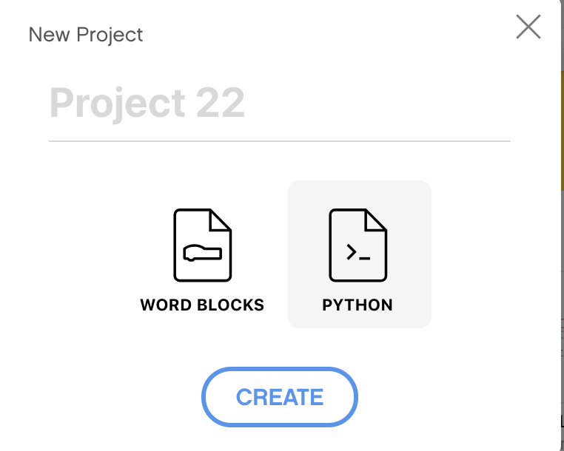
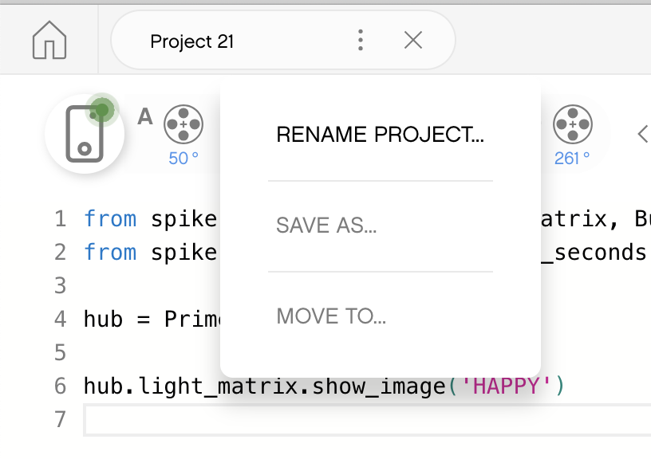
CREATING A PYTHON PROJECT
Select Python from the pop-up
Click on the three dots to change the file name

Slide 3
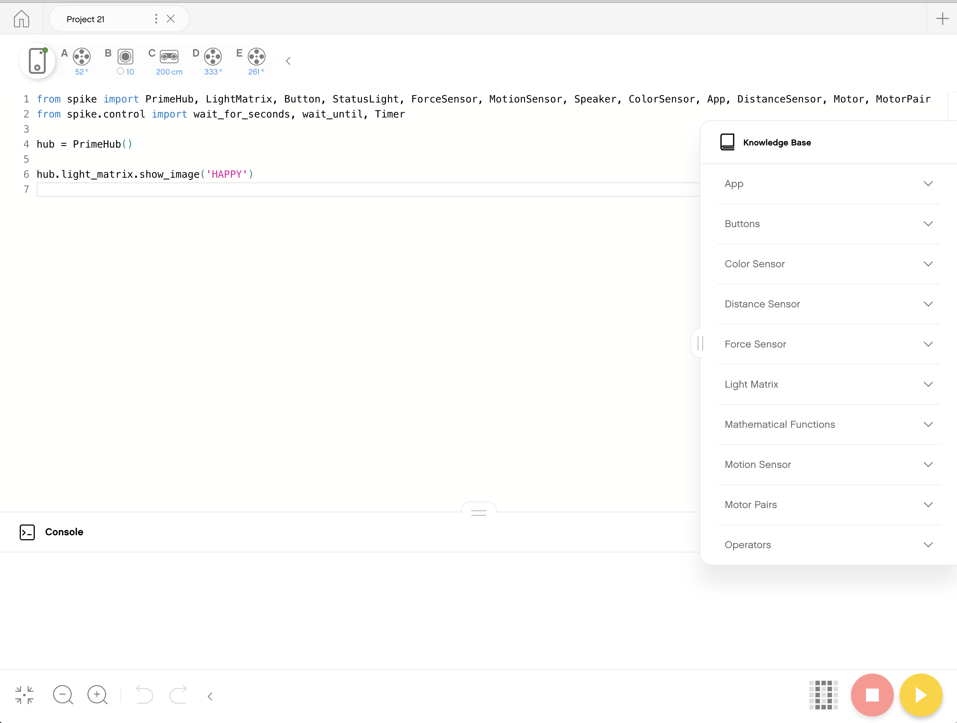
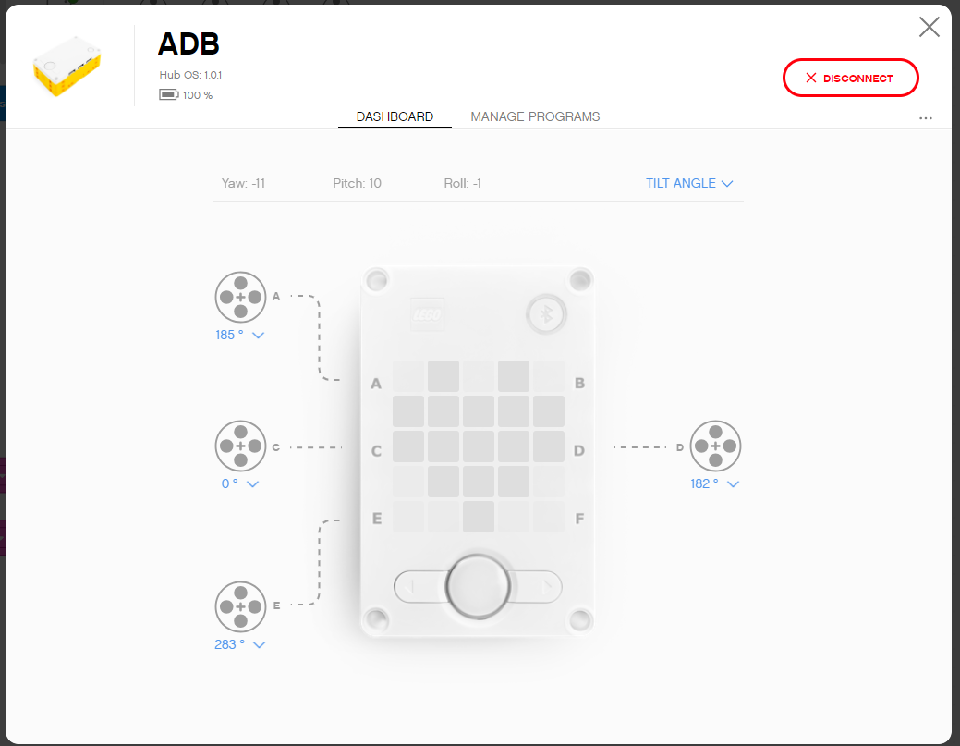
Programming Canvas
Knowledge Base: MicroPython Tips
Programming Canvas: The main programming canvas is where you will create each program (called ‘Project’)
The Connect Icon lets you access the Hub Dashboard
Stop/Play Icon lets you pick which slot to download the code to and run your code
Console: Anything you print as well as errors will show up here
Hub Dashboard
Programming Canvas
Console
Knowledge Base
Stop and Play

Slide 4

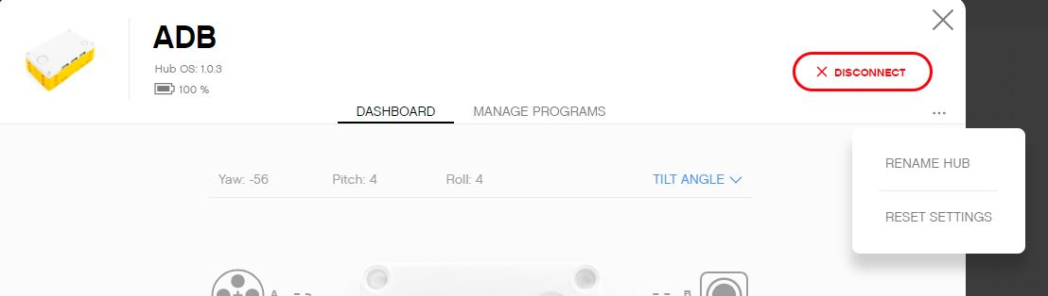
HUB DASHBOARD
You must connect your Hub to access this section
This section is very useful for:
Checking battery level
Hub OS version
Gyro Sensor Values
See which motors and sensors are connected
Get real time values from the motors and sensors
You can also rename your Hub in this panel by clicking on the three dots (…)
The Manage Programs has a list of all programs on the Hub (maximum of 20). Use this section to change the order of the programs.

Slide 5
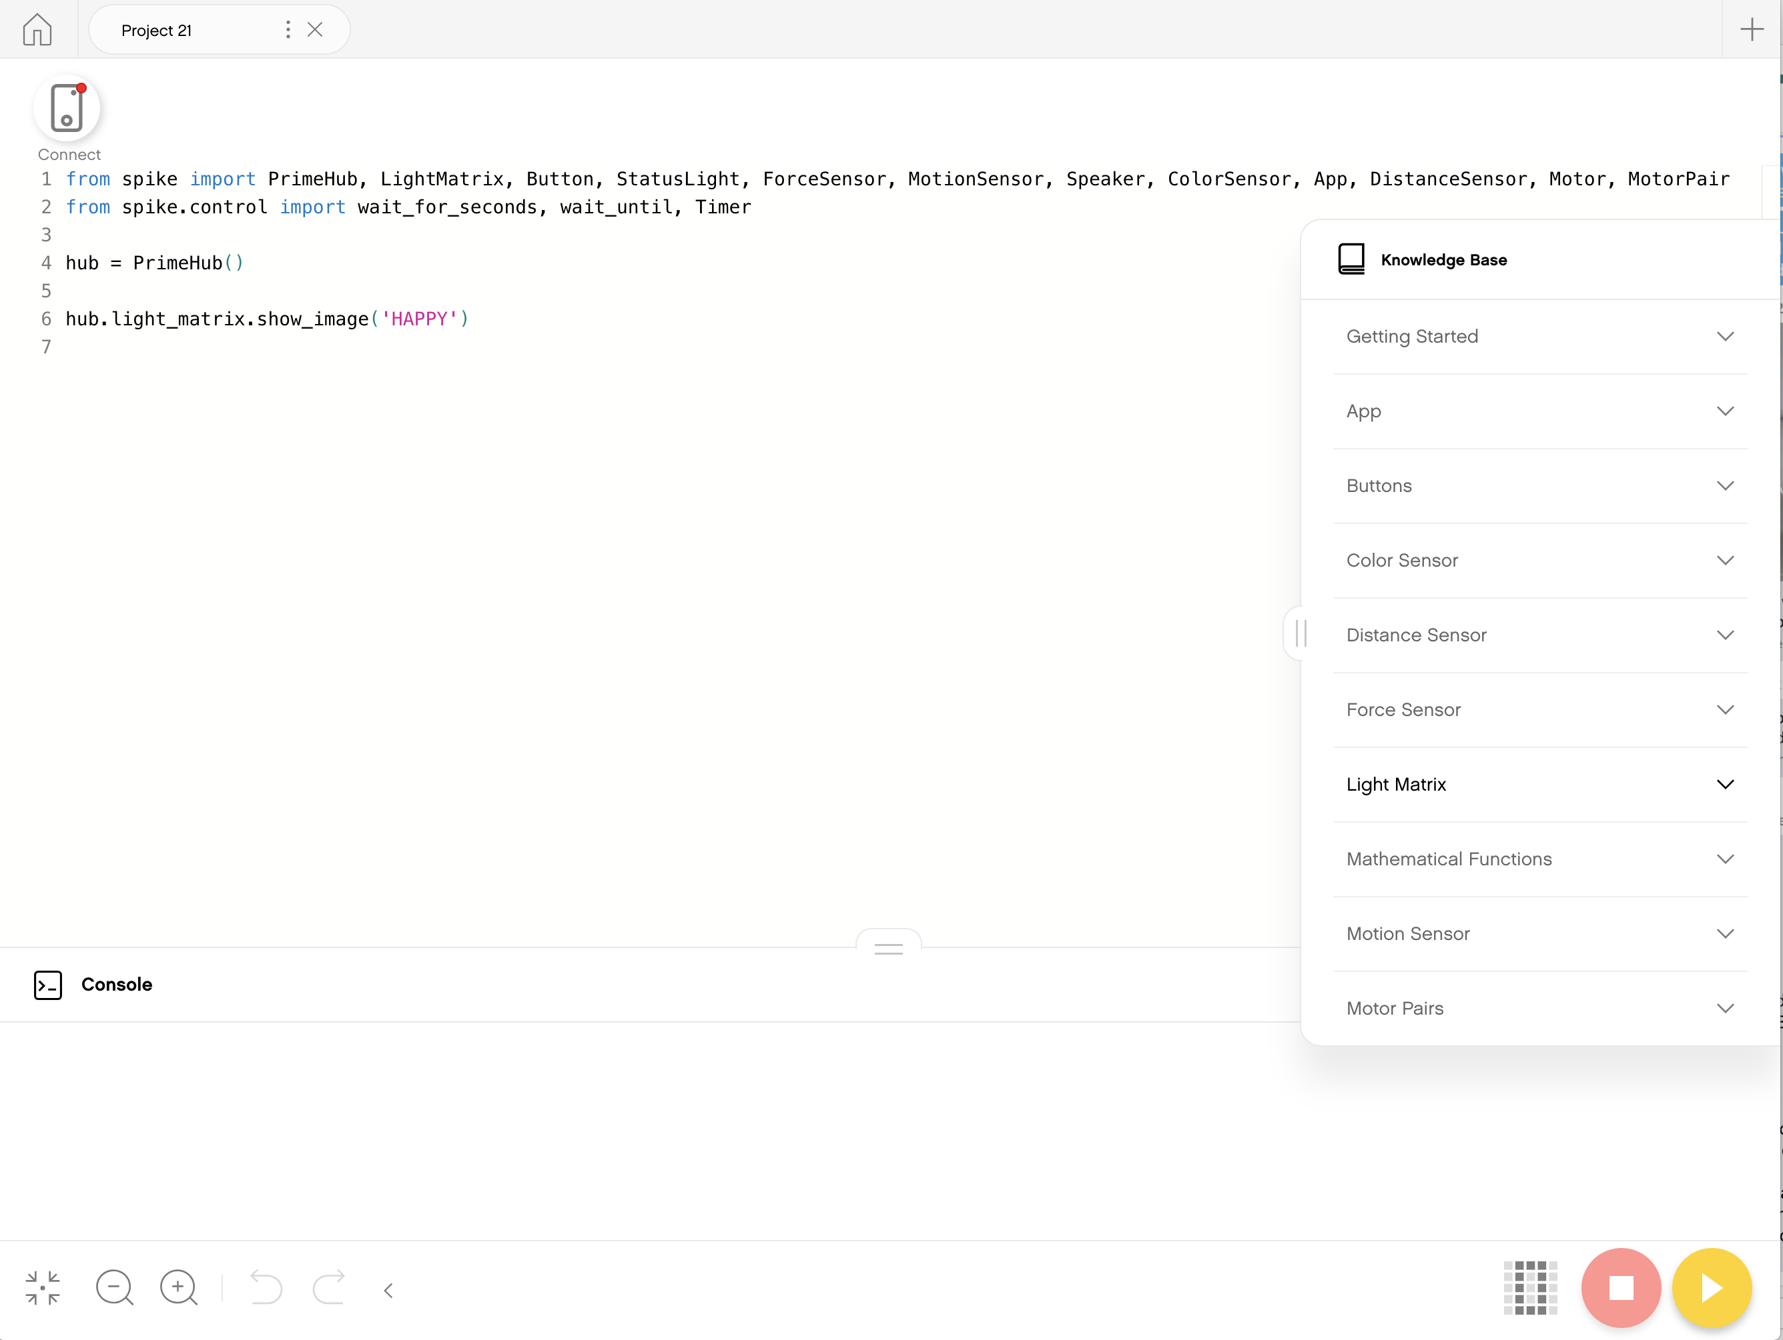
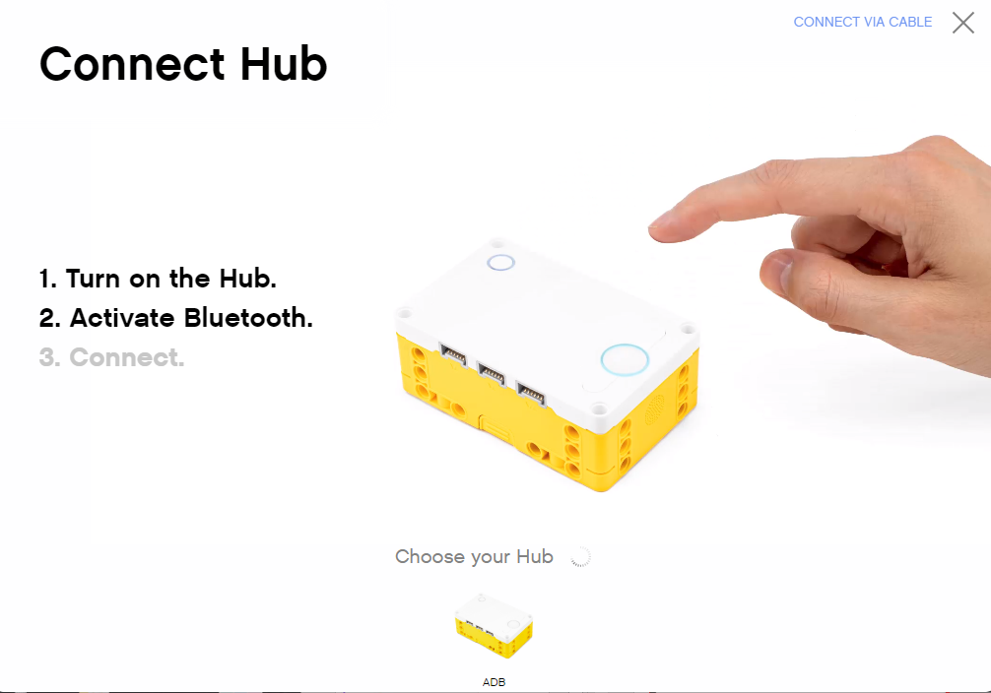
Connecting to brick
The software will auto-connect to the brick if you are using USB
To connect over Bluetooth, click the connect icon in the software.
Enable Bluetooth by pressing the Bluetooth button on the brick.
Your brick will show up in the list at the bottom. Click connect on your hub

Slide 6
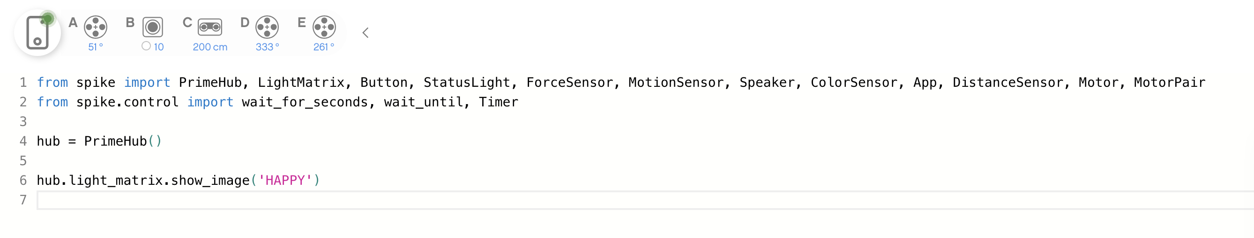
DEFAULT PYTHON CODE
All Python programs will begin with the following code by default
Generally, keep lines 1-4 in all programs
The imports will allow you to use the sensors/motors/etc. in your programs

Slide 7
CREDITS
This lesson was created by Sanjay and Arvind Seshan for Prime Lessons
More lessons are available at www.primelessons.org
This work is licensed under a Creative Commons Attribution-NonCommercial-ShareAlike 4.0 International License.

