Slide 1
Moving straight
By Sanjay and Arvind Seshan

Slide 2
Lesson Objectives
Learn how to make your robot go forward and backwards
Learn how to use the Motor Pair Move methods
Note: Although images in this lessons may show a SPIKE Prime, the code is the same for Robot Inventor

Slide 3
Creating a motor pair object
Basic movement is done using a MotorPair object
See Configuring Robot Movement lesson for details on creating this object
The following slides will cover the different methods of this object that are used for movement
E.g., motor_pair.move(5, unit='cm', speed='100')
Do not initialize more than one motor pair with the same ports → this is redundant, will only waste memory and may cause undesired conflicts

Slide 4
Motor pair methods
get_default_speed()
move(amount, unit='cm', steering=0, speed=None)
move_tank(amount, unit='cm', left_speed=None, right_speed=None)
set_default_speed(speed)
set_motor_rotation(amount, unit='cm')
set_stop_action(action)
Action is 'brake','hold’, or 'coast'
start(steering=0, speed=None)
start_at_power(power, steering=0)
start_tank(left_speed, right_speed)
start_tank_at_power(left_power, right_power)
stop()
We will be covering the yellow methods in this lesson

Slide 5
Motor_pair.Move()
Direction and quantity to steer the robot
Distance/
Duration
Unit of amount
Motor speed
.move(amount, unit='cm', steering=0, speed=None)
'in'
'rotations'
'degrees' 'seconds'
-100 to 100
-100 to 100
Set in Configuration
To use this method, you will set the speed, stop mode, motor ports, wheel size (see Configuring Robot Movement Lesson)
unit='cm', steering=0, and speed=None, are the default values if nothing is set. When speed=None, the speed value used is the default speed set by set_default_speed(). Positive steering values turn the robot right, negative turn left. Larger values turn more sharply.

Slide 6
Motor_pair.Move_tank()
Distance/
Duration
Unit of amount
Left motor speed
Right motor speed
.move_tank(amount, unit='cm', left_speed=None, right_speed=None)
'in'
rotations'
'degrees' 'seconds'
-100 to 100
-100 to 100
Set in Configuration
To use this method you will set the speed, stop mode, motor ports, wheel size (see Configuring Robot Movement Lesson)
unit='cm', left_speed=None, and right_speed=None, are the default values if nothing is set. When left_speed=None and/or right_speed=None, the speed value used is the default speed set by set_default_speed().

Slide 7
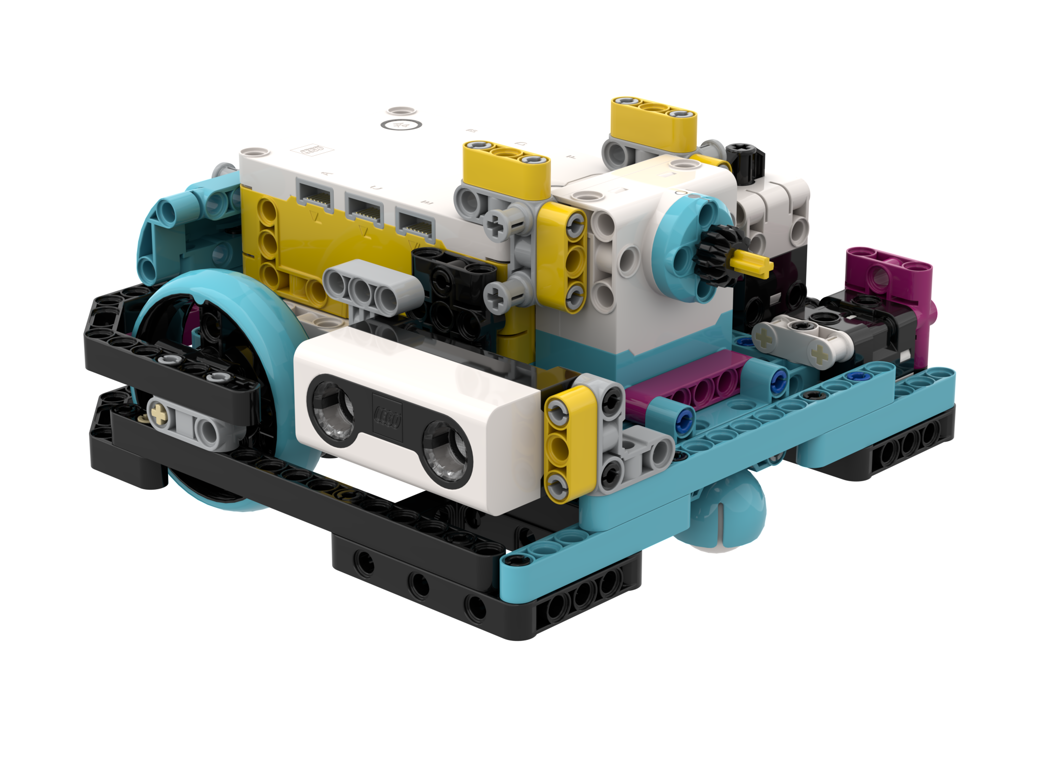
NEGATIVE Values
You can enter negative values for power or distance
This will make the robot move backwards
If you negate two values (e.g., speed and distance negative), the robot will move forward.
Negative Power = Backwards
Negative Power = Backwards
A
Positive Power = Forward
E
Positive Power = Forward

Slide 8
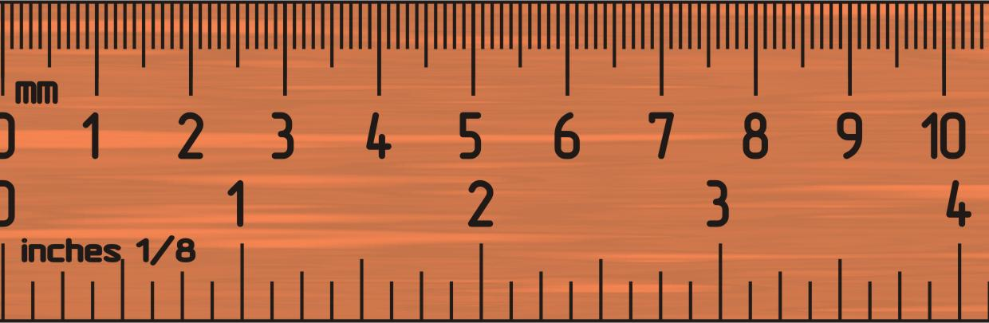
Challenge 1: Move 10 CM
Move the robot 10 centimeters forward
Basic steps:
Configure your robot
Use a MotorPairs method (move() or move_tank()) to move forward for 10cm

Slide 9
Challenge 1 Solution
Configure your robot
If you are using the smaller SPIKE Prime wheels on Droid Bot IV, set the one rotation to 17.5cm (in the code shown)
If you are using the larger SPIKE Prime wheels on ADB, remember to set one rotation to 27.6cm
Move forward for 10 cm. The same cm mode is available in the move_tank() method as well.
motor_pair = MotorPair('A', 'E')
motor_pair.set_stop_action('brake')
motor_pair.set_motor_rotation(17.5, 'cm')
motor_pair.set_default_speed(50)
motor_pair.move(10, 'cm')

Slide 10
Challenge II: Move Forward and Back
Move your robot forward from the start line to the finish line (1) and back to the start (2)
Basic steps:
Configure your robot
Use a MotorPair method and move forward for the desired amount (40cm)
Use the same MotorPair method to move backwards (40cm)
FINISH
1
40CM
2
START

Slide 11
Challenge II solution
Configure your robot
If you are using the smaller SPIKE Prime wheels on Droid Bot IV, set the one rotation to 17.5cm (in the code shown)
If you are using the larger SPIKE Prime wheels on ADB, you will set one rotation to 27.6cm
Robot moves forward 40cm and backwards 40cm by setting the distance to -40.
motor_pair = MotorPair('A', 'E')
motor_pair.set_stop_action('brake')
motor_pair.set_motor_rotation(17.5, 'cm')
motor_pair.set_default_speed(50)
motor_pair.move(40, 'cm')
motor_pair.move(-40, 'cm')

Slide 12
Start Moving and Stop Moving Methods
There are 5 more move methods
The start method will turn on your drive motors at the given speed (and steering if given).
These methods have no duration/distance. After turning the motor on, the program instantly moves to the next line
The motor will continue running until stopped or controlled by another method
stop() method will halt your drive motors no matter what action they are running.
There are also methods that allow you to control motor power instead of speed.
start(steering=0, speed=None)
stop()
start_tank(left_speed, right_speed)
start_at_power(power, steering=0)
start_tank_at_power(left_power, right_power)

Slide 13
Analysis: Motor_Pair.start_tank()
Turns on motors at given powers (for left and right motor)
Power can be anywhere between -100% to 100%
This method is called “asynchronous”, meaning that it schedules the motor to run in the background
.start_tank(left_speed, right_speed)
Motors will move until stopped by the .stop() method
Note: you can use the .set_stop_action(action) method to set how the motors will stop
The action can be 'brake','hold', or 'coast'

Slide 14
Wait/sleep
Since Start and Stop Moving methods execute asynchronously, they need to be used with other code to be made useful. One common way they are used is with Wait Functions. Wait Functions hold up the program execution until some event occurs. The lessons on sensors cover Wait Functions in more detail.
There are two ways to wait for a duration:
Option 1 (Recommended): Use the standard Python API. Place import time at the beginning of your program once. Use time.sleep(seconds) to wait for a specified duration
Option II: Use the LEGO API: Place wait_for_seconds(seconds) anywhere in your program to wait for a specified duration

Slide 15
Challenge iii
Use Start Moving, Stop Moving, and Wait to make the robot move forward for 3 seconds
Some hints:
Start the robot moving at 50, 50 speed
After turning on the motors, make the program wait 3 seconds using the time.sleep() function.
Use the stop() method makes the robot stop

Slide 16
Challenge III: moving For 3 Seconds
Can you Move 3 Seconds using just the Start Moving and Wait blocks?
Start the robot moving at 50, 50 speed
After turning on the motors, the program begins running the time.sleep() function. This takes 3 seconds to run.
The stop() method makes the robot stop
Import time
motor_pair = MotorPair('A', 'E')
motor_pair.set_stop_action('brake')
motor_pair.start_tank(50, 50)
time.sleep(3)
motor_pair.stop()

Slide 17
CREDITS
This lesson was created by Arvind and Sanjay Seshan for Prime Lessons
More lessons are available at www.primelessons.org
This work is licensed under a Creative Commons Attribution-NonCommercial-ShareAlike 4.0 International License.

