Slide 1
More accurate Turns
BY SANJAY AND ARVIND SESHAN

Slide 2
Lesson Objectives
Learn how to improve the accuracy of turns
Learn alternative ways to do pivot and spin turns
Note: Although images in this lessons may show a SPIKE Prime, the code blocks are the same for Robot Inventor

Slide 3
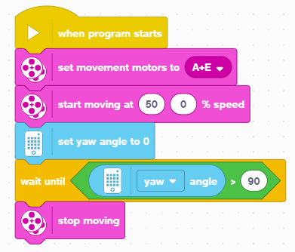
How Accurate Is Your pivot Turn?
Run this code and use the Dashboard to see if turning 90 degrees actually turns 90 degrees.
Note that we have set the motor speed to 50 instead of 20 in the previous lesson.
For ADB at 50% Speed, this code turns the robot 102 degrees, For Droidbot IV, it turns 98 degrees
This is for two reasons
It takes a short time to read the gyro. In this time, the robot has moved. This delay on the SPIKE Prime is relatively small but will produce a few degrees of error.
It takes some time to stop the robot since it has momentum. This produces several degrees of additional error.

Slide 4
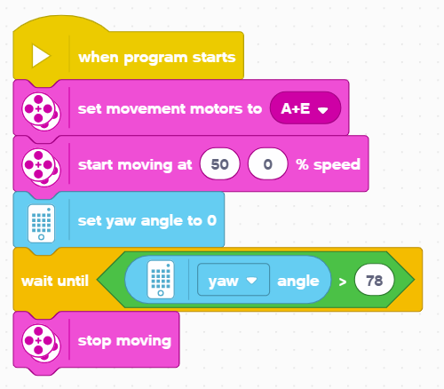
Improving pivot Turn Accuracy
As we mentioned on the previous slide, using ADB at 50% Speed, the robot 102 degrees instead of 90 degrees. For Droidbot IV, it turns 98 degrees
How do we solve this problem?
One solution is to ask it to turn 12 degrees less for ADB or 8 degrees less for Droid Bot IV.
The amount to reduce your turn will depend on the speed of your turn and your robot’s physical design. You will need to try some values to get this right.
The code on the right performs a 90 degree turn using ADB using this method.

Slide 5

Another solution for pivot turns
Another way to turn is to use movement blocks with duration
One advantage of these movement blocks is that they decelerate at the end of a move to improve accuracy
How much do the wheels turn for the above block?
The distance specified is the average distance traveled by the two wheels
At the end of any tank move, the sum of the distance traveled by both wheels will be twice the entered duration.
Answer: The left wheel will turn 360 degrees and the right wheel will turn 0 degrees
Note that the above move will cause a Droidbot IV to turn the “robot” 90 degrees to the right
A
E

Slide 6
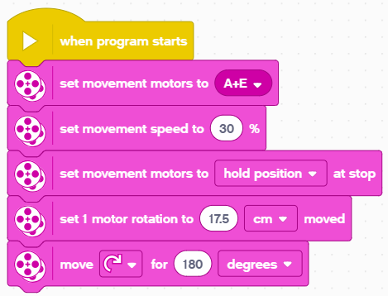
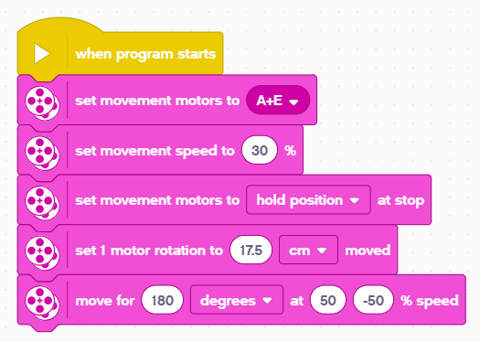
WHAT ABOUT SPIN TURNS
Below are two ways to make a spin turn using two different movement blocks
In this example, on Droid Bot IV, each wheel on the robot will travel 180 degrees – but in opposite directions
As a result, robot will turn 90 degrees to the right
We recommend using the tank block since it supports pivot turns, spin turns and curved movement.
A
E

Slide 7
Challenge
Make a 90 degree right pivot turn using just movement blocks
You can use the Dashboard to determine how far to move for a given turn. Hold one wheel and rotate the other by hand until the robot reaches the target. Record the number of degrees of motor rotation – you will use this in your program.
For Droidbot IV, the left motor needs to rotate 360 degrees to perform and 90 degree right turn
Recall from the previous slide how to calculate each wheel’s rotation when using the Movement Block below
A
E

Slide 8
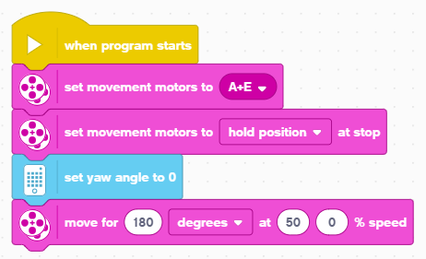
Challenge Solution
Start by configuring your motor ports
Use hold position to ensure that the robot stays where it finished its turn
Reset the yaw angle. This will let us see how far the robot turns on the Dashboard.
Move the robot using Tank Move. Note that this Tank Move has duration of 180 degrees. The right wheel does not move, the left wheel will spin 360 degrees. This is for Droid Bot IV.
After running this code, check your actual turn angle by using the Dashboard. It should be close to 90 degrees

Slide 9
CREDITS
This lesson was created by Sanjay Seshan and Arvind Seshan for SPIKE Prime Lessons
More lessons are available at www.primelessons.org
This work is licensed under a Creative Commons Attribution-NonCommercial-ShareAlike 4.0 International License.

