Slide 1
Moving straight
Arvind Seshan

Slide 2
Lesson Objectives
Learn how to make your robot go forward and backwards
Learn how to use the Move functions
Note: Although images in this lessons may show a SPIKE Prime, the code blocks are the same for Robot Inventor

Slide 3
Move()
Direction and quantity to steer the robot
Distance/
Duration
Unit of amount
Motor speed
move(amount, unit='cm', steering=0, speed=None)
'in'
'rotations'
'degrees' 'seconds'
-100 to 100
-100 to 100
Set in Configuration
To use this function you will set the speed, stop mode, motor ports, wheel size (see Configuring Robot Movement Lesson)
unit='cm', steering=0, and speed=None, are the default values if nothing is set. When speed=None, the speed value used is the default speed set by set_default_speed().

Slide 4
Move_tank()
Distance/
Duration
Unit of amount
Left motor speed
Right motor speed
move_tank(amount, unit='cm', left_speed=None, right_speed=None)
'in'
rotations'
'degrees' 'seconds'
-100 to 100
-100 to 100
Set in Configuration
To use this function you will set the speed, stop mode, motor ports, wheel size (see Configuring Robot Movement Lesson)
unit='cm', left_speed=None, and right_speed=None, are the default values if nothing is set. When left_speed=None and/or right_speed=None, the speed value used is the default speed set by set_default_speed().

Slide 5
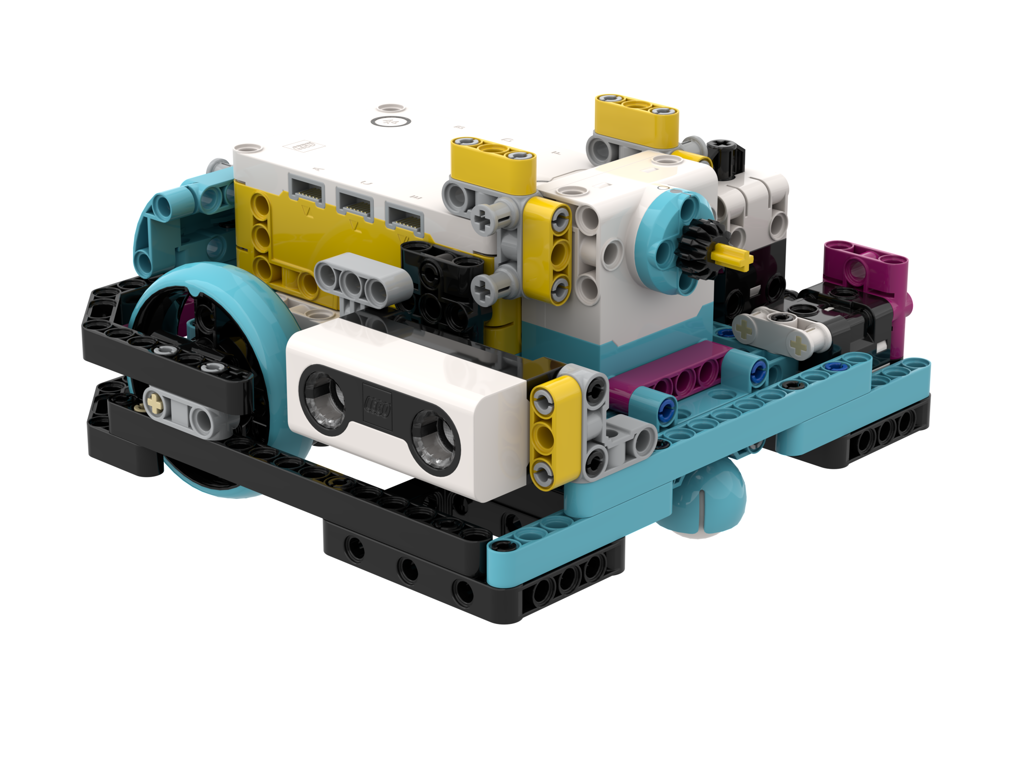
NEGATIVE Values
You can enter negative values for power or distance
This will make the robot move backwards
If you negate two values (e.g. speed and distance negative), the robot will move forward.
Negative Power = Backwards
Negative Power = Backwards
A
Positive Power = Forward
E
Positive Power = Forward

Slide 6
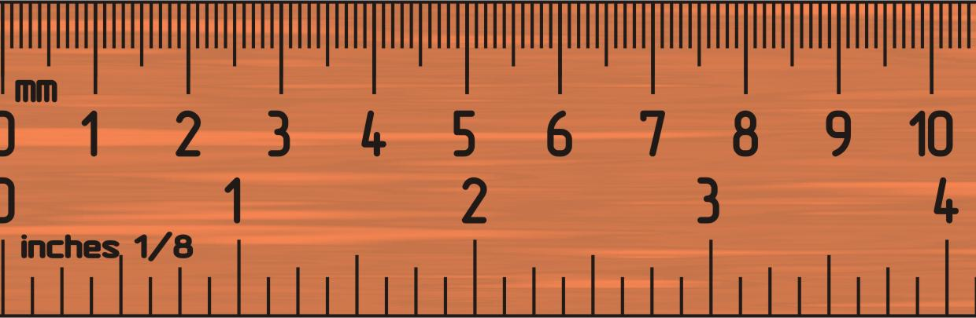
Challenge 1: Move 10 CM
Move the robot 10 centimeters forward
Basic steps:
Configure your robot
Use a MotorPairs function (move() or move_tank()) and move forward for 10cm

Slide 7
Challenge 1 Solution
Configure your robot
If you are using the smaller SPIKE Prime wheels on Droid Bot IV, set the one rotation to 17.5cm (in the code shown)
If you are using the larger SPIKE Prime wheels on ADB, remember to set one rotation to 27.6cm
Move forward for 10 cm. The same cm mode is available in the move_tank() function as well.
motor_pair = MotorPair('A', 'E')
motor_pair.set_stop_action('brake')
motor_pair.set_motor_rotation(17.5, 'cm')
motor_pair.set_default_speed(50)
motor_pair.move(15, 'cm')

Slide 8
Challenge II: Move Forward and Back
Move your robot forward from the start line to the finish line (1) and back to the start (2)
Basic steps:
Configure your robot
Use a MotorPair function and move forward for the desired amount (40cm)
Use the same MotorPair function to move backwards (40cm)
FINISH
1
40CM
2
START

Slide 9
Challenge II solution
Configure your robot
If you are using the smaller SPIKE Prime wheels on Droid Bot IV, set the one rotation to 17.5cm (in the code shown)
If you are using the larger SPIKE Prime wheels on ADB, you will set one rotation to 27.6cm
Robot moves forward 40cm and backwards 40cm by setting the distance to -40.
motor_pair = MotorPair('A', 'E')
motor_pair.set_stop_action('brake')
motor_pair.set_motor_rotation(17.5, 'cm')
motor_pair.set_default_speed(50)
motor_pair.move(40, 'cm')
motor_pair.move(-40, 'cm')

Slide 10
Start Moving and Stop Moving Functions
There are 5 more move functions
The start functions will turn on your drive motors at the given speed (and steering if given).
These functions have no duration/distance. After turning the motor on, the program instantly moves to the next line
The motor will continue running until stopped or controlled by another function
stop() will halt your drive motors no matter what action they are running.
There are also functions that allow you to control motor power instead of speed.
start(steering=0, speed=None)
stop()
start_tank(left_speed, right_speed)
start_at_power(power, steering=0)
start_tank_at_power(left_power, right_power)

Slide 11
Wait Functions and Challenge iii
Since Start and Stop Moving functions execute instantly, they need to be used with other functions to be made useful. One common way they are used is with Wait Functions. Wait Functions hold up the program execution until some event occurs. The lessons on sensors cover Wait Functions in more detail.
For now, we will use wait_for_seconds()
This functions takes the entered number of seconds to run
wait_for_seconds(seconds)
Challenge III:
Use Start Moving, Stop Moving and Wait Functions to make the robot move forward for 3 seconds

Slide 12
Challenge III: moving For 3 Seconds
Can you Move 3 Seconds using just the Start Moving and Wait blocks?
The start() function starts the robot moving
After turning on the motors, the program begins running the wait_for_seconds() functions. This takes 3 seconds to run.
The stop() function makes the robot stop
motor_pair = MotorPair('A', 'E')
motor_pair.set_stop_action('brake’)
motor_pair.start()
wait_for_seconds(3)
motor_pair.stop()

Slide 13
CREDITS
This lesson was created by Arvind Seshan for SPIKE Prime Lessons
More lessons are available at www.primelessons.org
This work is licensed under a Creative Commons Attribution-NonCommercial-ShareAlike 4.0 International License.

