Slide 1
pseudocode
BY SANJAY AND ARVIND SESHAN

Slide 2
Lesson Objectives
Learn what pseudocode means
Learn why you use pseudocode
Learn to write pseudocode for a common task
Learn how to plan programs for FIRST Lego League

Slide 3
What is pseudocode?
Robots follow directions that people give them. They need detailed, step-by-step instructions to complete a task.
It is a set of detailed notes that the programmer can use to write the code when they are ready.
It is not written in any particular programming language. Pseudocode can be in part English and part code.
Pseudocode allows the programmer to communicate his/her plan with others
Pseudocode is detailed enough to create the actual code

Slide 4
Why is pseudocode important?
A great way to learn the importance of good pseudocode is to try writing instructions for something simple:
How to make a sandwich, how to decorate a cake, how to plant a seed, etc.
Students should write the instructions and then the teacher should follow them.
Then compare the results.
Some examples of student responses for how to make a peanut butter and jelly sandwich:
Student 1 wrote: “Put the peanut butter on the bread”. So the teacher placed the entire jar on the slices of bread.
Student 2 wrote: “Take bread and spread the peanut butter on it”. So the teacher spread peanut butter on the entire loaf.
Student 3 wrote: “Take 2 slices of bread and spread peanut butter and jelly on them”. So the teacher spread peanut butter and jelly on both sides of both slices.
Communicating instructions well is important. The more detailed and exact your instructions are, the better the results will be

Slide 5
How do you write pseudocode for a robot?
Write down the goal of the program? What does the robot have to do?
Think about how the robot will achieve this goal. What are the specific steps?
Write down each step the robot will take. Start at Step 1 and continue.
Make sure you write down if the robot has to repeat a task.
Does the robot keep doing the task forever or does it end?
A fun game to try….Human Robot
How good are you at giving a robot instructions?
Pick one student on your team or in your class to be the robot.
Have the student navigate move across a busy classroom with obstacles only using specified instructions from the rest of the students.

Slide 6
Pseudocode Challenge
The robot needs to go once around a square box. It starts at the line and faces north. It will end on the line facing north.
Write the pseudocode for this program
Pseudocode Solution
Step 1: Go forward 20 centimeters
Step 2: Turn left 90 degrees
Step 3: Repeat steps 1 and 2 a total of four times
A
E
You can write this pseudocode on a piece of paper or even in a comment block inside your SPIKE Prime software (see the next lesson on commenting code)

Slide 7
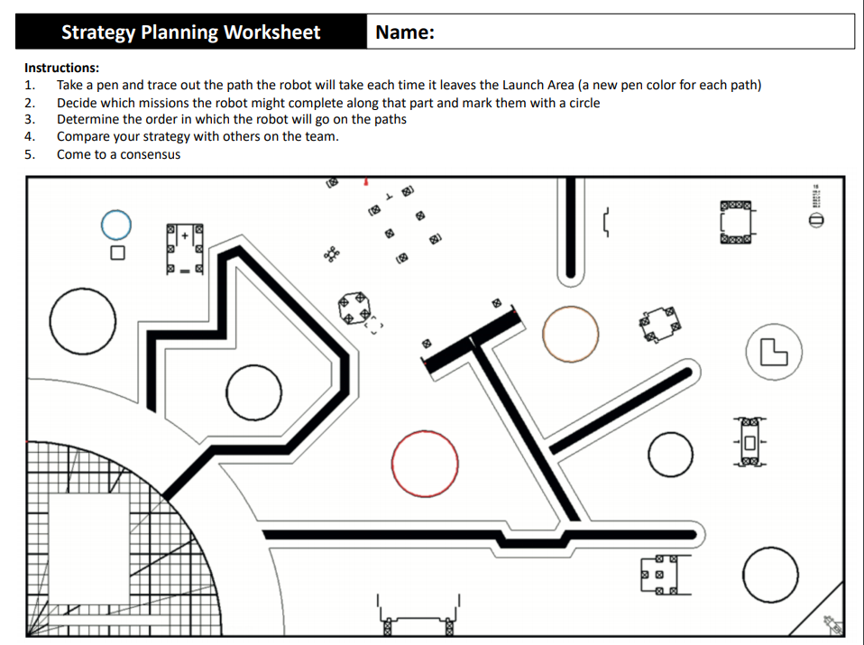
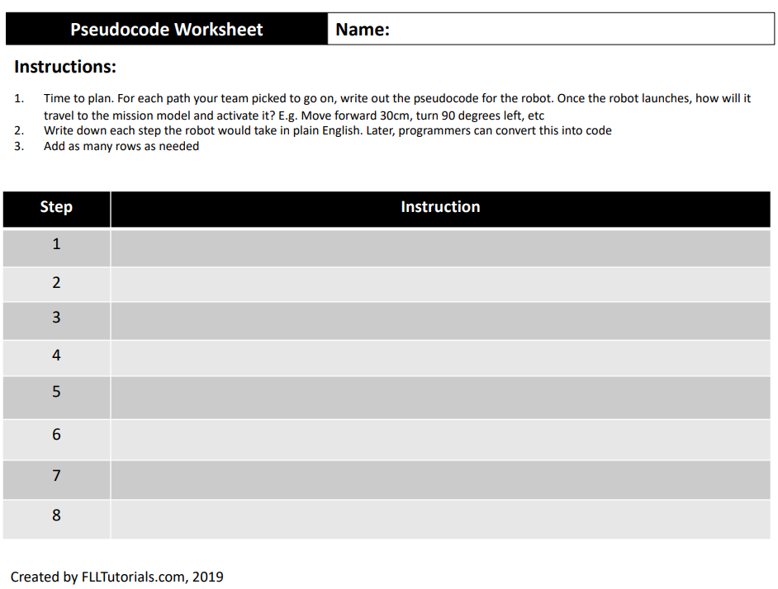
Pseudocode for missions
If you have a series of missions for your robot to complete, planning ahead can be a big help.
You can draw out the path your robot needs to take and then write out the instructions for the robot step-by-step
FLLTutorials.com provides path planning and pseudocode worksheets for FIRST LEGO League teams each season. (http://flltutorials.com/Worksheets.html)

Slide 8
CREDITS
This lesson was created by Sanjay Seshan and Arvind Seshan for SPIKE Prime Lessons
More lessons are available at www.primelessons.org
This work is licensed under a Creative Commons Attribution-NonCommercial-ShareAlike 4.0 International License.

