Slide 1



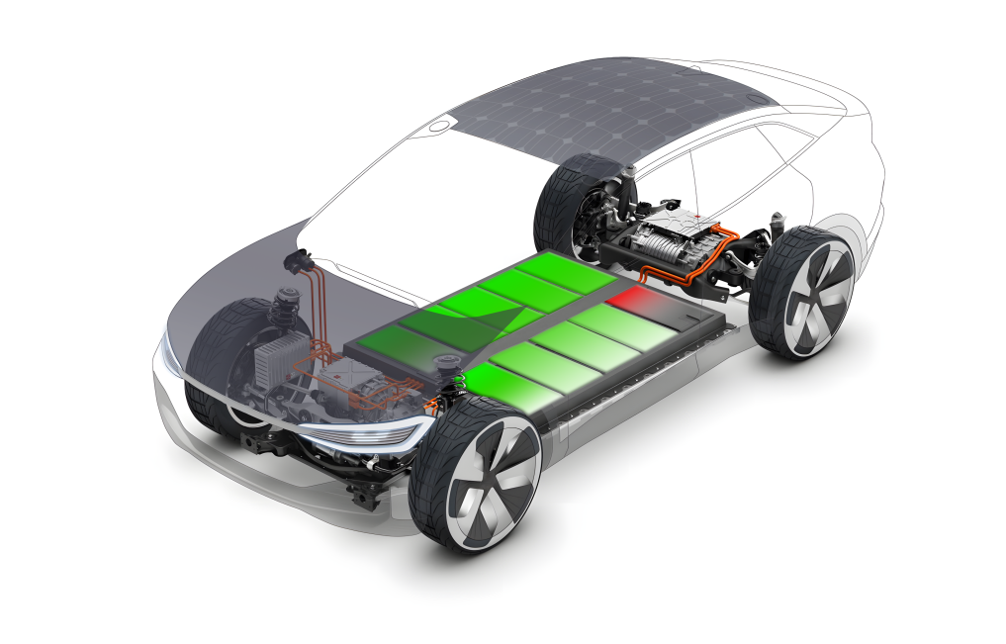
Notes:
Our solution: Use solar to balance battery, kill 2 birds with one stone. No extra hardware needed for active balancing when solar is not available

