Slide 1

WOMEN’S WELFARE ON THE BASIS OF SENTIMENTAL ANALYSIS
Under the guidance of
Dr. CHRISTY. A
by
MD ABDUL GHANI FAIZ(39110627)
PENMETSA GOUTAM NAGA SAI VARMA(39110763)

Slide 2
Presentation Outline
Introduction
Motivation
Objectives
System Architecture
Description of Software for Implementation
Project Management Plan
References
Q&A

Slide 3
Introduction
This project focuses on the role of social media in promoting the safety of women in Indian cities with special reference to the role of social media websites and applications including the Twitter platform
Tweets on Twitter which usually contains images and text and also written messages and quotes which focus on the safety of women in Indian Cities and educate people to take strict action and punish those who harass the women.
Analysis of Twitter text also include tweet and the location of the user.

Slide 4
Objectives
The objectives of this project are:
The objective of sentiment analysis is to evaluate the person's opinion in certain cases
To teach the machine to analyze the various grammatical nuances.
To implement an algorithm for automatic classification of text into positive or negative.
Graphical representation of the sentiment in form of Pie-Chart or Bar Diagram.

Slide 5
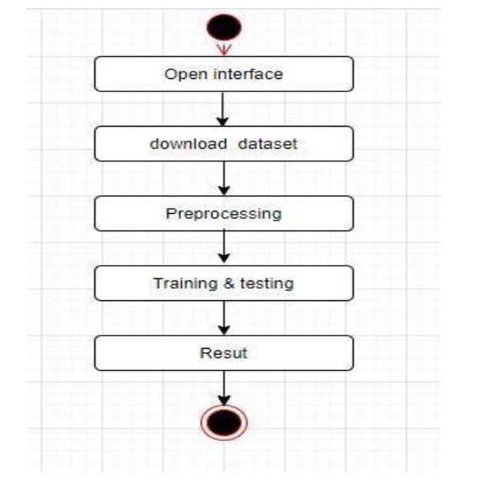
System Architecture

Slide 6
Description of Software for Implementation
Python is one of the most unique languages which seem to be literally simple yet you may find it more powerful and contemporary. It has efficient high-level data structures and a simple but effective approach to object-oriented programming. Python’s elegant syntax and dynamic typing, together with its interpreted nature, make it an ideal language for scripting and rapid application development in many areas on most platforms. Guido Van Rossum is the creator of the python language. Some of the features of python are:
• Simple
• Easy to Learn
• High-level language
• Portable
• Interpreted
• Object Oriented

Slide 7
Description of Software for Implementation
Python is open source and it is automatically included with Linux distributions, Macintosh computers and wide range of products and hardware, further clouding the user base picture.
Few points about the importance of Python:
Python is great open source, interpreted, object-oriented programming language. There is no any concept of structure like C/C++ & Go language.
Decorators, Generators provides much functionality.
Great web frameworks like Django, Flask etc. that encourages rapid web development.
With Flask, we can use loops, conditional statements etc. inside HTML document that adds dynamic nature to web pages.
Python has a rich set of libraries/packages that we can use to create excellent applications, games etc.
We can easily install libraries using pip. You can create great projects using different Python libraries for web scrapping, calculators, text editor & other innovative apps.

Slide 8
Description of Software for Implementation
For aspiring Data Scientists, Python is probably the most important language to learn because of its rich ecosystem.
Python's major advantage is its breadth. For example, R can run Machine Learning algorithms on a pre-processed dataset, but Python is much better at processing the data.
Python is very easy to learn.
List, Tuple & dictionary comprehensions makes our task easy while working with sequences & their related operations

Slide 9
Project Management Plan
Step1:
Initially Download the Twitter data which contains tweets for analysis.
Step2:
The pre-processing is performed on the data. Pre-processing includes
Cleaning the data by removing duplicate data. Tweets that contain null values are removed. Stop words are eradicated from tweets
Step3:
Tokenization is the process of splitting text into smaller units known as tokens.
The most common tokenization process is using delimiters like whitespace, semicolon, colon. Splitting is performed on data through delimiters.

Slide 10
Project Management Plan
Step4:
Words extraction is performed through tokenization. All the redundant information will be removed. Lemmatization is performed to convert words to meaningful base form which is used in classifying the tweet into polarity
Step5:
Classifying the data into polarity is performed by Support Vector Machine.
Step6:
Train the chosen model with trained dataset. This makes model to learn the pattern of words from tweets, which will be useful in predicting whether the given tweet is positive or negative
Step7:
Finally , based on the polarity we organize the data into graphical representation categorized as positive and negative

Slide 11
References
[1] S. Rammorthy et al.,” Safety Measures Against Women Violence in India using Sentimental Analysis “,International Journal of Innovative Technology and Exploring Engineering,ISSN:22782 3075,p.no:150 -154,April 2019
[2] MadhuraShrirodkar “Result Prediction using Twitter data”, International Research Journal Of Engineering And Technology,ISSN:2395-0056,2 Feb 2020
[3] AbdullahaAlasedi “Sentimental analysis of Twitter data”, International Journal of Computer Application,ISSN:2395-0072,2 Nov 2019
[4] EmanAlyami,”Mining Saudi Twitter sphere for expressive support towards women” Fourth World Conference on Smart Trends in system, 26 Oct 2020
[5] Sahayak V, Shete V & Pathan A (2015). “Sentiment analysis on twitter data.” International Journal of Innovative Research in Advanced Engineering (IJIRAE), 2(1), 178-183.

Slide 12
References
[6] Gupta B, Negi M, Vishwakarma K, Rawat G &Badhani P (2017). “Study of Twitter sentiment analysis using machine learning algorithms on Python.” International Journal of Computer Applications, 165(9) 0975-8887.
[7] Sahayak V, Shete V & Pathan A (2015). “Sentiment analysis on twitter data.” International Journal of Innovative Research in Advanced Engineering (IJIRAE), 2(1), 178-183.
[8] Soo-Min Kim and Eduard Hovy. "Determining the sentiment of opinions." Proceedings of the 20th international conference on Computational Linguistics. Association for Computational Linguistics, 2004.
[9] Michael Gamon. "Sentiment classification on customer feedback data: noisy data, large feature vectors, and the role of linguistic analysis." Proceedings of the 20th international conference on Computational Linguistics. Association for Computational Linguistics, 2004

Slide 13
THANK YOU
We thank our guide and panel and all technical and non technical staff helped us in achieving this.

