Slide 1
DATA SCIENCE
Done By:
L.Tanuja
Y20AIT463
Information Technology
Section-B

Slide 2
What is data science?
Data-description of the word around us.
Datascience is about drawing useful conclusions from large and diverse data sets through exploration,prediction and inference.
Datascience is about datagathering,analysis,decisionmaking.

Slide 3
Why data science?
Datadriven decision making has already transformed a tremendous breadth of industries,including finance,advertising,manufacturing and real estate.

Slide 4
Project topic : hate speech detection
Abstract:
Hate speech detection is the model which identifies and detects hateful and offensive speech being poured on the internet. Most of the approaches used for hate speech detection tasks are supervised methods. We had achieved 90% accuracy on the validation data which is quite sufficient to prove the power of supervised models in NLP-related tasks.

Slide 5
Existing System: Existing System is nothing but that how many types we used in the process of Implementing Our Project Work. My Project Topic : HATE SPEECH DETECTION is operated by using the Supervised Methods. We use dataset in this method and the dataset consists of Twitter hate speech detection data, used to research hate-speech detection.

Slide 6
Proposed System: In My project I used NLTK because NLTK (Natural Language Toolkit) is the go-to API for Natural Language Processing)with Python. It is a really powerful tool to preprocess text data for further analysis like with ML models for instance. It helps convert text into numbers, which the model can then easily work with.

Slide 7
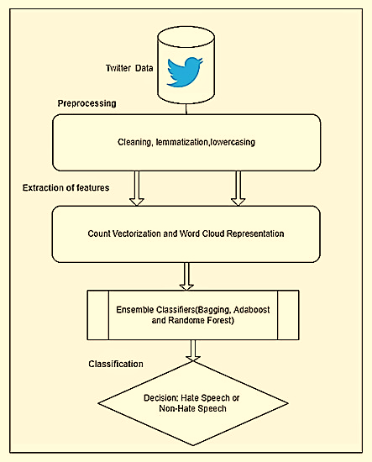
Flowchart:

Slide 8
Project Code: Hate speech detection is the model which identifies and detects hateful and offensive speech being poured on the internet. So hate speech detection has become an important solution to problems in today’s online world. The steps in building a Hate Speech Detection Project is: 1.Set up the development environment 2.Understand the data 3.Import the required libraries 4.Preprocess the data 5.Split the data 6.Build the model 7.Evaluate the results

Slide 9
References: While Doing my Internship Project I used The Following References: 1.Internet 2.Other Online Videos On Machine Learning Project Coding. 3.Consulting My mentor and Lecturers. 4.Guidelines from Our Seniors.

Slide 10


