Slide 1
Week 13
The Philippines
A Century Hence

Slide 2
Introduction
2
“The Philippines a century Hence” is an essay written by our National Hero Dr. Jose Rizal to forecast the future of the country within a hundred years.
Rizal felt that it was time to remind Spain that the circumstances that ushered in the French Revolution could have a telling effect for her in the Philippines.

Slide 3

This essay presents a radical prophesy of Rizal of how the Philippines would be on the century.
Rizal presented a clear idea of how out Motherland will end up centuries later proposing that our country will end up in either three ways:

Slide 4
These are:
That the Philippines will remain to be a colony of Spain but will be in good terms with its captors
That the Philippines will try to cut the ties of our Motherland from its captors through violent means
That we will be colonized by another country.

Slide 5
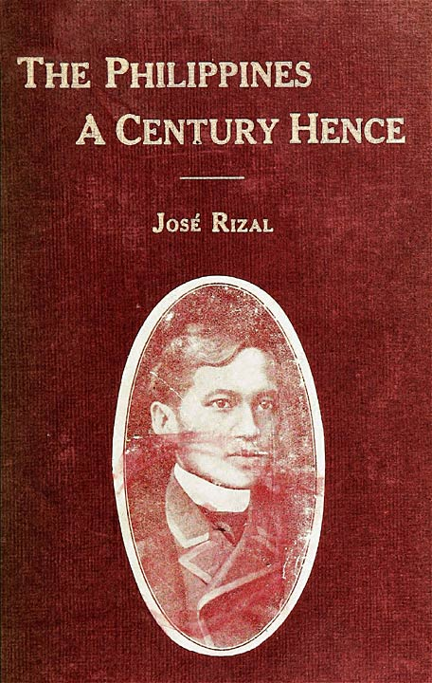
5
As “Filipinas dentro de Cien Años”, this article was originally published serially in the Filipino fortnightly review “La Solidaridad”, of Madrid, running through the issues from September 1889, to January 1890.
It supplements Rizal’s great novel “Noli Me Tangere” and its sequel “El Filibusterismo”, and the translation here given is fortunately by Mr. Charles Derbyshire who in his “The Social Cancer” and “The Reign of Greed” has so happily rendered into English those masterpieces of Rizal.

Slide 6


Rizal’s Forecasts:
Spain’s Implementation of her military policies
Deterioration and Disappearance of Indigenous Culture of the Filipinos
Passivity and submissiveness to the Spanish Colonizers

Slide 7
Spain’s implementation of her military policies:
Consequences of this policy are:
Country was depopulated
Poverty became widespread
Families and farmlands neglected

Slide 8
Deterioration and Disappearance of Indigenous Culture of the Filipinos:
Consequences of this policy are:
Filipinos started losing confidence in their past and heritage
Become doubtful of their present lifestyle
Lost hope in the future and the preservation of their race

Slide 9
Passivity and Submissiveness to the Spanish colonizers:
Consequences of this policy are:
They resigned themselves on their fates
The awakening of the national consciousness among the people had united them
The spread of enlightenment, the ilustrado class arose.

Slide 10
Third article of Rizal’s essay:
Keeping the people impoverished also came to no avail. Living a life of eternal destitution had allowed the Filipinos to act on the desire for a change in their way of life.
They began to explore other horizons through which they could move towards progress.

Slide 11
What Rizal had envisioned in his essay came true
In 1898, the Americans wrestled with Spain to win the Philippines, and eventually took over the country
Theirs was a reign of democracy and liberty
Five decades after Rizal’s death, the Philippines gained her long-awaited independence

Slide 12
The fulfillment of what Rizal had written in his essay:
“History does not record in its annals any lasting domination by one people over another, of different races, of diverse usages and customs, of opposite and divergent ideas. One of the two had to yield and succumb.”

Slide 13
Assignment:
1. Read Rizal’s work “The Philippines A Century Hence”
2. As a student of the subject Rizal, try to reflect on the things he mentioned about the Philippines on a century
3. Write your reflection on a paragraph form.

Slide 14
Thank You

