Slide 1
BCI Summary
Key contents of BCI, EEG
Motor imagery
EEG signal acquisition with Muse
Diagram of approached method and coding

Slide 2
BCI Summary
Key contents of BCI, EEG
Motor imagery
EEG signal acquisition with Muse
Diagram of approached method and coding

Slide 3
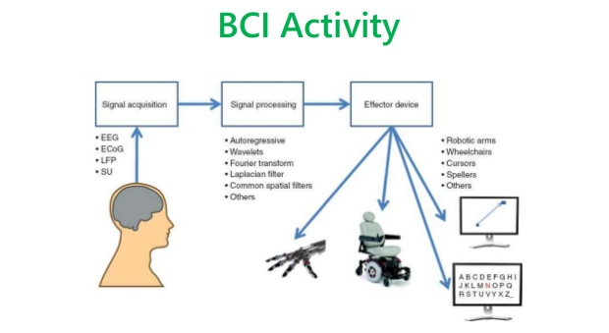
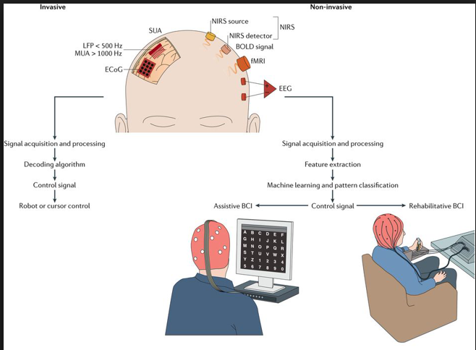
Brain-Computer Interface (BCI)
A brain–computer interface (BCI) is a direct communication pathway between an enhanced or wired brain and an external device.
BCI differs from neuromodulation in that it allows for bidirectional information flow.
BCIs are often directed at researching, mapping, assisting, augmenting, or repairing human cognitive or sensory-motor functions

Slide 4
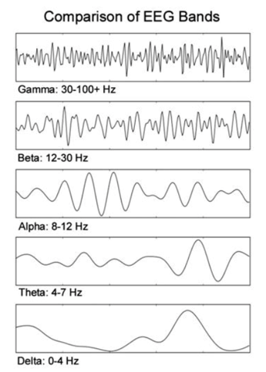
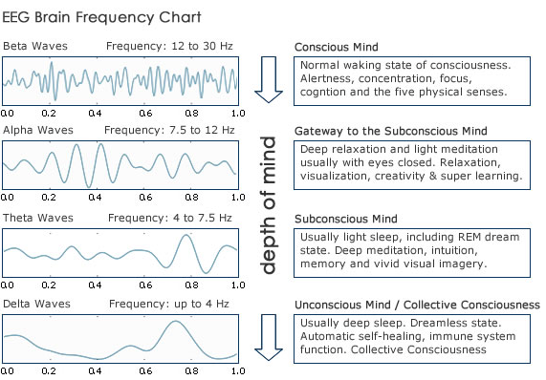
Electroencephalography (EEG)
EEG is an electrophysiological monitoring method to record electrical activity of the brain.
EEG is the most studied non-invasive, interface, mainly due to its fine temporal resolution, ease of use, portability and low set-up cost. The technology is somewhat susceptible to noise power.

Slide 5
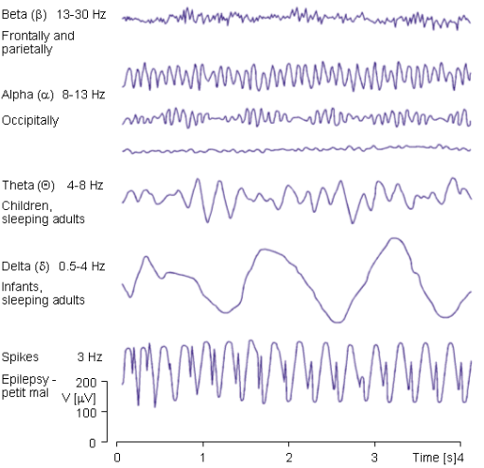
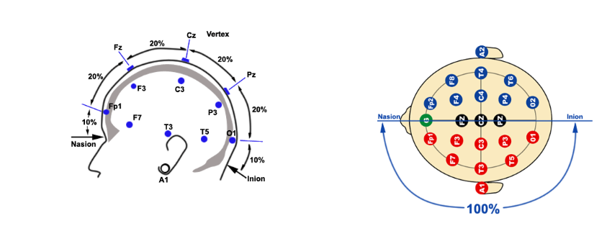
Electroencephalography (EEG)
The standardized placement of scalp electrodes for a classical EEG recording has become common since the adoption of the 10/20 system.
The essence of this system is the distance in percentages of the 10/20 range between Nasion-Inion and fixed points. These points are marked as the Frontal pole (Fp), Central (C), Parietal (P), occipital (O), and Temporal (T).
The midline electrodes are marked with a subscript z, which stands for zero. The odd numbers are used as subscript for points over the left hemisphere, and even numbers over the right.

Slide 6
BCI Summary
Key contents of BCI, EEG
Motor imagery
EEG signal acquisition with Muse
Diagram of approached method and coding

Slide 7
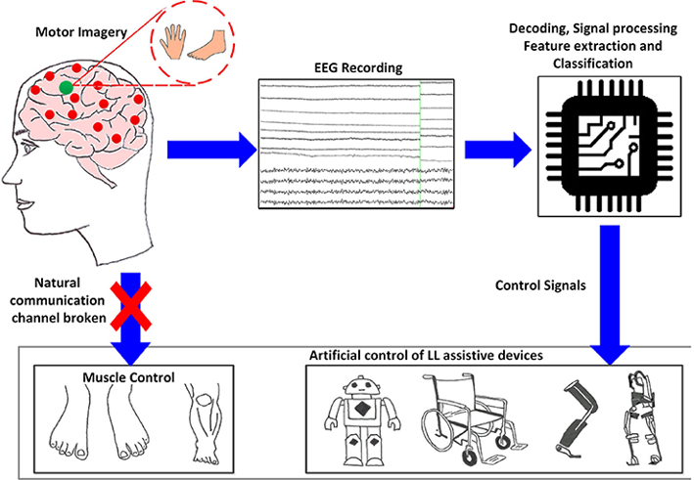
Motor imagery
Motor imagery involves the imagination of the movement of various body parts resulting in sensorimotor cortex activation.
Motor imagery typically requires a number of sessions of training (with feedback) before acceptable control of the BCI is acquired which take a number of hours over several days before users can consistently employ the technique with acceptable levels of precision.
The top performing algorithm from BCI Competition IV dataset 2 for motor imagery is the Filter Bank Common Spatial Pattern, developed by Ang et al. from A*STAR, Singapore).

Slide 8
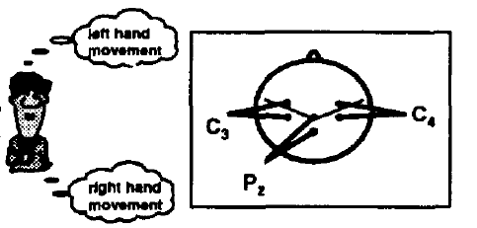
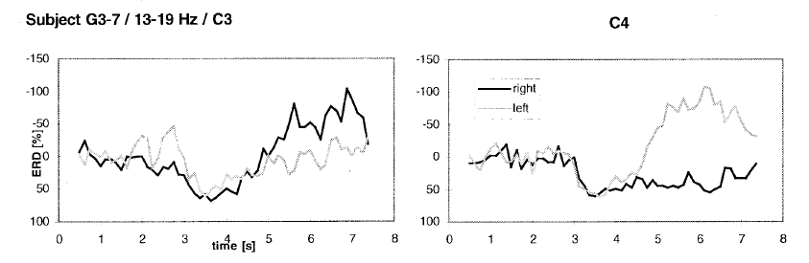
Motor imagery
The EEG was recorded bipolarly from left and right central and parietal regions
Different frequency components in the alpha and beta band were found which provided best discrimination between left and right hand movement imagination

Slide 9
BCI Summary
Key contents of BCI, EEG
Motor imagery
EEG signal acquisition with Muse
Diagram of approached method and coding

Slide 10
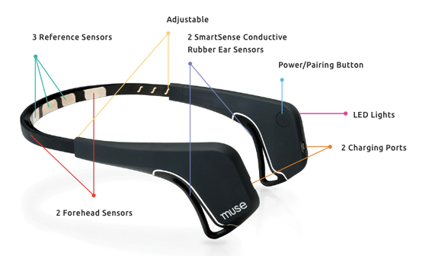
EEG signal acquisition with Muse
Muse is an EEG device widely used by neuroscience researchers around the world.
Features:
  4 electrodes
  Static Electrode Placement (Af7 and Af8)
  Dry Electrodes
  256 Hz Sampling Rate
  12 bits
  Research Tools for Windows, Mac and Linux
  SDK for Android, IOS, Windows

Slide 11
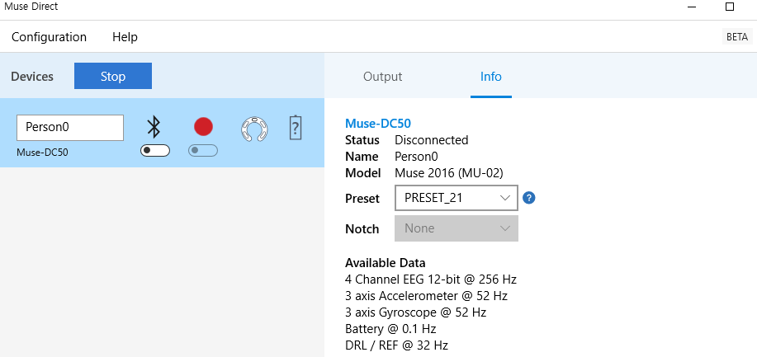
EEG signal acquisition with Muse

Slide 12
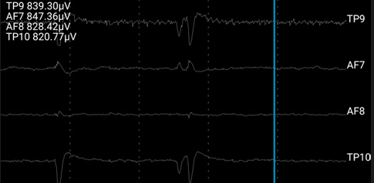
EEG signal acquisition with Muse
TP9 Left Ear, TP10 Right Ear, AF7 Left forehead AF8 Right forehead
Note that the location of AF7, AF8 will depend on head sizes On other heads, these may be closer to FP1, FP2

Slide 13
BCI Summary
Key contents of BCI, EEG
Motor imagery
EEG signal acquisition with Muse
Diagram of approached method and coding

