Slide 1
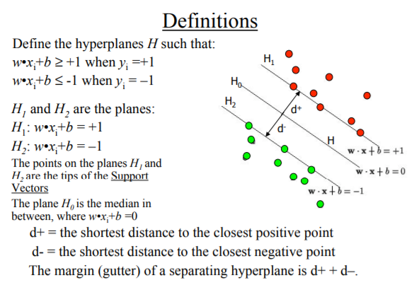
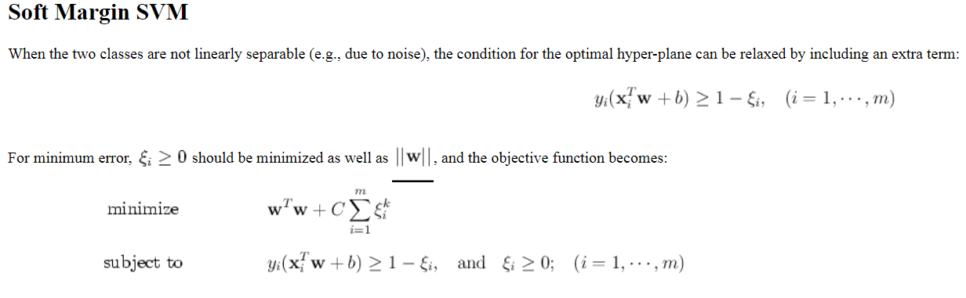
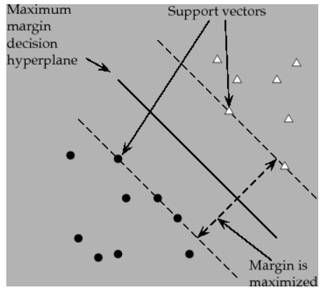
Overview of Theory
Here C is a regularization parameter that controls the trade-off between maximizing the margin and minimizing the training error. Small C tends to emphasize the margin while ignoring the outliers in the training data, while large C may tend to overfit the training data.

Slide 2
Overview of Theory
No of Interaction | C | No.support vectors | Train errors | Test errors | Margin

