Slide 1
Report 1

Slide 2
Nano-pattern Design and Technology for Patterned Media Magnetic Recording

Slide 3
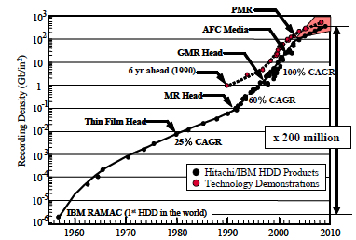
Growth in Recording density of Hard Disk Drive
The recording density of HDD has increased by a factor of 200 million from 1956 to 2010
Disk size scaled down from 24 to 2.5 and 1.8 in
Notes:
The recording density of HDD has increased by a factor of 200 million in 54 years since it was first born and brought
to the market in 1956. Various innovative new technologies have been invented and demonstrated before being applied
to products, while disk size scaled down from 24 to 2.5 and 1.8 in

Slide 4
Growth in Recording density of Hard Disk Drive (2)
The disk drive was born with coated particular media and composite heads in 1956.
In 1980’s, the head was replaced with a thin film type head and sputtered film disk followed.
In 1990’s, the magneto-resistive (MR) sensor head was introduced. Mean while, read-write channel technology innovation brought big progress to push to Gb/in2 density with MR head technology. Since then, more sensitivity was achieved with GMR.
TMR head with further sensitivity followed in early 2000’s. The latest big change is perpendicular magnetic recording (PMR) technology, drive was put into the PC HDD market in 2006 and all the model moved to PMR soon after

Slide 5
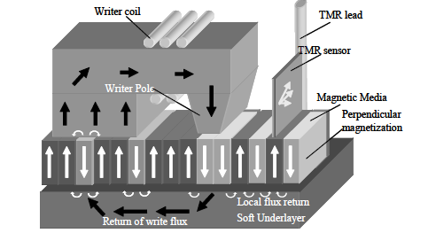
Perpendicular magnetic recording
A writer coil and a TMR sensor are built in the head.
A perpendicularly anisotropic media is sputtered on the soft under layer on the disk substrate.
In the writing process,
Magnetic flux is collected with the writer pole and generates a perpendicular magnetic field to switch the media magnetization direction.
The magnetic flux forms a loop through the soft under layer and wide area returning yoke or shield, where the returning field does not switch the media magnetization.
In reading the magnetization pattern, a tunneling magneto-resistance (TMR) sensor is used.
Notes:
Perpendicular magnetic recording is schematically shown. A writer coil and a TMR sensor are built in the head. A
perpendicularly anisotropic media is sputtered on the soft underlayer on the disk substrate. In the writing process,
magnetic flux is collected with the writer pole and generates a perpendicular magnetic field to switch the media
magnetization direction. The magnetic flux forms a loop through the soft underlayer and wide area returning yoke or
shield, where the returning field does not switch the media magnetization. In reading the magnetization pattern, a
tunneling magneto-resistance (TMR) sensor is used.

Slide 6
Limitation of Continuous film PMR Technology
When density is increased, the area of one bit is reduced
This results in the reduction in the number of magnetic crystal grains composing a bit, which causes an increase in noise.
Since a certain level of S/N needs to be maintained to make an HDD operational, a generation to generation increase of S/N is necessary.

Slide 7
Limitation of Continuous film PMR Technology (2)
Continuous reduction of grain size is needed in concert with increasing recording density;
However, grain size reduction conflicts with the thermal stability of the magnetization of grains. When the ratio of magnetic crystal anisotropy energy (KuV) and thermal energy (kbT) is reduced with the grain volume (V) reduction, the thermal magnetization reversal probability increases.
Due to this thermal stability concern, the limitation of longitudinal magnetic recording (LMR) has been generally recognized and in 2006, PMR started replacing LMR technology, because bit magnetization is fundamentally more stable with PMR.
Notes:
Schematic picture of head writer pole and media for (a) DTR (b) and BPR are shown. With DTR as shown in (a),
magnetic data bits are recorded on the concentric circular lands. Dark and light stand for magnetization direction and
they correspond to bits. Bits are not separated along the track in DTR. With BPR as shown in (b), each magnetic island,
separated in radial direction and also along track, will hold one bit of magnetic information

Slide 8
Limitation of Continuous film PMR Technology (3)
To realize Tb/in2 or more recording density within a few years, Tp and Bp need to be halved or more. Track width is limited by the head fabrication process and positioning accuracy limitation.
The actual read sensor width is about a half of Tp, which is the same or narrower than semiconductor line width (HP) . This means that the head dimension control is almost at the lithography technology limit.
In the writer, due to the limitation of saturation magnetization of the writer core material and narrow track width, recording magnetic field increase is no longer expected.
If magnetic field is not sufficient, the media with high coercivity (Hc), which has good thermal stability, is not available. This results in the loss of thermal stability margin even with PMR technology.

Slide 9
Limitation of Continuous film PMR Technology (4)
HDD design work includes consideration of adjacent track interference (ATI) robustness, where written data on a track is affected by the magnetic field of the writing head field on the adjacent track.
Head misalignment toward the center track and lateral write field leakage are the causes of ATI. Track-to-track space or a track edge region which is not read by the reader provide margin to avoid this interference, however, this space is narrowing down with Tp reduction.
HDD design optimization from this aspect is getting more difficult in recent years. Still, there is an announcement that 1 Tb/in2 recording with existing PMR is achievable .
The engineering limit of conventional PMR has not been reached yet; however for further increase of recording density with PMR, these technical difficulties need to be resolved.

Slide 10
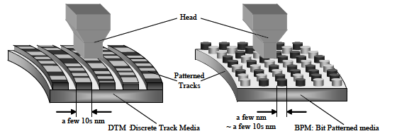

Slide 11
Report 2

Slide 12
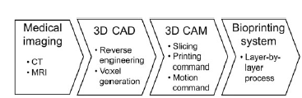
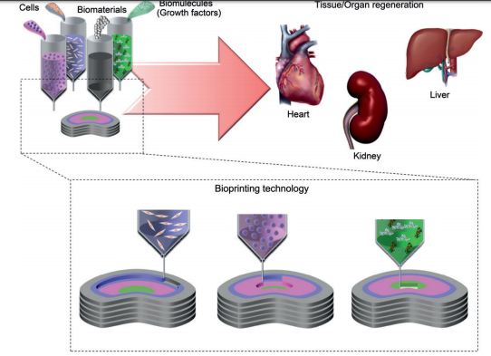
Bioprinting technology and its applications
A powerful tool for building tissue and organ structures
It allows precise placement of cells, biomaterials and biomolecules in spatially predefined locations within confined three-dimensional (3D) structures.

Slide 13
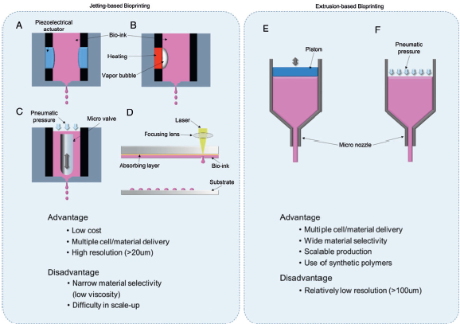
- Bioprinting technology is categorized into jetting- and extrusion-based bioprinting - Jetting-based bioprinting generates picolitre droplets containing cells and biological molecules using (A) piezoelectrical actuator, (B) thermal, (C) pneumatic pressure and valve (D) focused laser energy. - Extrusion-based bioprinting dispenses continuous filaments of a material through a micro-nozzle using (E) piston or (F) pneumatic pressure.
Bioprinting technology and its applications

Slide 14
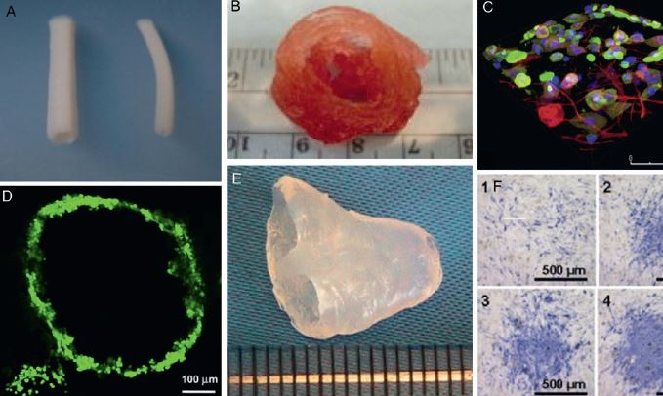
Bioprinting technology and its applications
(A) Blood vessel construct fabricated by extrusion-based bioprinting.
(B) Aortic valve conduit fabricated by extrusion-based bioprinting
(C) Confocal microscopic image of multilayered skin structure fabricated by jetting-based bioprinting.
(D) Fluorescent image of microvascular structure fabricated by jetting based-bioprinting
(E) Three-dimensional cardiac tissue with biomimetic shape fabricated
by jetting-based bioprinting.
(F) Alkaline phosphate staining of cultured muscle stem cells on spatially controlled BMP-2 by jetting-based bioprinting

Slide 15
Report 3

Slide 16
REPORT
Bio-ink
Laser Assistant Bio-printing
Pyroelectricity

Slide 17
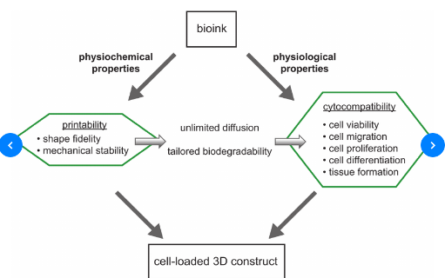
Bio-Ink
Bioinks are substances made of living cells that can be used for 3D printing of complex tissue models. Bioinks are materials that mimic an extracellular matrix environment to support the adhesion, proliferation, and differentiation of living cells.
Differences from traditional 3D printing materials
Printed at a much lower temperature (37 °C or below)
Mild cross-linking conditions
Natural derivation
Bioactive
Cell manipulatable

Slide 18
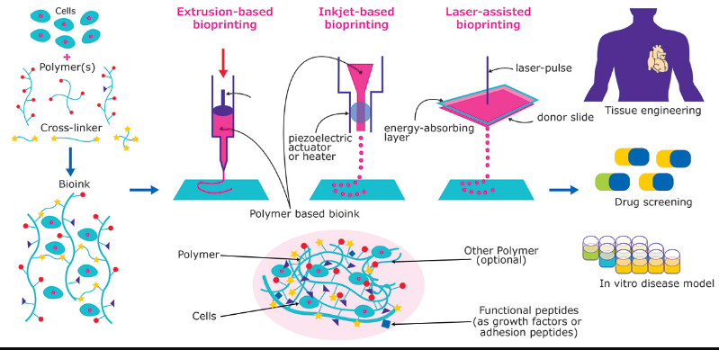
Bio-Ink
Important considerations in printability include:
Uniformity in filament diameter
Angles at the interaction of filaments
"Bleeding" of filaments together at intersects
Maintenance of shape fidelity after printing but before cross-linking
Printing pressure and nozzle diameter

Slide 19
Bio-Ink
Alginate-based
Alginate is a naturally derived biopolymer from the cell wall of brown algae that has been widely used as a biomaterial. Alginates are particularly suitable for bioprinting due to their mild cross-linking conditions via incorporation of divalent ions such as calcium. These materials have been adopted as bioinks through increasing their viscosity.[7] Additionally, these alginate-based bioinks can be blended with other materials such as nanocellulose for application in tissues such as cartilage

Slide 20
Bio-Ink
Gelatin-based
has been widely utilized as a biomaterial for engineered tissues. The formation of gelatin scaffolds is dictated by the physical chain entanglements of the material which forms a gel at low temperatures. However, at physiological temperatures, the viscosity of gelatin drops significantly. Methacrylation of gelatin is a common approach for the fabrication of gelatin scaffolds that can be printed and maintain shape fidelity at physiological temperature.^{[9]}

Slide 21
Bio-Ink
Decellularized ECM-based
Decellularized extracellular matrix based bioinks can be derived from nearly any mammalian tissue. However, often organs such as heart, muscle, cartilage, bone, and fat are decellularized, lyophilized, and pulverized, to created a soluble matrix that can then be formed into gels.[These bioinks possess several advantages over other materials due to their derivation from mature tissue. These materials consist of a complex mixture of ECM structural and decorating proteins specific to their tissue origin. Therefore, dECM-derived bioinks are particularly tailored to provide tissue-specific cues to cells. Often these bioinks are cross-linked through thermal gelation or chemical cross-linking such as through the use of riboflavin.[
]

Slide 22
Bio-Ink
Pluronics edit
Pluronics have been utilized in printing application due to their unique gelation properties.^{[12]} Below physiological temperatures, the pluronics exhibit low viscosity. However, at physiological temperatures, the pluronics form a gel. However, the formed gel is dominated by physical interactions. A more permanent pluronic-based network can be formed through the modification of the pluronic chain with acrylate groups that may be chemically cross-linked.^{[13]}
]

Slide 23
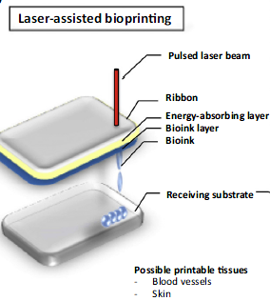
Laser Assistant Bio-printing
Laser-assisted bioprinters use pulsed laser beams focused on an energy-absorbing substrate to generate pressure that propels cell-containing material to deposit onto a receiving substrate
Advantage Can be used with viscous materialsHighly accurate
Disadvantage: Heat generated by laser can impact cells

Slide 24
Pyroelectricity
Pyroelectricity is the property presented by certain materials that exhibit an electric
polarization P when a temperature variation T is applied uniformly:
P = γ ×T (1)
where γ is the pyroelectric coefficient at constant stress. Pyroelectric crystals actually have
a spontaneous polarization, but the pyroelectric effect can only be observed during
a temperature change.

Slide 25
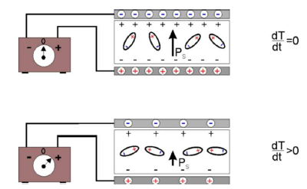
Pyroelectricity
If a pyroelectric crystal with an intrinsic dipole moment (top) is fashioned into a
circuit with electrodes attached on each surface (FIG. 1), an increase in temperature T
prompts the spontaneous polarization PS to decrease as the dipole moments, on average,
diminish in magnitude. The horizontal tilting of the dipoles, (pictured at bottom of FIG. 1),
signifies the effect. A current flows to compensate for the change in bound charge that
accumulates on the crystal edges.

Slide 26
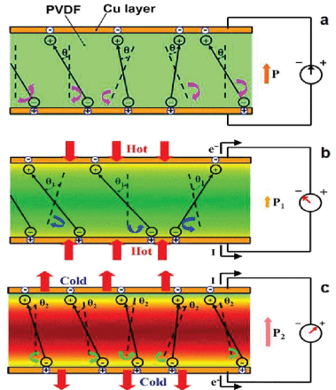
Pyroelectricity
Another definition of pyroelectricity is ability to generation of induced charges on the crystal
surface when they are heated or cooled. It is explained as a migration of positive and negative
charges (and therefore establishment of electric polarization) to opposite ends of a crystal's
polar axis as a result of change in temperature. This can be expressed as follows:
Q = γ ×ST

Slide 27
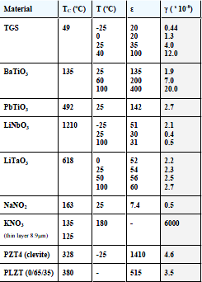
Pyroelectricity
Figure of merit for various pyroelectric materials.
TC (oC) - Curie temperature; T (oC) - temperature in °C at which measurements
were made; ε - dielectric permittivity; γ - pyroelectric coefficient in C/cm2K .
Applications
Movement detector
Pollution monitoring and gas analysis
Fire alarms
Pyroelectric thermal imaging

Slide 28
Report 4

Slide 29
Laser Assistant Bio-printing

Slide 30
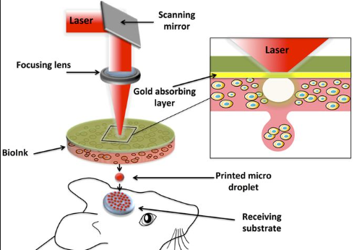
Overview of system

Slide 31
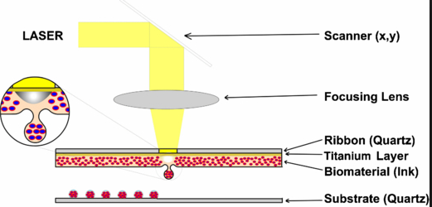
Components of system

Slide 32
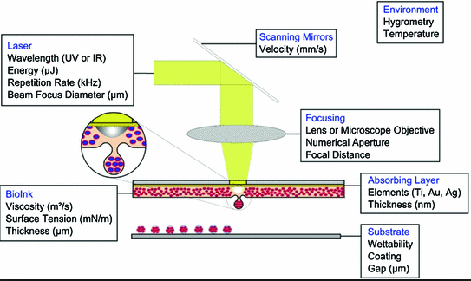
Parameter of Systems

