Slide 1
LONG-TERM FORECASTING USING TENSOR-TRAIN RNNS
Rose Yu, Stephan Zheng, Anima Anandkumar, Yisong Yue
16 Feb 2018 (modified: 16 Feb 2018)ICLR 2018 Conference

Slide 2
Problem Statement.
.
Long-term forecasting in such systems is highly challenging:
  long-term temporal dependencies,
  higher-order correlations
  sensitivity to error propagation.

Slide 3
Proposed Method
Tensor recurrent architecture addresses issues by learning the nonlinear dynamics directly using higher order moments and high-order state transition functions.
Furthermore, authors decompose the higher order structure using the tensor-train (TT) decomposition to reduce the number of parameters while preserving the model performance.
Authors theoretically establish the approximation properties of Tensor-Train RNNs for general sequence inputs, and such guarantees are not available for usual RNNs.
Authors also demonstrate significant long-term prediction improvements over general RNN and LSTM architectures on a range of simulated environments with nonlinear dynamics, as well on real-world climate and traffic data

Slide 4
Proposed Method
Proposed models have two key features:
  Explicitly model the higher-order dynamics, by using a longer history of previous hidden states and high-order state interactions with multiplicative memory units.
  They are scalable by using tensor trains, a structured low-rank tensor decomposition that greatly reduces the number of model parameters, while mostly preserving the correlation structure of the full-rank model.

Slide 5
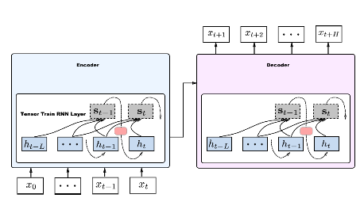
Proposed Model
Tensor-train recurrent cells within a seq2seq model. Both encoder (blue) and decoder (pink) contain tensor-train recurrent cells (red) with high-order hidden states.

Slide 6
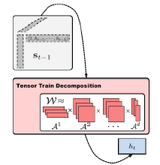
Proposed Model
Tensor-train cell with factorized hidden states using tensor-train model

Slide 7
Datasets
Genz dynamics The Genz “product peak” is one of the Genz functions (Genz, 1984), which are often used as a basis for high-dimensional function approximation. In particular, used them to analyze tensor-train decompositions. We generated 10; 000 samples of length 100 using (2) with w = 0:5; c = 1:0 and random initial points.
Traffic The traffic data of Los Angeles County highway network is collected from department of transportation The prediction task is to predict the speed readings for 15 locations across LA, aggregated every 5 minutes. After upsampling and processing the data for missing values, we obtained 8; 784 sequences of length 288.
Climate data is collected from the U.S. Historical Climatology The prediction task is to predict the daily maximum temperature for 15 stations. The data spans approximately 124 years. After preprocessing, we obtained 6; 954 sequences of length 366.

Slide 8
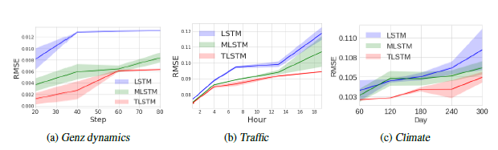
Results
The test prediction error (in RMSE) for 3 datasets.
TLSTM is more robust to long-term error propagation.
Two salient benefits of using TT-RNNs over the unfactorized models.
  First, MRNN and MLSTM can suffer from overfitting as the number of weights increases.
  Second, on traffic, unfactorized models also show considerable instability in their long-term predictions.
LSTM(long short term memory); MLSTM(multiplicative LSTM) , TLSTM(Tensorized LSTM)

Slide 9
Author’s contributions
TT-RNNs encode higher-order non-Markovian dynamics and high-order state interactions. To address the memory issue, we propose a tensor-train (TT) decomposition that makes learning tractable and fast.
Theoretical guarantees for the representation power of TT-RNNs for nonlinear dynamics, and obtain the connection between the target dynamics and TT-RNN approximation. In contrast, no such theoretical results are known for standard recurrent networks.
Authors validate TT-RNNs on simulated data and two real-world environments with nonlinear dynamics (climate and traffic). Here, author show that TT-RNNs can forecast more accurately for significantly longer time horizons compared to standard RNNs and LSTMs.

Slide 10
MLSTM
multiplicative LSTM (mLSTM), a recurrent neural network architecture for sequence modelling that combines the long short-term memory (LSTM) and multiplicative recurrent neural network architectures. mLSTM is characterised by its ability to have different recurrent transition functions for each possible input, which we argue makes it more expressive for autoregressive density estimation. We demonstrate empirically that mLSTM outperforms standard LSTM and its deep variants for a range of character level language modelling tasks. In this version of the paper, we regularise mLSTM to achieve 1.27 bits/char on text8 and 1.24 bits/char on Hutter PrizeS

Slide 11
TLSTM
Long Short-Term Memory (LSTM) is a popular approach to boosting the ability of Recurrent Neural Networks to store longer term temporal information. The capacity of an LSTM network can be increased by widening and adding layers. However, usually the former introduces additional parameters, while the latter increases the runtime. As an alternative we propose the Tensorized LSTM in which the hidden states are represented by tensors and updated via a cross-layer convolution. By increasing the tensor size, the network can be widened efficiently without additional parameters since the parameters are shared across different locations in the tensor; by delaying the output, the network can be deepened implicitly with little additional runtime since deep computations for each timestep are merged into temporal computations of the sequence. Experiments conducted on five challenging sequence learning tasks show the potential of the proposed model.

