Slide 1
STOCK PRICE PREDICTION USING LSTM,RNN AND CNN-SLIDING WINDOW MODEL
2017 International Conference on Advances in Computing, Communications and Informatics (ICACCI)
978-1-5090-6367-3/17/$31.00 ©2017 IEEE

Slide 2
INTRODUCTION
Forecasting spans many areas including business and industry, economics, environmental science and finance
Stock market has a profound impact in today’s economy. A rise or fall in the share price has an important role in determining the investor’s gain
Stock can either be univariate or multivariate. Univariate data includes information about only one particular stock whereas multivariate data includes stock prices of more than one company for various instances of time.
Analysis of time series data helps in identifying patterns, trends and periods or cycles existing in the data

Slide 3
STATE PROBLEM
.
The existing forecasting methods make use of both linear (AR,MA,ARIMA) and non-linear algorithms (ARCH,GARCH Neural Networks).
The main disadvantage of current models is that, they do not account for the latent dynamics existing in the data.
Since they consider only univariate time series, the inter dependencies among the various stocks are not identified by these models.
Also the model identified for one series will not fit for the other. Due to these reasons, it is not possible to identify the patterns or dynamics present in the data as a whole.

Slide 4

METHODOLOGY
The work is based on a sliding window approach for a short term future prediction.
The window size was fixed to be 100 minutes with an overlap of 90 minute’s information and prediction was made for 10 minutes in future.
The best window length was identified by calculating the error for various window sizes.
The train data consists of stock price of Infosys for the period July-01-2014 to October-14-2014 and test data consists of stock price for Infosys, TCS and CIPLA for the period of October-16-2014 to November-28-2014

Slide 5
METHODOLOGY
The data varies with in a range of 2000 to 4000 for Infosys and TCS and for Cipla it is 400 to 700.
To unify the data range, it was subjected to normalization and was mapped to a range of 0 to 1. This normalized data was given to the network for training.
All the models were trained for 1000 epochs by varying the layer size for fine tuning. If the loss (mean squared error) for the current epoch is less than the value obtained in previous epoch, the weight matrices for that epoch is stored.
After the training process each of these models were tested and the model with least RMSE (Root Mean Squared Error) is taken as the final model for prediction.

Slide 6
METHODOLOGY
Authors have used three different deep learning architectures, RNN, LSTM and CNN for this work
The motivation behind using these three models is to identify whether there is any long term dependency existing in the given data.
RNN and LSTM architectures are capable of identifying long term dependencies and uses them for future prediction.
However CNN architectures mainly focuses on the given input sequence and does not use any previous history or information during the learning process.

Slide 7
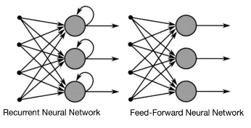
RNN
RNN is a class of neural network where connections between the computational units form a directed circle.
Unlike feed forward networks, RNN can use their internal memory to process arbitrary sequence of inputs.
Each of the computing unit in an RNN has a time varying real valued activation and modifiable weight. RNNs are created by applying the same set of weights recursively over a graph-like structure. Many of the RNNs use to define the values of their hidden units.

Slide 8
RNN
In the case of RNN, the learned model always has the same input size, because it is specified in terms of transition from one state to another.
Also the architecture uses the same transition function with the same parameters at every time step.

Slide 9
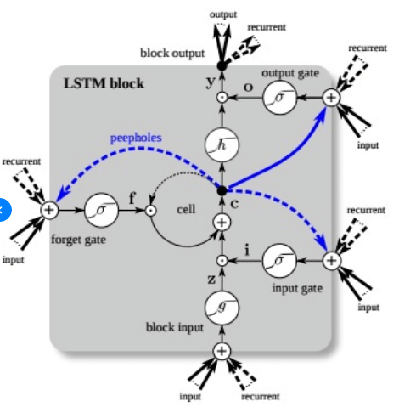
LSTM (Long Short Term Memory)
In the case of LSTM architecture, the usual hidden layers are replaced with LSTM cells.
The cells are composed of various gates that can control the input flow. An LSTM cell consists of input gate, cell state, forget gate, and output gate.
It also consists of sigmoid layer, tanh layer and point wise multiplication operation.

Slide 10
LSTM (Long Short Term Memory)
The various gates and their functions are as follows Input gate :
Input gate consists of the input.
Cell State : Runs through the entire network and has the ability to add or remove information with the help of gates.
Forget gate layer: Decides the fraction of the information to be allowed.
Output gate : It consists of the output generated by the LSTM.
Sigmoid layer generates numbers between zero and one, describing how much of each component should be let through.
Tanh layer generates a new vector, which will be added to the state

Slide 11
CNN
Convolutional neural networks or CNNs, are a specialized kind of neural network for processing data that has a known, grid-like topology.
This include time-series data, which can be thought of as a 1D and image data, which can be thought of as a 2D grid of pixels.
The network employs a mathematical operation called convolution and hence known as convolutional neural network. It is a specialized kind of linear operation.
Convolutional networks use convolution instead of general matrix multiplication in at least one of their layers.

Slide 12


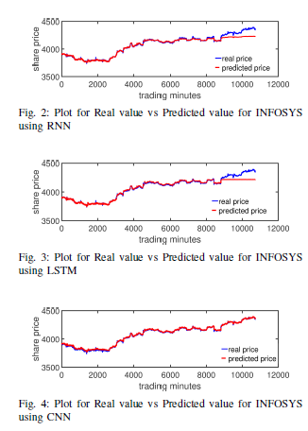
Results
From Table[I] and Table[II] it is clear deep learning models are outperforming traditional method
From the table and figures ,it is clear that CNN is giving more accurate results than the other two models.

Slide 13
Discussion
CNN does not depend on any previous information for prediction. It uses only the current window for prediction. This enables the model to understand the dynamical changes and patterns occurring in the current window.
RNN and LSTM use information from previous lags to predict the future instances.
Since stock market is a highly dynamical system, the patterns and dynamics existing with in the system will not always be the same. This cause learning problems to LSTM and RNN architecture and hence the models fails to capture the dynamical changes accurately.

Slide 14
Discussion
CNN architecture is good for forecasting ?
→ NO. Let consider: Short term forecasting, Medium term forecasting or Long term forecasting.
.

