Slide 1
Deep Learning
Early Work
Why Deep Learning
Stacked Auto Encoders
Deep Belief Networks

Slide 2
Deep Learning Overview
Train networks with many layers (vs. shallow nets with just a couple of layers)
Multiple layers work to build an improved feature space
First layer learns 1st order features (e.g. edges…)
2nd layer learns higher order features (combinations of first layer features, combinations of edges, etc.)
In current models layers often learn in an unsupervised mode and discover general features of the input space – serving multiple tasks related to the unsupervised instances (image recognition, etc.)
Then final layer features are fed into supervised layer(s)
And entire network is often subsequently tuned using supervised training of the entire net, using the initial weightings learned in the unsupervised phase
Could also do fully supervised versions, etc. (early BP attempts)

Slide 3
Deep Learning Tasks
Usually best when input space is locally structured – spatial or temporal: images, language, etc. vs arbitrary input features
Images Example: view of a learned vision feature layer (Basis)
Each square in the figure shows the input image that maximally activates one of the 100 units
Notes:
Each square in the figure above shows the (norm bounded) input image that maximally activates one of 100 hidden units. We see that the different hidden units have learned to detect edges at different positions and orientations in the image.
This image if for a simple auto-encoder with 100 hidden units trained on 10x10 images (from UFLDL tutorial)

Slide 4
Why Deep Learning
Biological Plausibility – e.g. Visual Cortex
Hastad proof - Problems which can be represented with a polynomial number of nodes with k layers, may require an exponential number of nodes with k-1 layers (e.g. parity)
Highly varying functions can be efficiently represented with deep architectures
Less weights/parameters to update than a less efficient shallow representation
Sub-features created in deep architecture can potentially be shared between multiple tasks
Type of Transfer/Multi-task learning

Slide 5
Early Work
Fukushima (1980) – Neo-Cognitron
LeCun (1998) – Convolutional Neural Networks (CNN)
Similarities to Neo-Cognitron
Many layered MLP with backpropagation
Tried early but without much success
Very slow
Diffusion of gradient
Very recent work has shown significant accuracy improvements by "patiently" training deeper MLPs with BP using fast machines (GPUs) – may be best most general approach
We are seeking improvements to basic BP algorithm
We will focus on deep networks with unsupervised early layers after a review of CNNs

Slide 6
BP Training Problems
Error attenuation, long fruitless training
Recent – Long patient training with GPUs and special hardware
Becoming more popular, Rectified Linear Units
….
Notes:
Usually more nodes in internal layers than input layer, layers not same size
Save this until later slide which has it.: Another important reason error is low. Final layer updates weights so that overall accuracy is pretty good just based on the last hidden layer (and the still pretty much initial weights of the earlier layers). Thus T-Z already gets small pretty fast based on just the learning of the last few layers using the initial layers as a random shuffle.
RLEs, constant derivate, thus just can treat as 1 and scale with LR. 0 once saturated, can come back? Review these more before next time
Evidence that tanh and other activations better than sigmoid for avoiding early top layer saturation

Slide 7
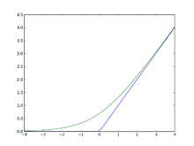
Rectified Linear Units
More efficient gradient propagation, derivative is 0 or constant, just fold into learning rate
More efficient computation: Only comparison, addition and multiplication.
Leaky ReLU f(x) = x if > 0 else ax where 0 ≤ a <= 1, so that derivate is not 0 and can do some learning for that case.
Lots of other variations
Sparse activation: For example, in a randomly initialized networks, only about 50% of hidden units are activated (having a non-zero output)
Notes:
Green is softplus function f(x) = ls(1+e^x) (smooth version of RLU), whose derivative is the sigmoid 1/(1+e^-x)
Leaky RLU f(x) = x if > 0 else .01x – some effect for x < 0

Slide 8
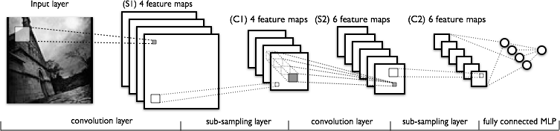
Convolutional Neural Networks
C layers are convolutions, S layers pool/sample
Often starts with fairly raw features at initial input and lets CNN discover improved feature layer for final supervised learner – eg. MLP/BP

Slide 9
Convolutional Neural Networks
Networks built specifically for problems with low dimensional (e.g. 2-d) local structure
Character recognition – where neighboring pixels will have high correlations and local features (edges, corners, etc.), while distant pixels (features) are un-correlated
Natural images have the property of being stationary, meaning that the statistics of one part of the image are the same as any other part
While standard NN nodes take input from all nodes in the previous layer, CNNs enforce that a node receives only a small set of features which are spatially or temporally close to each other called receptive fields from one layer to the next (e.g. 3x3, 5x5), thus enforcing ability to handle local 2-D structure.
Can find edges, corners, endpoints, etc.
Good for problems with local 2-D structure, but lousy for general learning with abstract features having no prescribed ordering
Notes:
Exact position of detected feature not important, but the relative positions can be and can be captured by later layers
5x5, 4x4 common

Slide 10
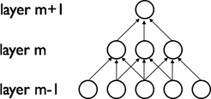
CNN – Translation Invariance
The 2-d planes of nodes (or their outputs) at subsequent layers in a CNN are called feature maps
To deal with translation invariance, each node in a feature map has the same weights (based on the feature it is looking for), and each node connects to a different overlapping receptive field of the previous layer
Thus each feature map searches the full previous layer to see if and how often its feature occurs (precise position not critical)
The output will be high at each node in the map corresponding to a receptive field where the feature occurs
Later layers could concern themselves with higher order combinations of features and rough relative positions
Each calculation of a node’s net value, Σxw in the feature map, is called a convolution, based on the similarity to standard overlapping convolutions
Notes:
Exact position of detected feature not important, but the relative positions can be and can be captured by later layers
5x5, 4x4 common

Slide 11
CNN Structure
Each node (e.g. convolution) is calculated for each receptive field in the previous layer
During training the corresponding weights are always tied to be the same (ala BPTT)
Thus a relatively small number of unique weight parameters to learn, although they are replicated many times in the feature map
Each node output in CNN is sigmoid(Σxw + b) (just like BP)
Multiple feature maps in each layer
Each feature map should learn a different translation invariant feature
Convolution layer causes total number of features to increase
Notes:
Note increase in first convolution layer from initial image

Slide 12
Sub-Sampling (Pooling)
Convolution and sub-sampling layers are interleaved
Sub-sampling (Pooling) allows number of features to be diminished, non-overlapped
Reduces spatial resolution and thus naturally decreases importance of exactly where a feature was found, just keeping the rough location
Averaging or Max-Pooling (Just as long as the feature is there, take the max, as exact position is not that critical)
2x2 pooling would do 4:1 compression, 3x3 9:1, etc.
Pooling smooths the data and makes the data invariant to small translational changes
Since after first layer, there are always multiple feature maps to connect to the next layer, it is a pre-made human decision as to which previous maps the current map receives inputs from
Notes:
Max pooling – winner take all for receptive field
Small fields most common (2x2), also allows for deeper network
Note depth of network is basically decided by the sub sampling pool size, since once the feature maps are small (e.g. 5x5) there no more room for convoluting and need to just put then in the MLP
Review two Gif slides of convolutions and pooling (10x10)
Can get some effects of Pooling and save computation by having convolutional layers less tightly overlapped

Slide 13
CNN Training
Trained with BP but with weight tying in each feature map
Randomized initial weights through entire network
Just average the weight updates over the tied weights in feature map layers
Convolution layer
Each feature map has one weight for each input and one bias
Thus a feature map with a 5x5 receptive field would have a total of 26 weights, which are the same coming into each node of the feature map
If a convolution layer had 10 feature maps, then only a total of 260 unique weights to be trained in that layer (much less than an arbitrary deep net layer without sharing)
Sub-Sampling (Pooling) Layer
All elements of receptive field max’d, averaged, or summed, result multiplied by one trainable weight and a bias added, then squashed for each pooling node
If a layer had 10 pooling feature maps, then 20 unique weights to be trained
While all weights are trained, the structure of the CNN is currently usually hand crafted with trial and error.
Number of total layers, number of receptive fields, size of receptive fields, size of sub-sampling (pooling) fields, which fields of the previous layer to connect to
Typically decrease size of feature maps and increase number of feature maps for later layers
Notes:
Note that pooling (size and function) are hand-crafted by the network designer, though there is a trainable weight and bias to “tune” the pooling
Or BP variant
Can use Local response normalization or variants – effort to have feature maps learn different features, but not essential
Usually need more maps in layers (100s…)

Slide 14
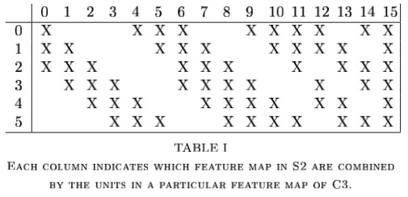
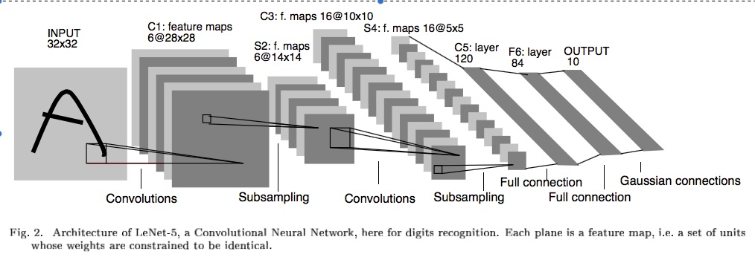
Example – LeNet-5
To help it all sink in:
How many weights to be trained at each layer?
5x5 2x2 5x5 2x2 Fully Connected
Notes:
Why 32x32 to start with. Actual characters never bigger than 28x28. Just padding the edges so for example the top corner node of the feature map can have a pad of two up and left for its feature map.
Same things happens with 14x14 to 10x10 drop S2 to C3
C1: 156 weights (26*6), 122,304 connections 26*28*28*6
S2: 12 weights (6*2). 5 (4 connections plus bias)*6*14*14 = 5880 connections
C3: 6 connect to 3, 9 to 4, and 1 to all 6, forces discovery of more diverse feature combinations
Table 1 only considers contiguous subsets of 3, and more mixed subsets of 4 feature maps, and one with all – heuristic explanation
6*(25*3+1) + 9*(25*4+1) + 1*(25*6+1) =1516 total weights, total connections are 10*10 more than that for 151,600
S4: 16*2 = 32 weights, 16*5*5*5(4 connections plus bias) = 2000 connections
C5: 120*(5*5*16+1) = 48,120 weights and connections are the same since it is just a fully connected MLP at this point
F6: 84*(120+1) = 10,164
Output: 10*(84+1) = 850
He used a special RBF output approach in his LeCun-5 model. Could commonly have just gone into an output layer at F6 with 10 output nodes. Then would have been 10*(120+1) = 1210 weights going to the last output layer
Total: 340,908 connections, but 60,000 trainable parameters

Slide 15
LeCun-5 Example
Layer | Trainable Weights | Connections
C1 | (25+1)*6 = 156 | (25+1)*6*28*28 = 122,304
S2 | (1+1)*6 = 12 | (4+1)*6*14*14 = 5880 (2x2 links and bias)
C3 | 6*(25*3+1) + 9*(25*4+1) + 1*(25*6+1) = 1516 | 1516*10*10 = 151,600
S4 | 16*2 = 32 | 16*5*5*5 = 2000 (2x2 links and bias)
C5 | 120*(5*5*16+1) = 48,120 | Same since fully connected MLP at this point
F6 | 84*(120+1) = 10,164 | Same
Output | 10*(84+1) = 850 (RBF) | Same
Why 32x32 to start with? Actual characters never bigger than 28x28. Just padding the edges so for example the top corner node of the feature map can have a pad of two up and left for its feature map.
Same things happens with 14x14 to 10x10 drop from S2 to C3
C3: 6 maps connect to 3, 9 to 4, and 1 to all 6. Forces discovery of more diverse feature combinations. Table 1 only considers contiguous subsets of 3, and more mixed subsets of 4 feature maps, and one with all – heuristic attempt
LeCun used a special RBF output approach in his LeCun-5 model. Could commonly have just gone into an output layer at F6 with 10 output nodes. Then would have been 10*(120+1) = 1210 weights going to the last output layer
~340,000 total connections, with 60,000 trainable parameters 97% of which are in the final MLP
Notes:
Last total does not include 850 output layer as trainable weights

Slide 16
CNN Summary
High accuracy for image applications
Special purpose net – Just for images or problems with strong local spatial/temporal correlation
Lots of hand crafting and CV tuning to find the right recipe of receptive fields, layer interconnections, etc.
Lots more Hyperparameters than standard nets, and even than other deep networks, since the structures of CNNs are so handcrafted
Recent research proposing simpler more consistent structure also effective. If 5x5, 2x2, depth just a function of initial image and pooling field (2x2), thus main parameters are only number of feature maps per layer, and MLP hidden nodes
CNNs getting wider and deeper with speed-up techniques (e.g. ReLU)
Drop-out often used for overfit avoidance
Advanced convolution (e.g. NiN) and Pooling approaches
Notes:
Simard 2003, Simple consistent CNN structure 5x5 with 2x2 subsampling with number of features 5 in first C-layer, 50 in next, until too small.
Don’t actually used pool layer as instead just connect every other node which samples rather than max/average.
Each layer reduces feature size by (n-3)/2. Just two layers for mnist.
They also use elastic distortions which is a type of jitter to get increased data. 99.6% - best at the time, Distortions also help a lot with standard MLP
Thus an approach with less Hyperparameter fiddling
Ciresan and Schmidhuber 2012, Multi column DNN. CNN with depth 6-10 (deeper if initial input image is bigger), and wider on fields, 1-2 hidden layers in MLP, columns are CNNs (an ensemble with different parameters, features, etc.) where their output is averaged, jitter inputs, multi-day GPU training, annealed LR (.001 dropping to .00003) 99.76% mnist

Slide 17
Training Deep Networks
Build a feature space
Note that this is what we do with SVM kernels, or trained hidden layers in BP, etc., but now we will build the feature space using deep architectures
Unsupervised training between layers can decompose the problem into distributed sub-problems (with higher levels of abstraction) to be further decomposed at subsequent layers

Slide 18
Training Deep Networks
Difficulties of supervised training of deep networks
Early layers of MLP do not get trained well
Diffusion of Gradient – error attenuates as it propagates to earlier layers
Leads to very slow training
Exacerbated since top couple layers can usually learn any task "pretty well" and thus the error to earlier layers drops quickly as the top layers "mostly" solve the task– lower layers never get the opportunity to use their capacity to improve results, they just do a random feature map
Need a way for early layers to do effective work
Instability of gradient in deep networks: Vanishing or exploding gradient
Product of many terms, which unless “balanced” just right, is unstable
Either early or late layers stuck while “opposite” layers are learning
Often not enough labeled data available while there may be lots of unlabeled data
Can we use unsupervised/semi-supervised approaches to take advantage of the unlabeled data
Deep networks tend to have more sensitive training issues problems than shallow networks during supervised training
Notes:
If weights were large gradient could explode as go down the net –much less common but still can happen
Note large weights usually lead to saturation and even smaller f’(net)
: Another important reason error is low. Final layer updates weights so that overall accuracy is pretty good just based on the last hidden layer (and the still pretty much initial weights of the earlier layers). Thus T-Z already gets small pretty fast based on just the learning of the last few layers using the initial layers as a random shuffle.
Local minima? Some say, More likely difficult slow curvatures (Martens: Hessian Free Learning), Properly tuned Moment with proper initial conditions can make a big difference.
LSTM are more specialized approach for very long memory cases, but is it best for typical tasks? Hessian free claims to out-perform it and can also do the specialized tasks

Slide 19
Greedy Layer-Wise Training
One answer is greedy layer-wise training
Train first layer using your data without the labels (unsupervised)
Since there are no targets at this level, labels don't help. Could also use the more abundant unlabeled data which is not part of the training set (i.e. self-taught learning).
Then freeze the first layer parameters and start training the second layer using the output of the first layer as the unsupervised input to the second layer
Repeat this for as many layers as desired
This builds our set of robust features
Use the outputs of the final layer as inputs to a supervised layer/model and train the last supervised layer(s) (leave early weights frozen)
Unfreeze all weights and fine tune the full network by training with a supervised approach, given the pre-training weight settings
Notes:
If do full supervised, we may not bet the benefits of building up the incrementally abstracted feature space
Steps 1-4 sometimes called pre-training as it gets the weights close enough so that standard training in step 5 can be effective
Do fine tuning for sure if lots of labeled data, if little labeled data, not as helpful.

Slide 20
Deep Net with Greedy Layer Wise Training
Supervised
Learning
ML Model
New Feature Space
Unsupervised
Learning
Original Inputs
Notes:
Can input both new and original spaces

Slide 21
Greedy Layer-Wise Training
Greedy layer-wise training avoids many of the problems of trying to train a deep net in a supervised fashion
Each layer gets full learning focus in its turn since it is the only current "top" layer
Can take advantage of unlabeled data
When you finally tune the entire network with supervised training the network weights have already been adjusted so that you are in a good error basin and just need fine tuning. This helps with problems of
Ineffective early layer learning
Deep network local minima
We will discuss the two most common approaches
Stacked Auto-Encoders
Deep Belief Networks

Slide 22
Self Taught vs Unsupervised Learning
When using Unsupervised Learning as a pre-processor to supervised learning you are typically given examples from the same distribution as the later supervised instances will come from
Assume the distribution comes from a set containing just examples from a defined set up possible output classes, but the label is not available (e.g. images of car vs trains vs motorcycles)
In Self-Taught Learning we do not require that the later supervised instances come from the same distribution
e.g., Do self-taught learning with any images, even though later you will do supervised learning with just cars, trains and motorcycles.
These types of distributions are more readily available than ones which just have the classes of interest
However, if distributions are very different…
New tasks share concepts/features from existing data and statistical regularities in the input distribution that many tasks can benefit from
Note similarities to supervised multi-task and transfer learning
Both approaches reasonable in deep learning models

Slide 23
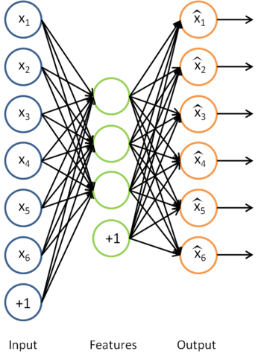
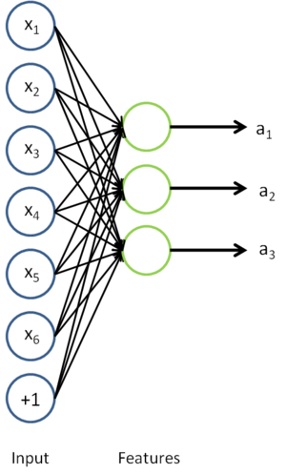
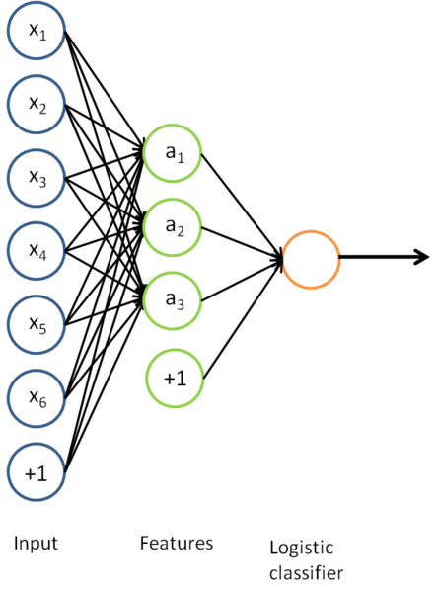
Auto-Encoders
A type of unsupervised learning which tries to discover generic features of the data
Learn identity function by learning important sub-features (not by just passing through data)
Compression, etc.
Can use just new features in the new training set or concatenate both
Notes:
Mention Zipser auotencoder with reverse engineering, then Cottrell compression where unable to reverse engineer
Point out that don't have to have less hidden nodes in the next layer, but careful, if train too long, will just learn to pass through, more on that in a bit

Slide 24
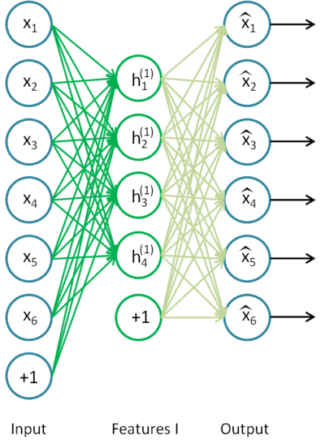
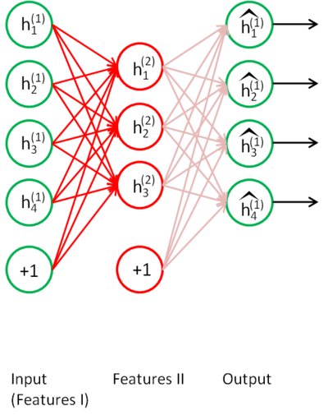
Stacked Auto-Encoders
Bengio (2007) – After Deep Belief Networks (2006)
Stack many (sparse) auto-encoders in succession and train them using greedy layer-wise training
Drop the decode output layer each time

Slide 25
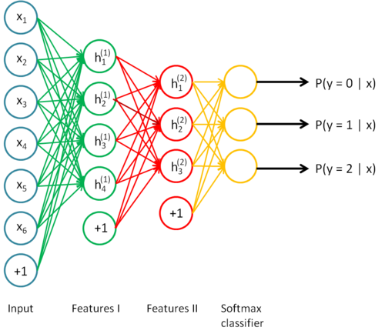
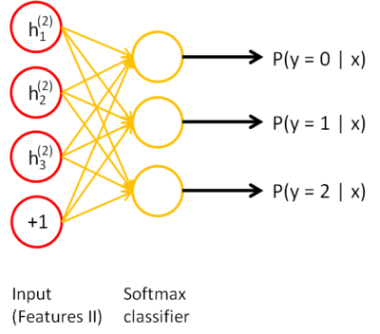
Stacked Auto-Encoders
Do supervised training on the last layer using final features
Then do supervised training on the entire network to fine- tune all weights
Notes:
Shows softmax, but could use BP or any other variation

Slide 26
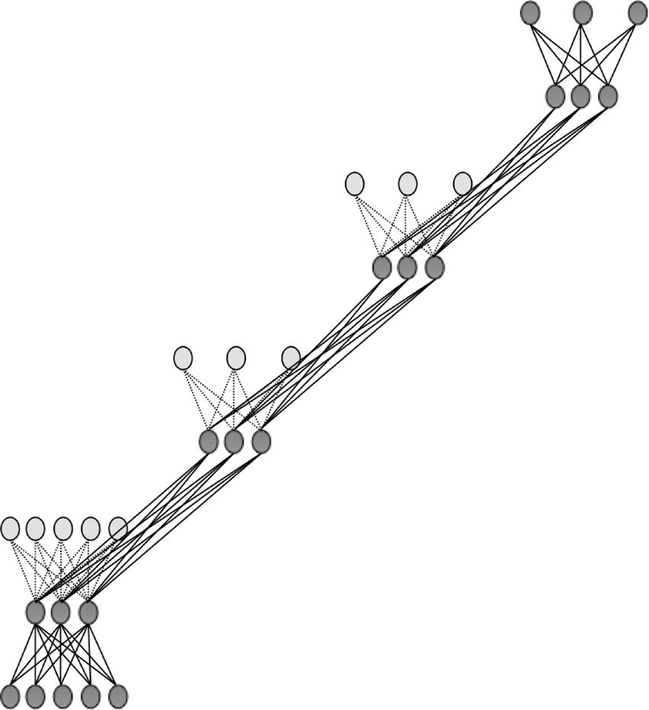

Slide 27
Sparse Encoders
Auto encoders will often do a dimensionality reduction
PCA-like or non-linear dimensionality reduction
This leads to a "dense" representation which is nice in terms of parsimony
All features typically have non-zero values for any input and the combination of values contains the compressed information
However, this distributed and entangled representation can often make it more difficult for successive layers to pick out the salient features
A sparse representation uses more features where at any given time many/most of the features will have a 0 value
Thus there is an implicit compression each time but with varying nodes
This leads to more localist variable length encodings where a particular node (or small group of nodes) with value 1 signifies the presence of a feature (small set of bases)
A type of simplicity bottleneck (regularizer)
This is easier for subsequent layers to use for learning
Notes:
A Common approach is to have more nodes in hidden layer than input, but with a sparsity constraint (since sparse a bit like the compressed version at any given moment (i.e each encoding is compressed), but more overall node options, and also using a sparse (0-1) vs continuous encoding)

Slide 28
How do we implement a sparse Auto-Encoder?
Use more hidden nodes in the encoder
Use regularization techniques which encourage sparseness (e.g. a significant portion of nodes have 0 output for any given input)
Penalty in the learning function for non-zero nodes
Weight decay
etc.
De-noising Auto-Encoder
Stochastically corrupt training instance each time, but still train auto-encoder to decode the uncorrupted instance, forcing it to learn conditional dependencies within the instance
Better empirical results, handles missing values well
Notes:
And make sure it doesn't just learn the pass through identity
Sparsity parameter (approach in UFLDL tutorial) is target average activation for all hidden nodes across training set (e.g. .05) requires a forward pass of all data first to calculate current average activation, then a penalty term on error to push avg activation towards the sparsity parameter.

Slide 29
Sparse Representation
For bases below, which is easier to see intuition for current pattern - if a few of these are on and the rest 0, or if all have some non-zero value?
Easier to learn if sparse
Notes:
Each square in the figure above shows the (norm bounded) input image that maximally activates one of 100 hidden units. We see that the different hidden units have learned to detect edges at different positions and orientations in the image.
This image if for a simple auto-encoder with 100 hidden units trained on 10x10 images (from UFLDL tutorial)

Slide 30
Stacked Auto-Encoders
Concatenation approach (i.e. using both hidden features and original features in final (or other) layers) can be better if not doing fine tuning. If fine tuning, the pure replacement approach can work well.
Always fine tune if there is a sufficient amount of labeled data
For real valued inputs, MLP training is like regression and thus could use linear output node activations, still sigmoid at hidden
Stacked Auto-Encoders empirically not quite as accurate as DBNs (Deep Belief Networks)
(with De-noising auto-encoders, stacked auto-encoders competitive with DBNs)
Not generative like DBNs, though recent work with de-noising auto-encoders may allow generative capacity
Notes:
Linear decoder, And note that with linear output activations the error signal at the output layer is (t-net)*f’(net) = t-net since f’(net)=1,
But standard MLP error, etc. at hidden nodes!

Slide 31
Deep Belief Networks (DBN)
Geoff Hinton (2006)
Uses Greedy layer-wise training but each layer is an RBM (Restricted Boltzmann Machine)
RBM is a constrained
Boltzmann machine with
No lateral connections between
hidden (h) and visible (x) nodes
Symmetric weights
Does not use annealing/temperature, but that is all right since each RBM not seeking a global minima, but rather an incremental transformation of the feature space
Typically uses probabilistic logistic node, but other activations possible
Notes:
Remember Hinton was also the Boltzmann guy

Slide 32
RBM Sampling and Training
Initial state typically set to a training
example x (can be real valued)
Sampling is an iterative back and forth process
P(h_{i} = 1|x) = sigmoid(W_{i}x + c_{i}) = 1/(1+e^{-net(hi)}) // c_{i} is hidden node bias
P(x_{i} = 1|h) = sigmoid(W'_{i}h + b_{i}) = 1/(1+e^{-net(xi)}) // b_{i} is visible node bias
Contrastive Divergence (CD-k): How much contrast (in the statistical distribution) is there in the divergence from the original training example to the relaxed version after k relaxation steps
Then update weights to decrease the divergence as in Boltzmann
Typically just do CD-1 (Good empirical results)
Since small learning rate, doing many of these is similar to doing fewer versions of CD-k with k > 1
Note CD-1 just needs to get the gradient direction right, which it usually does, and then change weights in that direction according to the learning rate
Notes:
Since x starts as a training example, after a bit of training, it should already be close to/in an energy well

Slide 33
Notes:
Q and P are probability distribution vectors, for hidden(h) and visible/input (x) vectors respectively
Do a small example on the board, at least one x value real and not all same weights (set it up like HW)
Why back to Q?, need a p1, q1, p2. q2 then can update
Note W update based on when they are both simultaneously on as in standard Boltzmann If h1 and x1 both 1 then weight change >= 0, else <=0, if x2 = 0, then no weight change, else change by c*Q(h2), real or sampled
Delta w works both ways for h and x. Delta w = initial product of x1 and h1 – final product of xk and Qk)
binomial is standard MLP sigmoid unit

Slide 34
RBM Update Notes and Variations
Binomial unit means the standard MLP sigmoid unit
Q and P are probability distribution vectors for hidden (h) and visible/input (x) vectors respectively
During relaxation/weight update can alternatively do updates based on the real valued probabilities (sigmoid(net)) rather than the 1/0 sampled logistic states
Always use actual/binary values from initial x -> h
Doing this makes the hidden nodes a sparser bottleneck and is a regularizer helping to avoid overfit
Could use probabilities on the h -> x and/or final x -> h
in CD-k the final update of the hidden nodes usually use the probability value to decrease the final arbitrary sampling variation (sampling noise)
Lateral restrictions of RBM allow this fast sampling
Notes:
No lateral – allows set up and back passes
Optional: Persistent MCMC for free (negative) phase – Just keep sampling from a long-term chain (ignoring the weight updates)
trade-off long term chain accuracy vs updated weights
Early sampling can be a type of de-noise which could aid sparseness

Slide 35
RBM Update Variations and Notes
Initial weights, small random, 0 mean, sd ~ .01
Don't want hidden node probabilities early on to be close to 0 or 1, else slows learning, since less early randomness/mixing? Note that this is a bit like annealing/temperature in Boltzmann
Set initial x bias values as a function of how often node is on in the training data, and h biases to 0 or negative to encourage sparsity
Better speed when using momentum (~.5)
Weight decay good for smoothing and also encouraging more mixing (hidden nodes more stochastic when they do not have large net magnitudes)
Also a reason to increase k over time in CD-k as mixing decreases as weight magnitudes increase

Slide 36
Deep Belief Network Training
Same greedy layer-wise approach
First train lowest RBM (h⁰ – h¹) using RBM update algorithm (note h⁰ is x)
Freeze weights and train subsequent RBM layers
Then connect final outputs to a supervised model and train that model
Finally, unfreeze all weights, and train full DBN with supervised model to fine-tune weights
During execution typically iterate multiple times at the top RBM layer
Notes:
Picture above is for generative model (so ignore solid vs dotted lines at this point

Slide 37
Can use DBN as a Generative model to create sample x vectors
Initialize top layer to an arbitrary vector
Gibbs sample (relaxation) between the top two layers m times
If we initialize top layer with values obtained from a training example, then need less Gibbs samples
Pass the vector down through the network, sampling with the calculated probabilities at each layer
Last sample at bottom is the generated x value (can be real valued if we use the probability vector rather than sample)
Alternatively, can start with an x at the bottom, relax to a top value, then start from that vector when generating a new x, which is the dotted lines version. More like standard Boltzmann machine processing.
Notes:
Alternatively, Can start with an x at bottom, relax to a top value, then start from that vector when generating a new x, which is the dotted lines added version

Slide 38
Notes:
Initial x can be real valued
Note that nodes have two sets of biases. Only one is used at a time depending on if node is visible or hidden for that layer
While loop does RBM weight training until convergence for the kth layer
second for loop samples from x up to k-1 so that we can then do RBM update at the kth layer
Mean_field_computation just a flag on whether we sample or use the real values – Lots of wiggle room here, could do it different for different layers or even randomly, etc.
Follow through code for k=1 and k=3 so they see the flow

Slide 39
DBN Execution
After all layers have learned then the output of the last layer can be input to a supervised learning model
Note that at this point we could potentially throw away all the downward weights in the network as they will not actually be used during the normal feedforward execution process (as we did with the Stacked Auto Encoder)
Note that except for the downward bias weights b they are the same symmetric weights anyways
If we are relaxing M times in the top layer then we would still need the downward weights for that layer
Also if we are generating x values we would need all of them
The final weight tuning is usually done with backpropagation, which only updates the feedforward weights, ignoring any downward weights
Notes:
Downward weights were mostly necessary for training the feedforward weights

Slide 40
DBN Learning Notes
RBM stopping criteria still in issue. One common approach is reconstruction error which is the probability that the final x after CD-k is the initial x. (i.e. P(􏰀x|E[h|x􏰈]). The other most common approach is AIC (Annealed Importance Sampling). Both have been shown to be problematic.
Each layer updates weights so as to make training sample patterns more likely (lower energy) in the free state (and non-training sample patterns less likely).
This unsupervised approach learns broad features (in the hidden/subsequent layers of RBMs) which can aid in the process of making the types of patterns found in the training set more likely. This discovers features which can be associated across training patterns, and thus potentially helpful for other goals with the training set (classification, compression, etc.)
Note still pairwise weights in RBMs, but because we can pick the number of hidden units and layers, we can represent any arbitrary distribution

Slide 41
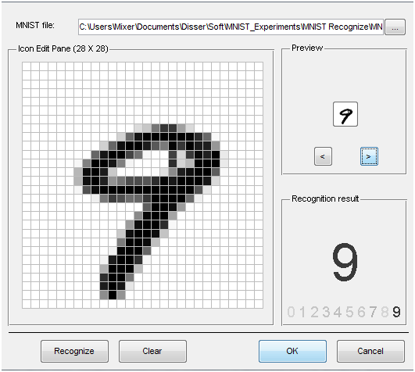
MNIST
Notes:
Go to project page
Mnist 28x28 (784) grey scale (0-255) values.
Could do some smarter preprocessing of features!
Just use straight data as our baseline.

Slide 42
DBN Project Notes
To be consistent just use 28×28 (764) data set of gray scale values (0-255)
Normalize to 0-1
Could try better preprocessing if want and helps in published accuracies, but start/stay with this
Small random initial weights
Parameters
Hinton Paper, others – do a little searching and e-mail me a reference for extra credit points
http://yann.lecun.com/exdb/mnist/ for sample approaches
Straight 200 hidden node MLP does quite good ~98%
Rough Hyperparameters - LR: ~.05-.1, Momentum ~.5
Best class deep net results: ~98.5% - which is competitive
About half students never beat MLP baseline
Can you beat the 98.5%?
Notes:
MLP results much better than that reported by LeCun and beats many of the other papers, including some of the Deep net results. BP results 1998, slower machines, higher LR, etc.??
http://yann.lecun.com/exdb/mnist/

Slide 43
Deep Learning Project Past Experience
Structure: ~3 hidden layers, ~500ish nodes/layer, more nodes/layers can be better but training is longer
Training time:
DBN: ~10 epochs with the 60K set, small LR ~.005 often good
Can go longer, does not seem to overfit with the large data set
SAE: Can saturate/overfit, ~3 epochs good, but will be a function of your de-noising approach, which is essential for sparsity, use small LR ~.005, long training – up to 50 hours, got 98.55
Larger learning rates often lead low accuracy for both DBN and SAE
Sampling vs using real probability value in DBN
Best results found when using real values vs. sampling
Some found sampling on the back-step of learning helps
When using sampling, probably requires longer training, but could actually lead to bigger improvements in the long run
Typical forward flow real during execution, but could do some sampling on the m iterations at the top layer. Some success with back-step at the top layer iteration (most don't do this at all)
We need to try/discover better variations
Notes:
Examples where nothing happening with quality learning, but once LR get low enough, suddenly they both learn real well.

Slide 44
Deep Learning Project Past Experience
Note: If we held out 50K of the dataset as unsupervised, then deep nets would more readily show noticeable improvement over BP
A final full network fine tune with BP always helps
But can take 20+ hours
Key take away – Most actual time spent training with different parameters. Thus, start early, and then you will have time to try multiple long runs to see which variations work. This does not take that much personal time, as you simply start it with some different parameters and go away for a day. If you wait until the last few days, there is no time to do these experiments.
Notes:
Final BP tune only works for the feedforward weights. Ignore the others which are not used anyways during normal forward processing (unless we iterate M times at the top layer).
We also could use the downward weights for generative.
Otherwise we just drop the downward weights after learning the forward weights which is what we really wanted (ala SAE).

Slide 45
DBN Notes
Can use lateral connections in RBM (no longer RBM) but sampling becomes more difficult – ala standard Boltzmann requiring longer sampling chains.
Lateral connections can capture pairwise dependencies allowing the hidden nodes to focus on higher order issues. Can get better results.
Deep Boltzmann machine – Allow continual relaxation across the full network
Receive input from above and below rather than sequence through RBM layers
Typically for successful training, first initialize weights using the standard greedy DBN training with RBM layers
Requires longer sampling chains ala Boltzmann
Conditional and Temporal RBMs – allow node probabilities to be conditioned by some other inputs – context, recurrence (time series changes in input and internal state), etc.

Slide 46
Discrimination with Deep Networks
Discrimination approaches with DBNs (Deep Belief Net)
Use outputs of DBNs as inputs to supervised model (i.e. just an unsupervised preprocessor for feature extraction)
Basic approach we have been discussing
Train a DBN for each class. For each clamp the unknown x and iterate m times. The DBN that ends with the lowest normalized free energy (softmax variation) is the winner.
Train just one DBN for all classes, but with an additional visible unit for each class. For each output class:
Clamp the unknown x, relax, and then see which final state has lowest free energy – no need to normalize since all energies come from the same network.
See http://deeplearning.net/demos/
Notes:
The Demo shows generated instance first with just one iteration from the top RBN. In practice would not do bottom generation until after m iterations. (i.e. after top has settled into a lower energy state)
Should improve in the discrimination variation also after m steps, though seems to get good results sooner
Using Hinton's generating digits demo
http://www.cs.toronto.edu/~hinton/adi/index.htm

Slide 47
Conclusion
Much recent excitement, still much to be discovered
"Google-Brain"
Sum of Products Nets
Biological Plausibility
Potential for significant improvements
Good in structured/Markovian spaces
Important research question: To what extent can we use Deep Learning in more arbitrary feature spaces?
Recent deep training of MLPs with BP shows potential in this area

