Slide 1
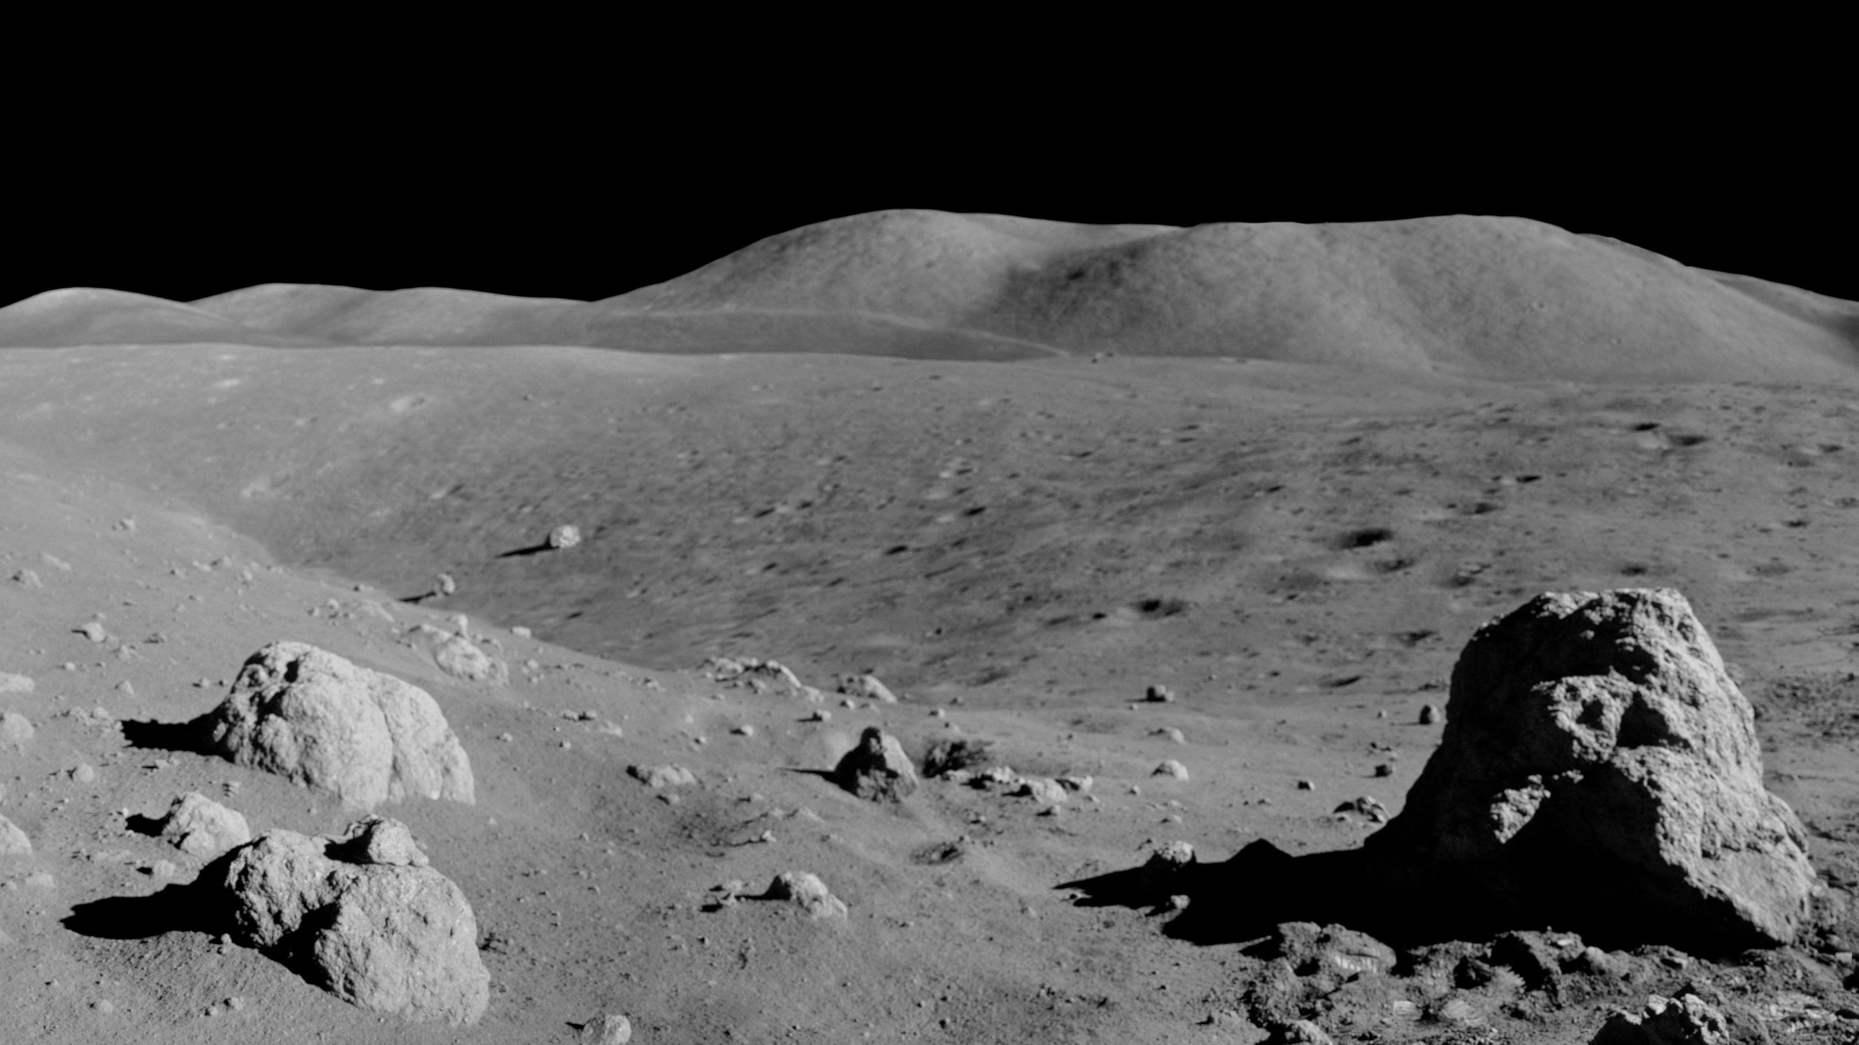
Challenge 2: Emergency Crew Transport
Len Johns Shaji, Aaron Hinkle, Ethan Bush, Tyler Martelon,
Celine Cherian

Slide 2
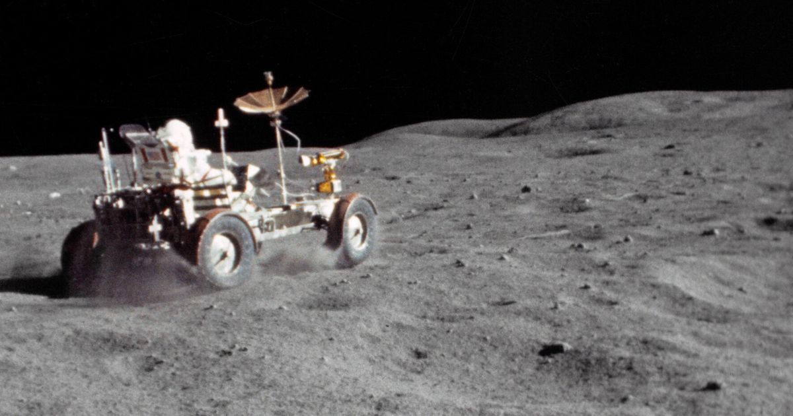
Part 1: Unpressurized transit vehicle
Develop a lightweight vehicle to transport an incapacitated crew member wearing an EVA suit.
Ensure materials selected can withstand lunar conditions
Design a structure that can withstand up to 5 times its weight

Slide 3
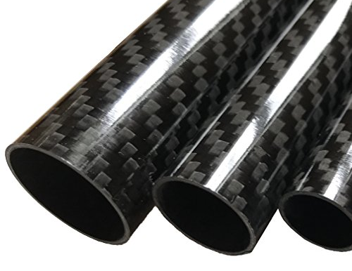
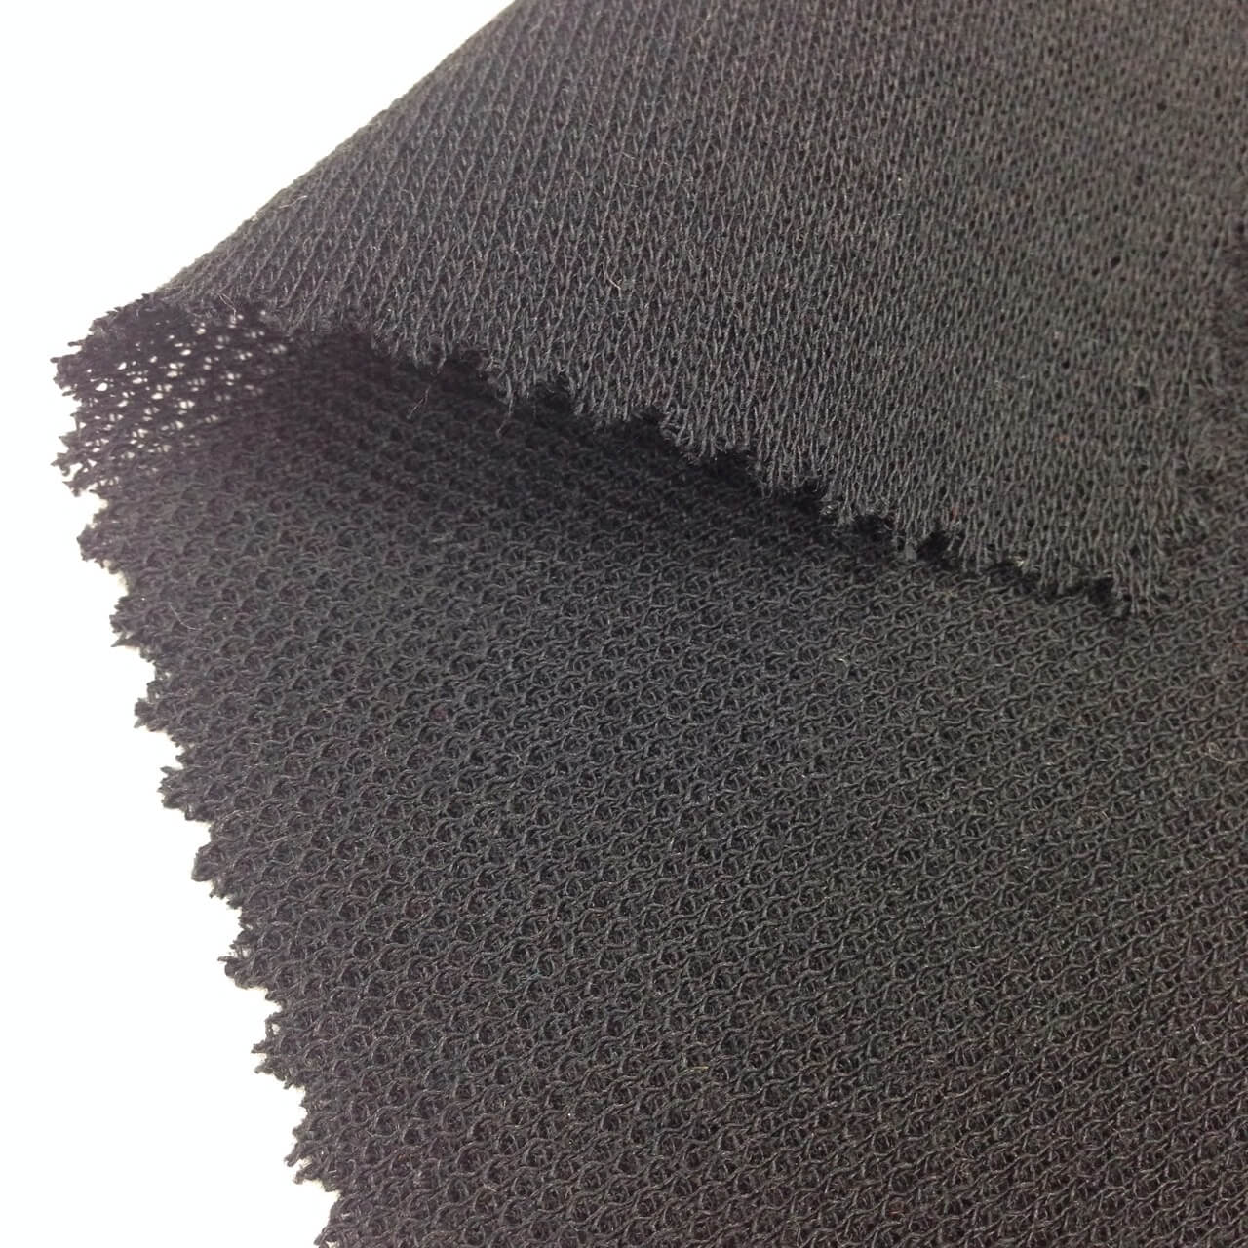
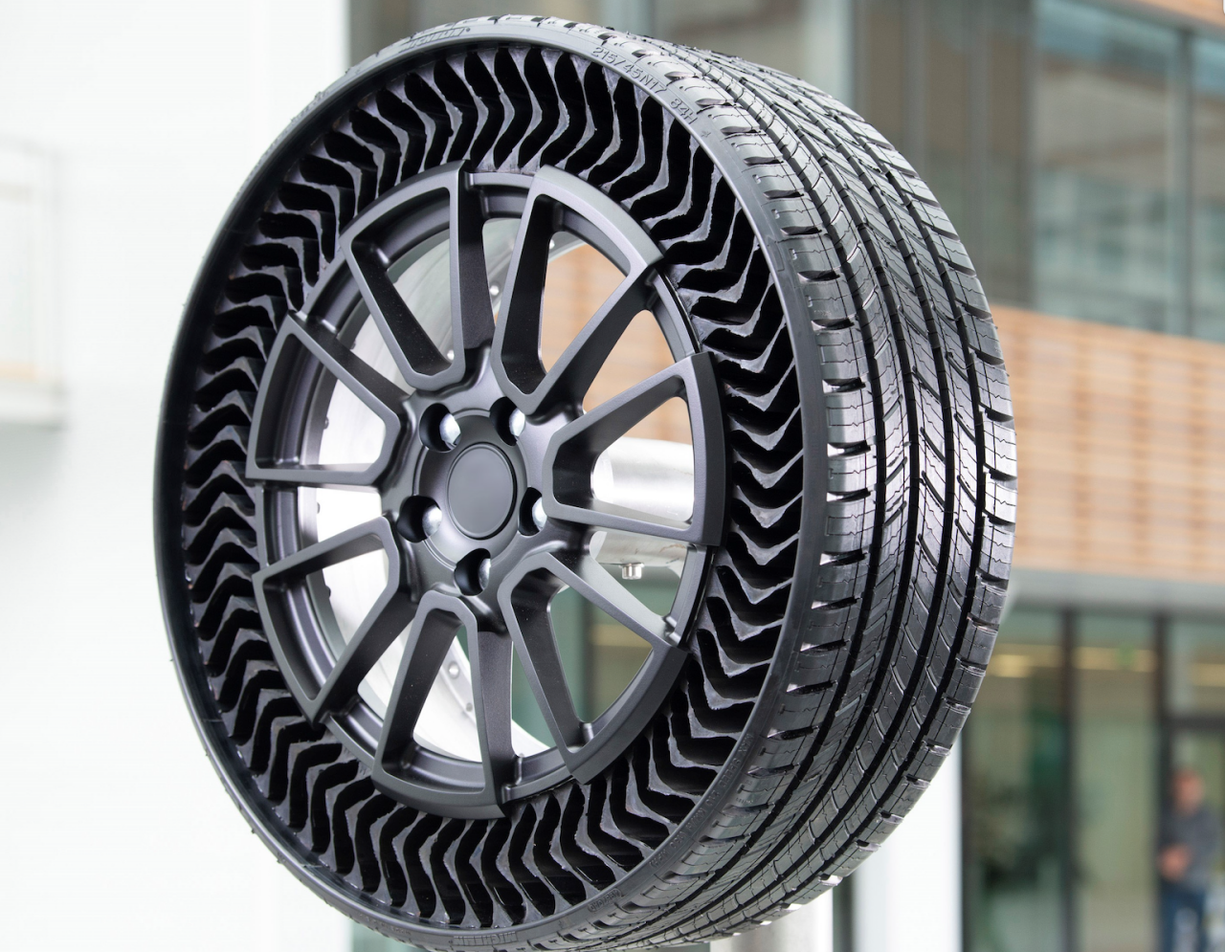
Material Selection
Structural - Aluminum; A comfortable balance of weight and strength.
Transport Harness – Nomex fabric; Environmental resistance and high strength.
Electronics Protection – Epoxyseal; Protects electronics from dust exposure.
Tires – Vulcanized Rubber; Combined with airless geometry rubber should function over the short distances intended for the system.
Other smaller component materials vary.

Slide 4
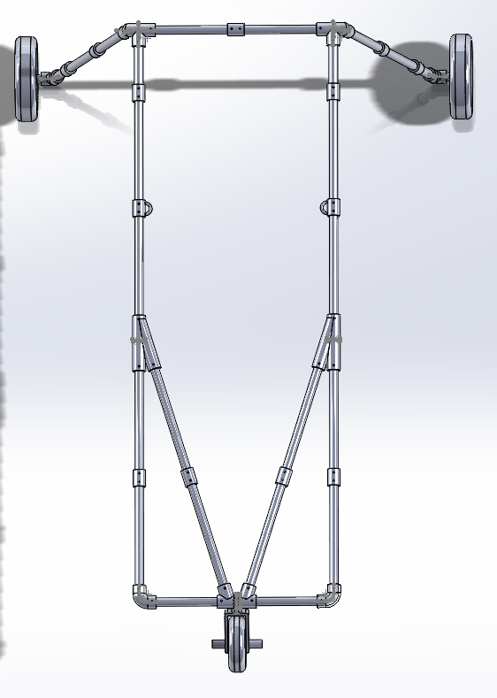
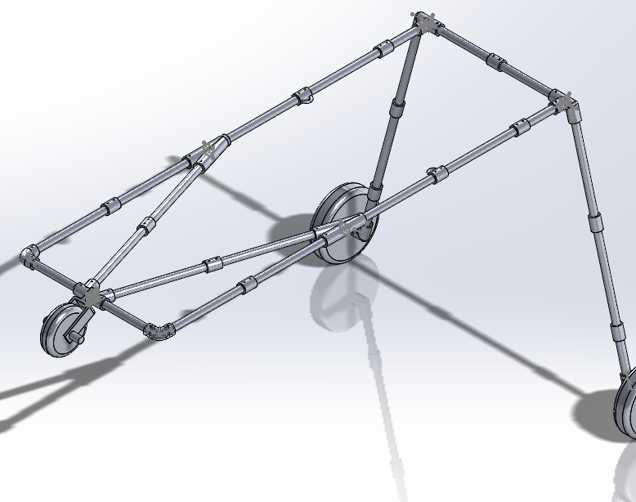
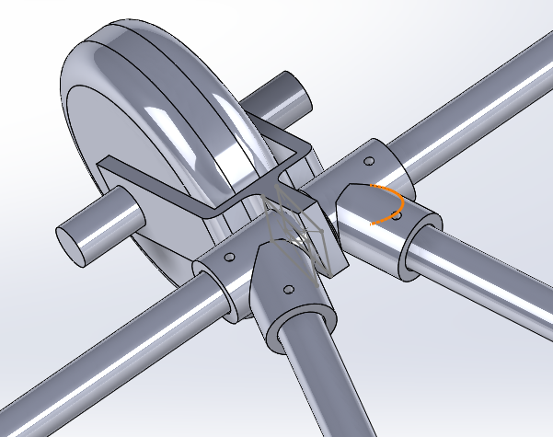
Structural Design
Collapsable structure, folded to be carried on astronaut’s thigh.
Spring-loaded locking mechanism
Easy assembly

Slide 5
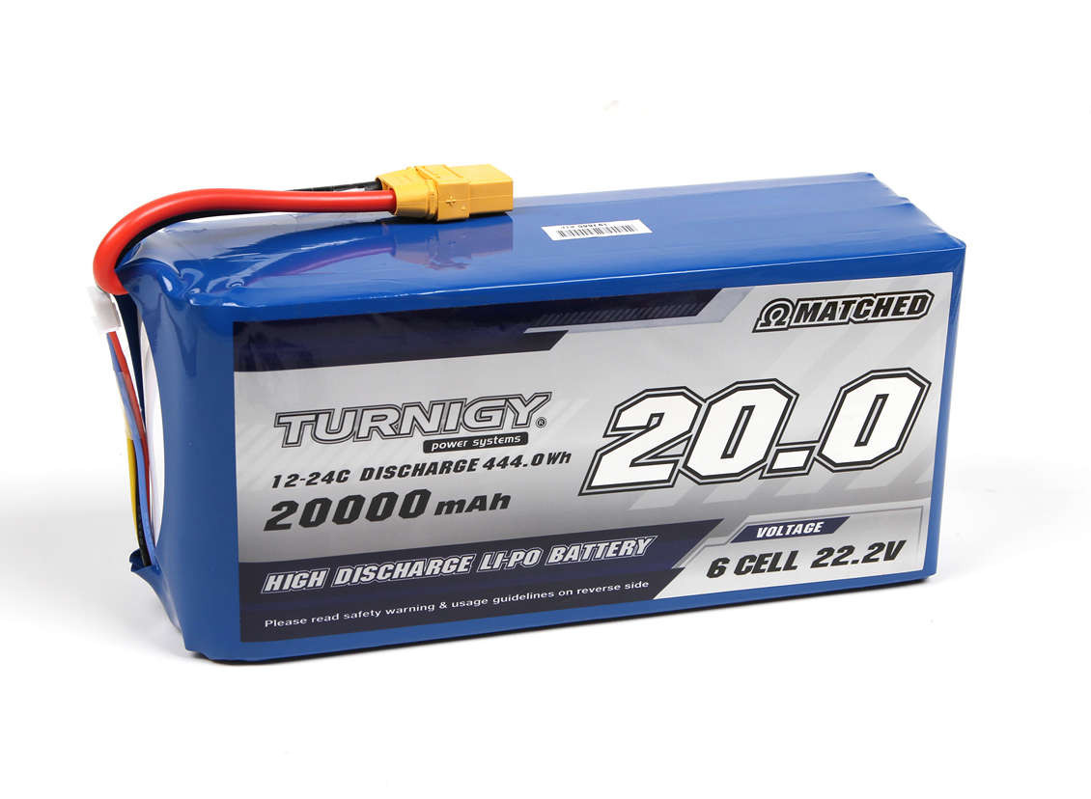
Electronics Integration
Drive motor in the 50-100 watt power range.
13000 mAh LiPo battery; Provides high energy density with low mass.
ESP32-based wireless drive control.

Slide 6
Cost Analysis
Parts | Material | Weight (lbs) | Cost
Motor+Wheel | Metal+Rubber | 7.05 | $109.90
Motor Controller | Metal | 1.07 | $17.87
LiPo Battery | Misc. | 1.91 | $146.95
Pipe Connectors | Aluminum 2034 | 8.7 | $30.45
Tubing | Carbon Fiber | 3.25 | $29.46
Casters | Metal+Rubber | 10 | $90.00
Caster Support | Carbon Fiber | 1.3 | $11.78
Straps | Beta Fabric | 10 | $115.50
Bluetooth Module | Misc. | 0.01 | $10.39
Arduino Nano | Misc. | 0.02 | $22.00
5V UBEC Step Down | Misc. | 0.02 | $13.99
5V Lithium Battery | Lithium-Ion | 0.25 | $13.99
Total Cost: $562.30 | Total Weight: 43.58 lbs

Slide 7
Risk Analysis
Carbon Fiber structure shattering
Unexpected power depletion
Fastener failure
Carbon Fiber decay causing structural failure
Insufficient motor power for terrain

