Slide 1
LENS WG4
Thomas Holm Rod (ESS), 12th September 2023

Slide 2
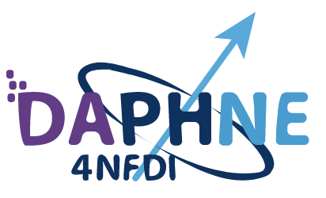





LENS WG4 – successful collaborations
EU projects: PaNOSC & ExPaNDS
Workshops and summer schools: MDANSE + several about ML and AI
Software: SasView, Mantid, CrysFML/easyDiffraction, SpinW, etc.
Data format: canSAS, ORSO, NeXus
Collaborations are often across LEAPS and LENS
LENS has an important role in representing neutrons in these collaborations
… and for sharing information across facilities

Slide 3
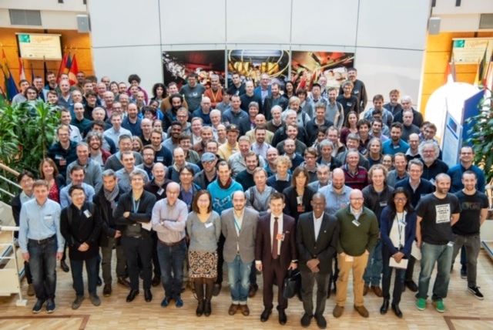
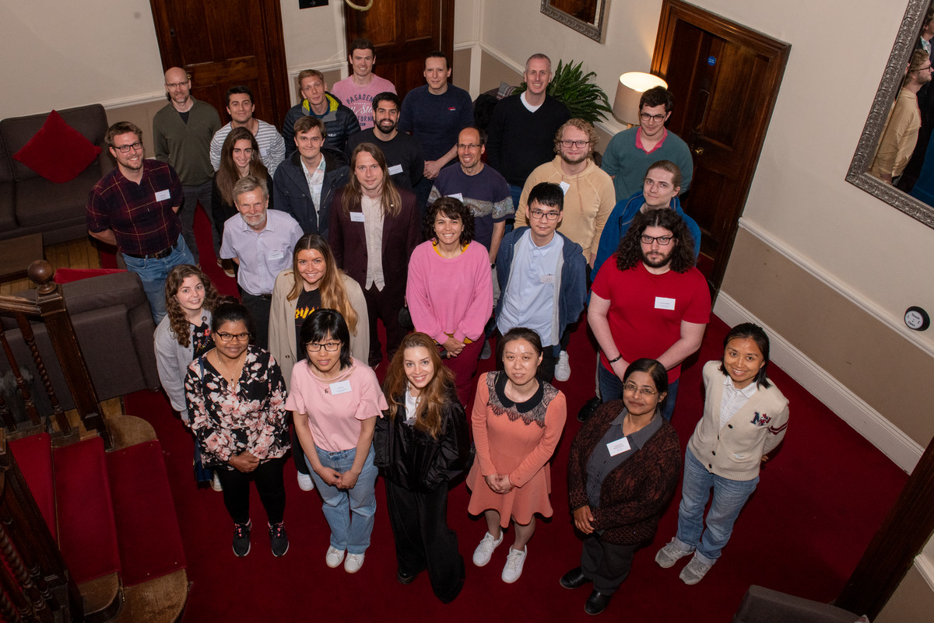
Workshops and summer schools
ILL 2019
Nov 2019, ILL, Artificial Intelligence Applied to Photon and Neutron Science
Feb 2021, online, LENS Machine Learning School
Jun 2022, STFC, MDANSE Summer school
Oct 2023, SOLEIL hybrid, Leveraging open data from PaN facilities for machine learning
STFC 2022

Slide 4
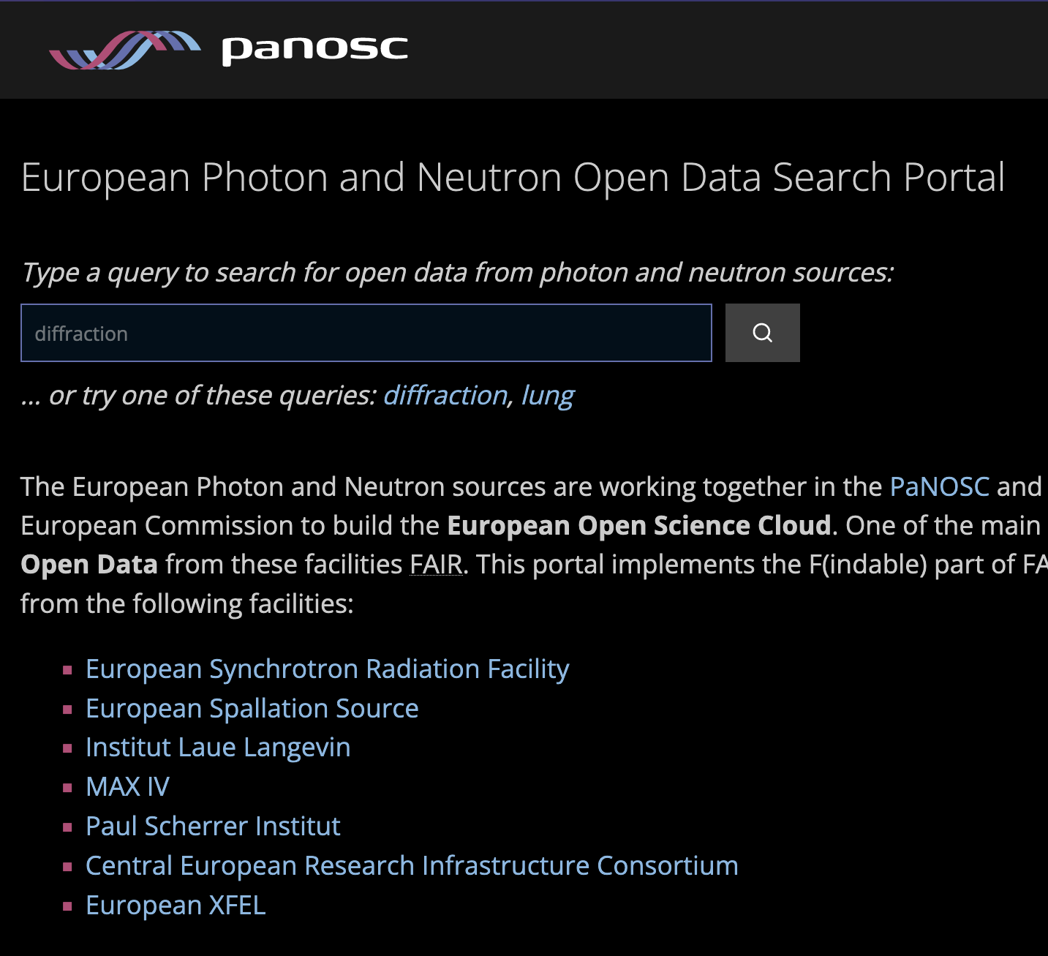
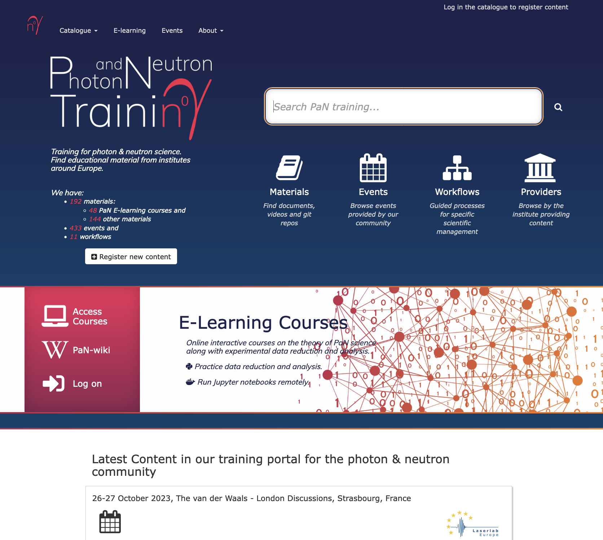
Community services

