Slide 1
HCI Lecture 1b
WPF
HCI Lecture 1b

Slide 2
Introducing WPF
Windows Presentation Foundation (WPF) is a presentation system for building client applications in the Windows operating system.
We can use WPF to build a range of Windows-based applications, from a simple word processor or media player to an enterprise-level, line-of-business application.
WPF is a graphical subsystem in .NET Framework 3.0 and is included with Windows Vista and Windows Server 2008 and is also available for Windows XP SP2 or later.
MM Lecture 1b

Slide 3
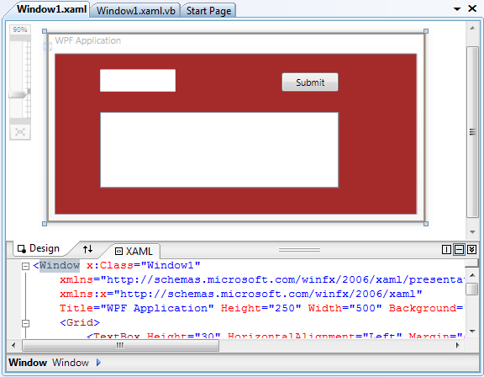
Introducing WPF
Zone Control
Split Mode
Design Pane
XAML Pane
Swap Pane
MM Lecture 1b

Slide 4
Introducing WPF
WPF uses the DirectX graphics engine to provide graphics and rendering.
WPF uses a markup language Extensible Application Markup Language (XAML) for user interface development.
WPF can be used to create stand-alone applications and applications that are hosted in a Web browser
WPF has a built-in set of data services enabling application developers to bind and manipulate data within applications.
MM Lecture 1b

Slide 5
Introducing WPF
WPF supports vector-based graphics. It includes support for two-dimensional graphics, three-dimensional graphics, and animations.
WPF supports 3D model rendering and interaction in 2D applications.
WPF supports the display of images in most common images formats
WPF supports the playing of audio and video files in common formats and supports all codecs installed for Windows Media Player.
MM Lecture 1b

Slide 6
XAML
XAML is a markup language for declarative application programming. It is typically used to create windows, dialog boxes, pages, and user controls, and to fill them with controls, shapes, and graphics. We store the XAML for our applications in files that have the .xaml extension
We can use XAML to make it easier to create UIs (by using the .NET Framework programming model).
We use declarative XAML markup to implement the UI elements of an application while we use managed programming languages (code-behind) to implement its behavior.
MM Lecture 1b

Slide 7
XAML
XAML is case sensitive
XAML enables the collaboration between designers and developers.
  Designers can use design or drawing tools (such as Microsoft Expression Design and Adobe Illustrator) to create the UIs and then export them as XAML
  Developers can develop business logics based on the XAML file.
Visual Studio 2008 has a visual editor for creating WPF applications featuring an XAML text editor with intelliSense, layout and document navigation.
MM Lecture 1b

Slide 8
Element Tree
In WPF applications, user interface elements are organized in a hierarchical structure that is known as the element tree.
Routed events can propagate up or down the element tree.
We can take advantage of routed events to write code efficiently.
MM Lecture 1b

Slide 9
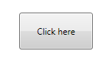
Handling Events
To handle WPF control events, we have to first specify the event handler for the control in the XAML file and then implement the event handler in Visual Basic.NET, Visual C# or any other language supported by the .NET Framework in the code-behind file.
Example : Specify an event handler for the Click event of a button in the XAML file
  <Button Name="Button1" Click="Button1_Click">
  Click here
  </Button>
MM Lecture 1b

Slide 10
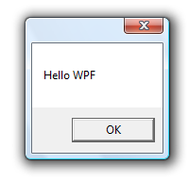
Handling Events
Example : Implement an event handler for the Click event of a button in the code-behind file.
  [Visual C#]
  public void Button1_Click(object sender, RoutedEventArgs e)
  {
  MessageBox.Show("Hello WPF");
  }
  [Visual Basic]
  Private Sub Button1_Click(ByVal sender As Object, ByVal e
  As RoutedEventArgs)
  MessageBox.Show("Hello WPF")
  End Sub
MM Lecture 1b

Slide 11
Layout
Canvas : Child controls provide their own layout.
DockPanel : Child controls are aligned to the edges of the panel.
Grid : Child controls are positioned by rows and columns.
StackPanel : Child controls are stacked either vertically or horizontally.
VirtualizingStackPanel : Child controls are virtualized and arranged on a single line that is either horizontally or vertically oriented.
WrapPanel : Child controls are positioned in left-to-right order and wrapped to the next line when there are more controls on the current line than space allows.
MM Lecture 1b

Slide 12
The Grid Layout
A Grid aligns all elements into a grid that covers the whole area of the panel.
Grids allow consistent positioning from one row to the next.
A Grid needs to know how many columns and rows are required and these can be specified by a series of ColumnDefinition and RowDefinition at the start.
Each element in the grid has its column and row specified explicitly using attached properties Grid.Column and Grid.Row with a zero-based numbering scheme.
MM Lecture 1b

Slide 13
The Grid Layout
<Window x:Class="Window1“
xmlns="http://schemas.microsoft.com/winfx/2006/xaml/presentation"
xmlns:x="http://schemas.microsoft.com/winfx/2006/xaml"
Title="Grid Demo" Height="300" Width="300">
<Grid>
<Grid.RowDefinitions>
<RowDefinition /> <RowDefinition /> <RowDefinition />
</Grid.RowDefinitions>
<Grid.ColumnDefinitions>
<ColumnDefinition />
<ColumnDefinition />
<ColumnDefinition />
</Grid.ColumnDefinitions>
MM Lecture 1b

Slide 14
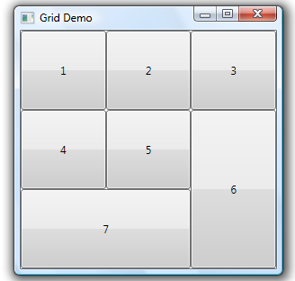
The Grid Layout
<Button Grid.Row="0" Grid.Column="0">1</Button>
<Button Grid.Row="0" Grid.Column="1">2</Button>
<Button Grid.Row="0" Grid.Column="2">3</Button>
<Button Grid.Row="1" Grid.Column="0">4</Button>
<Button Grid.Row="1" Grid.Column="1">5</Button>
<Button Grid.Row="1" Grid.Column="2"
Grid.RowSpan="2">6</Button>
<Button Grid.Row="2" Grid.Column="0"
Grid.ColumnSpan="2">7</Button>
</Grid>
</Window>
MM Lecture 1b

Slide 15
The Grid Layout
The width of a column and height of a row can be set to auto so that it can be automatic size.
  <Grid.RowDefinitions>
  <RowDefinition Width=“Auto”/>
  <RowDefinition />
  </Grid.RowDefinitions>
  <Grid.ColumnDefinitions>
  <ColumnDefinition Width=“Auto”/>
  <ColumnDefinition Width=“Auto”/>
  </Grid.ColumnDefinitions>
Cells in a grid can span across more than one column or one row by the Grid.ColumnSpan and Grid.RowSpan properties
  Grid.RowSpan="2“
  Grid.ColumnSpan=“3"
MM Lecture 1b

Slide 16
The StackPanel Layout
A StackPanel arranges its child elements in a row or in a column.
It is most useful for arranging small subsections but not the whole user interface.
The default behavior of a vertical StackPanel is to make all the controls as wide as the panel. Likewise, a horizontal StackPanel will make all the controls the same height.
MM Lecture 1b

Slide 17
The StackPanel Layout
<Window x:Class="Window1“
xmlns="http://schemas.microsoft.com/winfx/2006/xaml/presentation"
xmlns:x="http://schemas.microsoft.com/winfx/2006/xaml"
Title="StackPanel Demo" Height="300" Width="300">
<StackPanel Background="Gold">
<TextBlock Margin="4">Search for:</TextBlock>
<ComboBox Margin="4"/>
<TextBlock Margin="4">Filtered by:</TextBlock>
<ComboBox Margin="4"/>
<Button Margin="4,8" Foreground="red">Start Searching</Button>
<CheckBox Margin="8">Searching by Authors</CheckBox>
<CheckBox Margin="8">Searching by Titles</CheckBox>
<CheckBox Margin="8">Searching by Publishers</CheckBox>
</StackPanel>
</Window>
MM Lecture 1b

Slide 18
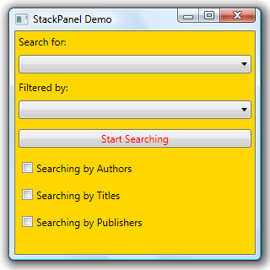
The StackPanel Layout
MM Lecture 1b

Slide 19
The StackPanel Layout
<StackPanel Margin="8" Orientation="Horizontal"> <Button MinWidth="93">OK</Button> <Button MinWidth="93" Margin="10,0,0,0">Cancel</Button> </StackPanel>
MM Lecture 1b

Slide 20
The DockPanel Layout
A DockPanel arranges each child element so that it fills a particular edge of the panel.
If multiple children are docked to the same edge, they simply stack up against that edge in order.
By default, the final child fills any remaining space not occupied by controls docked to the edges of the panel.
The DockPanel.Dock attribute is defined by DockPanel to allow elements inside the DockPanel to specify their positions.
MM Lecture 1b

Slide 21
The DockPanel Layout
<Window x:Class="Window1”
xmlns="http://schemas.microsoft.com/winfx/2006/xaml/presentation"
xmlns:x="http://schemas.microsoft.com/winfx/2006/xaml"
Title="DockPanel Demo" Height="300" Width="300">
<DockPanel>
<Button DockPanel.Dock="Top" Foreground="Blue" >Top</Button>
<Button DockPanel.Dock="Bottom“
Foreground="Blue">Bottom</Button>
<Button DockPanel.Dock="Left" Foreground="Blue">Left</Button>
<Button DockPanel.Dock="Right" Foreground="Blue">Right</Button>
<Button>Fill</Button>
</DockPanel>
</Window>
MM Lecture 1b

Slide 22
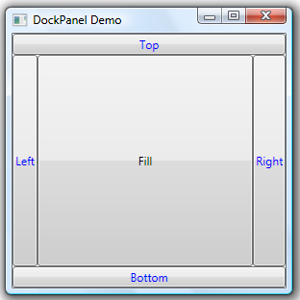
The DockPanel Layout
MM Lecture 1b

Slide 23
The Canvas Layout
A Canvas allows the location of the child elements to be specified precisely relative to the edges of the canvas.
A Canvas simply put things where it is told
A Canvas will not resize elements to fill the available space.
MM Lecture 1b

Slide 24
The Canvas Layout
<Window x:Class="Window1“
xmlns="http://schemas.microsoft.com/winfx/2006/xaml/presentation"
xmlns:x="http://schemas.microsoft.com/winfx/2006/xaml"
Title="Canvas Demo" Height="300" Width="300 "
  Background="Black" >
<Canvas Background="PowderBlue" Width="200" Height="200">
<TextBlock Canvas.Left="50" Canvas.Top="20">Hello</TextBlock>
<TextBlock Canvas.Right="50"
  Canvas.Bottom ="20">World!</TextBlock>
<Button Canvas.Left="80" Canvas.Top="80"
Foreground="red" >Click me</Button>
</Canvas>
</Window>
MM Lecture 1b

Slide 25
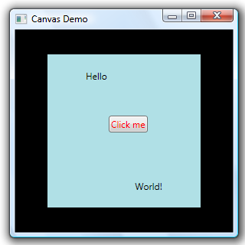
The Canvas Layout
MM Lecture 1b

Slide 26
2D Shapes
WPF provides a library of common vector-drawn 2-D shape objects such as the rectangles and ellipses, which are ready to use.
A Shape is a type of UIElement that enables you to draw a shape to the screen.
Common shapes:
  Rectangle
  Ellipse
  Line
  Polyline
  Polygon
  Path
MM Lecture 1b

Slide 27
2D Shapes
Shape objects share the following common properties
  Stroke : Describes how the shape's outline is painted.
  StrokeThickness: Describes the thickness of the shape's outline.
  Fill : Describes how the interior of the shape is painted.
  Data properties to specify coordinates and vertices, measured in device-independent pixels.
The shapes are primitives that act as elements in the user interface tree.
MM Lecture 1b

Slide 28
Rectangle
<Window x:Class="Window1"
xmlns="http://schemas.microsoft.com/winfx/2006/xaml/presentation"
xmlns:x="http://schemas.microsoft.com/winfx/2006/xaml"
Title="Rectangles" Height="250" Width="380">
<Canvas>
<Rectangle Canvas.Left="20" Canvas.Top="20"
Width="300" Height="180" Fill="ForestGreen" />
<Rectangle Canvas.Left="50" Canvas.Top="50"
Width="100" Height="40" Stroke="Black" Fill="Yellow" />
<Rectangle Canvas.Left="50" Canvas.Top="100"
Width="100" Height="40"
Stroke="Black" StrokeThickness="5" Fill="orange" />
MM Lecture 1b

Slide 29
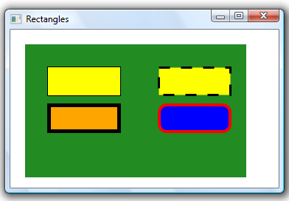
Rectangle
<Rectangle Canvas.Left="200" Canvas.Top="50"
Width="100" Height="40"
Stroke="Black" StrokeDashArray="5"
StrokeThickness="3" Fill="Yellow" />
<Rectangle Canvas.Left="200" Canvas.Top="100"
Width="100" Height="40"
Stroke="red" StrokeThickness="4" Fill="Blue"
RadiusX="10" RadiusY="10" />
</Canvas>
</Window>
MM Lecture 1b

Slide 30
Rectangle
The Width and Height attributes define the width and the height of the rectangle.
The RadiusX and the RadiusY attributes rounds the corners of the rectangle.
The Fill property defines the fill color of the rectangle.
The Stroke attribute defines the color of the border of the rectangle.
The StrokeThickness attribute defines the width of the border of the rectangle.
MM Lecture 1b

Slide 31
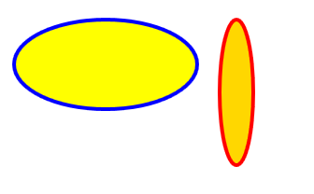
Ellipse
<Canvas Height="350" Width="350">
<Ellipse Canvas.Top="100"
Fill="Yellow" Height="100" Width="200"
StrokeThickness="4" Stroke="Blue"/>
<Ellipse Canvas.Top="100" Canvas.Left="220"
Fill="Gold" Height="160" Width="40"
StrokeThickness="4" Stroke="Red"/>
</Canvas>
MM Lecture 1b

Slide 32

Line and Polyline
<Canvas Height="500" Width="500">
<Polyline Stroke="Blue" StrokeThickness ="10"
Points="50,200 100,200 100,120 150,120 150,200 200,200" />
<Line
X1="300" Y1="200“ X2="400" Y2="100"
Stroke="Red" StrokeThickness="6" />
<Line
X1="300" Y1="100“ X2="400" Y2="200"
Stroke="Red" StrokeThickness="6" />
</Canvas>
MM Lecture 1b

Slide 33
Line and Polyline
<Line>
  The X1 attribute defines the start of the line on the x-axis
  The Y1 attribute defines the start of the line on the y-axis
  The X2 attribute defines the end of the line on the x-axis
  The Y2 attribute defines the end of the line on the y-axis
<Polyline>
  The Points attributes defines the x- and y-coordinates of each points of the polyline
MM Lecture 1b

Slide 34

Polygon
<Canvas Height="500" Width="500">
<Polygon Fill="Yellow" Stroke="Blue" StrokeThickness ="10"
Points="50,250 100,200 100,120 150,120 150,200 200,250"/>
<Polygon Fill="Red" Stroke="Blue" StrokeThickness="10"
Points="350,75 379,161 469,161 397,215 423,301 350,250
277, 301 303,215 231,161 321,161"/>
</Canvas>
MM Lecture 1b

Slide 35
Path
The Path object can draw closed or open shapes, multiple shapes, and even curved shapes.
The following commands are available for path data:
  M = Move
  L = Line
  H = Horizontal line
  V = Vertical line
  C = Bezier curve
  S = Smooth Bezier curve
  Q = Quadratic Bezier curve
  T = smooth quadratic Bezier curve
  A = Elliptical arc
  Z = Close path
MM Lecture 1b

Slide 36

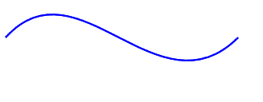
Path
<Canvas Height="350" Width="350">
<Path Data="M 50 50 L 100 150 150 50 Z" Fill="Red"
Stroke="Blue" StrokeThickness="2" />
</Canvas>
<Path Stroke="Blue" StrokeThickness="2"
Data="M 10 200 C 100 100 200 300 300 200" />
MM Lecture 1b

Slide 37
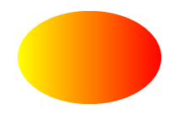
Linear Gradient
<Window x:Class="Window1"
xmlns="http://schemas.microsoft.com/winfx/2006/xaml/presentation"
xmlns:x="http://schemas.microsoft.com/winfx/2006/xaml"
Title="Linear Gradient" Height="300" Width="300">
<Canvas Height="300" Width="300">
<Ellipse Width="200" Height="100">
<Ellipse.Fill>
<LinearGradientBrush StartPoint="0,0.5" EndPoint="1,0.5">
<GradientStop Color="Yellow" Offset="0.0" />
<GradientStop Color="Orange" Offset="0.5" />
<GradientStop Color="Red" Offset="1.0" />
</LinearGradientBrush>
</Ellipse.Fill>
</Ellipse>
</Canvas>
</Window>
MM Lecture 1b

Slide 38
Linear Gradient
A LinearGradientBrush paints an area with a linear gradient.
A linear gradient defines a gradient along a line. The line's end points are defined by the StartPoint and EndPoint properties of the linear gradient. A LinearGradientBrush brush paints its GradientStops along this line.
The color range for a gradient can be composed of two or more colors. Each color is specified with a <GradientStop> element. The offset attribute is used to define where the gradient color begin and end.
MM Lecture 1b

Slide 39
Image Display
The Image element can be used to display images in WPF by setting its Source property correctly.
The Image element is able to resize the image depending on the layout of the application. If the layout provides the Image element with a specific amount of space, by default the image will be scaled to fill that space.
The default scaling behavior is to use the same scaling factor horizontally and vertically.
MM Lecture 1b

Slide 40
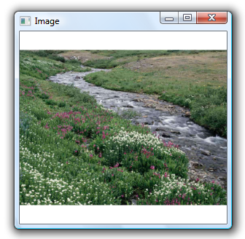
Image Display
<Window x:Class="Window1"
xmlns="http://schemas.microsoft.com/winfx/2006/xaml/presentation"
xmlns:x="http://schemas.microsoft.com/winfx/2006/xaml"
Title="Image" Height="300" Width="300">
<Grid>
<Image Source="f:\Creek.jpg" />
</Grid>
</Window>
MM Lecture 1b

Slide 41
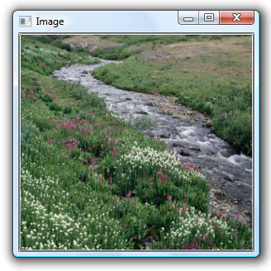
Image Display
<Window x:Class="Window1"
xmlns="http://schemas.microsoft.com/winfx/2006/xaml/presentation"
xmlns:x="http://schemas.microsoft.com/winfx/2006/xaml"
Title="Image" Height="300" Width="300">
<Button >
<Button.Background>
<ImageBrush ImageSource="f:\Creek.jpg" />
</Button.Background>
</Button>
</Window>
MM Lecture 1b

Slide 42
Image Display
The Stretch property controls how an image is stretched to fill its container. It accepts the following values: None, Fill, Uniform, UniformToFill.
None : The image is not stretched to fill the output area. If the image is larger than the output area, the image is clipped what does not fit.
Uniform : The image is scaled so that it fits completely within the output area. The image's aspect ratio is preserved.
MM Lecture 1b

Slide 43
Image Display
UniformToFill : The image is scaled so that it completely fills the output area while preserving the image's original aspect ratio.
Fill : The image is scaled to fit the output area. Because the image height and width are scaled independently, the original aspect ratio of the image might not be preserved.
MM Lecture 1b

Slide 44
Image Display
<Window x:Class="Window1"
xmlns="http://schemas.microsoft.com/winfx/2006/xaml/presentation"
xmlns:x="http://schemas.microsoft.com/winfx/2006/xaml"
Title="Images" Height="420" Width="420">
<Grid>
<Grid.ColumnDefinitions>
<ColumnDefinition Width="200" />
<ColumnDefinition Width="200" />
</Grid.ColumnDefinitions>
<Grid.RowDefinitions>
<RowDefinition Height="200"/>
<RowDefinition Height="200"/>
</Grid.RowDefinitions>
MM Lecture 1b

Slide 45
Image Display
<Border Grid.Row="0" Grid.Column="0" BorderBrush="Black"
BorderThickness=" 1" >
<Image Source="f:\sampleImages\Toco Toucan.jpg" Stretch="None"/>
</Border>
<Border Grid.Row="0" Grid.Column="1" BorderBrush="Black"
BorderThickness=" 1" >
<Image Source="f:\sampleImages\Toco Toucan.jpg" Stretch="Uniform" />
</Border>
<Border Grid.Row="1" Grid.Column="0" BorderBrush="Black"
BorderThickness=" 1" >
<Image Source="f:\sampleImages\Toco Toucan.jpg" Stretch="UniformToFill"/>
</Border>
<Border Grid.Row="1" Grid.Column="1" BorderBrush="Black“
BorderThickness=" 1" >
<Image Source="f:\sampleImages\Toco Toucan.jpg" Stretch="Fill"/>
</Border>
</Grid>
</Window>
MM Lecture 1b

Slide 46
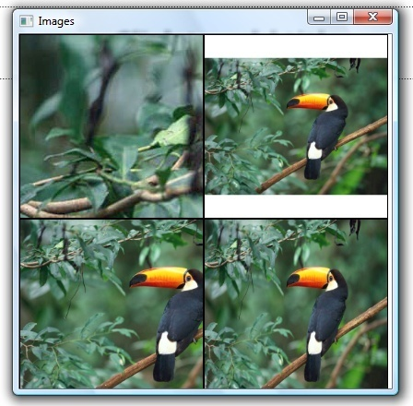
Toco Toucan.jpg is an image of size 1024 × 768
None
Uniform
UniformToFill
Fill
MM Lecture 1b

Slide 47
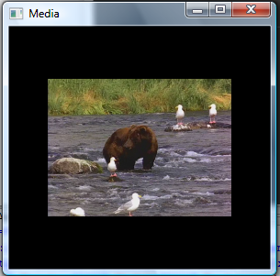

Simple Media Playback
The easiest way to play video and audio media in WPF is to use the MediaElement, pointing its Source property at the media file to be played.
e.g.
<MediaElement
Source="media/Bear.wmv"
Width="200"
Height= ="200“ />.
By default, the MediaElement
will resize video content to
match the space available.
MM Lecture 1b

Slide 48
Simple Media Playback
The MediaElement will play the material as soon as it loads.
To control the progress of playing the media, we can use the LoadBehavior property. The default value of the LoadBehavior property is Play.
When the LoadBehavior property is set to Manual, we can use Play, Pause, Stop methods to control the media element from the code-behind file.
MM Lecture 1b

Slide 49
References
Introduction to WPF
  http://msdn.microsoft.com/en-us/library/aa970268.aspx
  http://www.wpftutorial.net/GettingStarted.html
  http://windowsclient.net/wpf/
WPF in Visual Studio 2008
  http://www.codeguru.com/csharp/.net/net_wpf/article.php/c16005/
  http://www.codeguru.com/vb/gen/vb_general/miscellaneous/article.php/c16005/
  http://msdn.microsoft.com/en-us/library/ms748248.aspx
MM Lecture 1b

