Slide 1

G2M insight for Cab Investment firm
Virtual Internship 2021
Jaime Leon

Slide 2
Contents
The process of data analysis
Quantitative messages
Techniques for analyzing quantitative data
Analytical activities of data users
Barriers to effective analysis
Other topics
Practitioner notes
Free software for data analysis
International data analysis contests

Slide 3
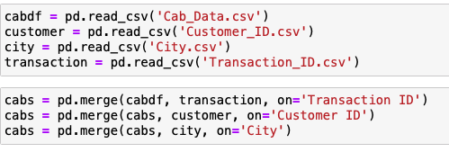
Data Exploration
19 Features
Timeframe of the data: 2016-01-31 to 2018-12-31
Total data points: 359392

Slide 4
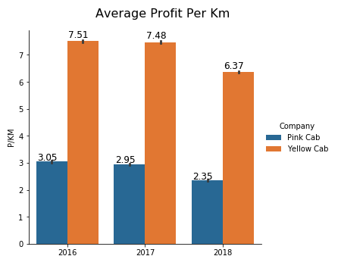
Profit Analysis
We can see clearly that Yellow Cab Company has more than double the Average profit per km from 2016 to 2018

Slide 5
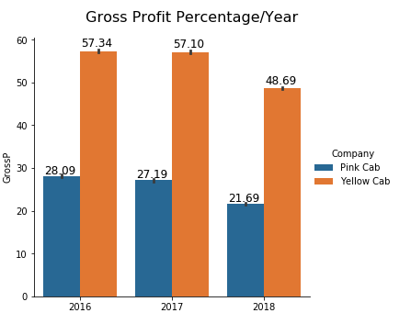
Gross Profit Percentage/Year
We can see that Yellow Cab company has double the profit percentage average per year than Pink Cab

Slide 6
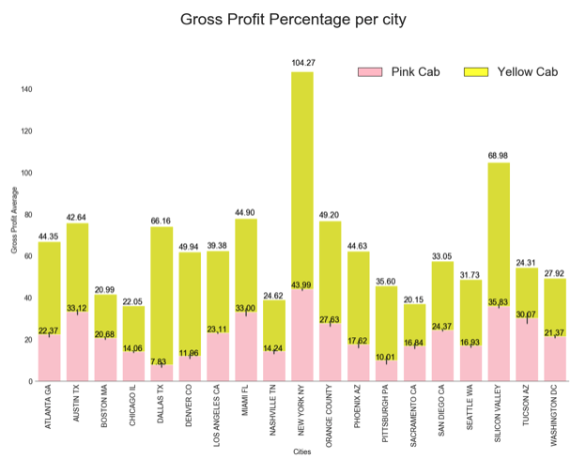
Gross Profit Percentage Per City
Here, we can see the gross profit average per city from each company, we can see that the Yellow Cab company has better gross profit percentage in every city but Tucson, Az.
Notes:
Consider talking about:
Confusing fact and opinion
Cognitive biases
Innumeracy

Slide 7
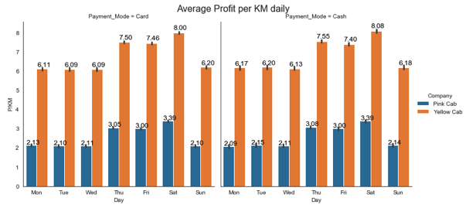
Average Profit per KM daily
Here, we can see the average profit per km daily(from Monday through Sunday).
We can see that the days the companies gain more profit is on Saturdays.
Notes:
Consider talking about:
Smart buildings
Analytics and business intelligence
Education

Slide 8
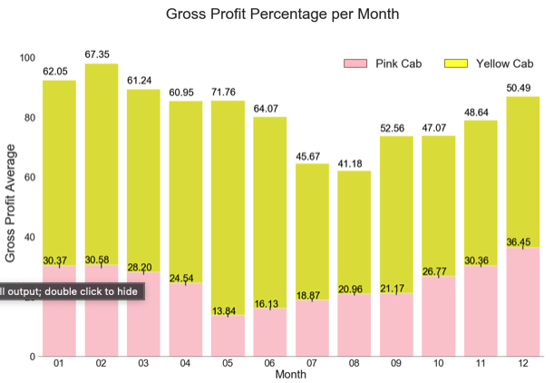
Here, we can see that the month with the most Gross Profit for the Yellow Cab company is May, and for the Pink Cab company is December

Slide 9
Age group
Notes:
Consider talking about:
Initial data analysis
Main data analysis

Slide 10
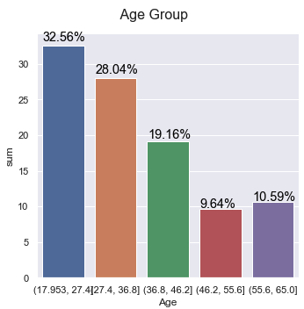
Age Group for GrossProfit
The age group for the whole data set are mostly people within 18-27 years old with a 32. 56%, followed by 27-36 years old with 28.04%.

Slide 11
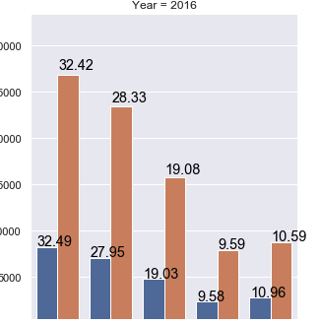
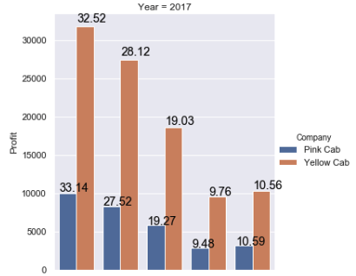
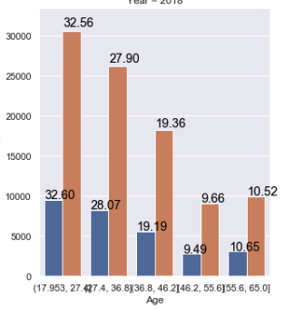
% of users through the years.
% of Number of people through the years within different group ages.
We can see that in 2018, the amount of people within 36-46 years old increased by .36% for the Yellow Cab company.

Slide 12
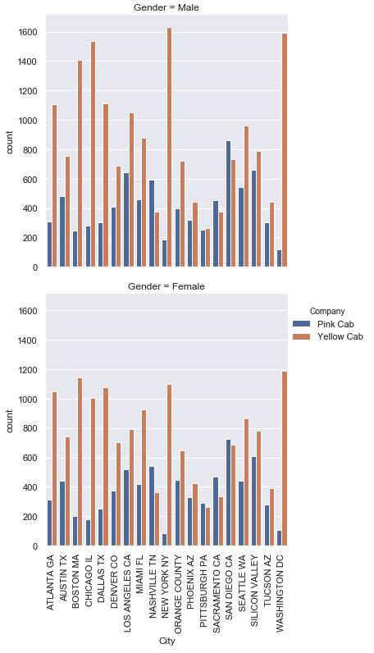
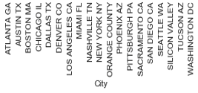
Amount of people per city divided by gender
In the following graphs we can see the amount of people each city has divided by gender.

Slide 13
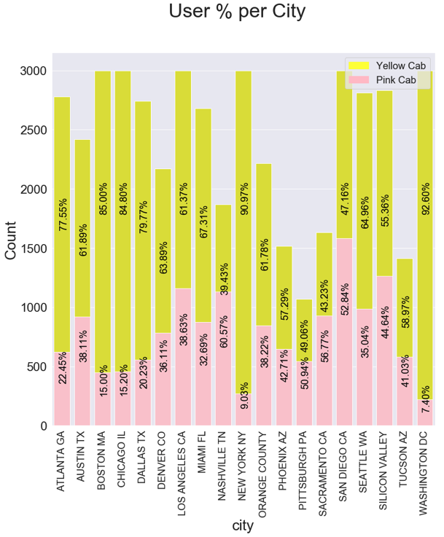
Unique User % Per City
In the following graph we show the % total amount of unique users (no duplicates) for each city, we can see that In most cities Yellow Cab Company predominates over the Pink Company, except on cities like Sacramento CA, Sand Diego CA and Nashville TN.

Slide 14
Conclusions
Following the previous analysis about both cab companies we can see clearly that the Yellow Cab company is a much better investment, since it has better profits, gross profits, not only per year but in most cities, the Yellow Cab Company also has the most users in every city, which makes him a better candidate to grow.

Slide 15
REFERENCES
GIT HUB REPOSITORY WITH JUPYTER NOTBEOOK:
https://github.com/LEON240196/DataGlacier/blob/main/Cabs/Cabs_project.ipynb

