Slide 1
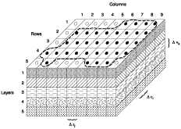
Flopy
Version 3

