Slide 1
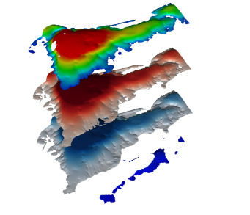
FloPy₃
a Python package to create, run, and post-process MODFLOW-based models

