Slide 1
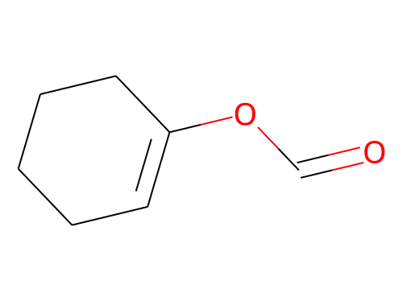
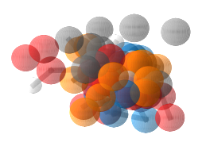
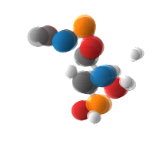
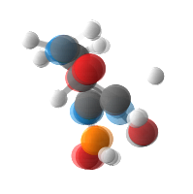
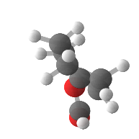







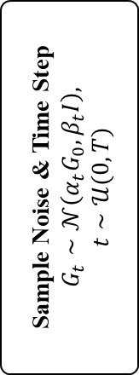





Structure of denoising kernel
Sample Noise & Time Step
$$G_{t}∼𝒩\left(α_{t}G_{0},β_{t}I\right),$$
$$t∼𝒰(0, T)$$
E(n) Equivariant Denoising Kernel
Training Objectives
$$X_{t}$$
$$A_{t}$$
$$V_{t}$$
$$t$$
$${\hat{X}}_{t}$$
$${\hat{A}}_{t}$$
$${\hat{V}}_{t}$$
Atom Features
Fuse Embeddings
Dual-track Transformer Network
Basic Loss
Pair-wise Distance Features
$$+$$
$λ⋅$GFLoss
$$P_{t}$$
Geometry Calculation
Triplet-wise Angle Features
Fuse Embeddings
$${\hat{P}}_{t}$$
$$G_{T}$$
…
$$G_{t}$$
$$p_{θ}(G_{t−1}|G_{t})$$
$$G_{t−1}$$
…
$$G_{0}$$
$$q(G_{t}|G_{t−1})$$

Slide 2










Structure of DTN
Atom Features
Atom-wise Attention
Feed Forward
Atom Features
$$×L$$
$$⨁$$
$$⨁$$
Pair-wise Features
Pair-wise Features
$$⨁$$
Connection
Module
Pair-wise Features
Triplet-wise
Features
Triplet-wise
Features
Pair-wise Attention
$$⨁$$
Feed Forward
$$⨁$$
Connection Module
$$d_{ij}$$
$$P_{t}$$
E(n) Position Update Module
$$P_{t}$$
Geometry
Calculation
$$φ_{ijk}$$

Slide 3



Structure of GFLoss
$${\hat{X}}_{t}$$
$${\hat{A}}_{t}$$
…
…
Atom Types
Pair-wise
Atom Types
$${\hat{P}}_{t}$$
…
Bond Predictions
Pair-wise
Distances
$${\hat{V}}_{t}$$
Valencies
…
GFLoss

Slide 4
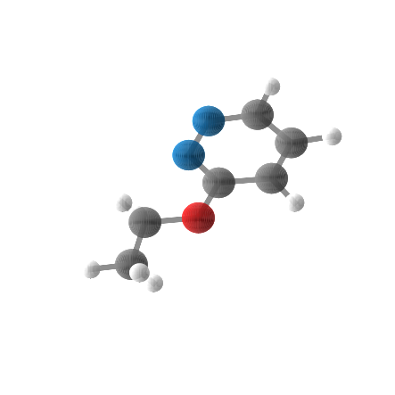
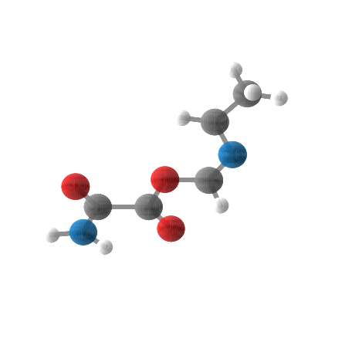
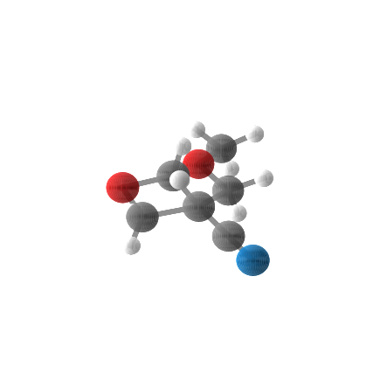
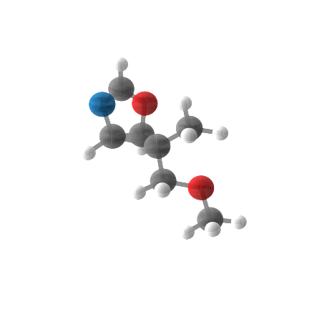
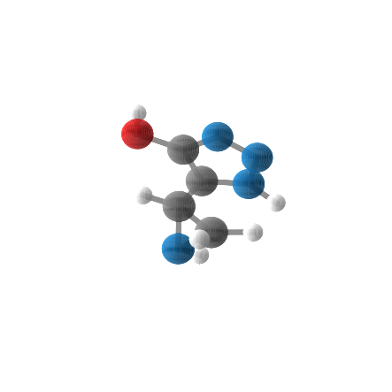
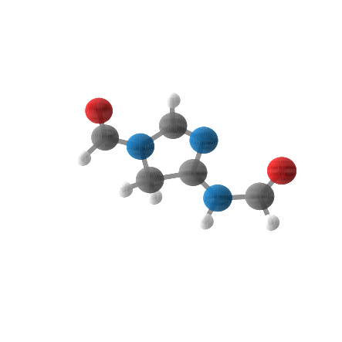
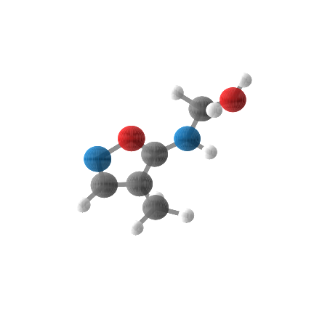
Samples for QM9

Slide 5
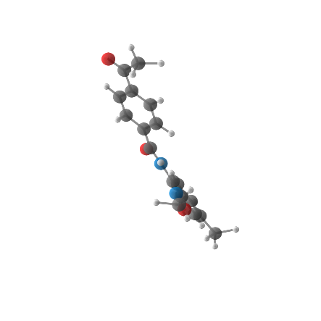
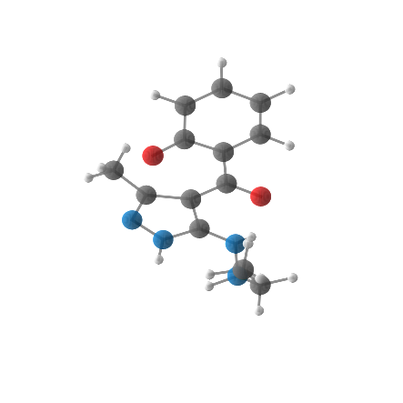
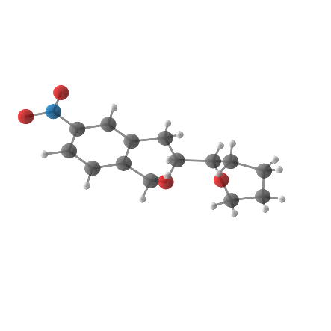
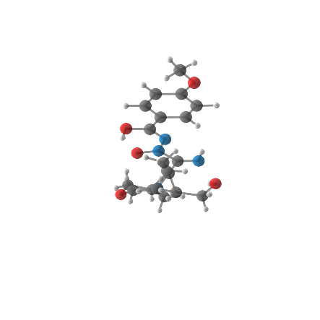
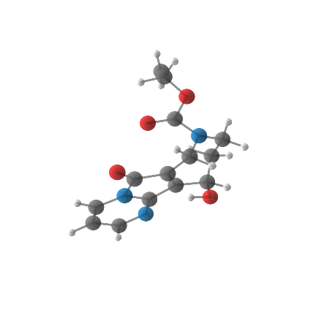
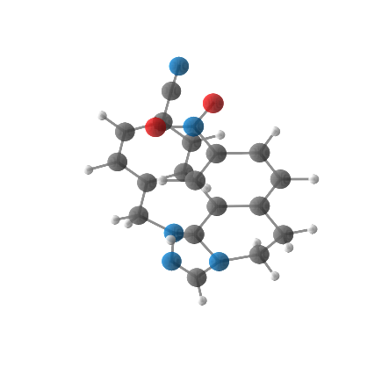
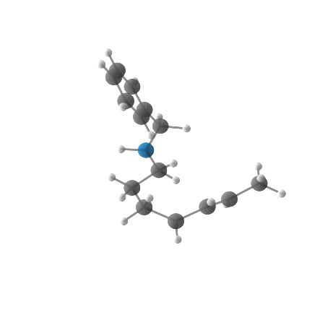
Samples for Drugs

Slide 6
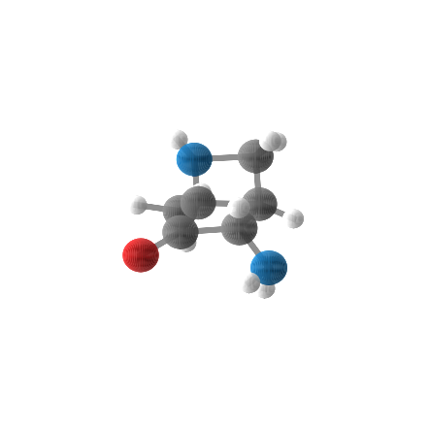
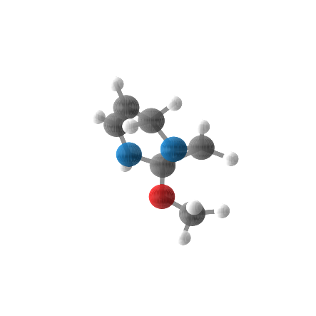
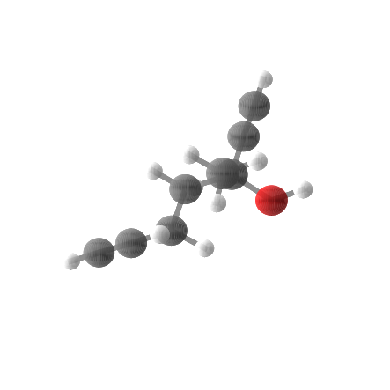
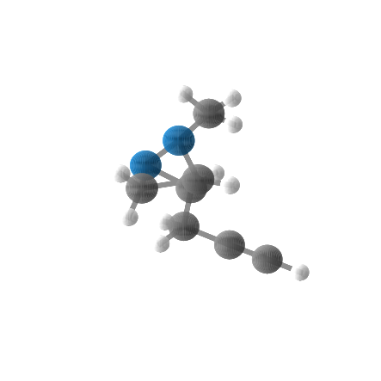
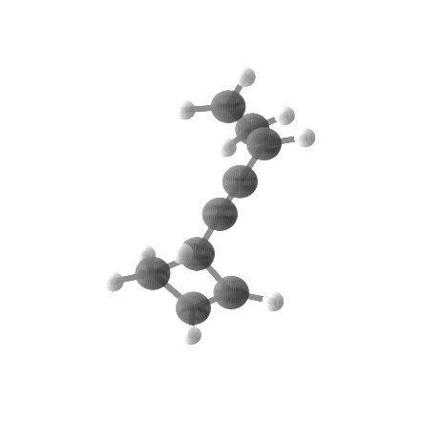
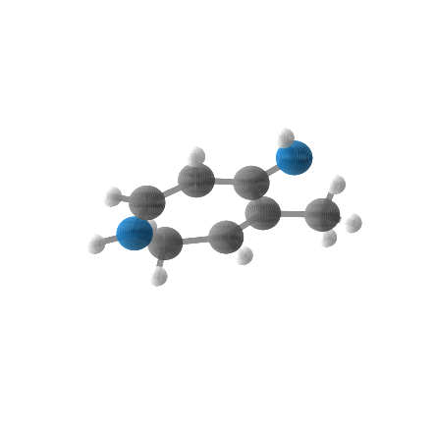
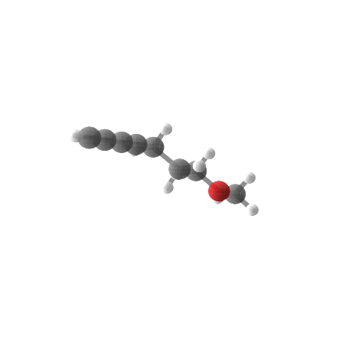
Samples for QM9 (Conditional)
$$α=77.1$$
$$α=80.6$$
$$α=84.1$$
$$α=87.6$$
$$α=91.1$$
$$α=94.6$$
$$α=98.1$$

Slide 7

Molecular learning
Feed Forward
Feed Forward
Feed Forward
$$⨁$$
Feed Forward
Feed Forward
Connection
Module
Pair-wise Features
Triplet-wise
Features
$$P_{t}$$

Slide 8
Structure of DTN
Atom Features
Atom-wise Attention
Feed Forward
Atom Features
$$×L$$
$$⨁$$
$$⨁$$
Pair-wise Features
Pair-wise Features
$$⨁$$
Connection
Module
Pair-wise Features
Triplet-wise
Features
Triplet-wise
Features
Pair-wise Attention
$$⨁$$
Feed Forward
$$⨁$$
Connection Module
$$d_{ij}$$
$$P_{t}$$
E(n) Position Update Module
$$P_{t}$$
Geometry
Calculation
$$φ_{ijk}$$

Slide 9
Structure of DTN
Atom Features
Atom-wise Attention
Feed Forward
Atom Features
$$×L$$
$$⨁$$
$$⨁$$
Pair-wise Features
Pair-wise Features
$$⨁$$
Connection
Module
Pair-wise Features
Triplet-wise
Features
Triplet-wise
Features
Pair-wise Attention
$$⨁$$
Feed Forward
$$⨁$$
Connection Module
$$d_{ij}$$
$$P_{t}$$
E(n) Position Update Module
$$P_{t}$$
Geometry
Calculation
$$φ_{ijk}$$

Slide 10
Structure of DTN
Atom Features
Atom-wise Attention
Feed Forward
Atom Features
$$×L$$
$$⨁$$
$$⨁$$
Pair-wise Features
Pair-wise Features
$$⨁$$
Connection
Module
Pair-wise Features
Triplet-wise
Features
Triplet-wise
Features
Pair-wise Attention
$$⨁$$
Feed Forward
$$⨁$$
Connection Module
$$d_{ij}$$
$$P_{t}$$
E(n) Position Update Module
$$P_{t}$$
Geometry
Calculation
$$φ_{ijk}$$

Slide 11
Structure of DTN
Atom Features
Atom-wise Attention
Feed Forward
Atom Features
$$×L$$
$$⨁$$
$$⨁$$
Pair-wise Features
Pair-wise Features
$$⨁$$
Connection
Module
Pair-wise Features
Triplet-wise
Features
Triplet-wise
Features
Pair-wise Attention
$$⨁$$
Feed Forward
$$⨁$$
Connection Module
$$d_{ij}$$
$$P_{t}$$
E(n) Position Update Module
$$P_{t}$$
Geometry
Calculation
$$φ_{ijk}$$

Slide 13









Structure of DTN
Atom Features
Atom-wise Attention
Feed Forward
Atom Features
$$×L$$
$$⨁$$
$$⨁$$
Pair-wise Features
Pair-wise Features
$$⨁$$
Connection
Module
Pair-wise Features
Triplet-wise
Features
Triplet-wise
Features
Pair-wise Attention
$$⨁$$
Feed Forward
$$⨁$$
Connection Module
$$d_{ij}$$
$$P_{t}$$
E(n) Position Update
$$P_{t}$$
Geometry
Calculation
$$φ_{ijk}$$

Slide 14






Structure of denoising kernel
$$X_{t}$$
$$A_{t}$$
$$V_{t}$$
$${\hat{X}}_{t}$$
$${\hat{A}}_{t}$$
$${\hat{V}}_{t}$$
Atom Features
Fuse Embeddings
Dual-track Transformer Network
$$d_{ij}$$
Pair-wise Distance Features
$$P_{t}$$
Geometry Calculation
$$φ_{ijk}$$
Triplet-wise Angle Features
Fuse Embeddings
$${\hat{P}}_{t}$$

Slide 15






Structure of DTN
Atom Features
Pair-wise Features
Triplet-wise
Features
$$X_{t}$$
$$A_{t}$$
$$V_{t}$$
$${\hat{X}}_{t}$$
$${\hat{A}}_{t}$$
$${\hat{V}}_{t}$$
Atom Features
Fuse embeddings
Dual-track Transformer Network
$$d_{ij}$$
Pair-wise Distance Features
$$P_{t}$$
Geometry Calculation
$$φ_{ijk}$$
Triplet-wise Angle Features
Fuse embeddings
$${\hat{P}}_{t}$$

Slide 16
Structure of DTN
Atom Features
Atom-wise Attention
Feed Forward
Atom Features
$$×L$$
$$⨁$$
$$⨁$$
Pair-wise Features
Pair-wise Features
$$⨁$$
Connection
Module
Pair-wise Features
Triplet-wise
Features
Triplet-wise
Features
Pair-wise Attention
$$⨁$$
Feed Forward
$$⨁$$
Connection Module
$$d_{ij}$$
$$P_{t}$$
E(n) Position Update Module
$$P_{t}$$
Geometry
Calculation
$$φ_{ijk}$$

