Slide 1
CSIT 5410 (Spring 2020)
Assignment 2

Slide 2
Task 1 – Histogram Equalization
Part 1: Histogram Equalization on gray-level images
(sub-task 1, sub-task 2)
1. Given a gray level image G, compute and display its histogram. Note: you need to compute the histogram by yourself.
2. Perform histogram equalization on G, then compute and display the histogram of the result image.
M-files need to be completed:
myhistogram_eq.m for histogram equalization;
histogram_routine.m for other operations such as computing the histogram;
You may create your own m-files for other operations such as computing the histogram.

Slide 3
Task 1 – Histogram Equalization
Part 2: Histogram Equalization on color images in RGB modes
(sub-task 3, sub-task 4)
3. Given a color image C in RGB mode, perform histogram equalization on the R, G, B channels of C separately. Rebuild a RGB image from these histogram-equalized channels.
4. Compute the histograms on R, G, B channels separately and then calculate an average histogram from these three histograms. Use this average histogram as the basis to obtain a single-valued histogram equalization intensity transformation function. Apply this function to the R, G, B channels individually. Rebuild a RGB image from these processed channels.
M-files need to be completed:
histogram_routine.m;
You may create your own m-files for other operations.

Slide 4
Task 1 – Histogram Equalization
Part 2: Histogram Equalization on color images in RGB mode
Sub-task 3:
Histogram
Equalization
C_R: M x N
Separate
Histogram
Equalization
Rebuild
C_G: M x N
C: M x N x 3
C_EQ: M x N x 3
Histogram
Equalization
C_B: M x N

Slide 5
Task 1 – Histogram Equalization
Part 2: Histogram Equalization on color images in RGB mode
Sub-task 4:
Histogram
Equalization
Average
+
Histogram
Equalization
Rebuild
T(r)
C_EQ: M x N x 3
Histogram
Equalization

Slide 6
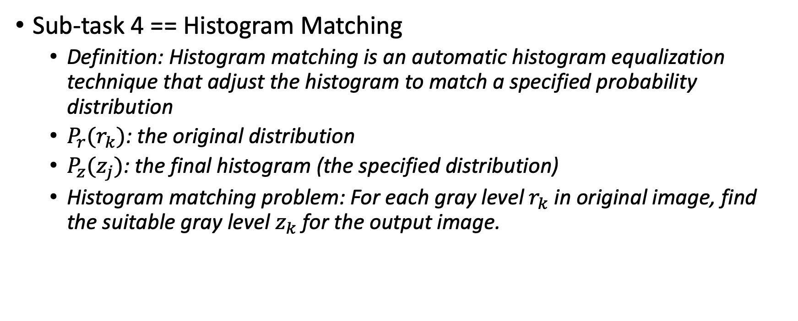
Task 1 – Histogram Equalization
Sub-task 4 == Histogram Matching
Definition: Histogram matching is an automatic histogram equalization technique that adjust the histogram to match a specified probability distribution
$P_{r}(r_{k})$: the original distribution
$P_{z}(z_{j})$: the final histogram (the specified distribution)
Histogram matching problem: For each gray level $r_{k}$ in original image, find the suitable gray level $z_{k}$ for the output image.

Slide 7
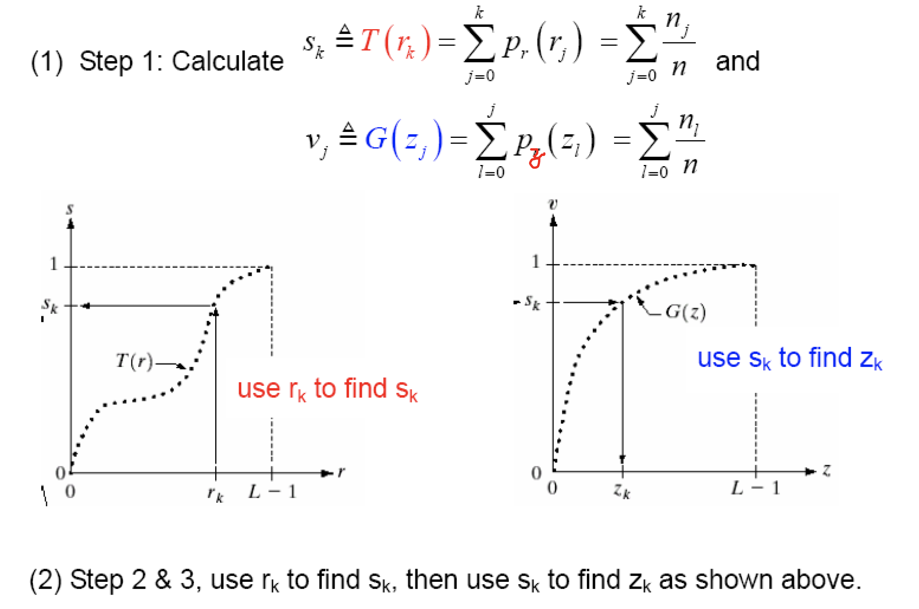
Task 1 – Histogram Equalization
Histogram Matching
z

Slide 8
Task 2 – Fisher Linear Discriminant
M-files need to be completed:
myfld.m classifies an input sample into either class 1 or class 2, from samples of class 1 (class1_samples) and samples of class 2 (class2_samples)
You must follow the descriptions given in the lecture notes.
In this assignment, you do not need to handle cases when the input of 'inv' function is a matrix which is badly scaled, singular or nearly singular.
All calculations are done using double-precision floating point.

Slide 9

Written Question
Topic: Registration
Find the transformation matrix
Find the intensity values of the transformed image using bilinear interpolation
Bilinear Interpolation: $g\left(x,y\right)=ax+by+cxy+d$, where a, b, c and d are coefficients.

Slide 10
Assignment Submission and Marking
1. Your submitted programs should be histogram_routine, myhistogram_eq, myfld and fld_routine plus all the other related M-files (plus README.txt file).
2. You must include a README.txt file indicating the programming software (Octave or MATLAB) that you are using for this assignment. By default, we will grade your assignment with Octave if the README.txt file is missing.
3. Runtime requirement: your program must be able to finish all the above tasks within 10 minutes.

Slide 11
Assignment Submission and Marking
4. You must compress all your files with the following filename format: [your 8-digit student ID]_assign2.rar (or zip), e.g. 09654321_assign2.rar, into one file.
5. If your assignment compressed file has been submitted multiple times before the due date (including late submission date), the new version will replace the old version in marking.
6. Note that we take plagiarism seriously. You are allowed to discuss or share your idea to your classmate, but you are not allowed to share your code/pseudocode of your assignment. Please also follow the referencing skills at https://libguides.ust.hk/referencing/plagiarism to avoid plagiarism.
7. Marks would be deducted if there are any violations of the above requirements.

Slide 12
Octave package installation
If you are using Octave, you need to install the image package.
>> pkg install -forge image
And load the image package by
>> pkg load image

Slide 13
Live Demo

