Slide 1
MOO method

Slide 2
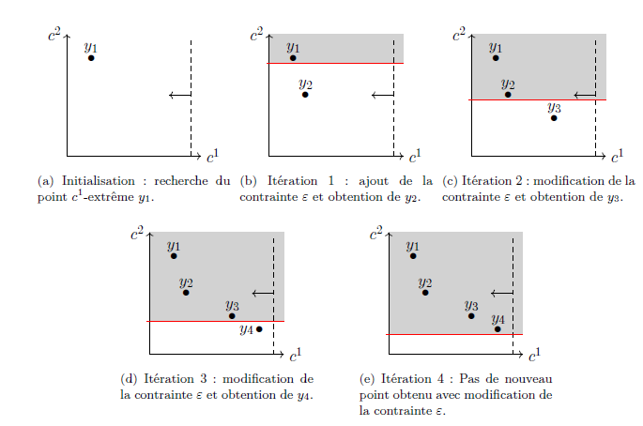
Simple limit (ex of FINE)
Only one objective function
Second one defined as a variable
Constraint on the varaible
Declining at every step

Slide 3
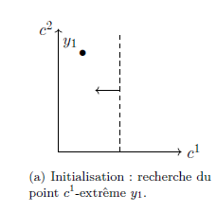
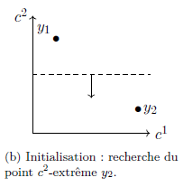
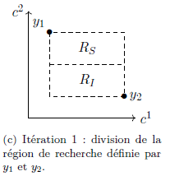
Sigma-constraint (ex of code from scratch)
Definition of functions A and B
Deactivation of function A, activation of function B
Optimization: max of function A registered
Activation of function A, deactivation of function B
Optimization: min of function A registered
Deactivation of function A, activation of function B
Optimization with constraint of function A between min and max
Plot of the Pareto front

Slide 4
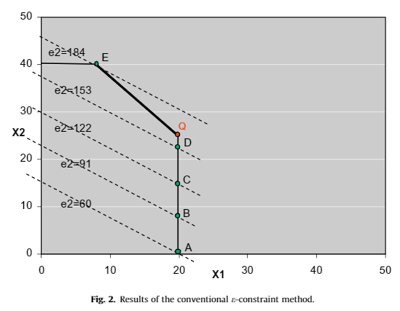
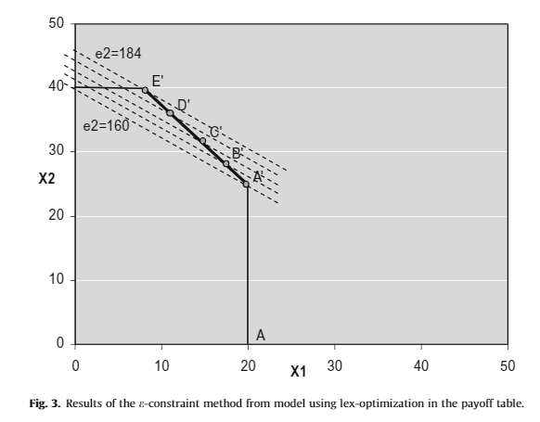
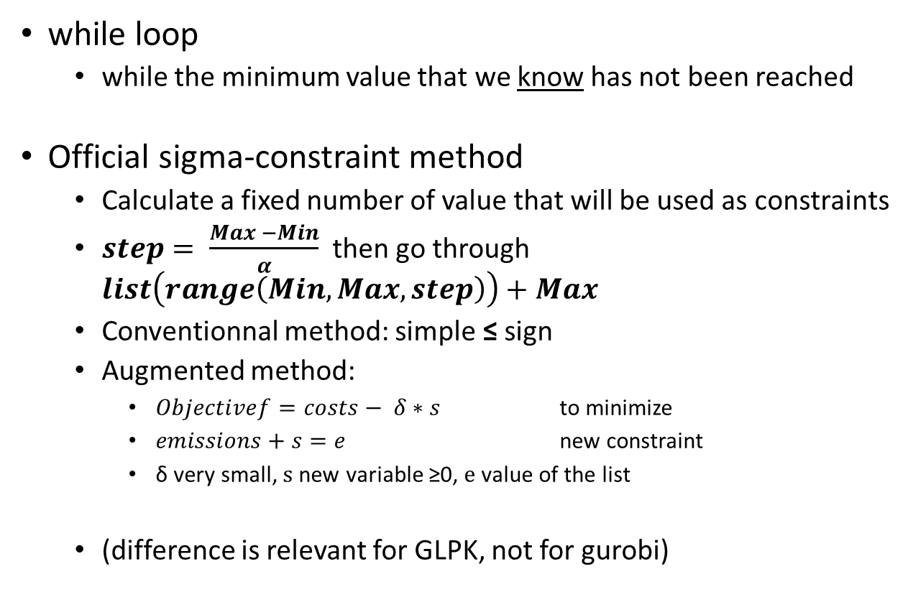
Sigma-constraint: different options
while loop
while the minimum value that we know has not been reached
Official sigma-constraint method
Calculate a fixed number of value that will be used as constraints
$step= \frac{Max −Min}{α}$then go through $list\left(range\left(Min, Max, step\right)\right)+Max$
Conventionnal method: simple ≤ sign
Augmented method:
$Objectivef=costs− δ∗s$ to minimize
$emissions+s=e$ new constraint
δ very small, s new variable ≥0, e value of the list
(difference is relevant for GLPK, not for gurobi)

Slide 5
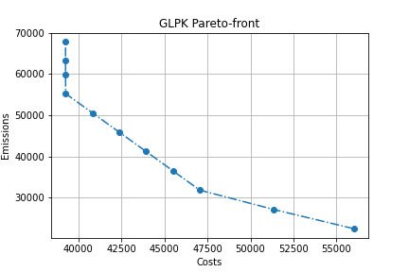
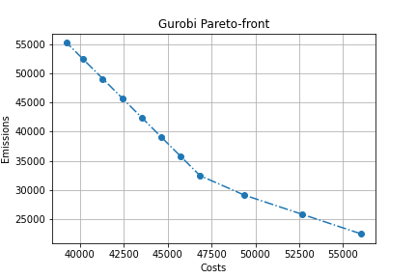
Augmented method of sigma-constraint
Augmented method with GLPK,
Both methods with Gurobi :
Conventionnal method with GLPK :

Slide 6
References
minimize - Multi-objective optimization example Pyomo - Stack Overflow
Effective implementation of the ε-constraint method in Multi-Objective Mathematical Programming problems | Elsevier Enhanced Reader
Méthodes exactes pour les problèmes combinatoires bi-objectif : Application sur les problèmes de tournées de véhicules - TEL - Thèses en ligne (archives-ouvertes.fr)

