Slide 1
Modeling progress
27.05.2021

Slide 2
Case-study
2 buildings on 24h
Electricity
Domestic hot water
Heat space
2 inputs
Electricity grid
Fuel (natural gas)
2 converters
Heat pump
CHP
2 storages
Battery
Hot water storage

Slide 3
Pyomo operation
Model creation | ConcreteModel() or AbstractModel().
Sets definition | Lists of “things” that define the problem.
Parameters definition | Inputs data.
Variables definition | Variables that will be optimized.
Constraints definition
Objective function creation | Defined as a constraint. Can be maximized or minimized, no automatic multi-objective optimization. Activation/deactivation of the functions is possible.
Model resolution | Different solvers can be used.

Slide 4
Pyomo operation
Model creation | ConcreteModel() or AbstractModel().
Sets definition | Lists of “things” that define the problem.
Parameters definition | Inputs data.
Variables definition | Variables that will be optimized.
Constraints definition
Objective function creation | Defined as a constraint. Can be maximized or minimized, no automatic multi-objective optimization. Activation/deactivation of the functions is possible.
Model resolution | Different solvers can be used.

Slide 5
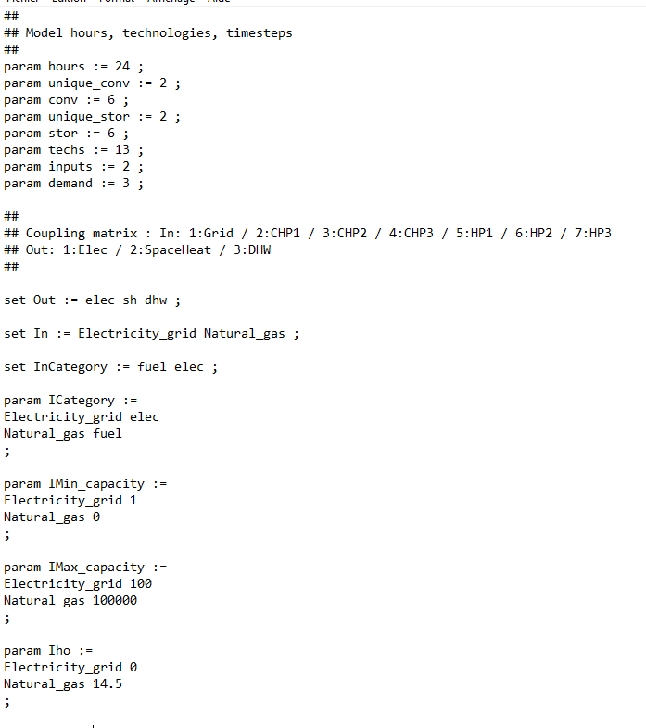
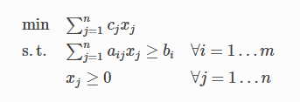
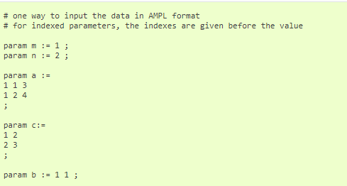
Abstract model
Example for OPTIM-EASE
Definition of the model with AMPL format as:

Slide 6
Pyomo operation
Model creation | ConcreteModel() or AbstractModel().
Sets definition | Lists of “things” that define the problem.
Parameters definition | Inputs data.
Variables definition | Variables that will be optimized.
Constraints definition
Objective function creation | Defined as a constraint. Can be maximized or minimized, no automatic multi-objective optimization. Activation/deactivation of the functions is possible.
Model resolution | Different solvers can be used.

Slide 7
Sets created
Time : [1, 24]
SubTime : [2, 24]
Buildings : [1, 2]
UConv : CHP, HP
Conv : CHP₁₋₂₋₃, HP₁₋₂₋₃
UStor : Battery, Hot water
Stor : Battery₁₋₂₋₃, Hot water₁₋₂₋₃
Techs : CHP₁₋₂₋₃, HP₁₋₂₋₃, Battery₁₋₂₋₃, Hot water₁₋₂₋₃
In : Electricity grid, Natural gas
InCategory : elec, fuel
Out : elec, sh, dhw
OutCategory : elec, heat
Heat : sh, dhw
HP : HP₁₋₂₋₃
CHP : CHP₁₋₂₋₃
Battery, HW
ElecIn : HP₁₋₂₋₃, Battery₁₋₂₋₃
ElecOut : Battery₁₋₂₋₃
FuelIn : CHP₁₋₂₋₃
HeatIn : Hot water₁₋₂₋₃
HeatOut : HP₁₋₂₋₃, Hot water₁₋₂₋₃
Fuels : Natural gas
Elec : Electricity grid
Hypothesis : max 3 of the same technology /building

Slide 8
Pyomo operation
Model creation | ConcreteModel() or AbstractModel().
Sets definition | Lists of “things” that define the problem.
Parameters definition | Inputs data.
Variables definition | Variables that will be optimized.
Constraints definition
Objective function creation | Defined as a constraint. Can be maximized or minimized, no automatic multi-objective optimization. Activation/deactivation of the functions is possible.
Model resolution | Different solvers can be used.

Slide 9
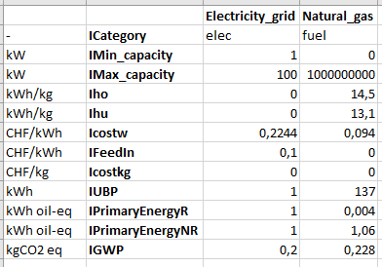
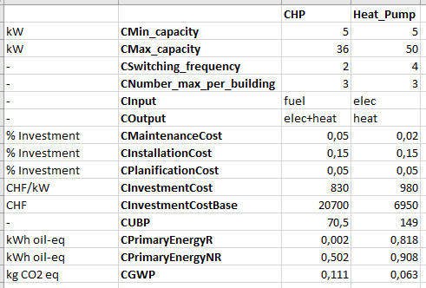
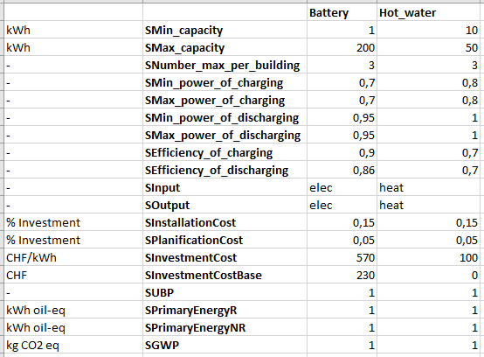
Parameters
Inputs
Converters
Storage
.dat file used in the code is created with python script data_extraction.py from an excel file

Slide 10
Pyomo operation
Model creation | ConcreteModel() or AbstractModel().
Sets definition | Lists of “things” that define the problem.
Parameters definition | Inputs data.
Variables definition | Variables that will be optimized.
Constraints definition
Objective function creation | Defined as a constraint. Can be maximized or minimized, no automatic multi-objective optimization. Activation/deactivation of the functions is possible.
Model resolution | Different solvers can be used.

Slide 11
Variables
Tinp (Time, In) : quantity of input consumed per time
ElecTech (Time, Building, ElecIn) : quantity of electricity from electricity grid that goes in every technologies per building that need it, per time
FuelTech (Time, Fuels, Building, FuelIn) : quantity of each fuel that goes in technologies that need it, per time and per building
FeedIn (Time, Building, ElecOut+CHP) : quantity of electricity that is sold to the grid, per time and per building
TechCapacity (Building, Techs) : capacity of the technology
TechUse (Building, Techs) : use binary on the whole horizon
TechUset (Building, Time, Techs) : use binary per time
Switch (Building, Time, CHP+HP) : Integer (-1, 0, 1) wich describe the transition between on and off state for CHP and HP per time (not used yet)
TechIn (Building, Time, Techs) : quantity of power received by every technology (except heat-in) per time
TechOut (Building, Time, Techs) : quantity of power out of every technology (except CHP and heat-out) per time
TechHeatInG (Building, Time, HeatIn, Heat) : quantity of heat received by corresponding technologies per time
TechHeatOutG (Building, Time, HeatOut, Heat) : quantity of heat out of corresponding technologies per time
TechCHPOut (Building, Time, CHP, Out) : quantity of power out of CHP technologies per time
Hypothesis : every technology can interact with others (except itself)

Slide 12
Variables
SOC (Building, Time, Battery) : state of charge of the battery per time
SOCdhw (Building, Time, HW) : state of charge of the HW dhw storage per time
SOCsh (Building, Time, HW) : state of charge of the HW sh storage per time
TechFlow (Building, Time, Tech, Techs, Out) : quantity of electricity/heat moving from a technology A to a technology B at a specific time and in a specific building
DemElec (Building, Time, Elec+ElecOut+CHP) : quantity of electricity satisfying the demand per time and its origins, per building
DemSH (Building, Time, HeatOut+CHP) : quantity of heat satisfying the demand of SH per time and its origins, per building
DemDHW (Building, Time, HeatOut+CHP) : quantity of heat satisfying the demand of DHW per time and its origins, per building
Hypothesis : every technology can interact with others (except itself)

Slide 13
Pyomo operation
Model creation | ConcreteModel() or AbstractModel().
Sets definition | Lists of “things” that define the problem.
Parameters definition | Inputs data.
Variables definition | Variables that will be optimized.
Constraints definition
Objective function creation | Defined as a constraint. Can be maximized or minimized, no automatic multi-objective optimization. Activation/deactivation of the functions is possible.
Model resolution | Different solvers can be used.

Slide 14
Constraints
Demand satisfaction
Link between the flows (heat-out, heat-in, elec-out, elec-in, …)
Constraining a technology not to provide itself
Bounding the capacity + introduction of the use binary (whole horizon)
Bounding the output of the technologies with the capacity chosen
For HW : SOC for SH storage and SOC for DHW storage <= capacity chosen /2
HP model (see next page)
SH relation (priority to DHW)
CHP model (similar to HP)
SOC definition for batteries, SH and DHW storage for HW (see next page)
SOCs initial and final state to 0
1st definition of the use binary per time : zero if whole use binary at 0

Slide 15
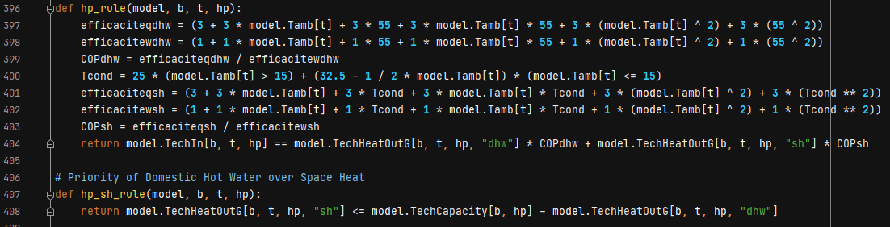

HP model
« 3 » : random number
$${\dot{q}}_{c}=bq_{1}+{bq}_{2}∗{\overline{T}}_{ext}+{bq}_{3}∗\overline{35}+{bq}_{4}∗{\overline{T}}_{ext}∗\overline{35}+{bq}_{5}∗{\overline{T}}_{ext}^{2}+{bq}_{6}∗\overline{35}$$
$${\dot{ω}}_{c}=bp_{1}+{bp}_{2}∗{\overline{T}}_{ext}+{bp}_{3}∗\overline{35}+{bp}_{4}∗{\overline{T}}_{ext}∗\overline{35}+{bp}_{5}∗{\overline{T}}_{ext}^{2}+{bp}_{6}∗\overline{35}$$
SH (out) $≤Capacity −DHW(out)$

Slide 16
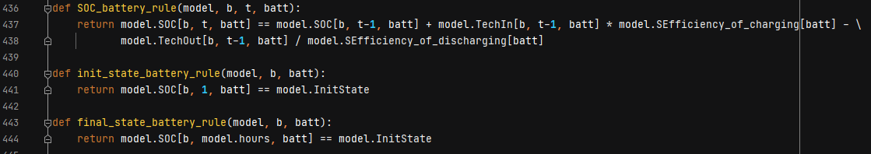
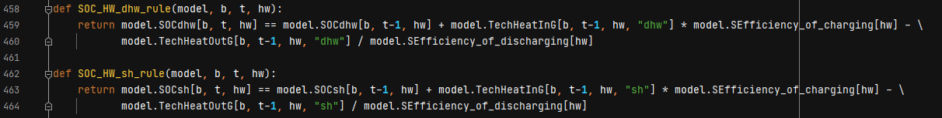
Storage model
SOCBt+1 = SOCBt + ηBc * PBct − (1/ηBd ) * PBdt
SPF model
SOCBt = SOCBt-1 + ηBc * PBct − (1/ηBd ) * PBdt
(urbs model)

Slide 17
Pyomo operation
Model creation | ConcreteModel() or AbstractModel().
Sets definition | Lists of “things” that define the problem.
Parameters definition | Inputs data.
Variables definition | Variables that will be optimized.
Constraints definition
Objective function creation | Defined as a constraint. Can be maximized or minimized, no automatic multi-objective optimization. Activation/deactivation of the functions is possible.
Model resolution | Different solvers can be used.

Slide 18


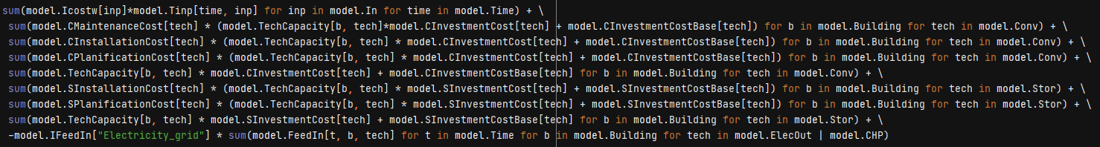
Objective function: costs
Inputs consumed (l 517)
Maintenance costs (l 518)
Installation costs (l 519, 522)
Planification costs (l 520, 523)
Investment costs (l 521, 524)
Feed-in costs (l 525)

Slide 19


Objective function: emissions
Global warming potential applied to outputs (l 529-534)

Slide 20
Mutli-objective optimization: sigma-constraint method
Definition of functions A and B
Deactivation of function A
Optimization: max of function A registered
Activation of function A, deactivation of function B
Optimization: min of function A registered
Deactivation of function A, activation of function B
Optimization with constraint of function A between min and max
Plot of the Pareto front

Slide 21
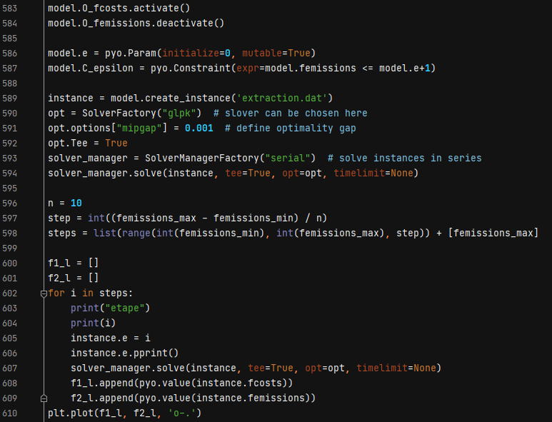

Slide 22
Pyomo operation
Model creation | ConcreteModel() or AbstractModel().
Sets definition | Lists of “things” that define the problem.
Parameters definition | Inputs data.
Variables definition | Variables that will be optimized.
Constraints definition
Objective function creation | Defined as a constraint. Can be maximized or minimized, no automatic multi-objective optimization. Activation/deactivation of the functions is possible.
Model resolution | Different solvers can be used.

Slide 23
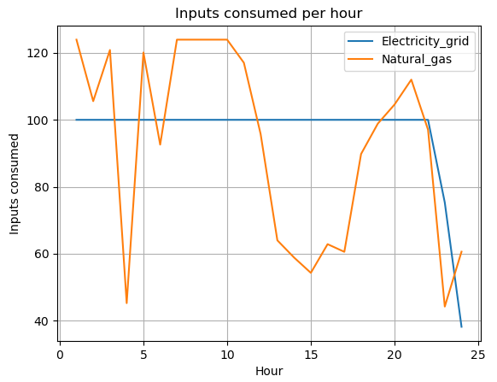
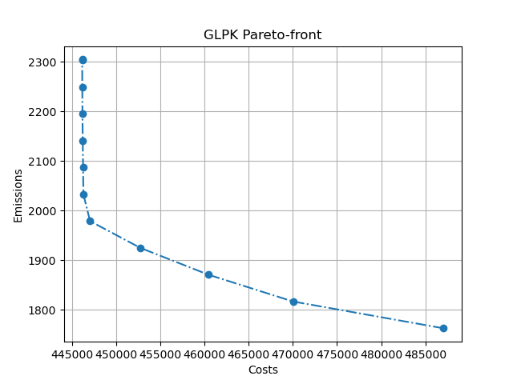
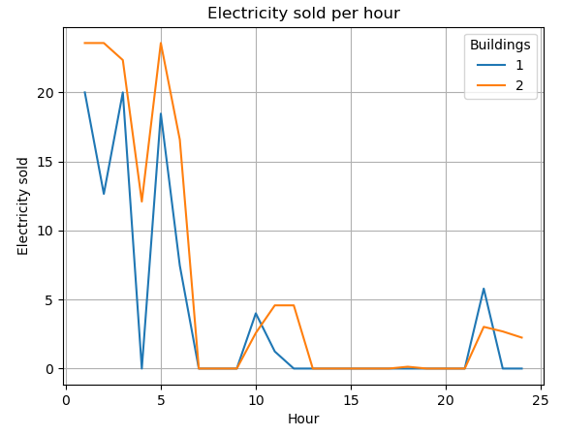
Resolution

