Slide 1

Continuous Integration Tools
TEAM C| MESW

Slide 2
What is Continuous Integration (CI)?
An important concept of any agile software development is getting reliable, working and integrated software at the end of every sprint or iteration.
Continuous integration is a software development practice addressing this challenge by merging all changes made to the software and integrate all changed components regularly.
Goal
wrap compilation, build, deployment and testing into a single, automated and regularly repeatable process.
Definition according ISTQB Foundation
Notes:
Development practice that requires developers to integrate code into a shared repository at regular intervals.
This concept was meant to remove the problem of finding later occurrence of issues in the build lifecycle.
Continuous integration requires the developers to have frequent builds.
The common practice is that whenever a code commit occurs, a build should be triggered. -> getting fast feedback.!!!
The fast feedback is important so you always know right after you broke the build (introduced changes that made either the compile/build cycle or the tests fail) what you did that failed and how to revert it.

Slide 3
Some benefits of CI
Each change on the code base or configuration is verified by an automated build and test, allowing teams to detect problems early!
By integrating regularly, errors are detected quickly, and can be located and analyzed more easily
Early identification of conflicting changes
Making progress is visible and encourages developers and testers
When unit tests fail or a bug emerges, developers might revert the codebase to a bug-free state, without wasting time for debugging and defect clearing
Constant availability of a deployable software at any time and at any place for testing, demo or education purposes
Reduces repetitive manual test activities
Notes:
The working code is committed and tested frequently, the team always knows if the code is working or not;
Provides confidence that the next sprint is based on a solid foundation;

Slide 4
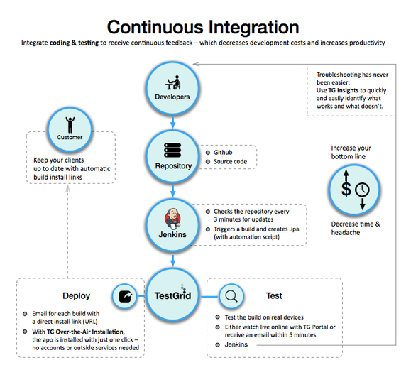
CI Tools
Some examples of CI Tools:
JENKINS
TRAVIS
BAMBOO
CODESHIP

Slide 5
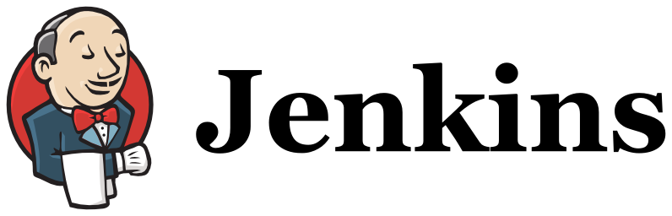
Open source automation server
Manages and controls development lifecycle processes, including build, document, test, deployment, static analysis and others
Can be set up to watch for any code changes - in places like SVN and GitHub
Automatically do a build - with tools like Ant and Maven
Initiate tests and then take actions like rolling back or rolling forward in production
Notes:
Along with Jenkins, sometimes, one might also see the association of Hudson.
Hudson is a very popular open-source Java-based continuous integration tool developed by Sun Microsystems which was later acquired by Oracle.
After the acquisition of Sun by Oracle, a fork was created from the Hudson source code, which brought about the introduction of Jenkins.
Operating System Version: Jenkins can be installed on Windows, Ubuntu/Debian, Red Hat/Fedora/CentOS, Mac OS X, openSUSE, FReeBSD, OpenBSD, Gentoo.

Slide 6
Using Jenkins: REAL TESTIMONIES
Pros
Efficient
Automatic Build for each commit
Cons
Too simplistic a presentation
Icons not very clear
A static code verification can also be done
Can be “overwhelming”
Open Source
Some plugins require complicated configurations
Constant awareness if build is “broken”
Constant effort for maintaince
Possibility to do “nightly builds” – good for big projects
Several plugins
Setup time
Notes:
ANDRE
o look and feel é extremamente datado
funciona mas é td à base de links e tem uma apresentação simplista
os icones do dashboard para mostrar a build stability são icones de meteorologia, nem toda a gente percebe imediatamente o q é
pontos positivos: é eficiente, a visão de consola permite ver exactamente o que se está a passar se quiseres uma visão mais técnica do job que estás a correr
e tem mtos plugins com outras ferramentas o que acrescentar valor à ferramenta, embora exija configurações um bocadinhos mais técnicas
LUIS
Positivos: se triggar uma build automática por cada commit
Sabes a todo o momento se a build está quebrada ou não
Podes ter verificação estática do código automática também (tipo cppcheck)
Podes configurar nightly builds que geram builds oficiais durante a noite caso não haja erros (este eh particularmente útil para projectos gigantes)
Podes associar ao mecanismo de code review (tipo do GIT) e funcionar como um reviewer (isto é são fazes merge do código para o master se estiver conpilavel)
Tens os teus projectos a buildar centralizados numa máquina (pode dar jeito saber quais são )
Acho que também podes fazer verificação dinâmica (tipo valgrind)
É open source, podes customizar, mas tens imensos plugins
Desvantagens:
overhead adicional
Tens que ter alguém a manter a ferramenta
Pode escalar a um ponto que depois tens aquilo tudo a buildar, mas são tantas coisas que já nem controlas bem
E o tempo de setup

Slide 7

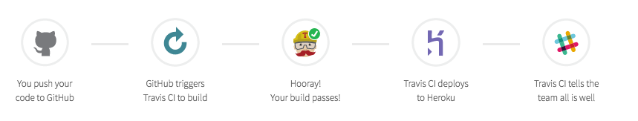
Hosted continuous integration server used to build and test software projects hosted at GitHub.
No need to install or configure Travis. Commands are taken from a file named travis.yml which sits along the project code.

Slide 8
Travis offers support for more that a dozen languages including C, C++, Erlang, Go, Haskell, Java, JavaScript, Perl, PHP, Python Ruby or Scala.
Travis is free for all public GitHub repos, however, it’s pretty expensive for commercial plans.
Travis only supports GitHub. No other version control software.
Running tests on Windows is not currently supported

Slide 9

What is it?
It is a CI developed by Atlassian (the maker of JIRA, Bitbucket, HipChat)
It still is very young, released in May of 2016.
Not open source software.
Written in Java – Multi-Platform Feature.
No longer is a cloud-based platform, remaining as server-product only.

Slide 10

How does it work?
Like most of the others CI’s, developers commits trigger build processes. Which passes though 4 phases (compilation, unit testing, integration testing, activating the new version).
Bamboo uses the concept of a ‘plan’ with ‘jobs’ and ‘tasks’ to configure and order actions in the workflow.
Plan
Stage
Stage
Job
Job
Job
Job
Task
Task
Task
Task
Task
Task
Task
Task

Slide 11




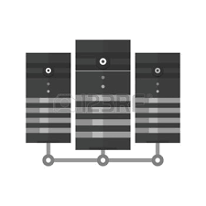
Pricing
Small Teams Packet
Growing Teams Packet
License cost:$10
License cost:$800-$80K
Unlimited Local Agents
Unlimited Local Agents
No Remote Agents
Limited Remote Agents
1-250

Slide 12

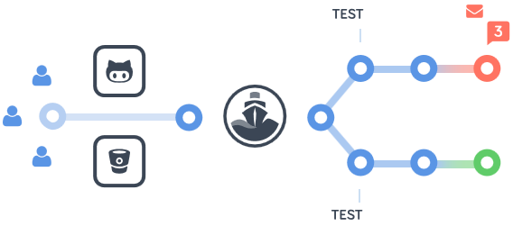
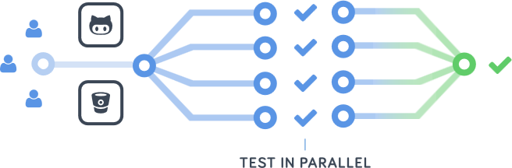
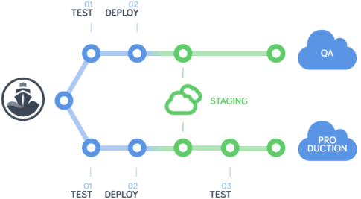
?What it does?
Automated Tests and Notifications
Team Management
Parallel CI
Debug build via SSH
Deployment Pipelines
Browser Testing

Slide 13
+ ^ -
+
-
Free plan has 5 private projects up to 100 builds per month.
Unlimited open source projects.
Support for multiple tools, languages and databases.
GitHub, BitBucket and Docker integration.
Too many permissions on Bitbucket.
Basic configuration options via shell variables and admin interface.

Slide 14
COMPARISON TABLE
TOOL | JENKINS | TRAVIS | BAMBOO | CODESHIP
Features
IDE Integration | Eclipse, IntelliJ IDEA, NetBeans (and others like JIRA) | None | Eclipse, IntelliJ | None
Versions Control | YES (SVN,GitHub) | GitHub | Git,SVN,Mercurial | GitHub, BitBucket
Hosted | Web server | YES | Web server | YES
Open source | YES | NO | NO | NO
Documentation | Good | Good (and good community) | Good | Good

Slide 15

References
https://www.cloudbees.com/jenkins/about
ISTQB: Chapter 1.2.4 in Agile Tester Add-On: Continuous Integration & In Chapter 1.2.4 in Agile Tester extension: Benefits of Continuous Integration, 2014
https://www.quora.com/What-is-Jenkins-When-and-why-is-it-used
https://travis-ci.org/
https://docs.travis-ci.com/user/for-beginners
https://codeship.com/

