Slide 1
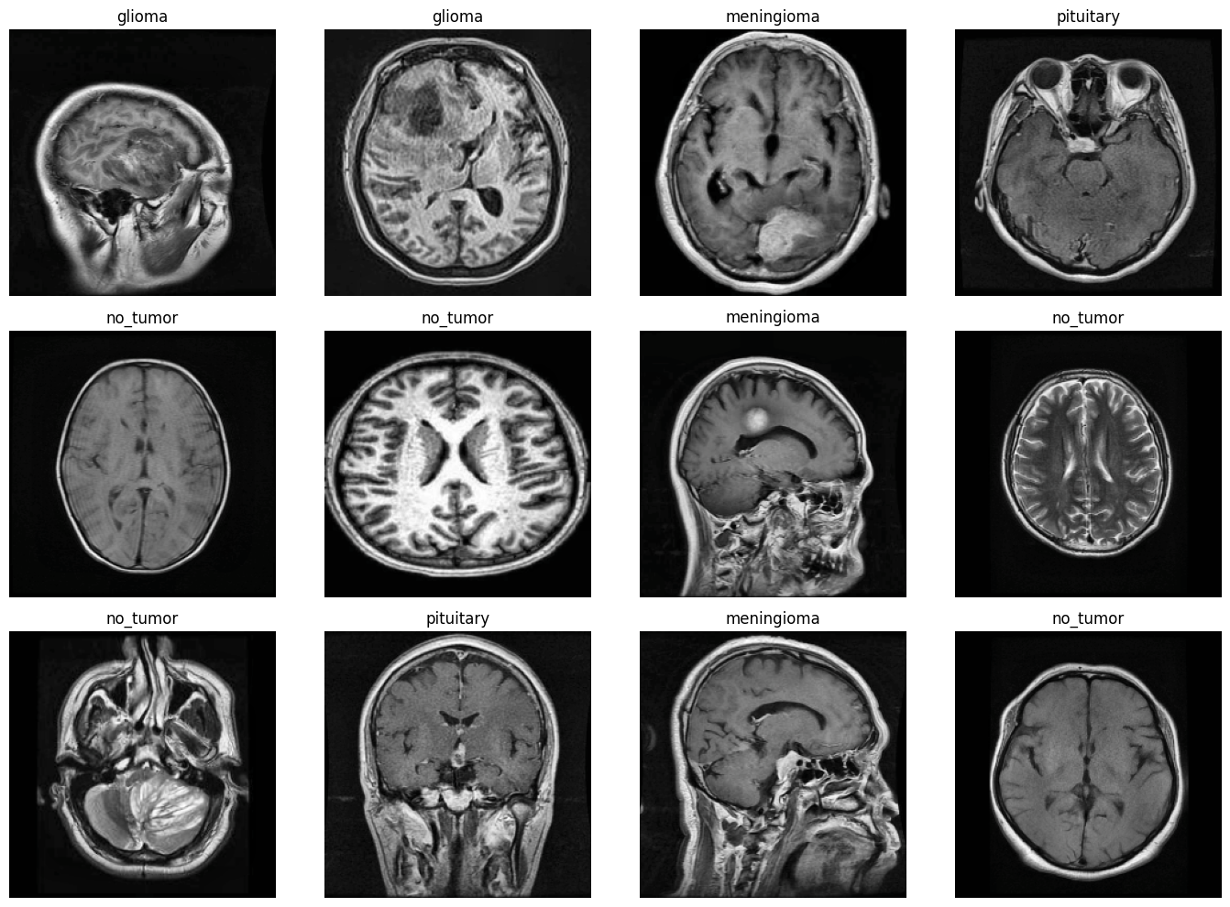
Brain Tumor Classification Using Deep Learning
An Automated System for Multi-Class MRI Image Analysis
Name: Ariful Hassan | CSE 713 /BRAC University | 26/04/2026

Slide 2
The Clinical Challenge
Current Diagnostic Process
AI-Driven Solution
Brain tumors represent one of the most challenging neurological conditions, requiring early and precise diagnosis for optimal patient outcomes. Current clinical practice relies heavily on manual analysis of magnetic resonance imaging (MRI) scans by expert radiologists.
Deep learning offers a transformative opportunity to automate initial tumor screening and classification. By training neural networks on thousands of annotated MRI images, we can develop systems that match or exceed human performance in specific diagnostic tasks.
This process is inherently time-consuming, resource-intensive, and subject to human variability. The shortage of qualified specialists in many regions creates diagnostic bottlenecks, delaying critical treatment decisions.
Such automation enables faster triage, reduces workload on specialists, and improves accessibility to expert-level diagnosis in underserved areas.

Slide 3

Research Objectives
Multi-Class Classification
High Accuracy Performance
Explainable Predictions
Develop a system capable of accurately classifying MRI images into four distinct categories: Glioma, Meningioma, Pituitary tumors, and healthy scans showing no tumor presence.
Achieve classification accuracy exceeding 90% while maintaining low false positive rates, ensuring reliable predictions that can support clinical decision-making.
Implement visualization techniques that reveal which image regions influence the model's decisions, building trust with medical professionals and enabling error analysis.

Slide 4
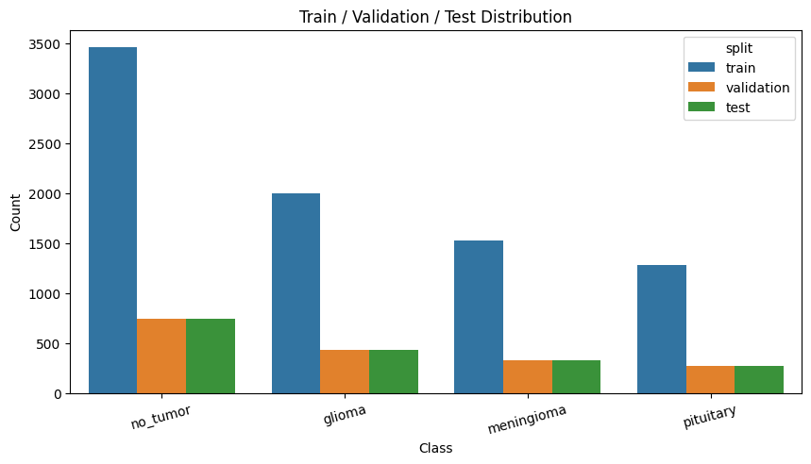
Dataset and Preprocessing Pipeline
Dataset Characteristics
The dataset sourced from Kaggle's MRI collection contains thousands of annotated brain MRI images spanning four diagnostic categories. Each image represents a unique patient scan, ensuring diversity in tumor presentations and imaging conditions.
Data Preparation
The four classes include:
Duplicate Removal: Perceptual hashing (pHash) eliminated redundant images, ensuring model training on unique samples.
Glioma: Most common primary brain tumor originating from glial cells
Meningioma: Typically benign tumors arising from meninges
Pituitary: Tumors in the pituitary gland region
No Tumor: Healthy control scans
Image Standardization: All images resized to 224×224 pixels for EfficientNet compatibility.
Quality Enhancement: CLAHE (Contrast Limited Adaptive Histogram Equalization) improved tumor visibility.
Normalization: Pixel values scaled to match pre-trained model expectations.

Slide 5
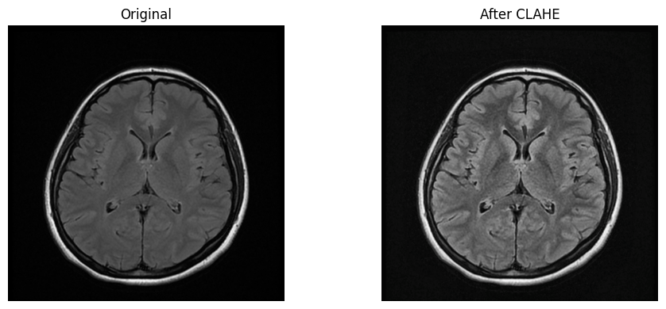
Image Enhancement: CLAHE Technique
Handling Data Imbalance
Why CLAHE?
The dataset exhibited class imbalance, with some tumor types represented more frequently than others. To prevent model bias, we employed:
Medical images often suffer from poor contrast, making subtle tumor boundaries difficult to distinguish. CLAHE addresses this by adaptively enhancing local contrast while preventing noise amplification.
Class weights: Adjusting loss function to penalize misclassification of underrepresented classes more heavily
Data augmentation: Applying random transformations (flips, rotations, zooms) to artificially expand minority classes
Stratified sampling: Ensuring balanced representation in each training batch
Unlike global histogram equalization, CLAHE operates on small image regions (tiles), preserving local details crucial for tumor detection. The "contrast limited" aspect prevents over-amplification of noise in homogeneous areas.
This preprocessing step proved essential for highlighting tumor regions, particularly for smaller or low-contrast lesions that might otherwise be overlooked.

Slide 6
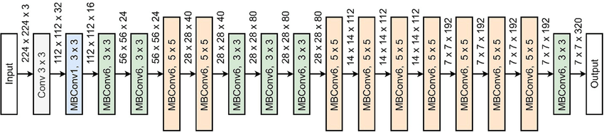
Model Architecture: EfficientNetB0
Pre-trained Foundation
Compound Scaling
Parameter Efficiency
EfficientNetB0 leverages ImageNet pre-training, transferring knowledge from millions of natural images to medical domain.
Balances network depth, width, and resolution systematically, achieving optimal accuracy with minimal parameters.
~4.38M total parameters with only ~0.33M trainable weights, enabling fast training and deployment.
EfficientNet represents a breakthrough in neural network design, using neural architecture search to identify optimal scaling coefficients. Compared to previous models like ResNet or VGG, EfficientNet achieves higher accuracy with significantly fewer parameters, making it ideal for resource-constrained medical applications.
The model's architecture includes compound scaling that uniformly increases depth (layers), width (channels), and resolution, unlike prior approaches that scaled only one dimension. This balanced approach maximizes accuracy while minimizing computational cost.

Slide 7
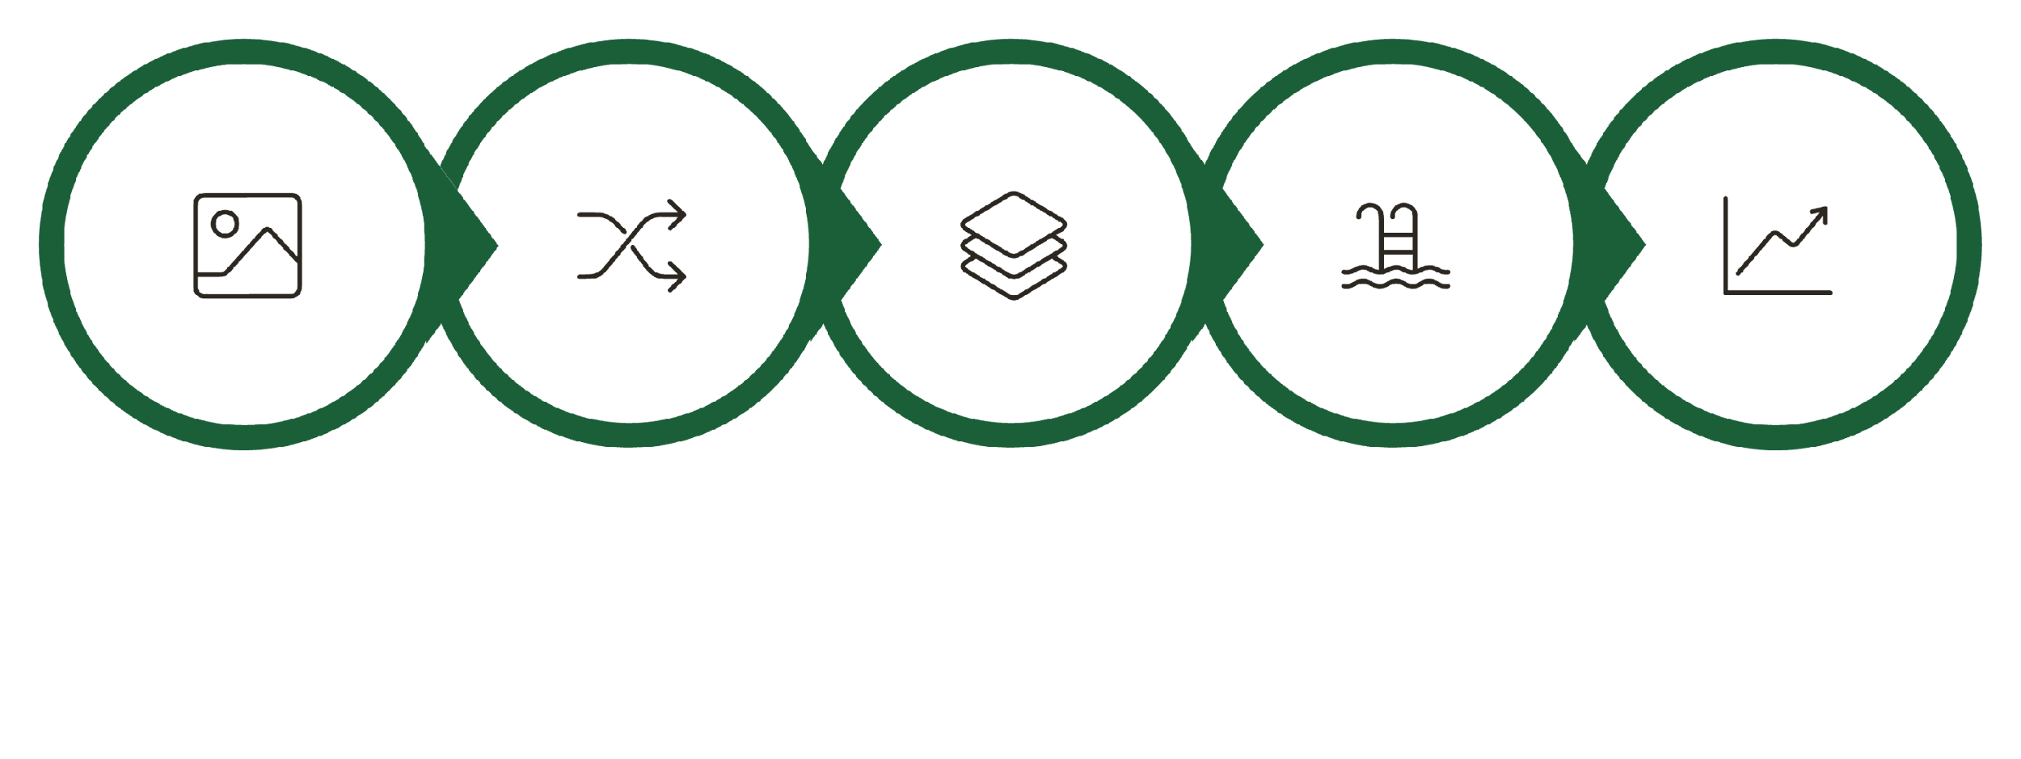
Detailed Model Architecture
Data Augmentation
EfficientNetB0
Global Avg Pooling
Dense Classifier
Input Images

Slide 8
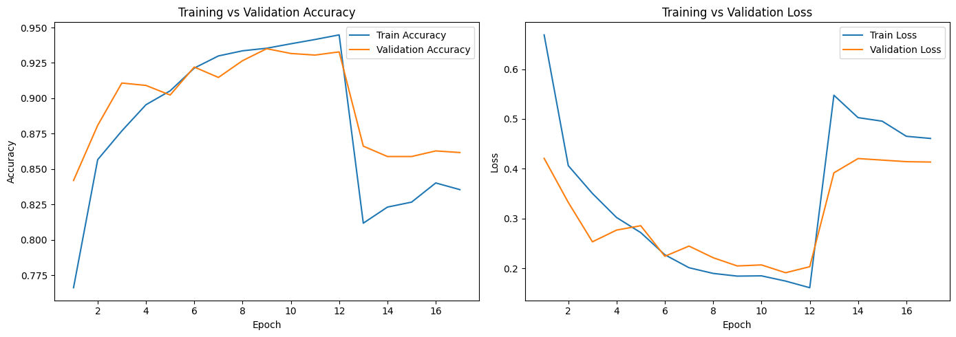
Training Performance and Results
94%
0.18
15
Classification Accuracy
Validation Loss
Training Epochs
Achieved 93-95% accuracy across validation set, correctly identifying tumor types in most cases
Low cross-entropy loss indicates confident and correct predictions on unseen data
Converged within reasonable time using early stopping to prevent overfitting
The model demonstrated stable training dynamics with validation accuracy tracking closely alongside training accuracy, indicating good generalization. Training curves showed consistent improvement without signs of overfitting, and early stopping prevented unnecessary computation while capturing optimal model weights.
Performance was consistent across all four classes, with confusion matrix analysis revealing particular strength in distinguishing healthy scans from tumor presence, and reasonable accuracy in differentiating between tumor types.

Slide 9
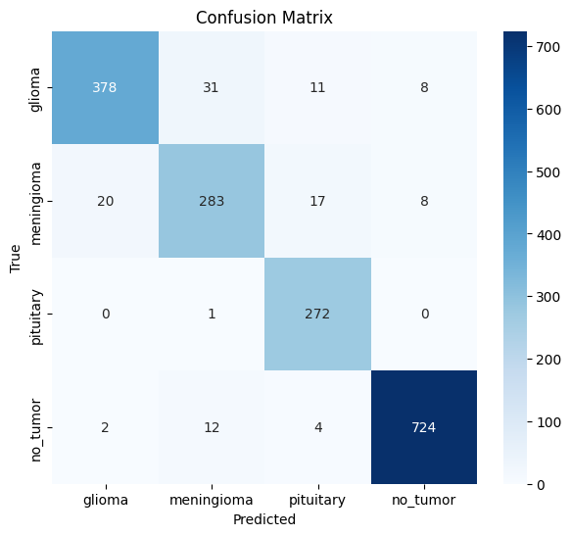
Model Evaluation and Explainability
01
02
Precision, Recall, and F1-Score
Confusion Matrix Analysis
Comprehensive metrics revealed class-specific performance. High precision indicates low false positive rates, while strong recall ensures minimal missed diagnoses.
Visualized misclassification patterns, identifying which tumor types were occasionally confused. Most errors occurred between visually similar tumor presentations.
03
04
Grad-CAM Visualization
Clinical Validation
Implemented Gradient-weighted Class Activation Mapping to generate attention heatmaps, showing exactly which image regions influenced classification decisions.
Compared model predictions with expert annotations, confirming focus on anatomically relevant tumor locations rather than image artifacts.
Grad-CAM proved particularly valuable for building trust with medical professionals. By overlaying color-coded attention maps on original MRI scans, clinicians could verify the model was focusing on biologically plausible tumor locations rather than learning dataset artifacts. This interpretability is crucial for clinical adoption and regulatory approval.

Slide 10
Conclusion and Future Directions
Key Achievements
Future Enhancements
This project successfully demonstrated that deep learning can achieve high-accuracy multi-class brain tumor classification using MRI images. The EfficientNetB0 architecture proved particularly well-suited, balancing accuracy with computational efficiency.
Web Application Deployment: Building user-friendly interface for clinical testing
Model Comparison: Benchmarking against Vision Transformers and other architectures
Key contributions include:
ROC-AUC Analysis: Comprehensive receiver operating characteristic evaluation
Robust preprocessing pipeline handling data quality and class imbalance
Two-stage training strategy optimizing feature extraction and fine-tuning
Explainable predictions using Grad-CAM visualization
Reproducible methodology documented for further research
External Validation: Testing on independent datasets from different hospitals
Ensemble Methods: Combining multiple models to improve robustness
Impact: This work contributes to the growing field of medical AI, demonstrating practical applications of deep learning for automated diagnosis. With further validation and deployment, such systems could significantly improve healthcare accessibility and diagnostic consistency worldwide.

Slide 11
Thank You

