Slide 1
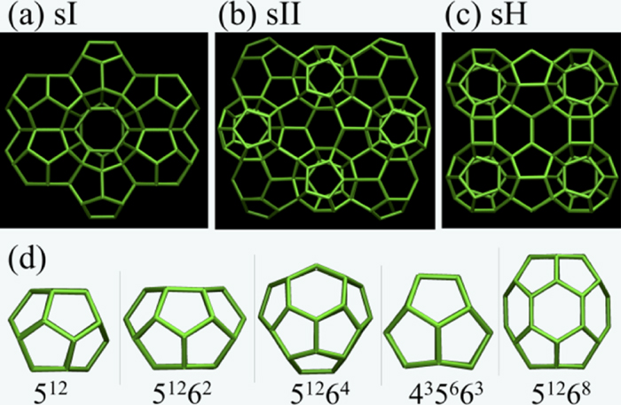
From: Communication: Structural interconversions between principal clathrate hydrate structures
J. Chem. Phys. 143, 011102 (2015)
^{Date of Download: 11/18/2025}
Copyright © 2025 . All rights reserved.
Notes:
Figure Legend: Representations of the three principal clathrate hydrate structures (a) sI, (b) sII, and (c) sH. The cages forming these crystals are shown in (d). Here, the hydrogen bonded network is represented by green sticks connecting water molecules that are within 3.0 Å of each other. The guest molecules are omitted for clarity.

