Slide 1
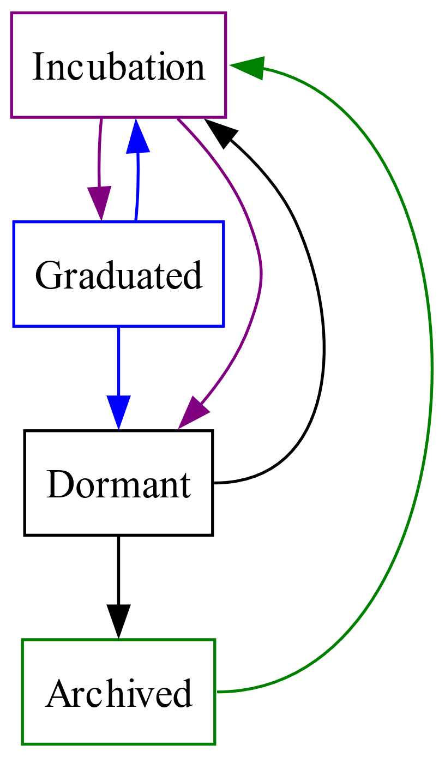
Legal
Diversity (>=3 orgs)
Releases
Testing and Q/A
Security
Structure
Documentation
Maintenance
Production
Releases
Security
Production
Maintenance
3
1
1
2
Legal
Diversity (<2 orgs)
Security
4
4
Legal
Diversity (<3 orgs)
Testing and Q/A
Structure
Documentation
3
5
6
7
2
Legal
Diversity (>=2 orgs)
Security
7
Legal
Diversity (>=2 orgs)
Security
Maintenance
6
5

