Slide 1
AnonCreds v2.0 Working Group
April 3, 2023

Slide 2
BC Petroleum & Natural Gas Title Credential
The Petroleum and Natural Gas Title Credential MUST be issued by the Ministry of Energy, Mines and Low Carbon Innovation (EMLI) Tenure and Resource Stewardship Branch. When petroleum and natural gas operators wish to obtain a Petroleum and Natural Gas Title in BC, a Petroleum and Natural Gas Title Document must be provided in accordance with the BC Petroleum and Natural Gas Act.

Slide 3
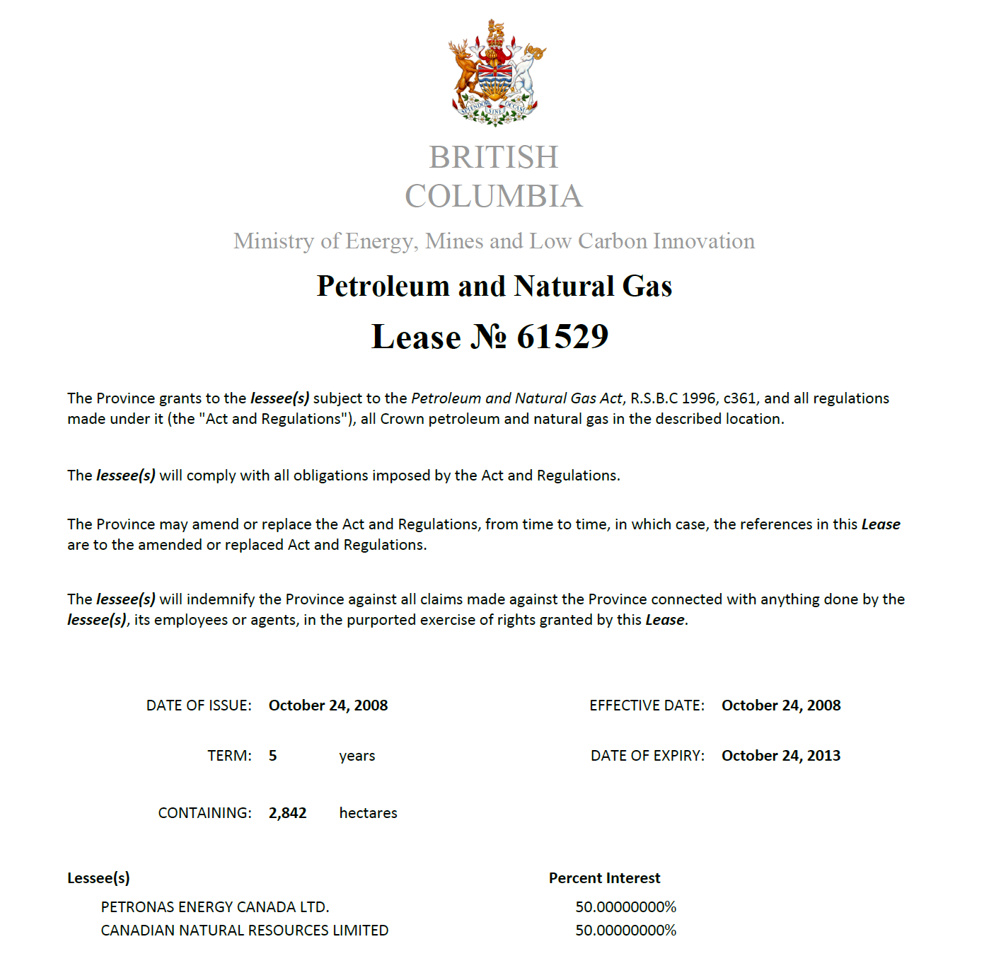

Slide 4
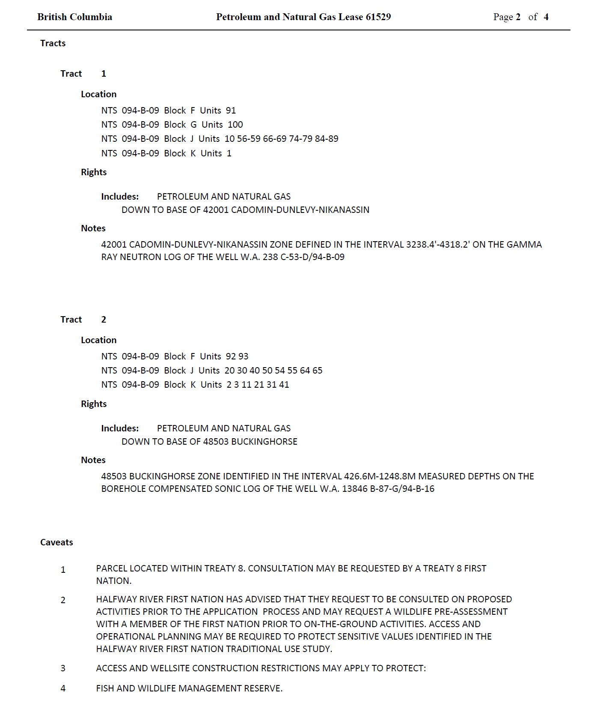

Slide 5
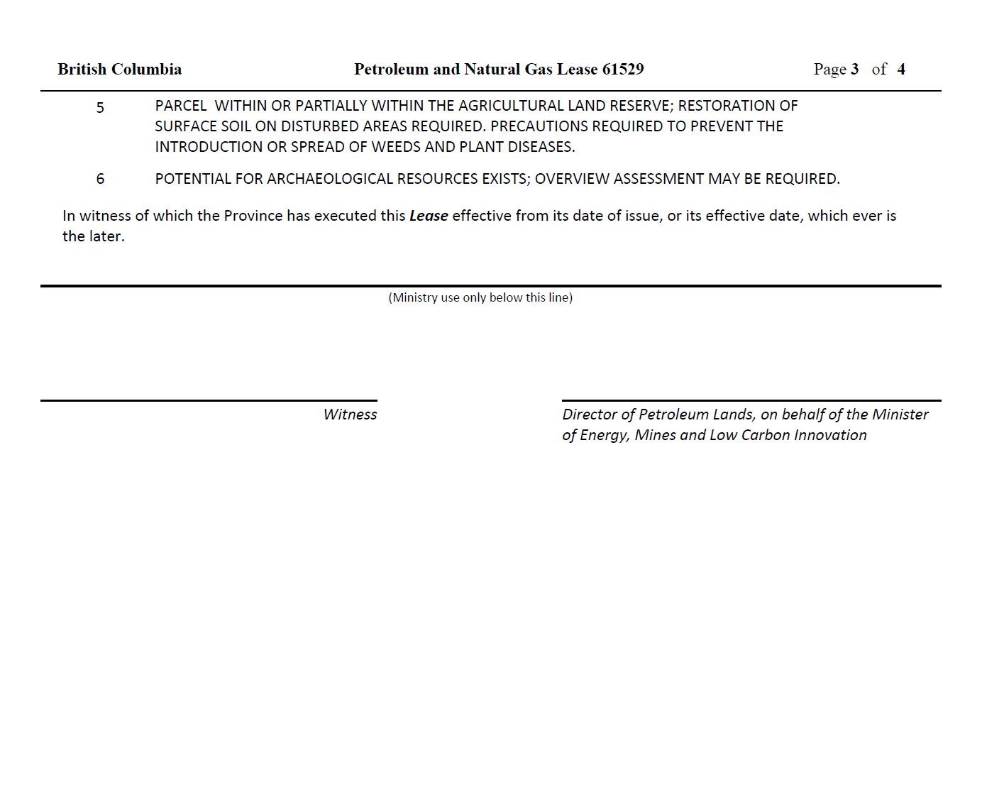

Slide 6
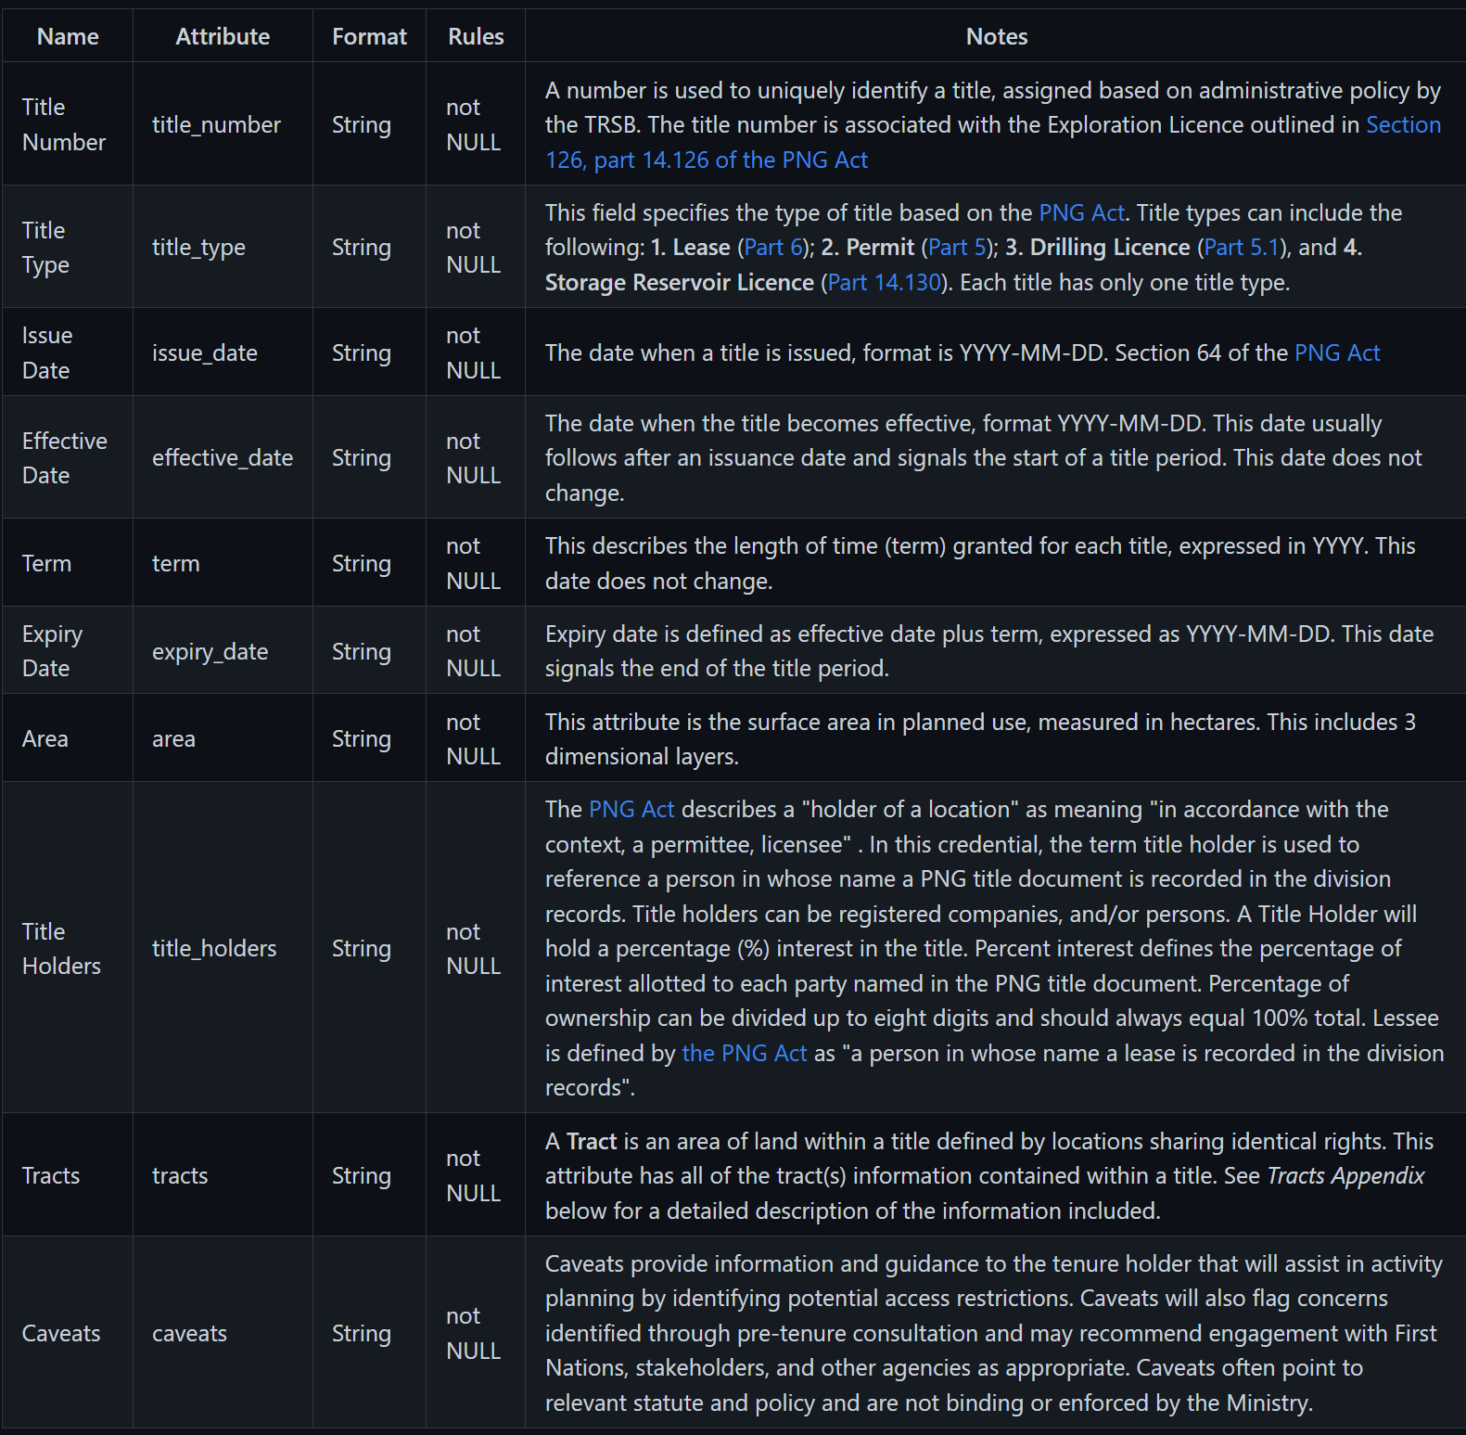
PNG.Title
Version 1.0
https://github.com/bcgov/bc-vcpedia/blob/main/credentials/credential-bc-petroleum-natural-gas-title.md
2.6.1 Schema Definition
Schema Name: png.title
Schema Version: 1.0
This schema definition follows the AnonCreds specification (https://wiki.hyperledger.org/display/anoncreds)
2.6.2. Credential Implementation
BCovrin Test 4uVA6nbXMGWYLE6hq99aDa:2:BC Petroleum and Natural Gas Title:1.0

