Slide 1
SICPA ACA-Py Roadmap
DID Registrar for DID Core
Monitoring performance metrics
Kafka queues performance testing
HSM integration
DIDComm v2 support

Slide 2
It’s a match 🔥, ACA-Py & HSMs
Planning ACA-Py integration with hardware cryptography solutions

Slide 3
What’s the aim
Protecting credential RSA keys BUT,
DID secret key become the weak link. Enables creating new credential definitions and issue/revoke using the new definitions
Protecting public DIDs keys is as relevant as protecting the RSA ones
Minor technical issue: in ACA-Py, a DID starts as private and is promoted to public. => Might need to generate/use all DID keys in the HSM
Our new weak link is…the DID seed provided to ACA-Py as configuration

Slide 4
How
Implement available ACA-Py interfaces to provide implementations for
Wallet and related plumbing
Anoncreds related operations (indy-credx – hsm mix)
An interface to the HSM (a plugin of the plugin)

Slide 5
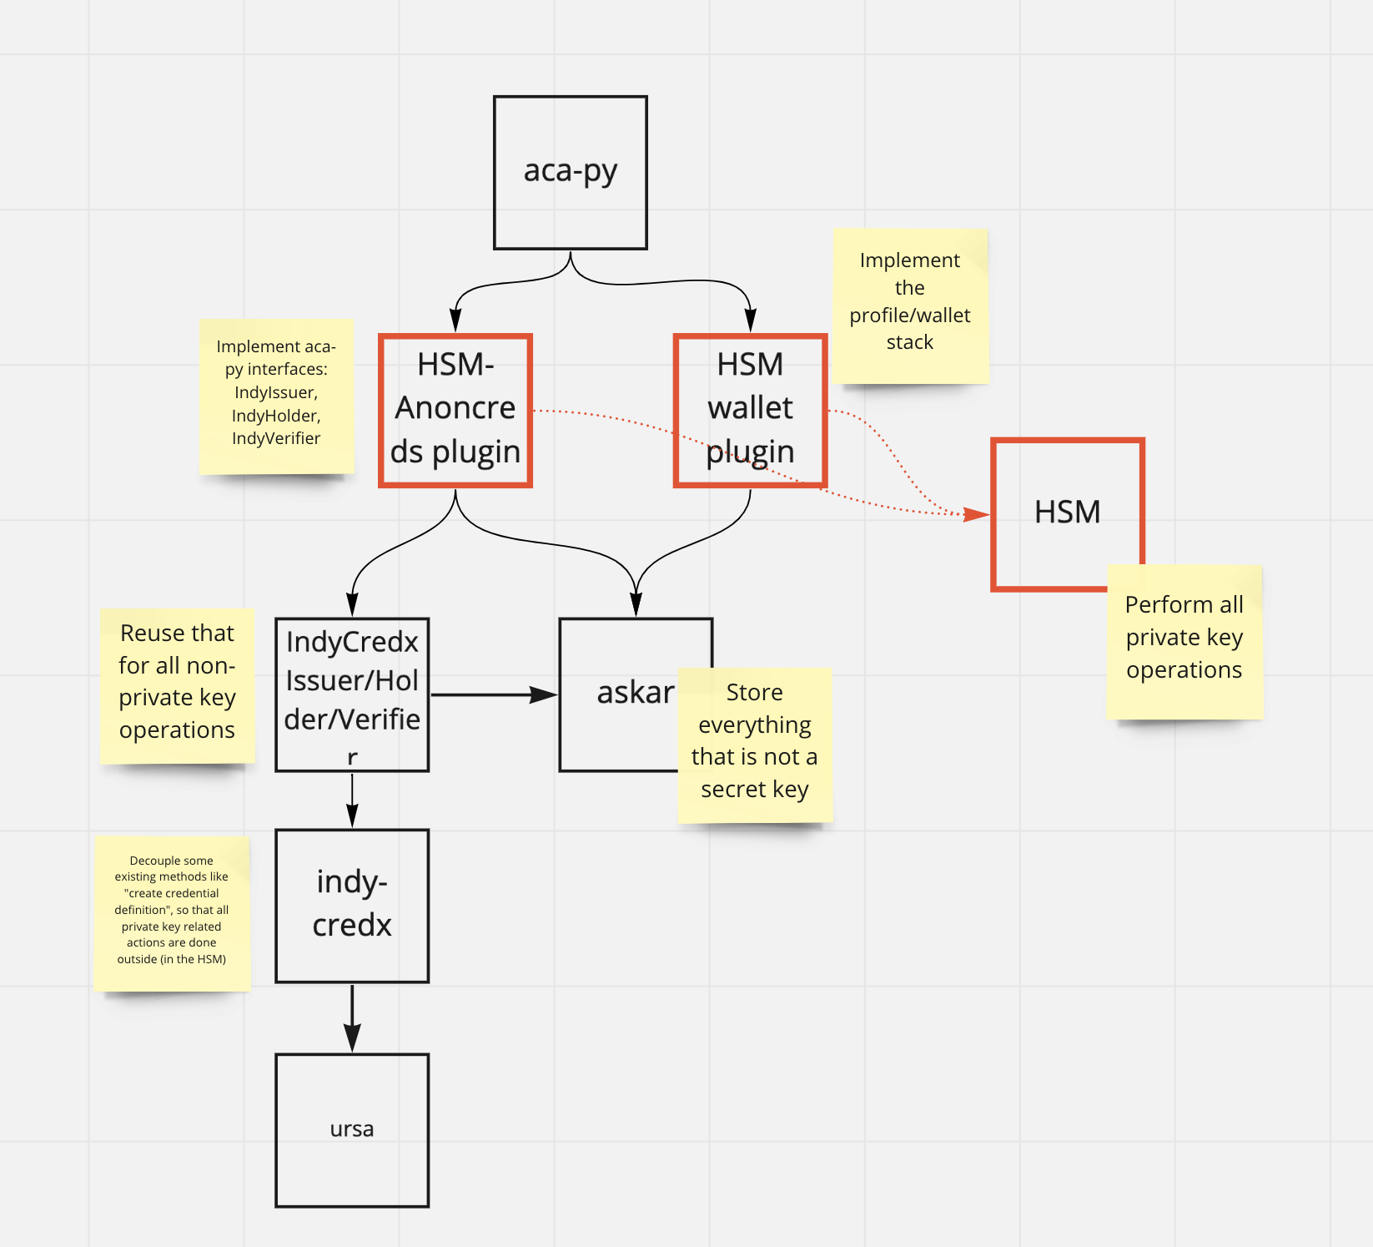
The big picture 🐙

