Slide 1
Cactus-Weaver
architecture diagram
discussion
Cactus and Weaver maintainers
(Peter, Rama, Takuma, Izuru, and more)

Slide 2
Question to weaver team
I checked RFC’s in Weaver’s RFC directory and tried to draw an asset transfer sequence (previous slide)
https://github.com/hyperledger-labs/weaver-dlt-interoperability/blob/main/rfcs/protocols/asset-transfer/generic.md
https://github.com/hyperledger-labs/weaver-dlt-interoperability/blob/main/rfcs/protocols/data-sharing/generic.md
Is my sequence in line with your assumptions?
Weaver team added functions to api-client class in “Unified Architecture (draft)” slide
AssetTransfer
DataTransfer
DataExchange
https://github.com/hyperledger-labs/weaver-dlt-interoperability/blob/main/rfcs/protocols/data-sharing/generic.md shows an Application initiating a Data-Sharing procedure. The Application sends NetworkQuery (not DataTransfer request) to Relay
From this figure, Application seems to be ideal place to provide DataTransfer function, as well as AssetTransfer and DataExchange
https://github.com/hyperledger-labs/weaver-dlt-interoperability/blob/main/rfcs/models/infrastructure/relays.md shows that Relay has (Protocol::) DataTransfer, etc.
Which node should implement these functions?
In either case, api-client isn’t ideal place to implement it
Application doesn’t directly talk to connectors, so it doesn’t have api-client anyway
Relay may talk to connectors, but AssetTransfer and other operations deal with more than one ledgers. An api-client is used to access one ledger (in your local network).

Slide 3

A new proposed API design [1/2]
Each API can be switched to the two modes
mode 1: System Contract OFF
mode 2: System Contract ON
cactus-node-server
ledger connector of each ledger
Business
logic
plugin
api-client
Protocol
Adapter
Platform
SDK
ledger node
Base API class
sendSyncRequest
request
sendAsyncRequest
(= AssetTransfer)
StartMonitor
https / socket.io / grpc
DataTransfer
https / socket.io /grpc
In the case of mode 1,
the embedded contract is not needed.
In the case of mode 2,
the embedded contract is needed
DataExchange
openAPI SDK
Ledger-specific API class
API 1 (depends on each ledger)
API (ledger-specific)
API 2 (depends on each ledger)
api-client can deal with each ledger API
where the common API does not supply

Slide 4
A new proposed API design [2/2]
base codes:
The merge of
Cactus APIs of Socket.io connection
and Weaver APIs
Each API can be switched to the two modes
mode 1: System Contract OFF
mode 2: System Contract ON
cactus-node-server
ledger connector of each ledger
Business
logic
plugin
api-client
Protocol
Adapter
Platform
SDK
ledger node
Base API class
sendSyncRequest
request
sendAsyncRequest
(= AssetTransfer)
StartMonitor
https / socket.io / grpc
DataTransfer
https / socket.io /grpc
In the case of mode 1,
the embedded contract is not needed.
In the case of mode 2,
the embedded contract is needed
DataExchange
openAPI SDK
Ledger-specific API class
API 1 (depends on each ledger)
API (ledger-specific)
API 2 (depends on each ledger)
api-client can deal with each ledger API
where the common API does not supply
base codes: Cactus APIs of OpenAPI connection

Slide 5
c.f.: the previous documents

Slide 6
A proposal of Cactus and Weaver APIs integration plan (v2022-03-15)
slide on the previous meeting
(2022-03-15)
Takuma Takeuchi
March 15, 2022 PST

Slide 7
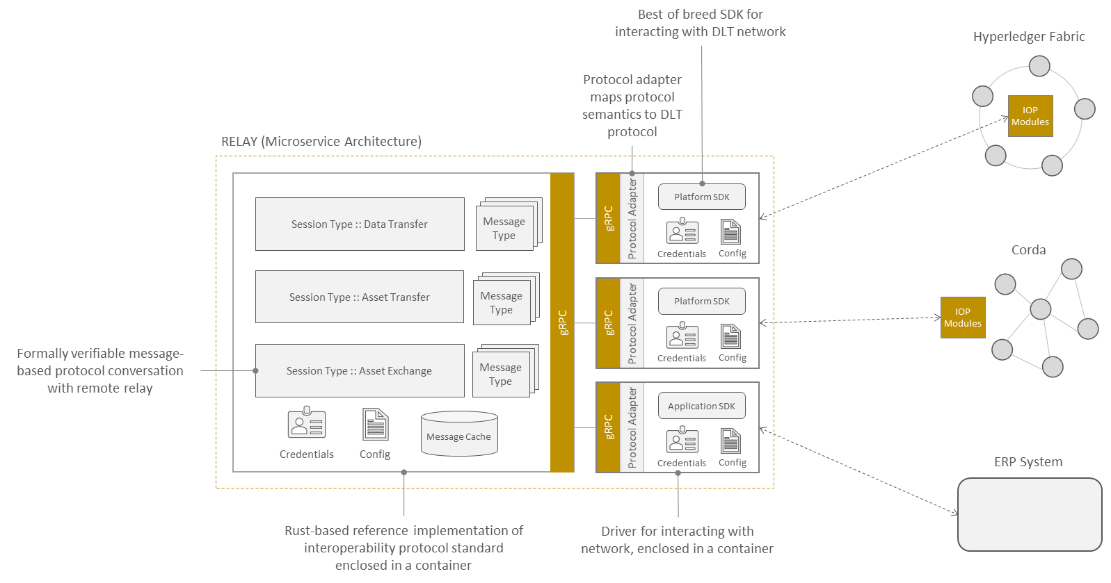

Current APIs (Weaver)
slide on the previous meeting
(2022-03-15)
The left parts provides the common APIs
DataTransfer / AssetTransfer / AssetExchange
The right parts provides the translater to each platform SDK and execute its SDK
Relay Node
gRPC
gRPC
Protocol
Adapter
DataTransfer
Blockchain
Platform
SDK
Weaver
network
AssetTransfer
gRPC
AssetExchange
System contract
System contract has to be embedded
before we use Weaver API

Slide 8
Current APIs (Cactus socket.io connection version)
slide on the previous meeting
(2022-03-15)
Common APIs on each ledger
sendSyncRequest: Send sync-typed requests to the ledgers (e.g. getBalance)
sendAsyncRequest: Send async-typed requests to the ledgers (e.g. sendTransaction)
startMonitor/stopMonitor: Start/stop monitoring blocks on the ledgers
cactus-node-server
socket.io
connection
ledger connector of each ledger
api-client
ledger node
Business
logic
plugin
sendSyncRequest
sendSyncRequest
(translate to each SDK)
execute
return
sendAsyncRequest
sendAsyncRequest
(translate to each SDK)
request
wait
time passes
socket.io
socket.io
startMonitor
startMonitor
(translate to each SDK)
blocks are
generated
monitor block
onEvent()
add signature to block
Don't need some embedded contract
on each ledger node
validator certs
Validator key

Slide 9
Current APIs (Cactus OpenAPI version)
slide on the previous meeting
(2022-03-15)
Cactus api-client loads each type of ledger-connector APIs to use each ledger API as it is. (There is no common APIs on each connector)
https://github.com/hyperledger/cactus/tree/main/packages/cactus-api-client#summary
This structure can use each ledger API (Web3, Fabric SDK, ...) as it is.
Cactus node server
Axios API Client (Manual Consortium)
(= management parts of each connector)
https
Business
logic
plugin
api-client
(besu)
https
https
Besu Connector
Besu
api-client
(corda)
https
https
Corda Connector
Corda
api-client
(fabric)
https
https
Fabric Connector
Fabric
Depends on each API
・・・

Slide 10
Summary of the above APIs
slide on the previous meeting
(2022-03-15)
Cactus API (socket.io connection)
pros: Provide the common API (sendSyncRequest / sendAsyncRequest / startMonitor) independent on each ledger
pros: Be able to work without embedding specific features into the target blockchain
cons: Data-transfer / Data-exchange are not treated uniformly
Cactus API (openAPI connection)
pros: Can use each ledger APIs as they are
cons: Cannot provide the common API
Weaver API
pros: Provide the common API (Asset-transfer / Data-transfer / Data-exchange) independent on each ledger
cons: Cannot work unless the system contracts are embedded in the target blockchains
These APIs have different benefits from each other and should be co-located.

Slide 11
Issue on merging
slide on the previous meeting
(2022-03-15)
Issue: Some features are duplicated
Due to our different design concepts of features, some features overlap each other
Solution: Redefine the API structure
To avoid sacrificing the benefits of the existing APIs of Cactus and Weaver

Slide 12
A new proposed API design [1/2]
slide on the previous meeting
(2022-03-15)
Each API can be switched to the two modes
mode 1: System Contract OFF
mode 2: System Contract ON
cactus-node-server
ledger connector of each ledger
Business
logic
plugin
api-client
Protocol
Adapter
Platform
SDK
ledger node
Base API class
sendSyncRequest
request
sendAsyncRequest
(= AssetTransfer)
StartMonitor
https / socket.io / grpc
DataTransfer
https / socket.io /grpc
In the case of mode 1,
the embedded contract is not needed.
In the case of mode 2,
the embedded contract is needed
DataExchange
openAPI SDK
Ledger-specific API class
API 1 (depends on each ledger)
API (ledger-specific)
API 2 (depends on each ledger)
api-client can deal with each ledger API
where the common API does not supply

Slide 13
A new proposed API design [2/2]
slide on the previous meeting
(2022-03-15)
base codes:
The merge of
Cactus APIs of Socket.io connection
and Weaver APIs
Each API can be switched to the two modes
mode 1: System Contract OFF
mode 2: System Contract ON
cactus-node-server
ledger connector of each ledger
Business
logic
plugin
api-client
Protocol
Adapter
Platform
SDK
ledger node
Base API class
sendSyncRequest
request
sendAsyncRequest
(= AssetTransfer)
StartMonitor
https / socket.io / grpc
DataTransfer
https / socket.io /grpc
In the case of mode 1,
the embedded contract is not needed.
In the case of mode 2,
the embedded contract is needed
DataExchange
openAPI SDK
Ledger-specific API class
API 1 (depends on each ledger)
API (ledger-specific)
API 2 (depends on each ledger)
api-client can deal with each ledger API
where the common API does not supply
base codes: Cactus APIs of OpenAPI connection

Slide 14
Enhancement plan by codes
slide on the previous meeting
(2022-03-15)
Current codes of API-client
https://github.com/hyperledger/cactus/tree/main/packages/cactus-api-client/src/main/typescript
cactus-node-server
Business
logic
plugin
api-client
/packages/cactus-api-client/src/main/typescript/socketio-api-client.ts
export class SocketIOApiClient ... {
public sendSyncRequest
public sendAsyncRequest
public watchBlocksV1 (= startMonitor)
}
Base API class
sendSyncRequest
sendAsyncRequest
(= AssetTransfer)
StartMonitor
https / socket.io / grpc
DataTransfer
DataExchange
/packages/cactus-api-client/src/main/typescript/api-client.ts
export class ApiClient ... {
...
}
Ledger-specific API class
API (ledger-specific)

Slide 15
Work items (draft)
slide on the previous meeting
(2022-03-15)
Item 1: Add the Weaver APIs to the base-api-client.ts (old name: ) (AssetTransfer/DataTransfer/DataExchange)
Goal of the item 1:
make the unit-test codes for working the assetTransfer, dataTransfer, dataExchange
success the integrate test with weaver-connectors
/packages/cactus-api-client/src/main/typescript/socketio-api-client.ts
abstracted-api-client.ts
export class SocketIOApiClient ... {
AbstractedApiClient
public sendSyncRequest
public sendAsyncRequest
public watchBlocksV1 (= startMonitor)
public assetTransfer
public dataTransfer
public dataExchange
}
rename the file
newly ported from Weaver API
(There is the difference of languages --> next page)

Slide 16
The difference of code languages
slide on the previous meeting
(2022-03-15)
Cactus = TypeScript
Weaver = Rust(Relay); Go, Kotlin, JavaScript
Plan A: call from Cactus-api-client(TypeScript) to WeaverAPI(Rust)
Use WebAssembly in Rust to be called from TypeScript
https://www.secondstate.io/articles/getting-started-with-rust-function/
Plan B: Unify to single language (unrealistic)

Slide 17
Work items (draft)
slide on the previous meeting
(2022-03-15)
Item 2: divide the two modes
Goal of the item 2:
Integrate sendAsyncRequest and assetTransfer to single function with 2 modes
cactus-node-server
Each API can be switched to the two modes
mode 1: System Contract OFF
mode 2: System Contract ON
ledger connector of each ledger
Business
logic
plugin
api-client
Protocol
Adapter
Platform
SDK
ledger node
Base API class
sendSyncRequest
request
sendAsyncRequest
(= AssetTransfer)
In the case of mode 1,
the embedded contract is not needed.
In the case of mode 2,
the embedded contract is needed
StartMonitor
https / socket.io / grpc
DataTransfer
https / socket.io /grpc
DataExchange
openAPI SDK
Ledger-specific API class
API 1 (depends on each ledger)
API (ledger-specific)
API 2 (depends on each ledger)

Slide 18
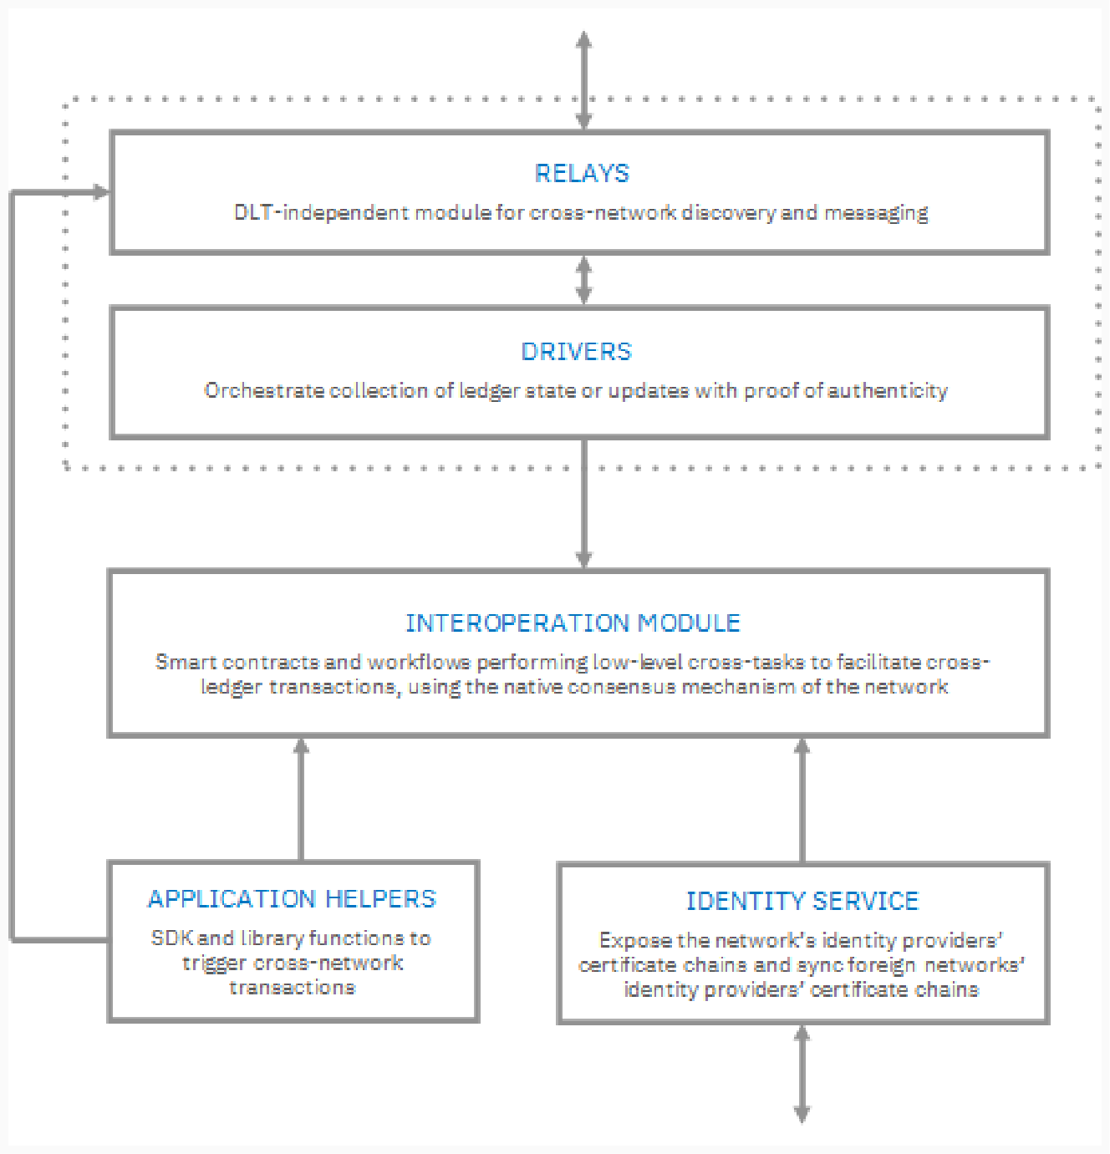
Weaver Architecture Components

Slide 19
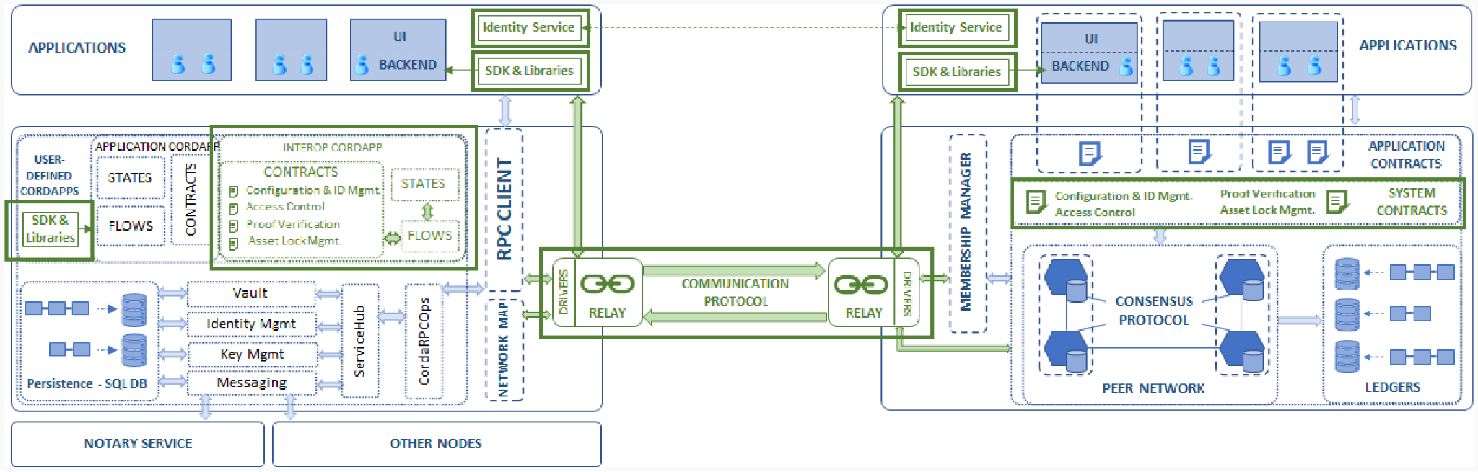
Weaver Components in Flow

Slide 20
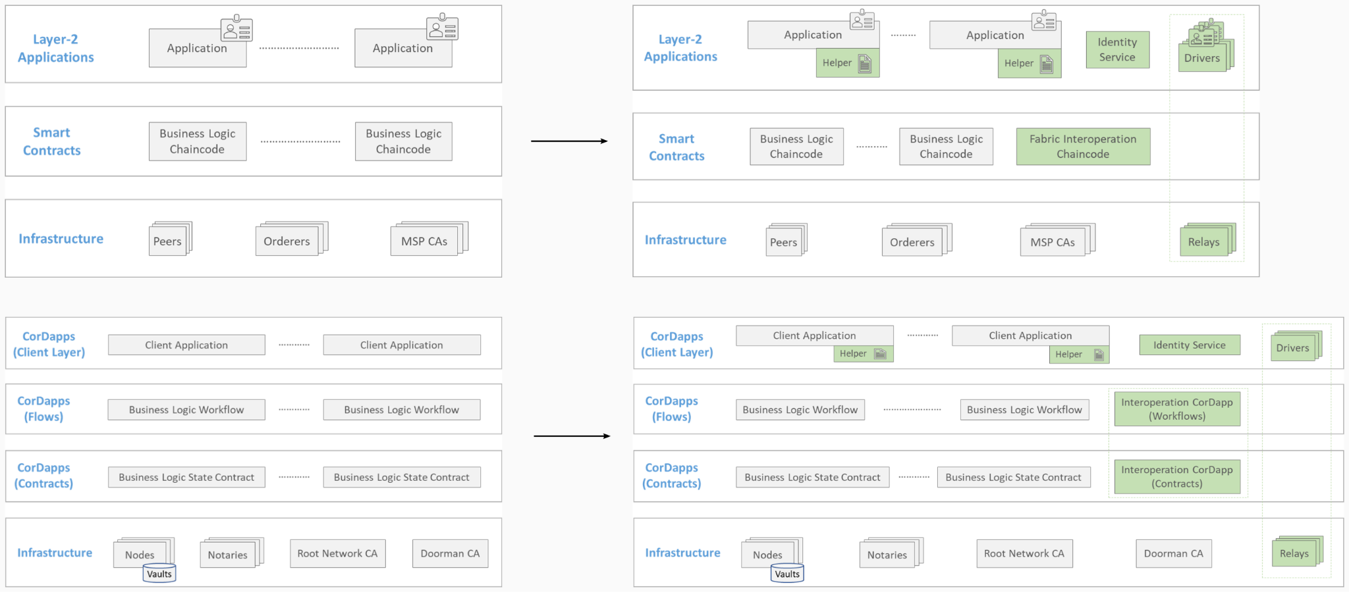
Network Augmentations with Weaver Components

Slide 21
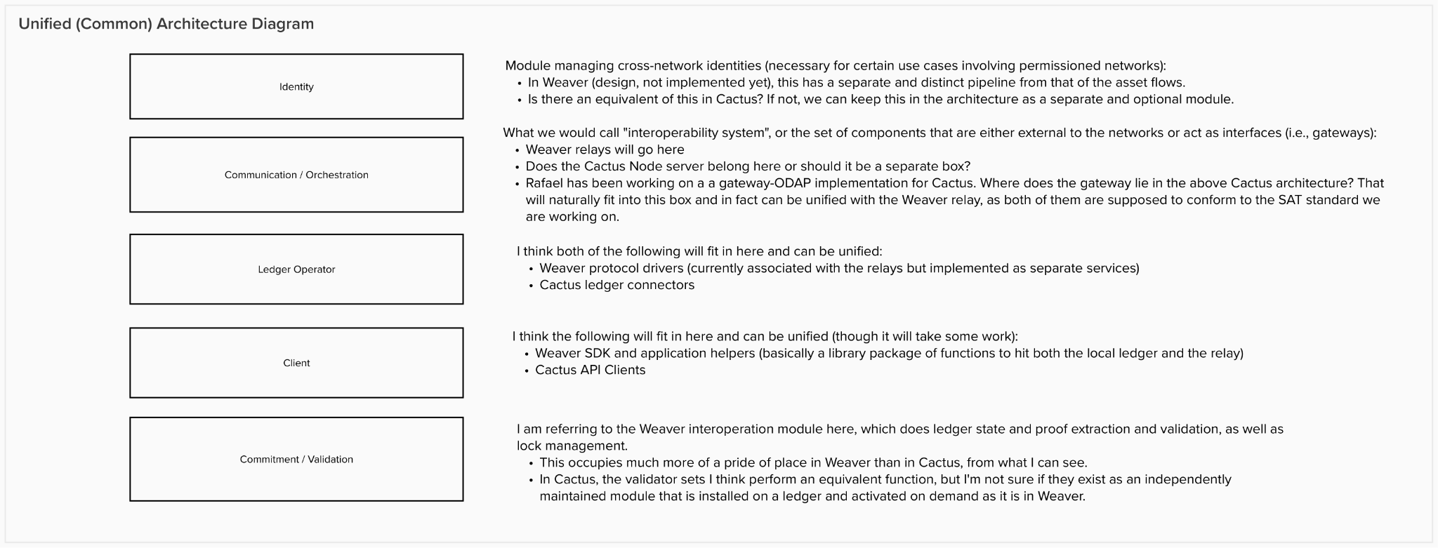
Unified Architecture: Placeholder Boxes

Slide 22
Unified Architecture (draft)
Network B
Network A
Interoperation
SDK
Do Alice and Bob directly send pledges and claims directly, or through relays?
End user’s application
(Business
logic
Plugin)
Alice’s app
https / socket.io / grpc
What does this sdk do?
requesting
AssetTransfer
(weaver protocol over grpc)
Sub plugins
Identity
Each API can be switched to the two modes
mode 1: System Contract OFF
mode 2: System Contract ON
keychain
Interoperation
SDK
Relay (network A)
Inter-relay communication path
Business
logic
plugin
api-client = Client
Base API class
Ledger operator = connector (network A)
ledger A
In the case of mode 1,
the embedded contract is not needed.
In the case of mode 2,
the embedded contract is needed
sendSyncRequest
Protocol
Adapter
Platform
SDK
sendAsyncRequest
(= AssetTransfer)
request
https / socket.io / grpc
Sub plugins
openAPI SDK
Identity
StartMonitor
https / socket.io /grpc
Alice’s asset here
keychain
DataTransfer
API 1 (depends on each ledger)
DataExchange
Interoperation Module for
Commitment / Validation
Why AssetTransfer in api-client?
Ledger-specific API class
API 2 (depends on each ledger)
API (ledger-specific)
Relay (network B)
Network C
Network D
Interoperation
SDK
End user’s application
Business
logic
plugin
ledger B
https / socket.io / grpc
https / socket.io / grpc
Interoperation
SDK
Bob’s app
https / socket.io /grpc
Ledger operator
= connector
(network B)
request
Bob’s asset here
Sub plugins
api-client
Identity
Identity
Interoperation Module for
Commitment / Validation
keychain

Slide 23
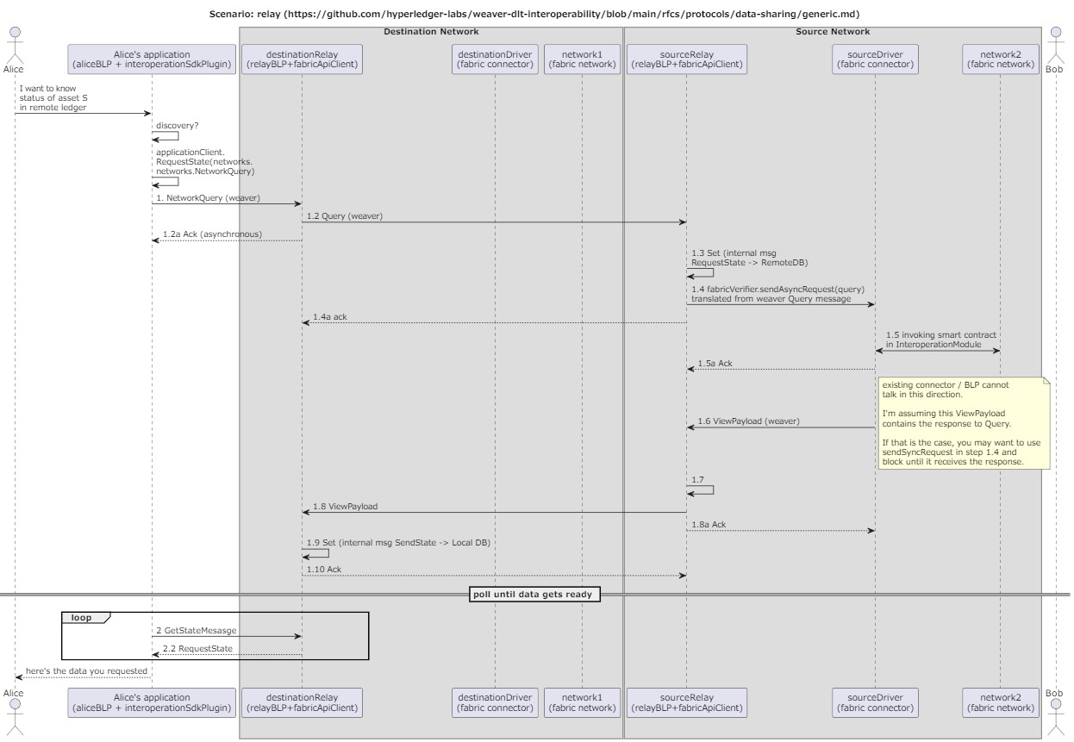
Getting data from remote ledger
Notes:
@startuml relay scenario
title Scenario: relay (https://github.com/hyperledger-labs/weaver-dlt-interoperability/blob/main/rfcs/protocols/data-sharing/generic.md)
actor alice as "Alice"
participant aliceApp as "Alice's application\n(aliceBLP + interoperationSdkPlugin)"
box Destination Network
participant destinationRelay as "destinationRelay\n(relayBLP+fabricApiClient)"
participant destinationDriver as "destinationDriver\n(fabric connector)"
participant network1 as "network1\n(fabric network)"
end box
box Source Network
participant sourceRelay as "sourceRelay\n(relayBLP+fabricApiClient)"
participant sourceDriver as "sourceDriver\n(fabric connector)"
participant network2 as "network2\n(fabric network)"
end box
actor bob as "Bob"
alice -> aliceApp: I want to know\nstatus of asset S\nin remote ledger
aliceApp -> aliceApp: discovery?
aliceApp -> aliceApp: applicationClient.\nRequestState(networks.\nnetworks.NetworkQuery)
aliceApp -> destinationRelay: 1. NetworkQuery (weaver)
destinationRelay -> sourceRelay: 1.2 Query (weaver)
destinationRelay --> aliceApp: 1.2a Ack (asynchronous)
sourceRelay -> sourceRelay: 1.3 Set (internal msg\nRequestState -> RemoteDB)
sourceRelay -> sourceDriver: 1.4 fabricVerifier.sendAsyncRequest(query)\ntranslated from weaver Query message
sourceRelay --> destinationRelay: 1.4a ack
sourceDriver <-> network2: 1.5 invoking smart contract\nin InteroperationModule
sourceDriver --> sourceRelay: 1.5a Ack
sourceDriver -> sourceRelay: 1.6 ViewPayload (weaver)
note right
existing connector / BLP cannot
talk in this direction.
I'm assuming this ViewPayload
contains the response to Query.
If that is the case, you may want to use
sendSyncRequest in step 1.4 and
block until it receives the response.
end note
sourceRelay -> sourceRelay: 1.7
sourceRelay -> destinationRelay: 1.8 ViewPayload
sourceRelay --> sourceDriver: 1.8a Ack
destinationRelay -> destinationRelay: 1.9 Set (internal msg SendState -> Local DB)
destinationRelay --> sourceRelay: 1.10 Ack
== poll until data gets ready ==
loop
aliceApp -> destinationRelay: 2 GetStateMesasge
destinationRelay -->aliceApp: 2.2 RequestState
end
aliceApp --> alice: here's the data you requested

Slide 24
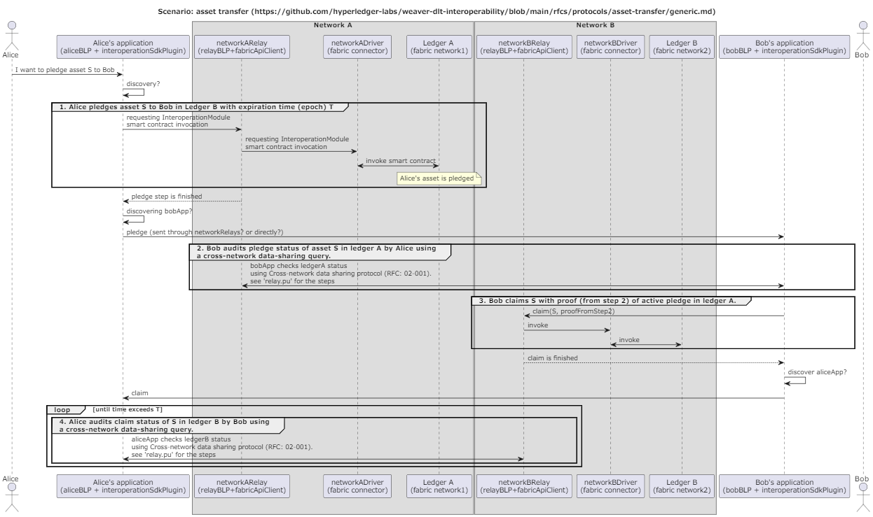
Sending Alice’s asset to Bob
Notes:
@startuml asset transfer scenario
title Scenario: asset transfer (https://github.com/hyperledger-labs/weaver-dlt-interoperability/blob/main/rfcs/protocols/asset-transfer/generic.md)
actor alice as "Alice"
participant aliceApp as "Alice's application\n(aliceBLP + interoperationSdkPlugin)"
box Network A
participant networkARelay as "networkARelay\n(relayBLP+fabricApiClient)"
participant networkADriver as "networkADriver\n(fabric connector)"
participant ledgerA as "Ledger A \n(fabric network1)"
end box
box Network B
participant networkBRelay as "networkBRelay\n(relayBLP+fabricApiClient)"
participant networkBDriver as "networkBDriver\n(fabric connector)"
participant ledgerB as "Ledger B\n(fabric network2)"
end box
participant bobApp as "Bob's application\n(bobBLP + interoperationSdkPlugin)"
actor bob as "Bob"
alice -> aliceApp: I want to pledge asset S to Bob
aliceApp -> aliceApp: discovery?
group 1. Alice pledges asset S to Bob in Ledger B with expiration time (epoch) T
aliceApp -> networkARelay: requesting InteroperationModule\nsmart contract invocation
networkARelay -> networkADriver: requesting InteroperationModule\nsmart contract invocation
networkADriver <-> ledgerA: invoke smart contract
note over ledgerA
Alice's asset is pledged
end note
end
networkARelay --> aliceApp: pledge step is finished
aliceApp -> aliceApp: discovering bobApp?
aliceApp -> bobApp: pledge (sent through networkRelays? or directly?)
group 2. Bob audits pledge status of asset S in ledger A by Alice using\na cross-network data-sharing query.
bobApp <-> networkARelay: bobApp checks ledgerA status\nusing Cross-network data sharing protocol (RFC: 02-001).\nsee 'relay.pu' for the steps
end
group 3. Bob claims S with proof (from step 2) of active pledge in ledger A.
bobApp -> networkBRelay: claim(S, proofFromStep2)
networkBRelay -> networkBDriver: invoke
networkBDriver <-> ledgerB: invoke
end
networkBRelay --> bobApp: claim is finished
bobApp -> bobApp: discover aliceApp?
bobApp -> aliceApp: claim
loop until time exceeds T
group 4. Alice audits claim status of S in ledger B by Bob using\na cross-network data-sharing query.
aliceApp <-> networkBRelay: aliceApp checks ledgerB status\nusing Cross-network data sharing protocol (RFC: 02-001).\nsee 'relay.pu' for the steps
end
end

Slide 25
Question to weaver team
I checked RFC’s in Weaver’s RFC directory and tried to draw an asset transfer sequence (previous slide)
https://github.com/hyperledger-labs/weaver-dlt-interoperability/blob/main/rfcs/protocols/asset-transfer/generic.md
https://github.com/hyperledger-labs/weaver-dlt-interoperability/blob/main/rfcs/protocols/data-sharing/generic.md
Is my sequence in line with your assumptions?
Weaver team added functions to api-client class in “Unified Architecture (draft)” slide
AssetTransfer
DataTransfer
DataExchange
https://github.com/hyperledger-labs/weaver-dlt-interoperability/blob/main/rfcs/protocols/data-sharing/generic.md shows an Application initiating a Data-Sharing procedure. The Application sends NetworkQuery (not DataTransfer request) to Relay
From this figure, Application seems to be ideal place to provide DataTransfer function, as well as AssetTransfer and DataExchange
https://github.com/hyperledger-labs/weaver-dlt-interoperability/blob/main/rfcs/models/infrastructure/relays.md shows that Relay has (Protocol::) DataTransfer, etc.
Which node should implement these functions?
In either case, api-client isn’t ideal place to implement it
Application doesn’t directly talk to connectors, so it doesn’t have api-client anyway
Relay may talk to connectors, but AssetTransfer and other operations deal with more than one ledgers. An api-client is used to access one ledger (in your local network).

Slide 26
Answers/Comments/Questions
Is my sequence in line with your assumptions?
Sequence looks fine, but let us make separate illustrations for architecture (with system components) and protocol flows for different use cases (asset transfer, asset exchange, data sharing, …….). We can highlight the system components exercised in each protocol.
We need to understand the “Open API SDK” module better so we can determine what role it purpose it serves in the interoperation architecture. At present, there is no equivalent of this in Weaver.
Which node should implement these functions?
I assume you are referring to asset transfer, etc.? These must be implemented as protocols, exercising several nodes. I’ll illustrate my proposals in subsequent architecture slides.
Application doesn’t directly talk to connectors, so it doesn’t have api-client anyway
Isn’t the Business Logic Plugin a part of the Application? At least conceptually, if not from a deployment perspective?
Relay may talk to connectors, but AssetTransfer and other operations deal with more than one ledgers. An api-client is used to access one ledger (in your local network).
Right. Operations involving more than one ledger will involve direct relay-relay communication at some stage in the pipeline. Every other protocol unit will be an in-network operation or message.

Slide 27
Interoperation Model
Network-run components
Network-run components
Interoperation System
Ledger/Chain/
Network
Ledger/Chain/
Network
External components

Slide 28
Interoperation Model: System Components
Identity Management
Business Logic Client
Business Logic Client
Ledger Operations
Communication
Communication
Ledger Operations
Validation & Commitment
Identity Management
Identity Management
Validation & Commitment
Transaction Orchestration

Slide 29
Discuss
Node Server
Connector
Validator
Business logic plugin
api-client = Client
Contracts
api-client
Base API class
Protocol
Adapter/Driver
Platform
SDK
lockAsset
pledgeAsset
sendSyncRequest
Interoperation SDK
claimAsset
remote ledger nodes
sendAsyncRequest
(= AssetTransfer)
generateProof
ledger nodes
https / socket.io / grpc
https / socket.io / grpc
verifyProof
https / socket.io / grpc
StartMonitor
openAPI SDK
Relay
Relay
accessControl
Data Transfer
API 1 (depends on each ledger)
Nodes
DataExchange
Node 1
Other plugins
API 2 (depends on each ledger)
Ledger-specific API class
Node 2
Identity
keychain
API (ledger-specific)
Discussion Notes
“Node server” can be called “relay” instead
and relay can be called “gateway” instead
Discuss

Slide 30
Revised version by Takuma (added Oct 18, 2022)
Internal Network 1 (Cacti server belongs)
External Network (Ledger nodes belongs)
Discuss
Node Server
Connector
api-client = Client
Protocol Adapter
Business logic plugin
sendSyncRequest
sendAsync
Request
openAPI SDK
Base API class
StartMonitor
Data Transfer
mode A
sendSyncRequest
DataExchange
APIs (depends on each ledger)
Interoperation SDK
sendAsyncRequest
(= AssetTransfer)
validateBlock
(private fn)
remote ledger nodes
mode B
ledger nodes
StartMonitor
https / socket.io / grpc
https / socket.io / grpc
System-contracts-nodes
Relay
Relay
Data Transfer
Contracts (mode B)
DataExchange
generateProof
lockAsset
verifyBlock (private fn)
pledgeAsset
verifyProof
Other plugins
Ledger-specific API class
claimAsset
accessControl
Identity
Nodes
keychain
API (ledger-specific)
Node 1
Node 2
Discussion Notes
“Node server” can be called “relay” instead
and relay can be called “gateway” instead
Discuss

