Slide 1
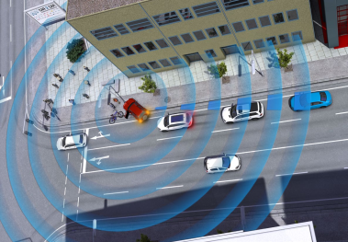
Model Based Systems Project: C-ITS
Awareness Driving
Luis Fernando Rodriguez Gutierrez
Hazhir Amiri
Fig. 1, Awareness Driving

Slide 2

Awareness Driving
Similar examples of this is “Waze” (Traffic navigation app).
Without a user, there is no notice of an accident.
Fig. 2, Waze App logo

Slide 3
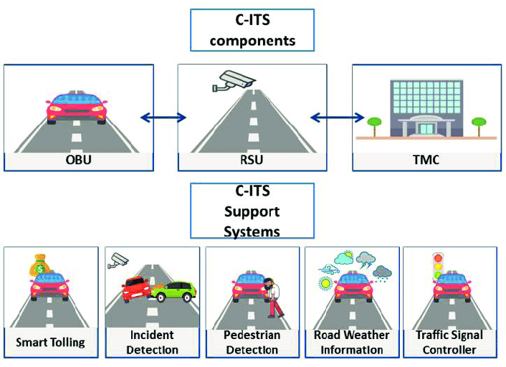
Awareness Driving
Take the user out of the notification process.
Ideal for scenarios like:
Dangerous Situation Warning
Stationary Vehicle Warning
Pre-/Postcrash Warning
Fig. 3, C-ITS components

Slide 4

HLN – SV Scenario
Hazardous Locations Notification – Stationary Vehicle: describes the use case of a broken-down car in the road.
DENM (Decentralized Environmental Notification Message): used to inform the infrastructure and alert vehicles.
Vehicle components in cooperation with a C-ITS OBU (Onboard Unit) notify nearby vehicles and RSUs (Roadside Unit) of the situation
Fig. 4, Broken-down vehicle

Slide 5
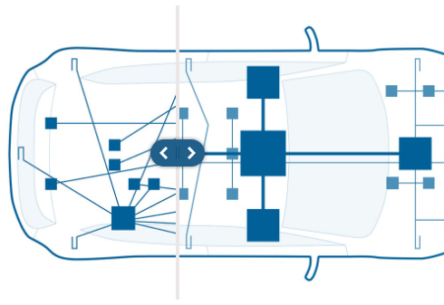
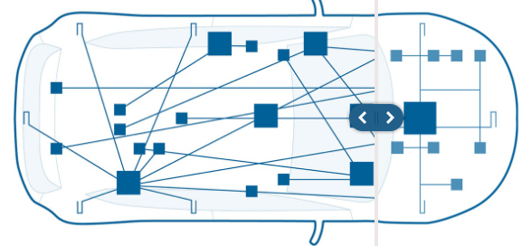
Hardware Automotive Control Units Distribution
Prev. Control Units or Modules were connected all over the vehicle. Now a more optimized architecture is being used.
Distributions can be such as:
Rear Zone
Front Zone
Central Zone / Cabin Zone
Fig. 5-6, New Zonal level.

Slide 6
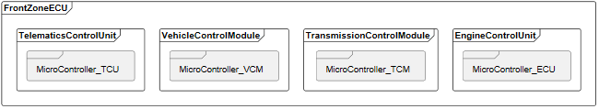
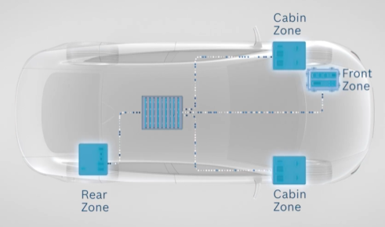
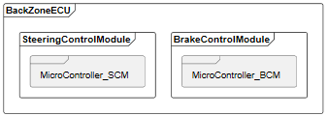
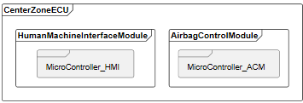
Vehicle - Hardware Car
Fig. 7, New Zonal level.

Slide 7
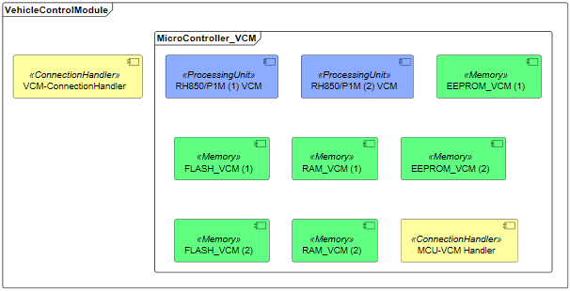

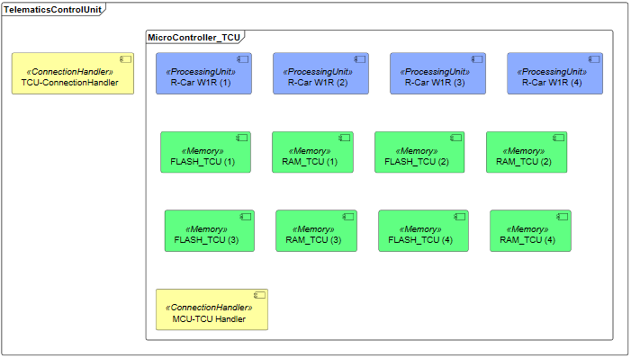
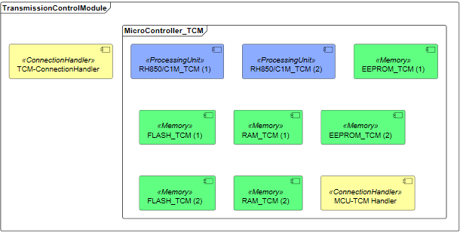
Vehicle - Front Zone

Slide 8
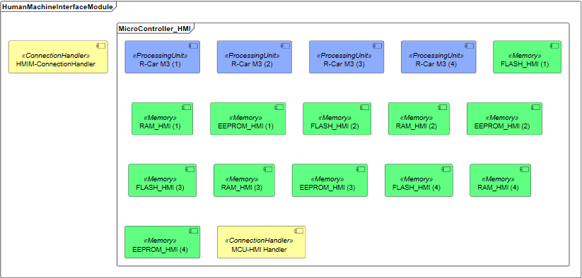
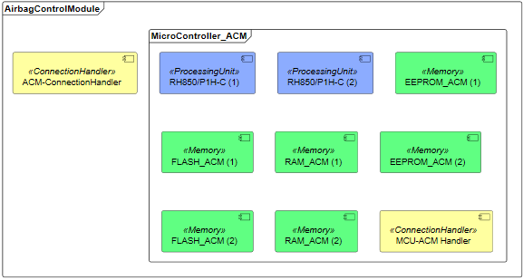
Vehicle - Central Zone

Slide 9
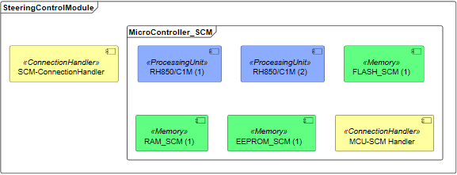

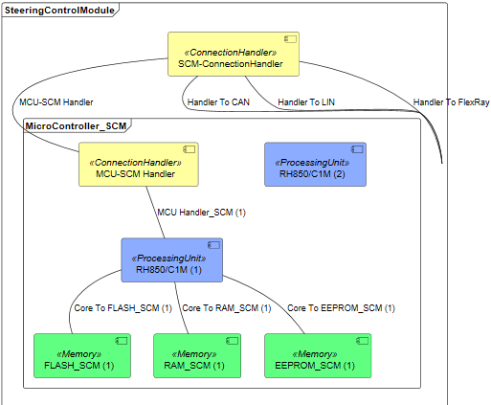
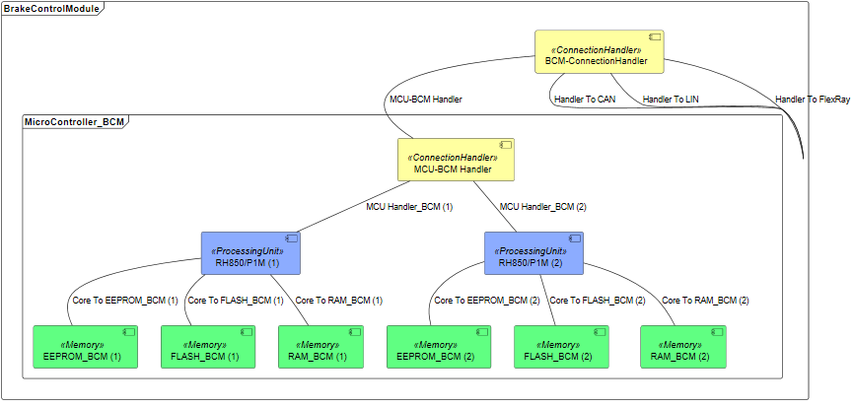
Vehicle - Rear Zone

Slide 10
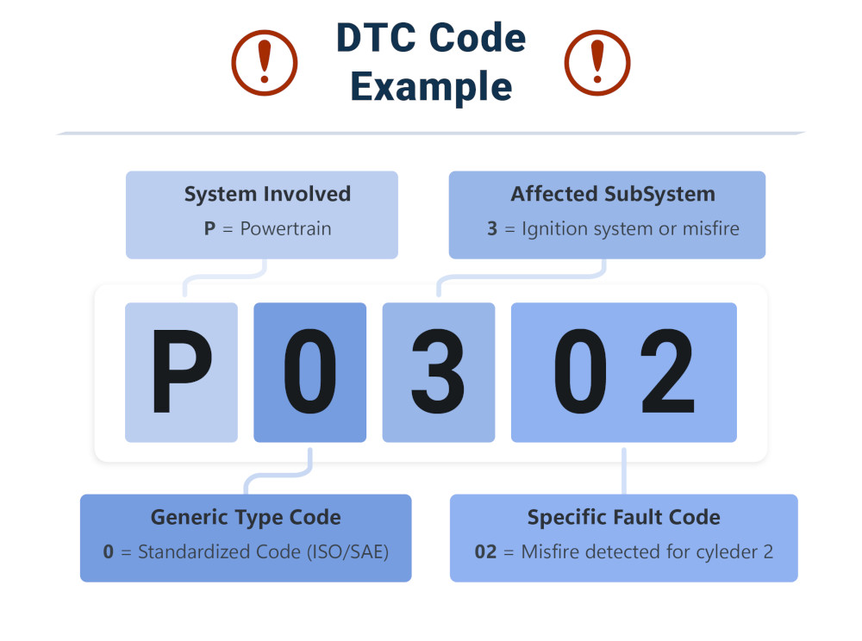
Vehicle - Software DTC (Diagnostic Trouble Codes)
Diagnostic Trouble Codes or OBD-II or J1939.
This codes are the way of communication of the vehicle to let the user what is happening inside. Notify you if there is a problem.
Using a telematics control unit (TCU), app or a gateway. You can access this codes to monitor the vehicle.
Fig. 8, DTC Code.

Slide 11
DTC (Diagnostic Trouble Codes)
First Character.
The part of the vehicle that has a fault.
Second Character
0: Standardized code.
1: Manufacturer-specific code.
Third Character
The subsystem of the vehicle that has a fault.
Fourth and Fifth Character
Exact problem that is active.
Values from 0-99.
Fig. 9, DTC Code.

Slide 12
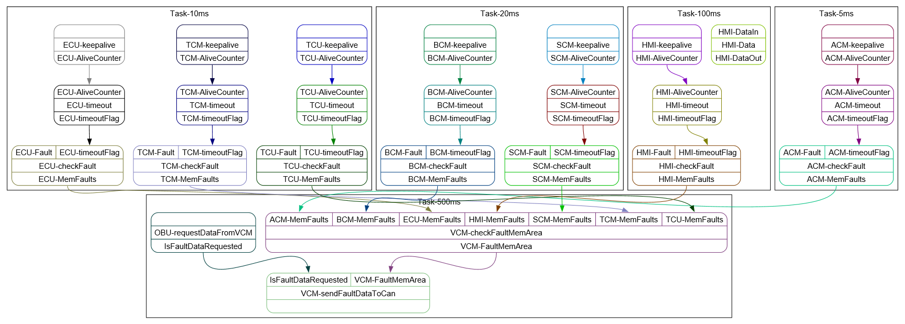
Vehicle - Software Model
The OBU communicates with the vehicle using mainly the fault memory area, which contains the Diagnostic Trouble Codes.

Slide 13
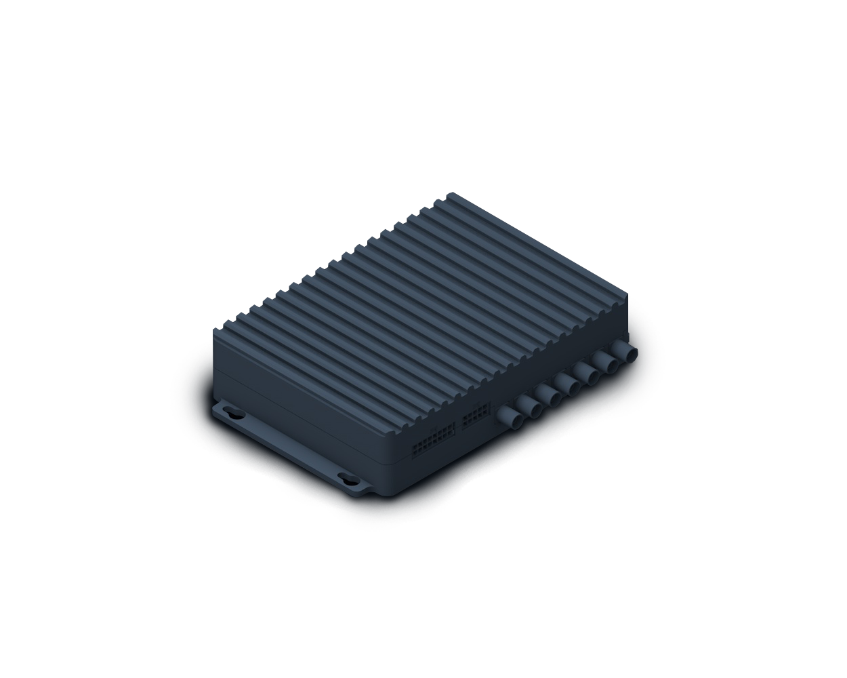
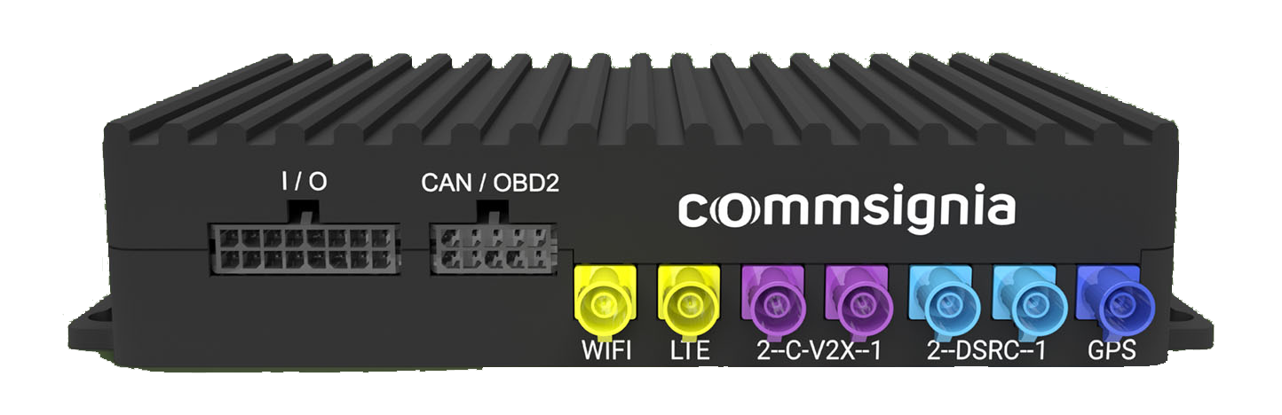
OBU
Onboard Unit providing C-ITS capabilities
Modeled after Commsignia’s ITS-OB4
Integrated into existing vehicle
Communicates mainly through CAN/OBD-II
Fig. 10, Commsignia OBU Ports
Fig. 9, Commsignia OBU

Slide 14
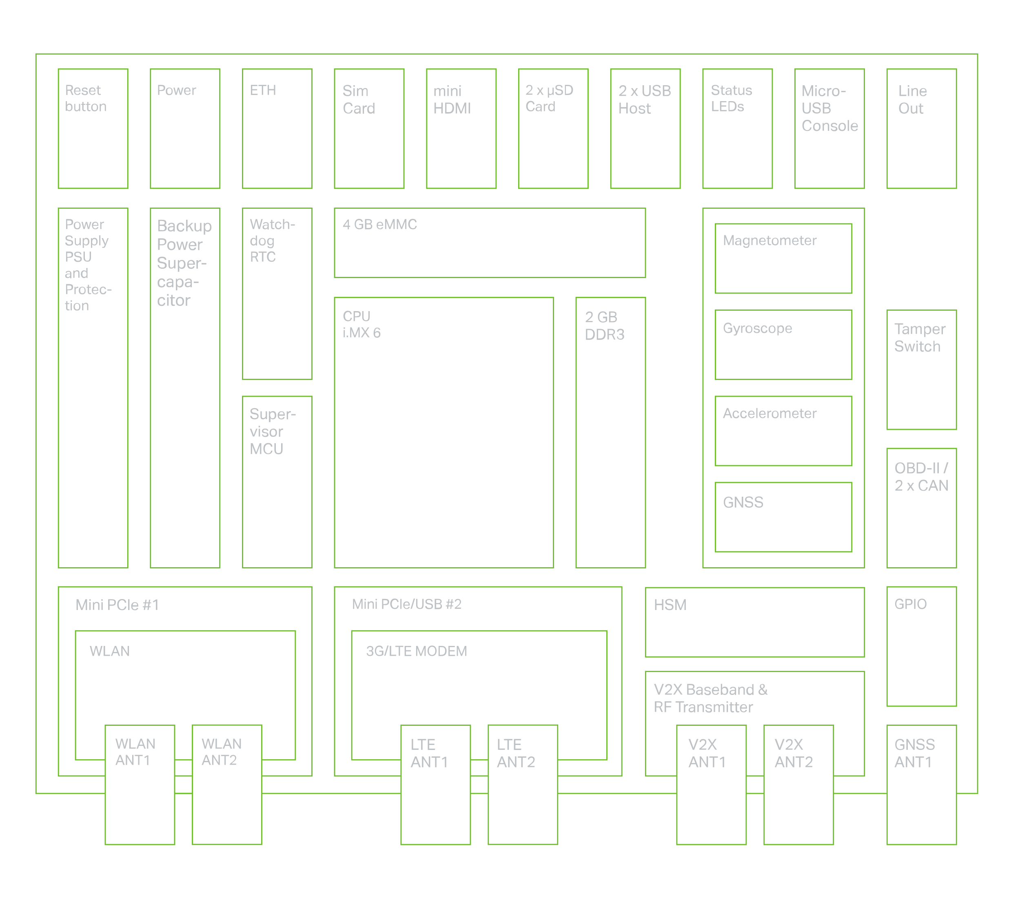
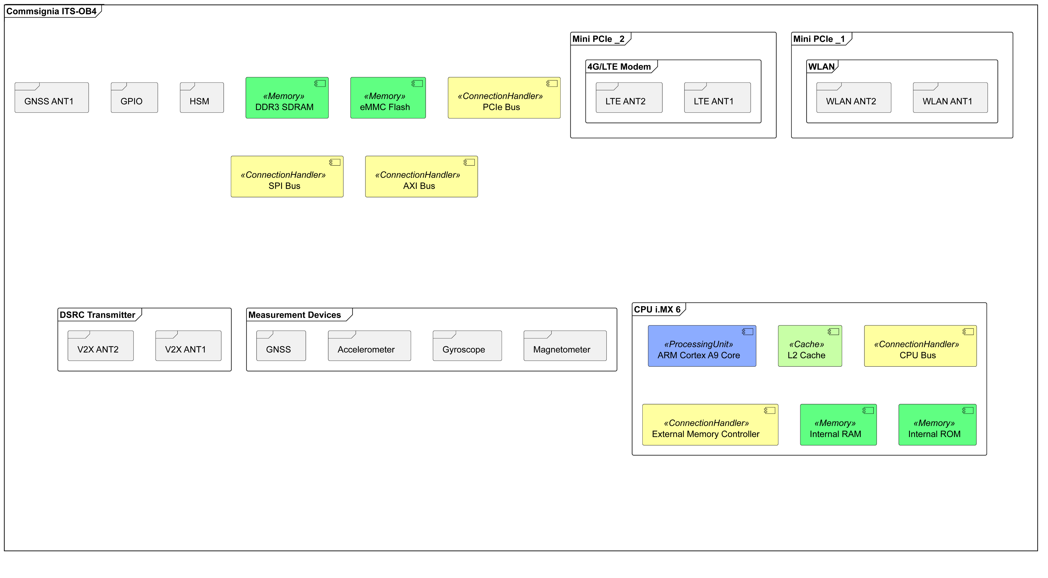

OBU - Hardware
Fig. 11, Commsignia OBU Architecture

Slide 15
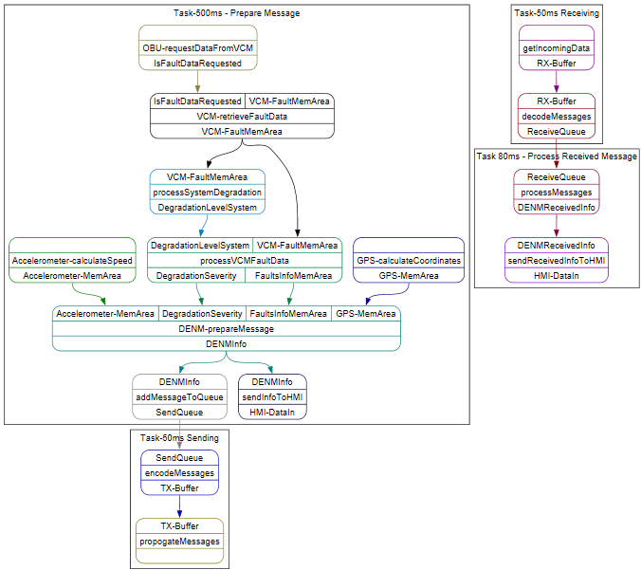
OBU - Software
The software checks for faults and communicates with the backend
Communication is either alerting backend of own fault or receiving info about another SV

Slide 16
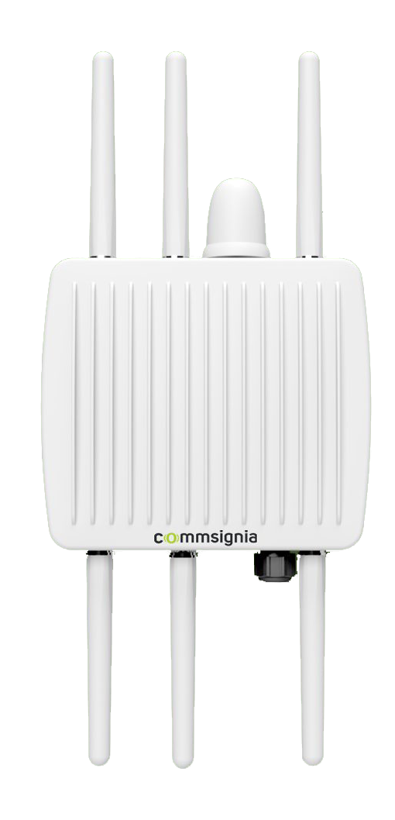
RSU
Roadside Unit facilitates communication between road users and infrastructure
Modeled after Commsignia’s ITS-RS4
Architecture is very similar to Commsignia’s ITS-OB4
Fig. 12, Commsignia RSU

Slide 17
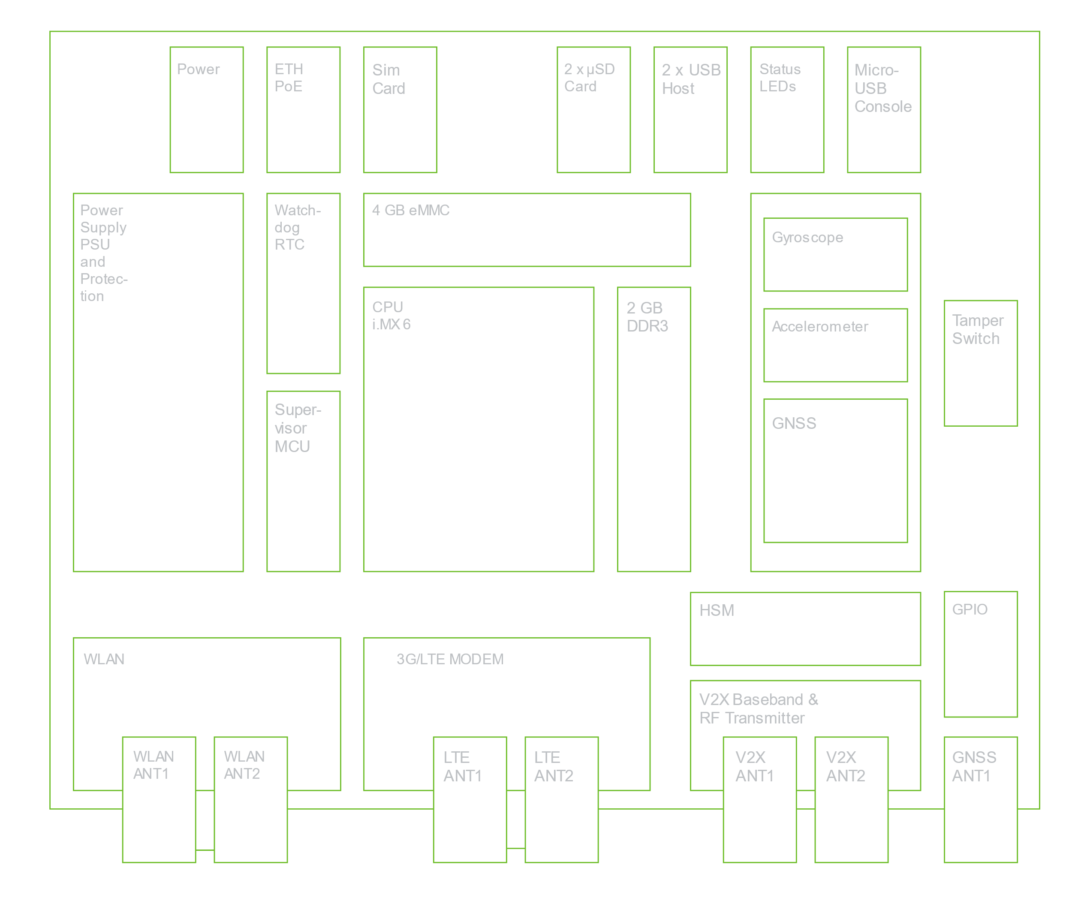
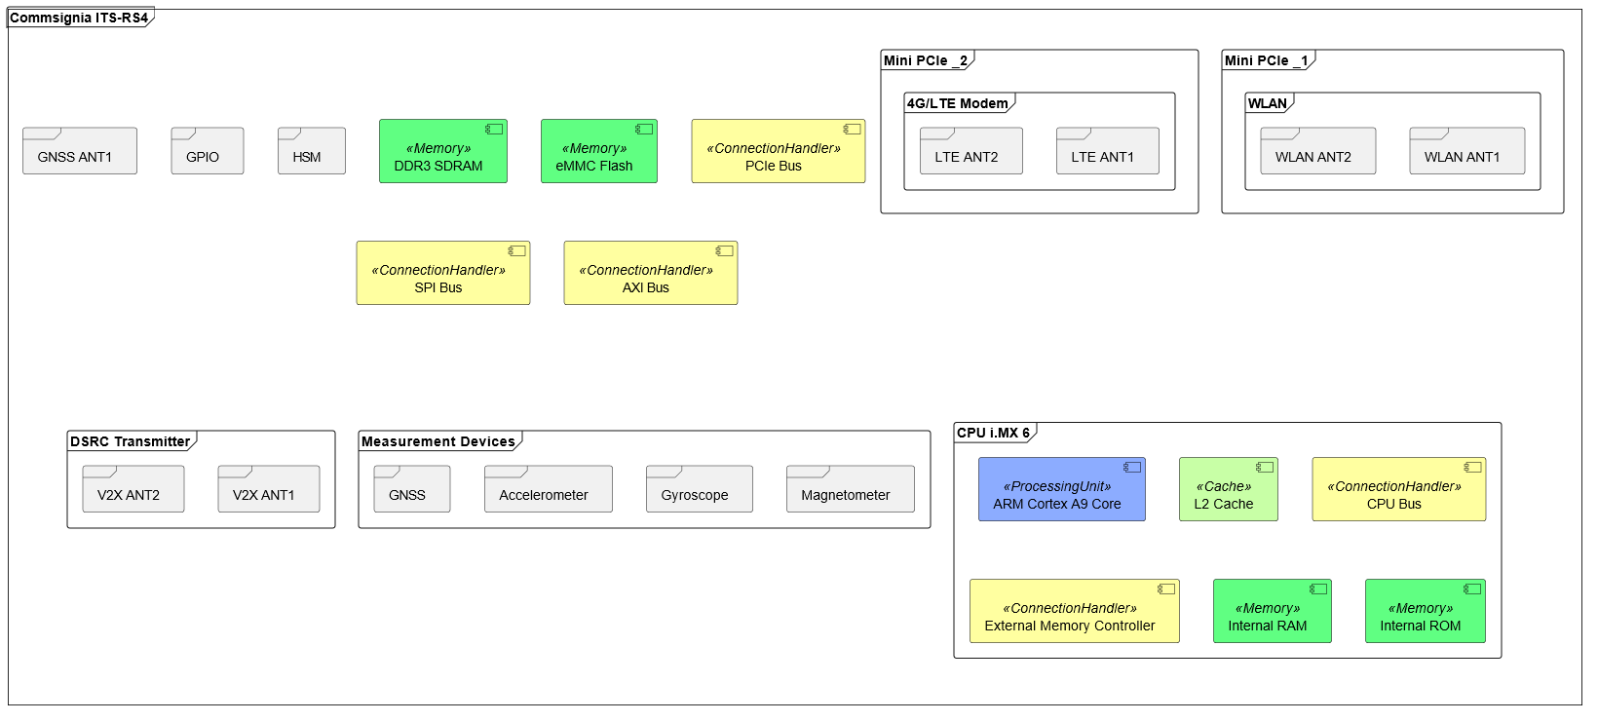
RSU - Hardware
Fig. 13, Commsignia RSU Architecture

Slide 18
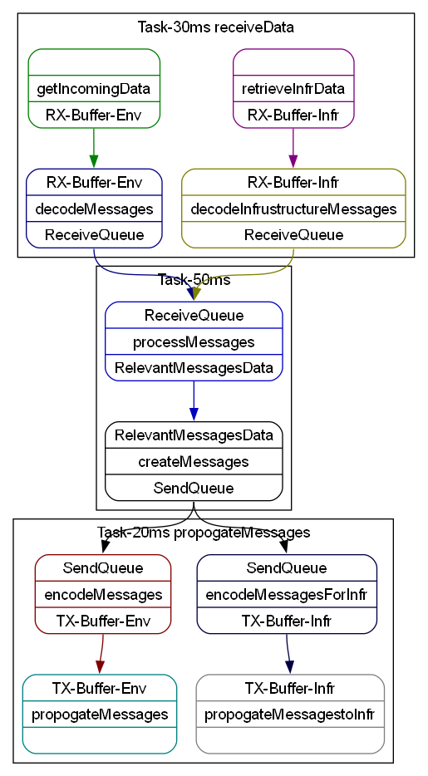
RSU - Software
RSU mainly handles propagation of messages between environment and infrastructure in this scenario

Slide 19
Further Work
DENM messages can also specify lane position information
This information could be used by ADAS systems and autonomous vehicles to adapt the vehicle’s driving lane.

Slide 20
Conclusion
C-ITS improves traffic safety and takes the user out of the notification process.
The Hazardous Locations Notification – Stationary Vehicle alerts drivers of a broken-down vehicle in the road.
For the model, a vehicle with three control unit zones was considered.
OBU and RSU units were modeled after Commsignia’s products.
Integration of lane position builds towards fully autonomous vehicles.

Slide 21
Thank You!
Questions?
Project files are also available on GitHub:
https://github.com/LF-RoGu/Model-Base-Systems

Slide 22
List of figures
Fig. 1, https://www.car-2-car.org/fileadmin/_processed_/2/9/csm_Dangerous_Situation_Warning_010b9e61f5.jpg
Fig. 2, https://www.waze.com/website/assets/packs/media/images/og_rebrand/whatsapp-65b8f38489f59ff7ecf15b3655a320df.png
Fig. 3, https://www.researchgate.net/figure/C-ITS-System-Components_fig2_333254227
Fig. 4, https://www.smfmotor.com/wp-content/uploads/2021/03/What-to-do-in-a-car-breakdown.jpg
Fig. 5-7, https://www.bosch-mobility.com/en/solutions/control-units/zone-ecu/
Fig. 8, https://www.autopi.io/glossary/diagnostic-trouble-codes/
Fig. 9, https://www.commsignia.com/wp-content/uploads/2020/11/hardware_002_transparent.png
Fig. 10, https://www.commsignia.com/wp-content/uploads/2020/11/green_bg_obu_2021.jpg
Fig. 11, https://www.commsignia.com/wp-content/uploads/2020/11/obu_architecture_outlined.svg
Fig. 12, https://www.commsignia.com/wp-content/uploads/2020/11/green_bg_rsu.jpg
Fig. 13, https://www.commsignia.com/wp-content/uploads/2020/11/rsu_architecture_outlined.svg

Slide 23
Bibliography
https://www.car-2-car.org/about-c-its
https://www.bosch-mobility.com/en/mobility-topics/ee-architecture/
https://www.kpit.com/insights/the-lifecycle-of-a-diagnostic-trouble-code-dtc/
https://www.embitel.com/blog/embedded-blog/decoding-the-implementation-of-uds-vehicle-diagnostics-in-autosar-base-software-module
https://www.obd-codes.com
https://www.sae.org/binaries/content/assets/cm/content/standards/p90475.pdf
https://www.sae.org/standards
https://www.ecutesting.com/categories/ecu-explained/
https://www.sintrones.com/application/understanding-vehicle-computer-system-key-components-and-how-it-works/
https://www.csselectronics.com/pages/can-bus-simple-intro-tutorial

Slide 24
Bibliography – ctd.
https://www.renesas.com/en/document/pre/main-specifications-rh850e2x-series
https://www.mouser.com/datasheet/2/698/r01uh0607ej0120_rh850c1m_a1_rh850c1m_a2-2930644.pdf
https://www.mouser.com/datasheet/2/698/REN_r01uh0641ej0130_rh850e2x_fcc1_General_MAH_2019-3196494.pdf
https://www.renesas.cn/zh/document/mat/rh850p1h-c-rh850p1m-c-292bga-piggyback-board-y-rh850-p1xc-292pin-pb-t1-v1
https://www.renesas.com/en/document/pre/main-product-specifications-r-car-m3-soc
R-Car M3 Automotive System-on-Chip (SoC)
RH850/P1H-C Automotive Microcontrollers
RH850/C1M Automotive Microcontrollers
RH850/E2x Automotive Microcontrollers

Slide 25
Bibliography – ctd.
https://www.commsignia.com/products/obu/
https://www.commsignia.com/products/rsu/
https://www.c-roads.eu/platform/about/news/News/entry/show/c-roads-specification-release-21.html

